Slide 1
Introduction to Econometrics
CMD

Slide 2
Class size vs. student achievement
  Policy question: What is the effect on test scores (or some other outcome measure) of reducing class size by one student per class? by 8 students/class?
Data: All K-6 and K-8 California school districts (n = 420)
Variables:
    5th grade test scores (Stanford-9 achievement test, combined math and reading), district average
    Student-teacher ratio (STR) = no. of students in the district divided by no. full-time equivalent teachers

Slide 3
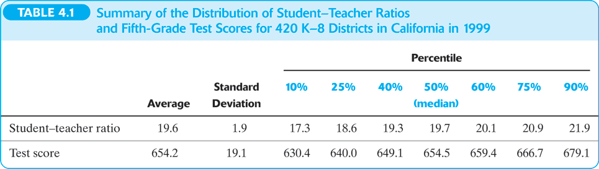
Data: First look
Source: California Department of Education, Stock and Watson (2015)

Slide 4
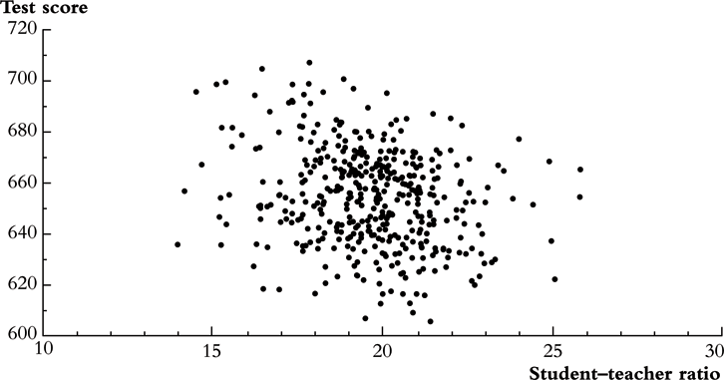
Data: First look
Source: California Department of Education, Stock and Watson (2015)

Slide 5
Estimators
Class Size | Average score ( ) | Standard deviation (s_{Y}) | n
Small (STR<20) | 657.4 | 19.4 | 238
Large (STR≥20) | 650.0 | 17.9 | 182

Slide 6
Estimators
Class Size | Average score ( ) | Standard deviation (s_{Y}) | n
Small (STR<20) | 657.4 | 19.4 | 238
Large (STR≥20) | 650.0 | 17.9 | 182
1. Estimation of Δ = difference between group means
2. Test the hypothesis that Δ = 0
3. Construct a confidence interval for Δ

Slide 7
Estimators
Class Size | Average score ( ) | Standard deviation (s_{Y}) | n
Small (STR<20) | 657.4 | 19.4 | 238
Large (STR≥20) | 650.0 | 17.9 | 182
What is the t-stat?

