Slide 1
The U.S. health care system: Past and Present
ECN 240: Intro

Slide 2
Pulse of the Health Economy
A health economy
Production and consumption of goods and services
Distribution of those goods to consumers
Performance indicators of medical care
Costs
Access
Quality

Slide 3
Figure 1.2 - Uses of Health Care Funds in the United States, 2010

Slide 4
Sources of Medical Funds
Funds spent on national health
From the private sector
53% in 2010
76% in 1960
Mid-1960s
Public health insurance programs
Medicare and Medicaid

Slide 5
Figure 1.3 - Sources of Health Care Funds in the United States, 2010
Source: Centers for Medicaid & Medicare Services, Accessed January 10, 2012

Slide 6
Sources of Medical Funds
Woolhandler and Himmelstein (2002)
Centers for Medicare and Medicaid Services (CMS) includes only direct purchasing of medical care (Medicare, Medicaid, and government-owned hospitals)
CMS excludes public employee benefits
Federal Employees Health Benefits Program
Various state employee health insurance programs
Employer-sponsored health insurance premiums are exempted from various federal, state, and city taxes

Slide 7
Sources of Medical Funds
Woolhandler and Himmelstein (2002)
Government - responsible for financing nearly 60 percent of all health care costs
Direct spending of government = 45%
Public employee benefits = 5.4%
Tax subsidy for health insurance premiums = 9.1%

Slide 8
Amount of Medical Care Spending
Costs of health care are high and continually rising
More and better medical care
$2.6 trillion in 2010
Slightly over $8,400 per person
$26.9 billion in 1960
$141 per person
Trade-offs may be involved
High health care costs = lower amounts of other goods produced and consumed

Slide 9
Amount of Medical Care Spending
Greater productive capacity
Productivity-improving technologies
Higher amounts of resources
The PPF has likely shifted out
More of one good or service can be produced without sacrificing the others
Amount of health care spending divided by GDP

Slide 10
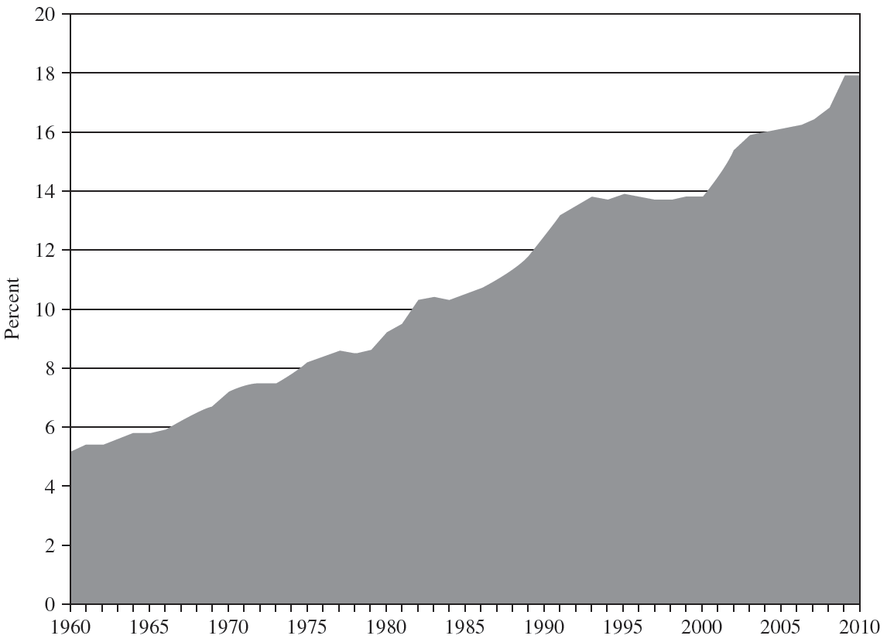
FIGURE 1–4 National Health Care Costs as a Percentage of GDP

Slide 11
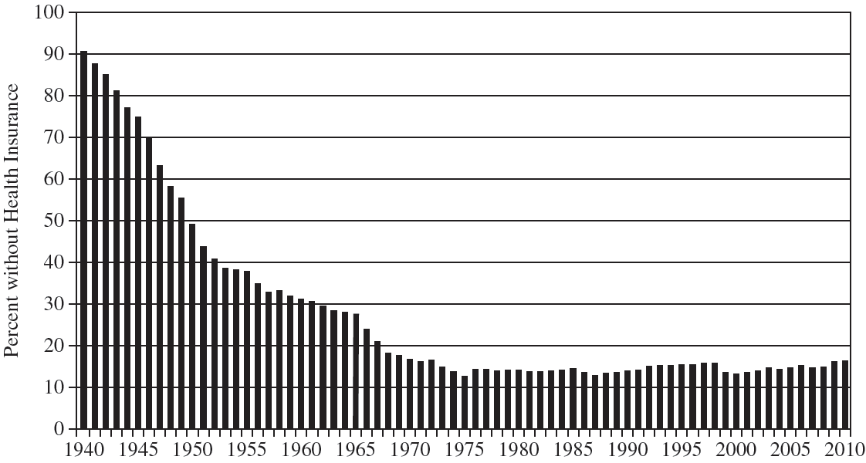
FIGURE 1–5 The Percentage of the U.S. Population without Health Insurance since 1940

Slide 12
FIGURE 1–6 Infant Mortality Rates in the U.S., 1960 to 2010
Source: Centers for Medicaid & Medicare Services, Accessed January 10, 2012

