Slide 1
So, What’s on the Test?
History of the Universe Stuff
There are a lot of things that happened, and a lot of times and temperatures were named
Some of them were no better than approximations
However, the order in which they occurred is pretty well known
I don’t expect you to remember all the details of when they happened and at what temperature
I do expect you to remember the order in which they happened
And you should know a few approximate dates and temperatures

Slide 2
Outline of History of Universe
Time T or k_{B}T Events
10⁻⁴³ s 10¹⁸ GeV Planck Era; time becomes meaningless?
10⁻³⁹ s 10¹⁶ GeV Inflation begins; forces unified
10⁻³⁵ s 10¹⁵ GeV Inflation ends; reheating; forces separate; baryosynthesis (?)
10⁻¹³ s 1500 GeV Supersymmetry breaking, LSP (dark matter)
10⁻¹¹ s 160 GeV Electroweak symmetry breaking
14 μs 150 MeV Quark Confinement
0.4 s 1.5 MeV Neutrino Decoupling
1.5 s 0.7 MeV Neutron/Proton freezeout
20 s 170 keV Electron/Positron annihilation
200 s 80 keV Nucleosynthesis
57 ky 0.76 eV Matter-Radiation equality
370 ky 0.26 eV Recombination
600 My 30 K First Structure/First Stars
13.8 Gy 2.725 K Today

Slide 3
Which Ones Should I Have t or T Memorized?
Now:
t ~ 14 Gyr, T ~ 2.7 K
Structure formation in the recent past
Recombination and matter/radiation equality:
t ~ 10⁵ yr, k_{B}T ~ eV
Neutrino decoupling, n/p freezeout, e⁺e⁻ annihilation, nucleosynthesis
t ~ s, k_{B}T ~ MeV
Everything else:
t ~ tiny, k_{B}T ~ hot

Slide 4
Scaling
You should know that the scale factor of the universe (a), and all distances and wavelengths scale the same way.
All these factors are related to the red-shift z by
And the scale factor is also roughly inversely proportional to the temperature
Why is this last relationship approximate?
Whenever a particle annihilates, its energy raises the temperature of everything else
Still, this formula works so well it is still good for approximations

Slide 5
Scaling And Densities
You should know how all components of the universe scale as the universe expands
Matter: ρ ~ a^{–3}
Includes both ordinary (baryonic) matter and dark matter
Radiation: ρ ~ a^{–4}
Includes any relativistic particles
Cosmological constant: ρ ~ a⁰
Does not scale
This allows us to relate densities at any time to densities today

Slide 6
Radiation Densities
You will probably be given
You will also be given g_{eff} today
This applies all the way back to electron positron annihilation
However, you may have to calculate g_{eff} yourself
And most important, know which particles to include in g_{eff}:
At temperature T, typical particles have energy:
If 3k_{B}T > mc², particle is present and treat it as massless
If 3k_{B}T < mc², particle will have annihilated

Slide 7
Time-Temperature Relations
You will probably be given two or three of the following time-temperature relations:
The two on the left are for matter dominated only, right is for radiation dominated only
You should know when to use which:
Matter for z < 3000, k_{B}T < 1 eV
Radiation for z > 3000, k_{B}T > 1 eV
Don’t use either of them today
We are cosmological constant dominated
t₀ ≈ 14 Gyr

Slide 8
Cosmological Numbers to Memorize
Here are some important cosmological parameters you should probably memorize:
Well, not really memorize, but:
You should know ρ_{Λ} > ρ_{d} > ρ_{b} >> ρ_{ν} >> ρ_{γ}
You should know that Ω = 1
You should know Hubble’s constant is around 70 km/s/Mpc
You should know the universe is around 14 Gyr old
You should know the temperature is around 3 K or so

Slide 9
Other Formulas to Memorize
Some formulas that you should know from the second half:
Hubble’s Law
Unreliable at large distances/red-shifts
“Horizon size”: The largest distance on which things can have any influence, based on age of universe
Rates for particles to collide:
n is the number density of particles (units m⁻³)
σ is the cross-section of the particles (units m²)
You probably can’t calculate it without help
Δv is the relative velocity (units m/s)
Often just estimate it as the velocity of one particle
Γ is the rate (units s⁻¹)
Often multiply by age of the universe to find out if something happens or not
Happens if Γt > 1, otherwise not

Slide 10
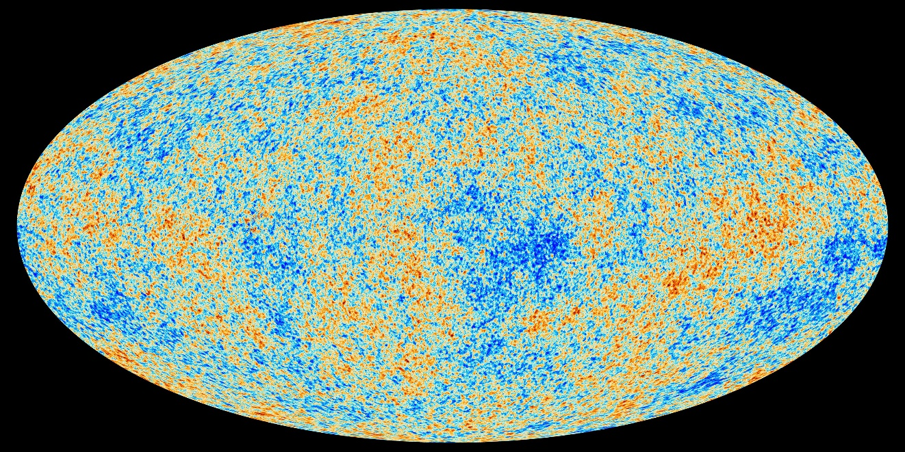
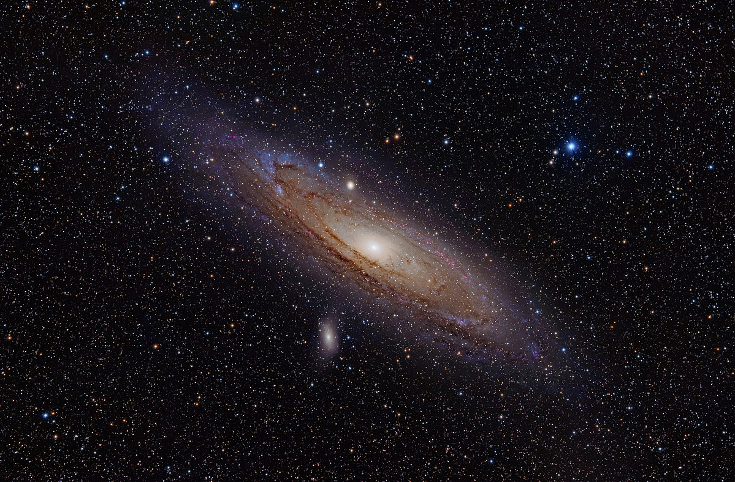
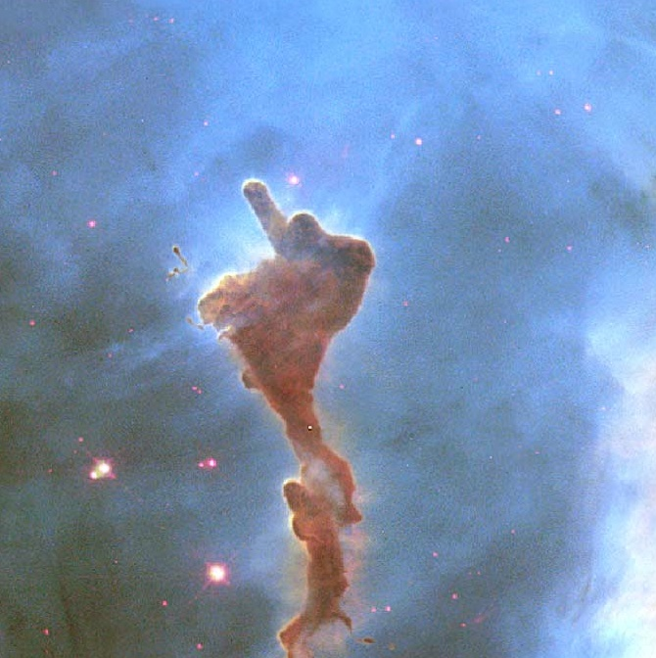
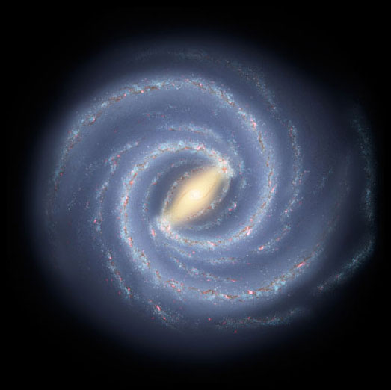
End of Material for Cosmology

