Slide 1
Cosmology in the Unknown
Particle Physics Inspired Ideas
Limits of Experimental Physics
We have very limited experience about particle physics above the electroweak scale
For example, the most powerful collider in the world is the Large Hadron Collider
Protons hitting protons at 7 TeV + 7 TeV
Protons are not fundamental
They contain a combination of three quarks plus some gluons
Optimistically, the quarks might carry ~ 2 TeV of energy each
As they collide, they can produce particles of energy up to ~ 4 TeV
This corresponds to temperatures of k_{B}T up to ~ 1.3 TeV
Cosmic rays hit the Earth at much higher energy
But these are rare and difficult to study directly
Anything above temperatures of about 1.5 TeV have not been tested by experiment

Slide 2
Sources of Inspiration
No one thinks the standard model is the final answer on particle physics
Many promising ideas have developed because of developments in particle physics
Sometimes, these developments should have cosmological consequences
In some cases, we can learn about particle physics by studying these consequences
The early universe can reach much higher energies than we can ever achieve in the laboratory
There are also some unsolved problems in cosmology
Sometimes, we can use the ideas already developed in particle physics to see if they can solve our cosmology problem
Sometimes, this seems very forced
Other times, new ideas in particle physics are thought up in hopes of solving cosmological problems

Slide 3
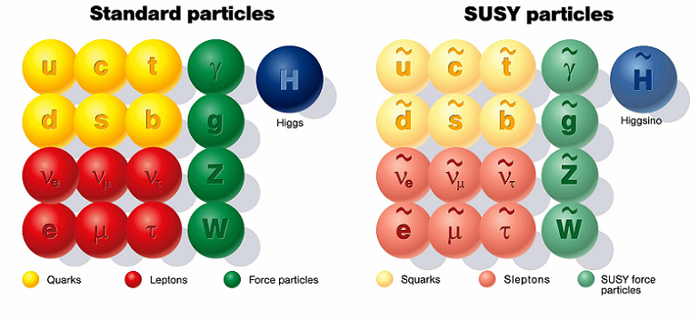
Supersymmetry
In conventional particle physics, fermions and bosons are fundamentally different
And never the twain shall meet
In a hypothesis called supersymmetry, fermions and bosons are interrelated
There must be a superpartner for every particle:
Supersymmetry also helps solve a problem called the hierarchy problem
But only if it doesn’t happen at too high an energy
If supersymmetry is right, then scale of supersymmetry breaking probably around k_{B}T = 500 GeV or so.
If this is right, the LHC should discover it
If supersymmetry is right, then we must revise upwards our estimate of where it happens
k_{B}T = 1.5 TeV or so.
Complete list of superpartners discovered at the Large Hadron Collider:
1.

Slide 4
The Lightest Superpartner
When would supersymmetry become relevant?
Assume supersymmetry breaking scale around 1.5 TeV
Most variations of supersymmetry assume that supersymmetric particles can only be created or destroyed in pairs
Guaranteed by something called R-parity
If this is true, then the lightest superpartner (LSP) must automatically be stable
Such a particle could be the dark matter
More on this later
Time T or k_{B}T Events
10^{–13} s 1.5 TeV Supersymmetry Breaking
10^{–11} s 160 GeV Electroweak Symmetry Breaking

Slide 5
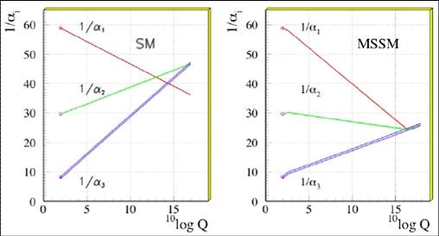
Grand Unification Theories (GUT’s)
In the standard model, there are three fundamental forces, and three corresponding coupling constants
These have rather different values
But their strength changes as you change the energy of the experiment, theoretically
How much they change depends on whether supersymmetry is right or not
If supersymmetry is right, then at an energy of about 10¹⁶ GeV, the three forces are equal in strength
At k_{B}T = 10¹⁶ GeV, there will be another phase transition – the Grand Unification transition
No Supersymmetry
With Supersymmetry
Baryogenesis might occur at this scale
Scale could be right for inflation

Slide 6
Inflation
How Flat Was the Universe?
The universe today is very nearly flat:
How flat was it in the past?
Recall the Friedman equation:
The radiation fraction Ω_{r} is defined as
The curvature (the last term) is given by
Taking the ratio of these equations, we have
Recall that radiation scales as a⁻⁴
So it all scales approximately, as T^{–2}
Not exactly, due to reheating

Slide 7
The Flatness Problem
When you include all the corrections for reheatings, you get
For definiteness, pick g_{eff} =200 and k_{B}T = 3×10¹⁵ GeV
Current values
In the early universe expect Ω_{r} = 1
So we find
You should memorize this value to about 55 digits or so
How did it happen to be so close to 1?

Slide 8
The Horizon Problem
The universe looks pretty uniform today
The universe used to be smaller
Could it have been smoothed out in the past?
Let’s look at the universe at the time of Grand Unified scale (k_{B}T = 10¹⁶ GeV):
At the time the universe was about 10⁻³⁹ seconds old
Universe then could be smooth on scales of about
Since then, the universe has grown immensely in size
Assume aT is roughly constant (not exactly)
So universe today could be smooth on scale of:
Actual universe today smooth on scale of:

Slide 9
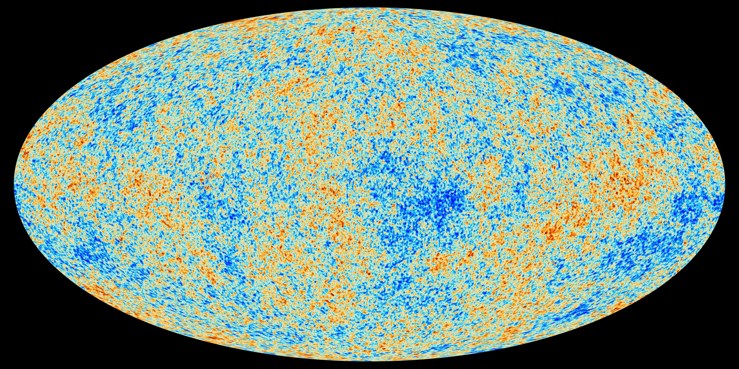
The Origin of Structure Problem
Where did all this variation come from?

Slide 10
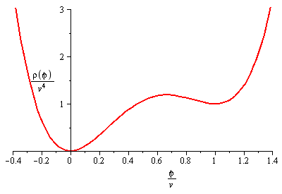
The Solution: Inflation
How can we get Ω to be close to one at some point in the past?
Recall,
Since ρ falls faster than 1/a², as universe expands, Ω is driven away from 1
If ρ fell slower than 1/a², as universe expands, Ω would be driven towards 1
Could there have been a period when universe dominated by vacuum in the past?
Need some field that is stuck in “wrong place” – “false vacuum”
Friedmann Equation:
False Vacuum, Early Universe
True Vacuum, Now

Slide 11
The Inflationary Era
Assume inflation occurs around the Grand unified scale, v = 10¹⁶ GeV
During inflation, Hubble’s constant is:
Universe increases by factor of e every 10⁻³⁷ s or so
We are not radiation dominated, so we can’t trust radiation era formulas

Slide 12
How Much Inflation Do We Need?
During inflation, Ω is driven towards one
Ω – 1 at GUT scale is less than 10^{–55}
We need a to increase by about 10²⁷
At GUT scale, universe was smooth on scale that becomes at most 0.1 m today
Today universe is smooth on scale of at least 10²⁷ m
We need a to increase by at least 10²⁸
Probably want 100 or so e-foldings of growth
If it is any number significantly bigger than the minimum required, then
Ω =1 to many more digits than we need at GUT scale
Ω =1 today to many digits
Universe is smooth on scales much bigger than we can see

Slide 13
More Comments on Inflation
During inflation, the universe expands by at least factor of 10²⁸
If there is anything besides vacuum, it is getting red shifted like crazy
Completely ignore radiation
Anything else in the universe also is diluted and disappears
By the time inflation is over, any record of previous universe is effectively erased

Slide 14
Density Fluctuations from Inflation
During inflation, you could think universe is very smooth
On microscopic scales, universe will have tiny density fluctuations, thanks to quantum mechanics
The size and magnitude of these fluctuations can be calculated
Gaussian, distribution, for example
In size, these are so small they would be irrelevant
Except the universe is inflating!
Little fluctuations grow up to be big fluctuations
Constant new fluctuations are appearing at all scales
During inflation: predict “scale invariant” density perturbations
“Spectral index” n = 1

Slide 15
Exiting Inflation and Reheating
Universe must make transition to true vacuum Old inflation picture:
It quantum tunnels from false vacuum to true
It oscillates back and forth around true
Oscillations generate all kinds of particles
Reheating
Baryogenesis must occur after inflation ends
Otherwise any baryons would just inflate away
We re-enter radiation era, but with t a little increased because of inflationary era
Event k_{B}T or T Time
Inflation begins 10¹⁶ GeV 10⁻³⁹ s
Inflation ends, baryons created, etc. 10¹⁵ GeV 10⁻³⁵ s

Slide 16
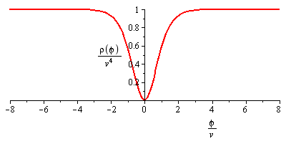
Inflation is Dead. Long Live Inflation!
The problem – it’s hard to quantum tunnel
It will only occur very rarely
It will occur at one place
Bubble nucleation
All the energy is on the walls of the expanding bubble
If bubbles collided, we could get reheating
But universe expands so fast, bubbles never find each other
The solution: change the potential
No quantum tunneling needed
“Slow roll” potentials
Whole universe moves to minimum at same time

Slide 17
Too Many Kinds of Inflation
Many many variations on inflation have since been explored
Slow Roll inflation
Chaotic inflation
Designer inflation
We don’t know which (if any) of these are correct
Generic features of modern inflation:
Universe “slows down” just before exiting inflation
Expansion not so fast at the end
Small fluctuations don’t grow quite so big
Fluctuation spectrum has more power at smaller scales
Not quite scale invariant
Spectral index just under 1

Slide 18
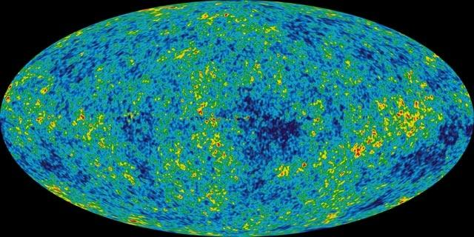
Density Fluctuations
Why We Need Them
If the universe were perfectly uniform, then how come the microwave background isn’t uniform?
Where did all the structure (galaxies, clusters, etc.) come from?
Can we understand where these variations come from?
Can we explain how these variations led to the structures we see?

Slide 19
Review: Spherical Harmonics
The temperature is a function of angle only
The spherical harmonics are a series of functions of angle only
Taught about them in PHY 215 and other courses
There are an infinite number of them
l = 0, 1, 2, 3 , …
m = – l, – l+1, …, l
The smaller indices represent functions that vary slowly with angle, the larger ones vary more quickly
For example, the φ dependence depends on m
The angular scale at which the function changes sign is, crudely,
This could be based on changes in θ or φ
Any function that depends only on angle can be written as a linear combination of spherical harmonics
The coefficients C_{lm} contain the same information as the function T(θ ,φ)

Slide 20
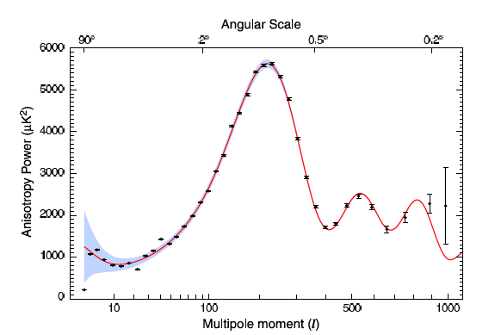
How to Describe the Fluctuations
When you rotate the coordinates, you change Y_{lm} spherical harmonics into others with the same value of l but different values of m
The coefficients C_{lm} get mixed within different values of m when you rotate
Exact values of C_{lm} depends on choice of axes
But, if you sum up the C_{lm}’s over fixed l, the total is independent of m, depends only on l
So the information about how much variation on each angular “scale” is contained in
Plot the result as a function of l
Dots are the data, solid is the fit
How do we explain all these features?

Slide 21
Growth of Density Pertubations
Assume inflation, or some other source, produces density perturbations at all scales
Spectral index = 1, or slightly less than 1
A bit more “power” at small scales than at large
Now, we need to discuss what happens at all possible scales during four eras:
Radiation dominated era: z > 3000
Matter domination before recombination: 1100 < z < 3000
Post recombination: 10 < z < 1100
Structure formation: z < 10
The cosmic microwave background shows us the universe at recombination

Slide 22
Coupling in the Different Eras:
The dark matter probably doesn’t collide with anything
It will do its own thing
It is moving slowly and has little thermal pressure
Neutrinos move nearly at the speed of light
As soon as they can, they simply erase any structure
Ignore them from now on
Everything else moves together before recombination:
The baryons collide with electrons (Coulomb scattering)
The photons collide with electrons (Thomson scattering)
The baryons, photons, and electrons all move together
The photons provide the lion’s share of the pressure
After recombination, the atoms decouple from the photons
The pressure drops effectively to zero

Slide 23
The Radiation Era: What Happens
Suppose we have a perturbation (say, a high density region) during this era:
Inflation predicts: every type of particle will have higher density in this region
Photons try to flow from high density to low density
They move at speed of light
When size of perturbation equals about ct, it gets wiped out
Actually, they oscillate, more on this later
The baryons also get wiped out, because they are caught with the photons
The dark matter stays behind, and gravity starts to gather it more
But very slowly, because radiation dominates
Radiation
Dark Matter
Baryons/Atoms

Slide 24
Matter Domination, Before Recombination
As before, the photons and baryons flow from high to low density as soon as they are able
Actually, they oscillate, as I’ll explain soon
However, now the dark matter dominates
Gravity causes high density regions to get higher density
They start to form structures
These structures will become galaxies, etc.
We see the microwave background from the end of this era
We don’t see large density perturbations from this era
We are looking only at the photons (coupled to baryons)
Radiation
Dark Matter
Baryons/Atoms

Slide 25
Acoustic Modes
Before recombination: The photons and baryons are all coupled together
Consider regions of alternating high density/low density:
High density regions try to flow to low density
This creates a sound wave, just like an ordinary sound wave
This process stops at recombination
We catch the wave, frozen at that moment of time

Slide 26
Acoustic Modes and Scales
Where will we catch the wave at recombination? It depends on wavelength
Longest wavelength: It hasn’t had time to even cycle at all
Relatively little “power” at largest scales
Next longest: It will be right at its first peak in oscillation cycle
This will be sensitive to Ω
Slightly longer: Wave is at a node, or minimum
Longer still: The second peak
Wave has oscillated, it is now at anti-node
Baryons feel gravity of dark matter, and resist (baryon drag)
Sensitive to Ω_{b}

Slide 27
Where Will the First Peak Be? (1)
This is a wave that has only gone through about a third of a cycle
This scale has since grown to about
The distance to this wave is now about
The angular size of the wave is then
More precise analysis says peak should be at l = 220

Slide 28
Where Will the First Peak Be? (2)
All calculations assumed standard cosmological values
Including Ω =1
There are many effects that change this, most notably, the curvature of spacetime
In flat space, Ω =1, we used the correct distance/angle relationship
If Ω >1, then curvature of universe will make angular size appear bigger
If Ω <1, then curvature of universe will make angular size appear smaller
θ
s
d
Actual peak occurs around:
By measuring actual position of peak, we can estimate Ω
This is the primary source of the information that Ω =1.00

Slide 29
Matter Domination, After Recombination
Photons completely decouple, they become completely smooth
Any dark matter high density regions will gather baryons
These regions quickly become high density again
These regions continue to grow more and more massive
Throughout all these periods (up to now) these regions are continuing to grow with the rest of the universe in physical size
Radiation
Dark Matter
Baryons/Atoms

Slide 30
Outline of History of Universe
Time T or k_{B}T Events
10⁻⁴³ s 10¹⁸ GeV Planck Era; time becomes meaningless?
10⁻³⁹ s 10¹⁶ GeV Inflation begins; forces unified
10⁻³⁵ s 10¹⁵ GeV Inflation ends; reheating; forces separate; baryosynthesis (?)
10⁻¹³ s 1500 GeV Supersymmetry breaking, LSP (dark matter)
10⁻¹¹ s 160 GeV Electroweak symmetry breaking
14 μs 150 MeV Quark Confinement
0.4 s 1.5 MeV Neutrino Decoupling
1.5 s 0.7 MeV Neutron/Proton freezeout
20 s 170 keV Electron/Positron annihilation
200 s 80 keV Nucleosynthesis
57 ky 0.76 eV Matter-Radiation equality
370 ky 0.26 eV Recombination
600 My 30 K First Structure/First Stars
13.8 Gy 2.725 K Today

Slide 31
Structure Formation
Up to now, the density fluctuations have been assumed small
As universe expands, can show in general that
But the density itself is falling as
Therefore,
Eventually, the perturbation becomes large (non-perturbative)
To some extent, must rely on computer simulations
Qualitatively:
Collapses in some direction first
Then it fragments
Fragments fragment further
Form successively smaller structures

Slide 32
Which Structures Form First?
For “scale invariant” density perturbations, all scales start about the same
But inflation implies smaller structures have a slight advantage
During radiation era, smaller structures can grow a little
Another slight advantage for small structures
Structures larger than the size of the universe ct at matter/radiation equality have a big disadvantage
This sets the largest scales at which structures form
This is a homework problem
There is also a smallest structure that can form, set by the Jeans Mass
When pressure overcomes gravity
Homework problem
Conclusion – smallest structures form first, but not by a lot
Globular Clusters/Dwarf Ellipticals – around z = 8 – 12
Galaxies/quasars/etc. – around z = 5–8
Galaxy Clusters – around z = 2–5
Galaxy Superclusters – around z = 0–2

Slide 33
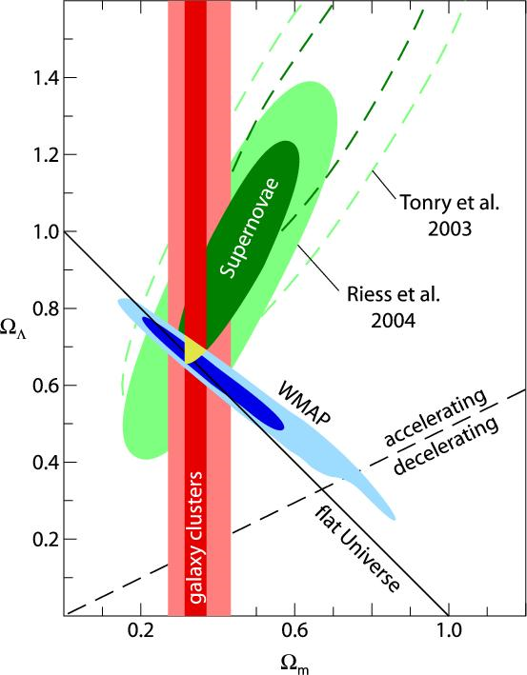
Cosmological Parameters (1)
We have three independent ways of estimating cosmological parameters
Cosmic background
Structure in the current universe
Supernovae red shift
Collectively, these give lots of independent information
The fact that these all work consistently together tells us we are on the right track
And note that Ω = 1
To extract the best values, do a full fit to everything simultaneously
Indications are that inflation (especially not quite scale invariant structure) yields best fit
Most cosmologists now think inflation is right

Slide 34
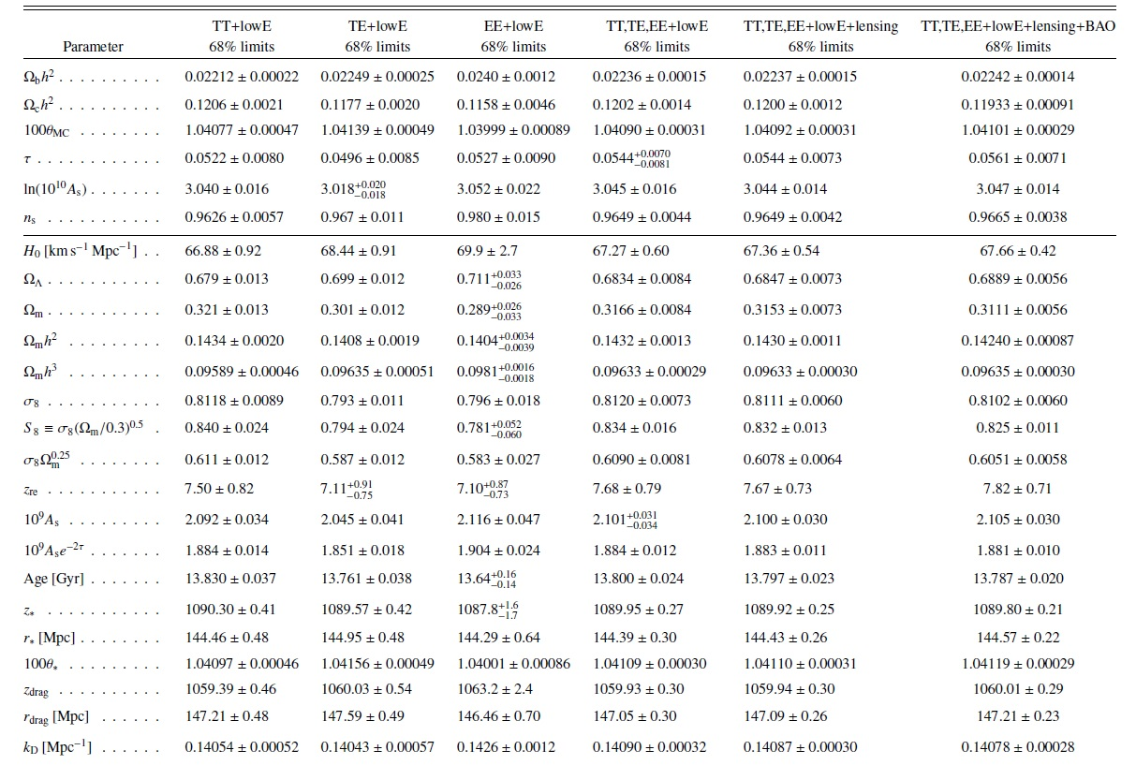
Cosmological Parameters (2)

