Slide 1
Alien Abduction and Sleep Paralysis
Benayas Dereje, Ryan Dunn, Sean Liu, Stephanie Pilutti

Slide 2
The “Typical” Alien Abduction (Blackmore)
Bedroom at night
“Intense” light, “buzzing or humming” sound, ominous presence
Transportation into the UFO
Probing

Slide 3
What does an alien look like? (Blackmore)
Blackmore elaborates on two classes of aliens:
“Grays”
4 ft. tall
Slender body and neck
Big head
Almond-shaped black eyes
Bald, with three fingers on each hand
Other entities: blue, green aliens, “Nordic” Aliens, “Human Types”

Slide 4
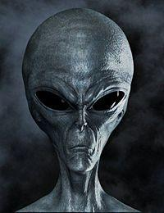

Slide 5
Why would aliens want to abduct us? (Blackmore)
Harmless warnings of “impending ecological disaster”
Alien breeding program

Slide 6
Theories and possible explanations behind abductions (Blackmore)
Fabricated memories through hypnosis
Mental illness
“Temporal lobe lability”
Sleep paralysis

Slide 7
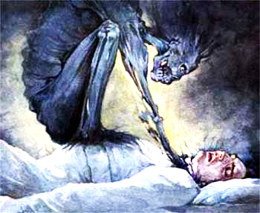
Sleep Paralysis
Sleep paralysis (sleep paralysis with hypnagogic and hypnopompic hallucinations/Experiences (HHE’s)) has been singled out as a particularly likely source of beliefs concerning not only alien abductions, but all manner of beliefs in alternative realities and otherworldly creatures.
It is a condition in which someone, most often lying in a supine position, about to drop of to sleep, or just upon waking from sleep realizes that she is unable to move, or speak, or cry out.
People frequently report feeling a "presence" that is often described as malevolent, threatening, or evil. The presence is likely to be vaguely felt or sensed just out of sight but thought to be watching or monitoring, often with intense interest, sometimes standing by, or sitting on the bed.
On some occasions the presence may attack, strangling and exerting crushing pressure on the chest.
Notes:
Information taken from an article published by The University of Waterloo, Canada

Slide 8
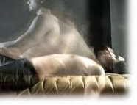
Hypnagogic: relating to the state immediately before falling asleep.
Hypnopompic: relating to the state immediately preceding waking up

Slide 9
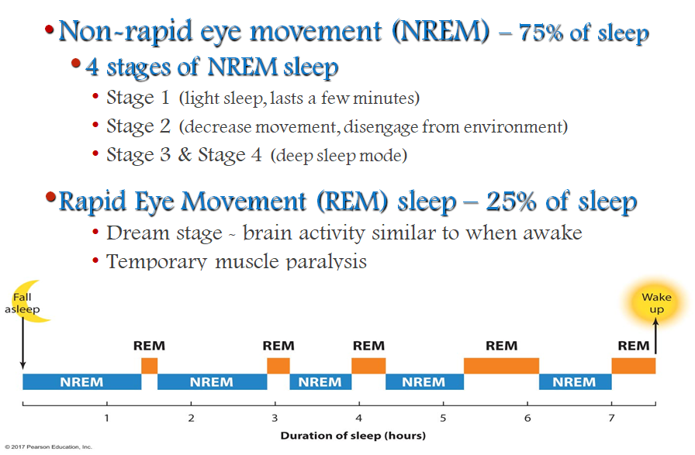
It is also widely accepted that dreaming is more common and more vivid during REM than during NREM sleep (Dement & Kleitman, 1957)
REM state is usually associated with Muscle atonia (extreme relaxed state of skeletal muscles)

Slide 10
How is it different from the regular dreams we have?
In Sleep Paralysis, there is little or no blocking of exteroceptive stimulation and there is no loss of waking consciousness (state of being aware of your thoughts, feelings and perceptions from internal events, as well as external surrounding).
Sleep Paralysis Experience
Sleep paralysis related experiences
There is no loss of intensity or vividness of the experience
The knowledge or belief that the experience is illusory reduces, for some, the terror of the experiences but appears to have relatively little impact on the apparent reality of the experiences.

Slide 11
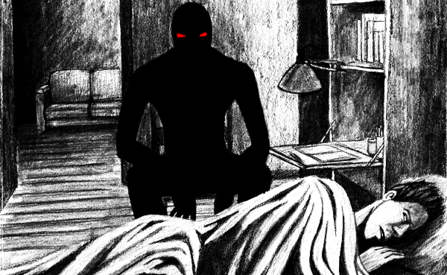
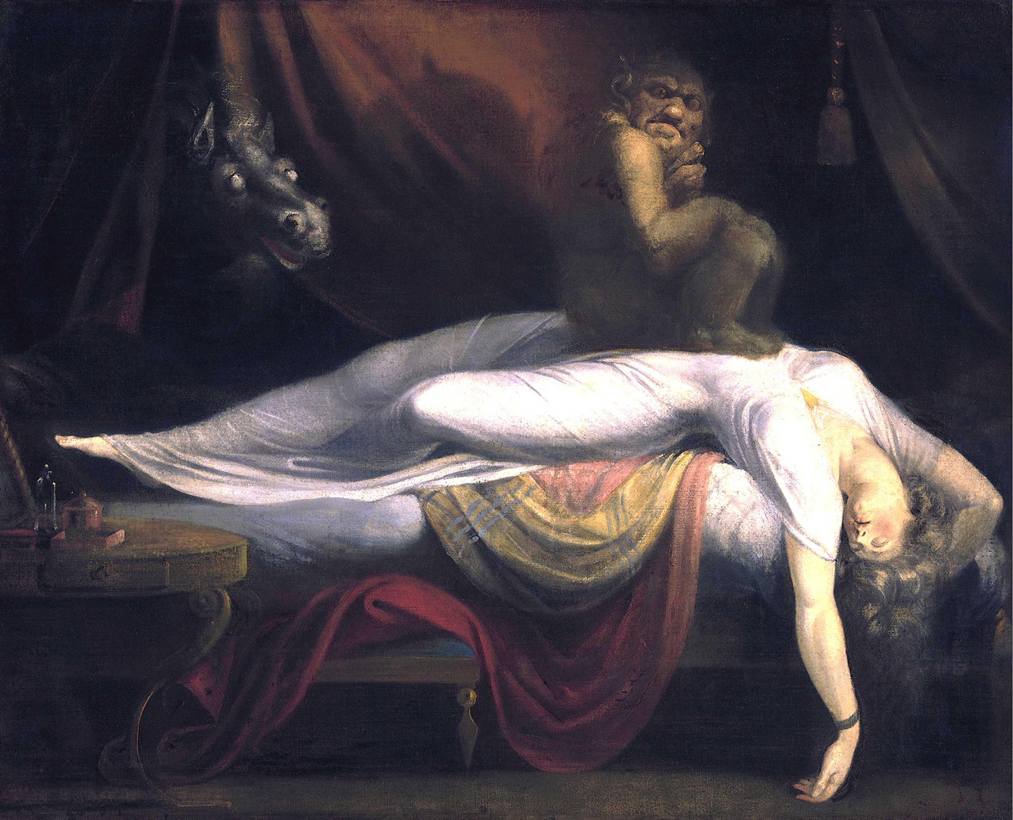
Myths Associated with Sleep Paralysis
Old Myths (some still believed)
The Old Hag of Newfoundland (“Witch”, Canada)
Kanshibari (Possession, “Bound with metal”,Japan)
Kokma (“Ghost Baby”,St. Lucia)
Popbawa (“Demonic Spirit”, Zanzibar)
Dukak (“Spirit of Depression”,Ethiopia)
Alien Abduction (Modern Myth)
Notes:
Henry Fuseli

Slide 12
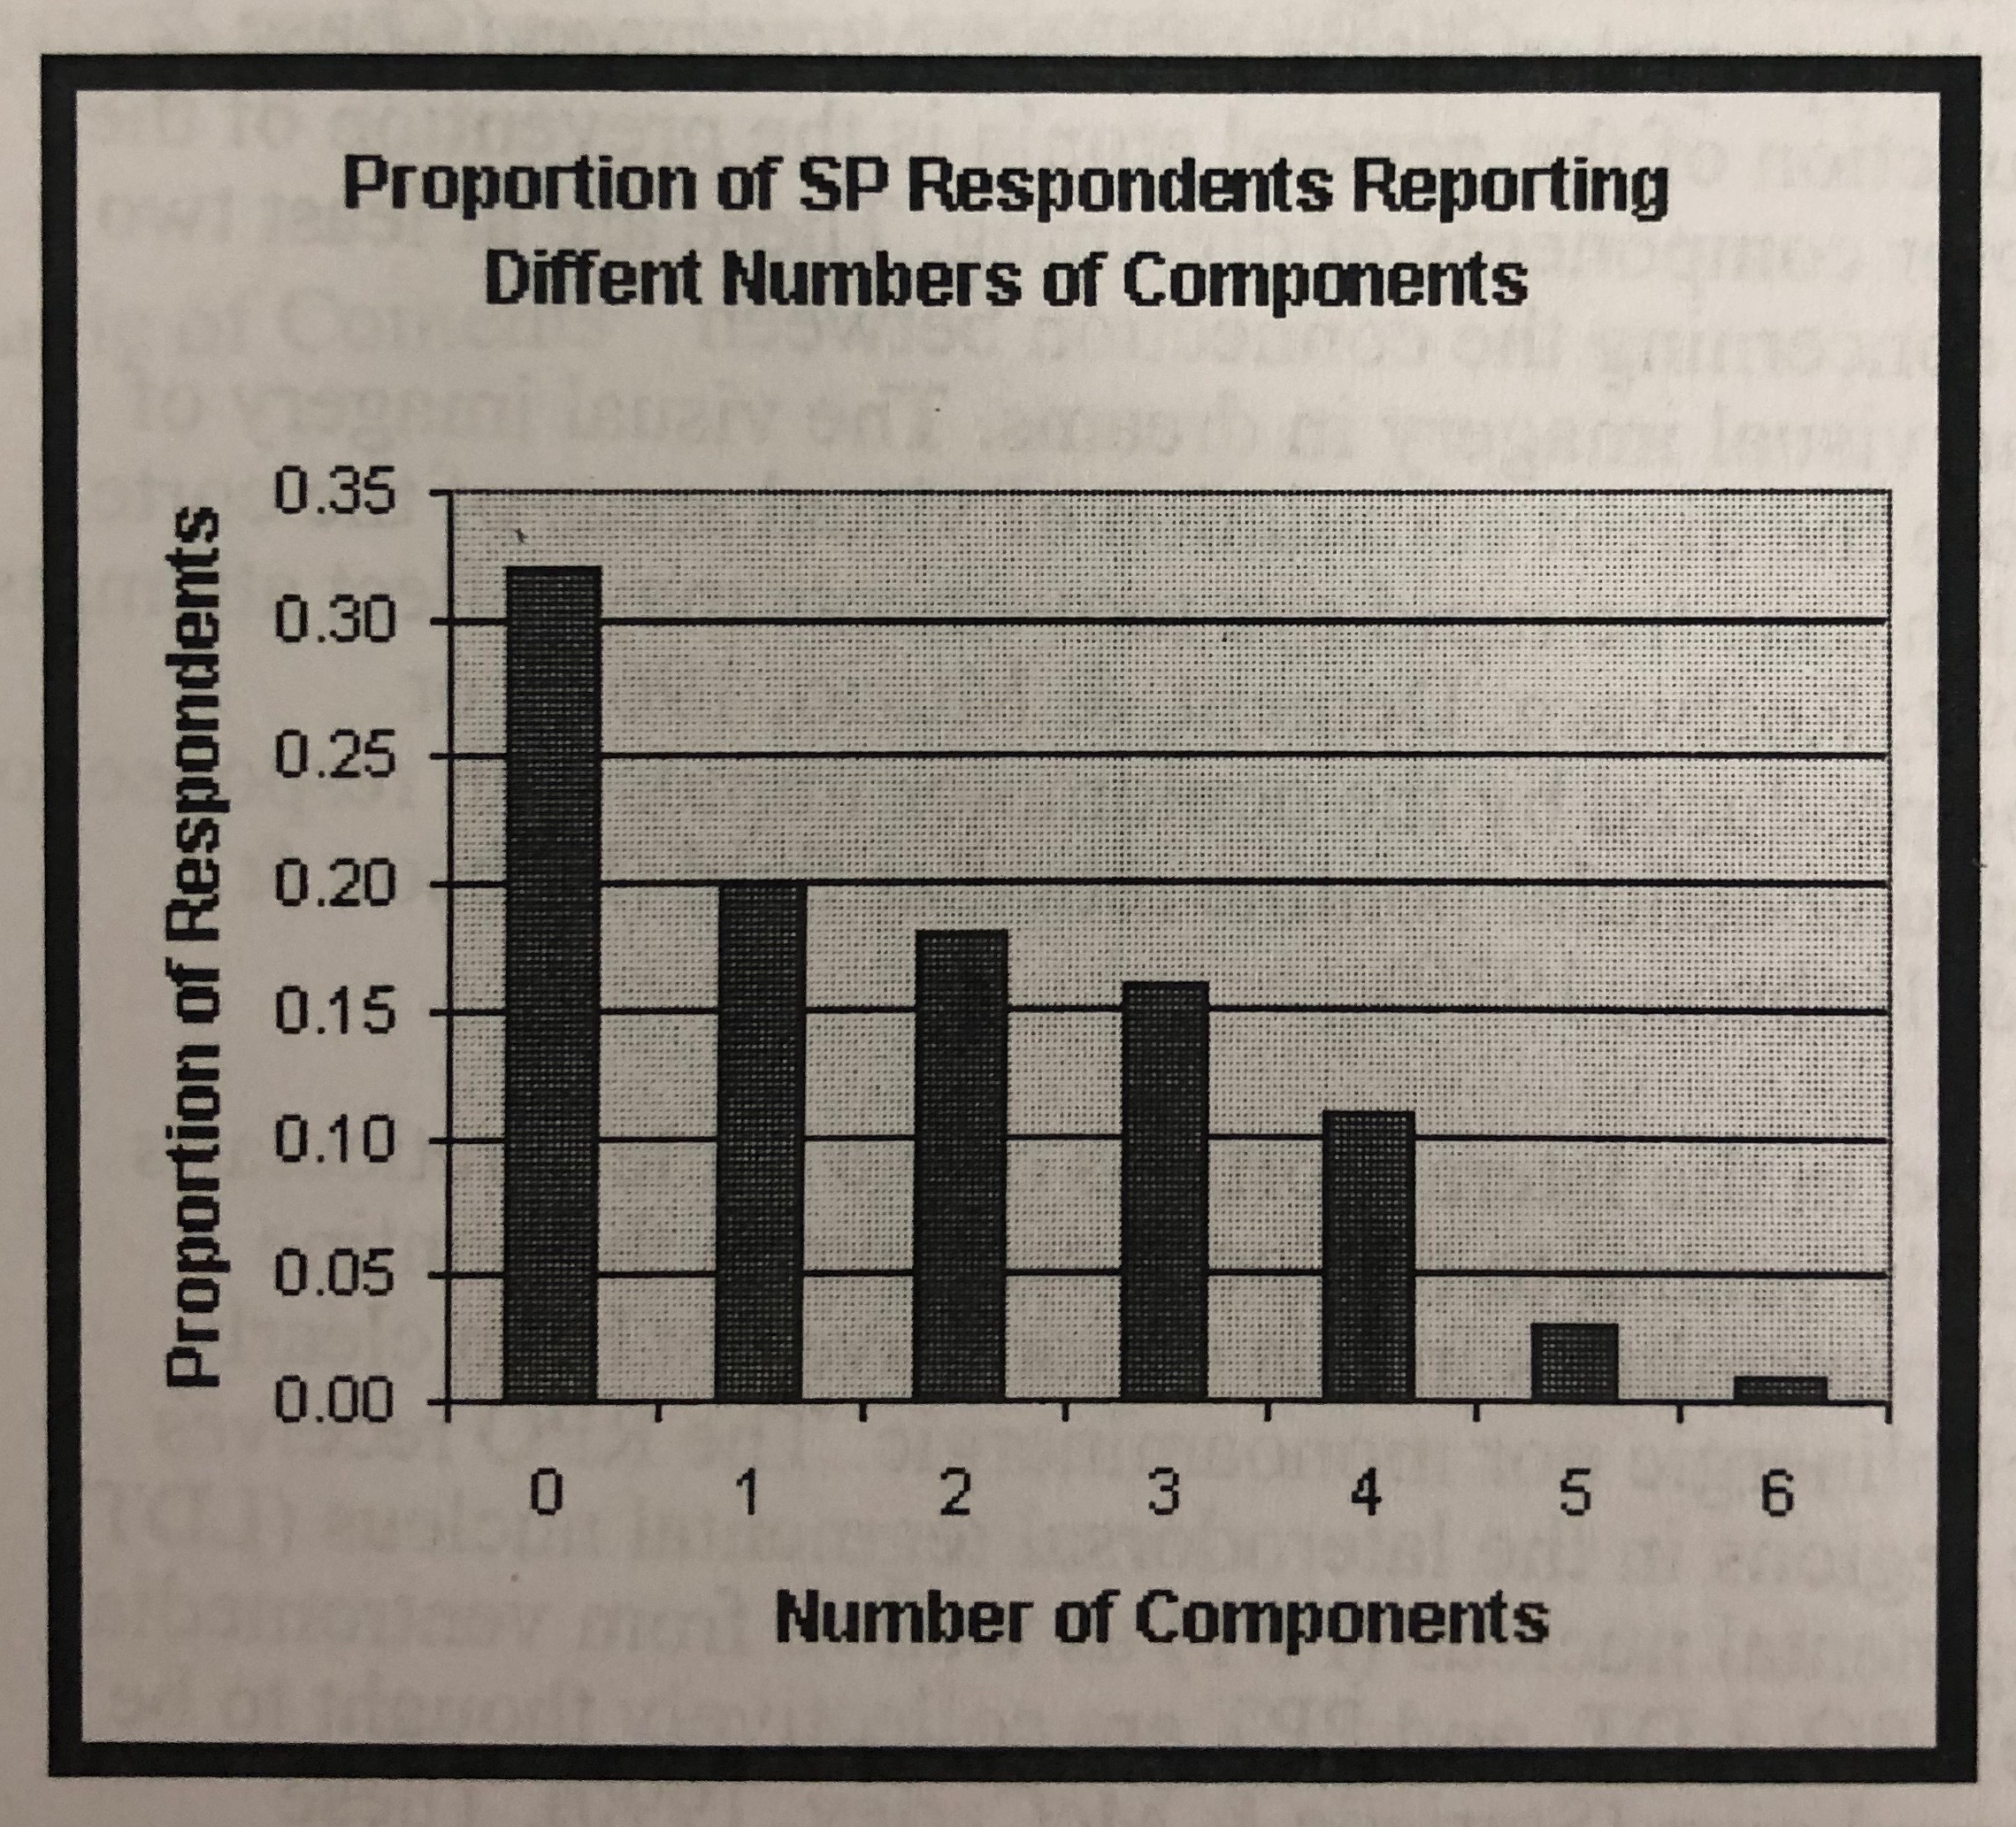
Frequency of Associated Experiences
About 20-40% of people surveyed reported experiencing sleep paralysis
⅓ of the population that was sampled believed that this was the extent of the experience
The remaining ⅔ of the population reported associated experiences referred to as hypnogogic and hypnopompic hallucinations
A presence was sensed that caused fear (most common symptom)
Intense blue/white light was seen
Buzzing/humming could be heard
Seeing a UFO
Waking up to paralysis
Notes:
The image represents how many people experienced how many symptoms: more people experienced fewer...fewer people experienced more

Slide 13
The Roper Poll
3.7 MILLION AMERICANS HAVE BEEN ABDUCTED!
Conducted between July and September 1991, published in 1992
Budd Hopkins: Painter/Sculptor
David Jacobs: Historian
Ron Westrum: Sociologist
There were 11 questions on the poll, and the survey population was asked to answer “more than twice,” “once or twice,” or “never” to each question
Waking up paralyzed with a sense of a strange person or presence or something else in the room
Feeling that you were actually flying through the air although you didn't know why or how
Experiencing a period of time of an hour or more, in which you were apparently lost, but you could not remember why, or where you had been
Seeing unusual lights or balls of light in a room without knowing what was causing them, or where they came from
Finding puzzling scars on your body and neither you nor anyone else remembering how you received them or where you got them
Notes:
The 5 questions listed = indicator experiences
Additional questions included: seeing a ghost, seeing or dreaming of a UFO, and leaving the body

Slide 14
Abduction or Just Sleep Paralysis?
Roper Poll Conclusion: If a respondent answered “yes” to at least FOUR out of the five indicator questions, then they were, in fact, abducted.
119 out of the 5,947 answered “yes” to at least FOUR (2%)
2% of 185 million is 3.7 million
Justification? Hopkins and Jacobs worked with nearly 500 abductees over a 17 year period and essentially jumped to conclusions based on similar findings.
The 119 people have either been abducted or have had interesting psychological experiences such as sleep paralysis

Slide 15
Methods
Test this using both adults and children in Bristol and encourage them to recall by relaxation and fill the missing details of an abduction story.
Subjects: 126 school children aged 8 to 13 and 224 first-year undergraduates aged 18 and over; tested in groups of 22 to 28. The adults were psychology and physiotherapy students at the University of the West of England tested in three large groups.
Procedure: For the children, told them to relax and read them the abduction story “Jackie and the Aliens”; details of the precise image of the aliens were not given; then, woke them up and gave them questionnaires. The procedure for the adults was slightly simplified.
Finally, all groups except one of the adult groups were asked to draw the aliens they imagined.

Slide 16
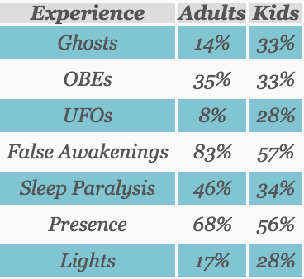
Results
Large numbers of both adults and children reported having had most of the experiences.
For each person, an “alien score” from 0 to 6 was given for the number of answers that conformed to the popular stereotype of the aliens, and another score for the number of Roper Poll indicator experiences reported (0-4).
For the children, the mean alien score was 0.95, and the mean number of experiences 1.51. There was no correlation between the two measures (rs = - 0.03, n = 101, p = 0.78). Twelve (12 percent) of the children drew grays and 87 did not.
For the adults, mean alien score was 1.23 and mean number of experiences 1.64. Again, there was no correlation between the two measures (rs = 0.07, n = 213, p = 0.29). Seventeen of the adults drew grays, and 103 did not.

Slide 17
Discussion
These results provide no evidence that people who reported more of the indicator experiences had a better idea of what an alien should look like or what should happen during an abduction.
The popular stereotype may be obtained more from television programs than from having been abducted by real aliens.
The four questions from the Roper Poll had a higher incidence than those in the actual Roper Poll.
Their Roper Poll study cannot prove that there is no real abduction happening on Earth.
They show that knowledge of the appearance and behavior of abducting aliens depends more on how much television a person watches.
Thus, their study is false.

