Slide 1
Chapter 10.3 Announcements:
Homework 10.3: due Tuesday, April 16, in class
Exercises: 30, 32, 33, 38, 40, 42
Problems: 19, 23, 24, 25, 26, 28, 29, 30
- Remember: Homework 9.2 is due Thursday, April 11, in class
All grades will continue to be posted at: http://www.wfu.edu/~gutholdm/Physics110/phy110.htm
Listed by last four digits of student ID
We’ll now cover only parts of each chapter (let me know if you want me to cover something that is not on the list and that interests you):
  5.1 Balloons
  7.1 Woodstoves
  9.1 Clocks
  9.2 Musical Instruments
  10.3 Flashlights
  11. Household Magnets & Electric Motor
  11.2 Electric Power Distribution
  15.1. Optics, cameras, lenses
  16.1 Nuclear Weapons

Slide 2
Chapter 10.3 Flashlights
Electric circuits, Ohm’s law
Demos and Objects
Concepts
How does a flashlight work
building an electric circuit
electric circuits
current
voltage
voltage rises and drops
resistance
Ohm’s law; V = R·I
electrons
charge
electric power, P = V·I

Slide 3
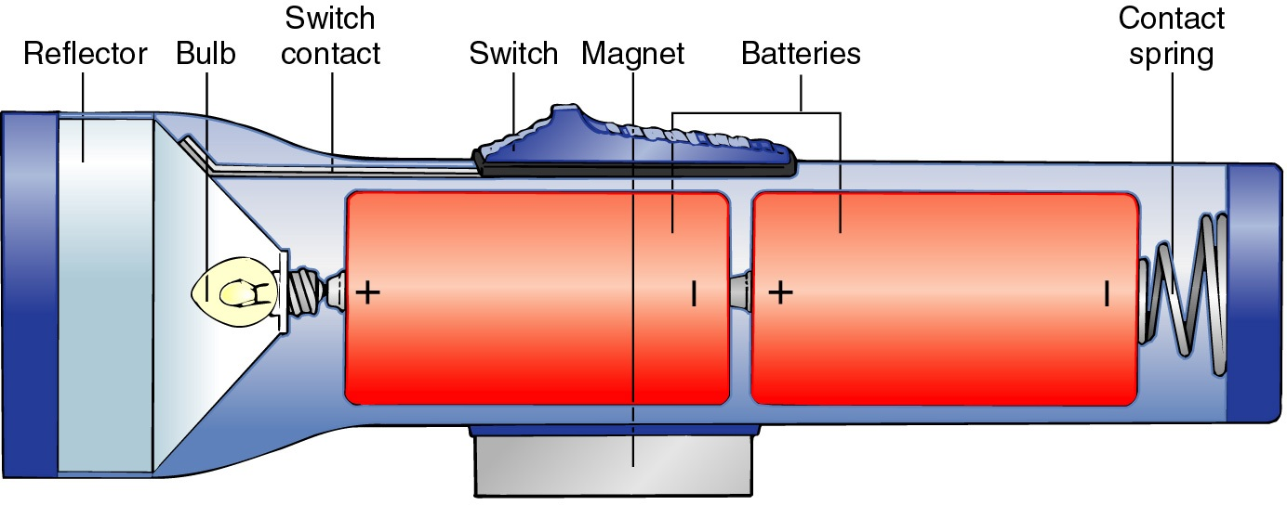
Observations About Flashlights
(and electrical circuits)
They turn on and off with a switch
More batteries usually means brighter
The orientation of multiple batteries matters
Flashlights dim as batteries age

Slide 4
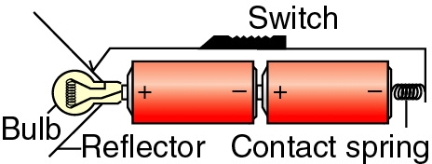
For a functioning circuit we need:
battery,
switch,
light bulb,
wire.

Slide 5
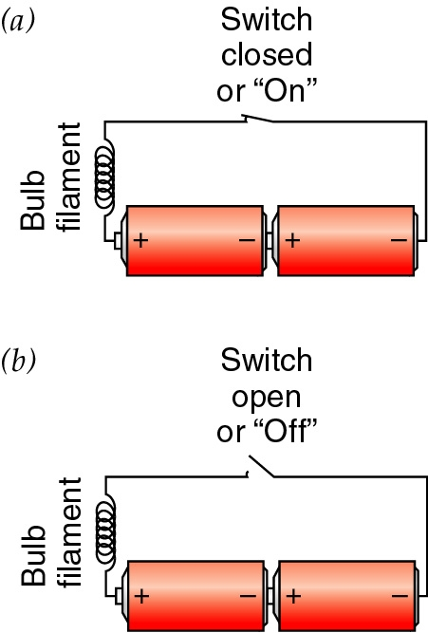
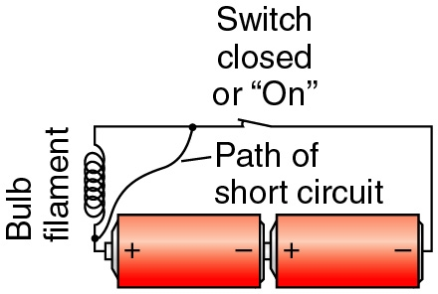
In a flashlight we are creating an:
Electrical circuit
An electrical current (electrons) runs through all the parts of the circuit (close circuit).
No current flows when switch is open (open circuit).
Electrons carry energy from batteries to the bulb.
Short circuit: A path (short cut) in which the light bulb is cut out.

Slide 6
i-clicker-1
If you remove the 2 batteries from a working flashlight (shown below) and reinstall them backward so that they make good contact inside, will the flashlight still work?
Yes
No

Slide 7
A Battery
Battery “pumps” charge from + end to – end
  Chemical potential energy is consumed
  Electrostatic potential energy is produced
Current undergoes a rise in voltage
  Alkaline cell: 1.5 volt rise
  Lead-acid cell: 2.0 volt rise
  Lithium cell: 3.0 volt rise
Chain of cells produces larger voltage rise

Slide 8
A Light Bulb
Structure
  Contains a protected tungsten filament
  Filament conducts electricity, but poorly
Filament barely lets charge flow through it
  Electrostatic potential energy (voltage) is consumed
  Thermal energy is produced
Current undergoes a drop in voltage
  Two-cell alkaline flashlight: 3.0 volt drop

Slide 9
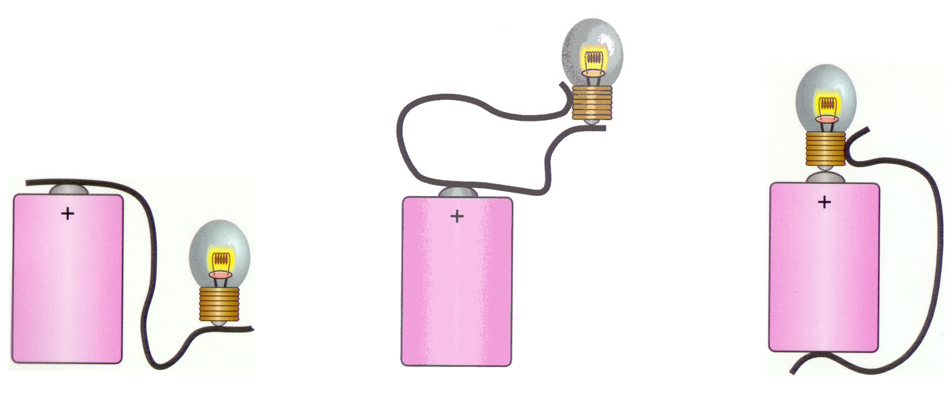
How to connect a battery
What’s wrong with each of the schemes shown in the Figure for lighting a flashlight with a flashlight battery and a single wire?
There is no loop for the current to flow around.
There is loop to and from the light bulb, but there is no potential difference.
Nothing wrong here. The bulb will light up.
-
-
-
(a)
(b)
(c)

Slide 10
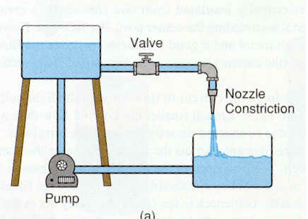
Electric Current Water Analogy
h V
water flow I
Current: number of electrons passing through per second
Water analogy: number of water molecules passing through per second

Slide 11
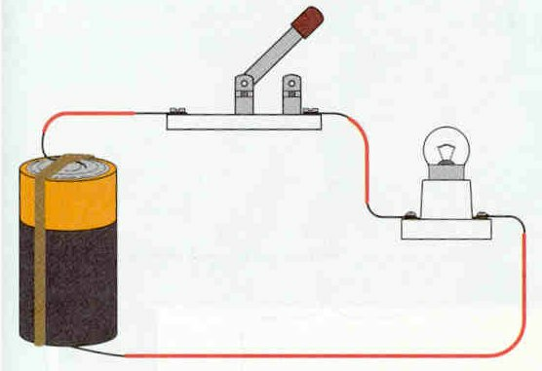
I

Slide 12
What determines the current through the circuit (Load)?
Ohm’s Law
V = I·R or
I = V/R
R
V
I
V… Voltage; units, Volt, 1V
I … Current; units, Ampere, 1A
R … Resistance; units, Ohm, 1Ω
So, 10V across a 100ohm load = 0.1 Amp
Where 1 Amp = 1 coulomb/sec = 6.25 x 10¹⁸ e/sec
1 Amp=62,500,000,000,000,000,000 electrons/sec

Slide 13
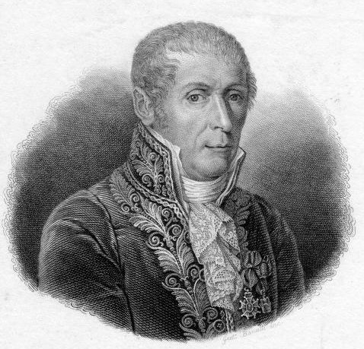
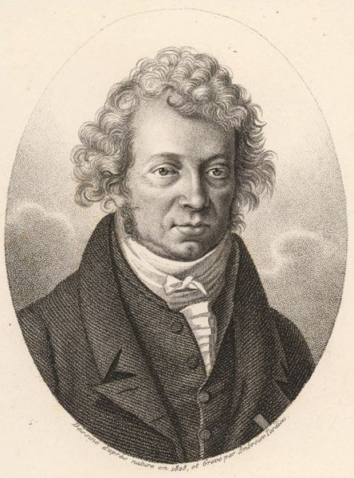
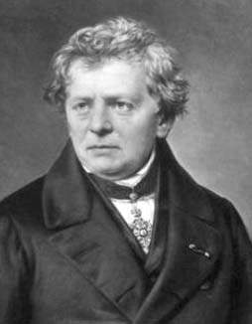
Ohm’s Law
V = I·R
Count Alessandro Giuseppe Antonio Anastasio Volta (1745 –1827) was an Italian physicist known especially for the development of the first electric cell in 1800.
André-Marie Ampère (1775 –1836) was a French physicist and mathematician who is generally regarded as one of the main discoverers of electromagnetism.
Georg Simon Ohm (1789 – 1854) was a German physicist. As a high school teacher, Ohm began his research with the recently invented electrochemical cell, invented by Italian Count Alessandro Volta. Discovered the relationship, V = I·R,
Ohm's law.

Slide 14
i-clicker-2; -3
A battery can produce 1.5 V. When connected to a light bulb a current of 2 A (Ampere) runs through the bulb. What is the resistance of the bulb?
A bulb in a lamp that is connected to a household outlet has a resistance of 100 Ω. What current flows through it?
Your skin has a resistance of about 10⁶ to 10⁴ Ω (dry) and 10³ Ω (wet) . What current runs through you when you stick your finger into an outlet (conduction to ground)?
1A. 0.5 Ω
1B. 0.75 Ω
1C. 1.5 Ω
1D. 2.0 Ω
1E. 3.0 Ω
2A. 1.2 A
2B. 2.4 A
2C. 3.6 Α
2D. 4.8 A
2E. 5.0 A

Slide 15
Electric shock
The severity of an electric shock depends on the magnitude of the current, how long it acts and through what part of the body it passes.
Can feel ~ 1 mA; pain at a few mA; severe contractions above 10 mA; heart muscle irregularities above 70 mA.
Resistance of dry skin ~ 10⁴ to 10⁶ Ω; wet skin 10³ Ω or less.
A person in good contact with ground who touches a 120 V line with wet hands can suffer a current

Slide 16
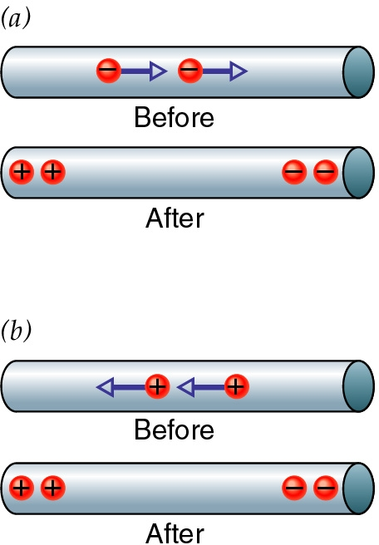
A word about the sign convention….
Positive Charge
Current points in the direction of positive flow
Flow is really negative charges (electrons)
It’s hard to distinguish between:
  negative charge flowing to the right
  positive charge flowing to the left
We pretend that current is flow of + charges
It’s really – charges flowing the other way

Slide 17
Power
Power is energy per unit of time
Power is measured in joules/second or watts
Batteries are power sources
Loads are power consumers

Slide 18
Battery Power power produced by the battery
Current: units of charge pumped per second
Voltage rise: energy given per unit of charge
current · voltage rise = power produced
P = V_{rise}·I
V_{rise}
I

Slide 19
Load Power
Current is units of charge passed per second
Voltage drop: energy taken per unit of charge
current · voltage drop = power received
V_{drop}
P = V_{drop}·I
I

Slide 20
i-clicker-4
A bulb in a lamp that is connected to a household outlet has a resistance of 100 Ω. How much power does it consume?
(Note: Look at previous i-clicker)
A. 120 J
B. 120 W
C. 144 J
D. 144 W
E. 100 J
A Kilowatt-hour costs 10 cents. If you run 10 lamps for 10 hours, how much does that cost you?

