Slide 1
Chapter 11.1 & 11.2 Announcements:
Homework 11.1, 11.2: due Thursday, April 25, in class
Exercises: 1, 4, 5, 6, 9, 17, 19, 21, 22, 23, 25
Problems: none
- Remember: Homework 10.3 is due Tuesday, April 16, in class
All grades will continue to be posted at: http://www.wfu.edu/~gutholdm/Physics110/phy110.htm
Listed by last four digits of student ID
We’ll now cover only parts of each chapter (let me know if you want me to cover something that is not on the list and that interests you):
5.1 Balloons
7.1 Woodstoves
9.1 Clocks
9.2 Musical Instruments
10.3 Flashlights
11. Household Magnets & Electric Motor
11.2 Electric Power Distribution
15.1. Optics, cameras, lenses
16.1 Nuclear Weapons

Slide 2
Chapter 11.1 Magnets
Demos and Objects
Concepts
North and south pole of a magnets
Like repels, unlike attracts
Earth is a big ol’ magnet
Current through a coil creates a magnet
Direction of magnet depends on direction of current
Permanent magnets
Electromagnets

Slide 3
Magnets and Magnetic fields
Magnets have a north and a south pole
Like poles repel, opposite poles attract
Only a few materials show strong magnetic effects (ferromagnetic materials, iron, cobalt, nickel, gadolinium, Neodymium (strong!))
There are no magnetic monopoles, i.e. when cutting a magnet the magnet is not separated into south and north, but two new magnets are obtained. (Electric charges are different, since a single electric charge does exist.
Magnets are surrounded by a magnetic field; charges are surrounded by an electric field.

Slide 4
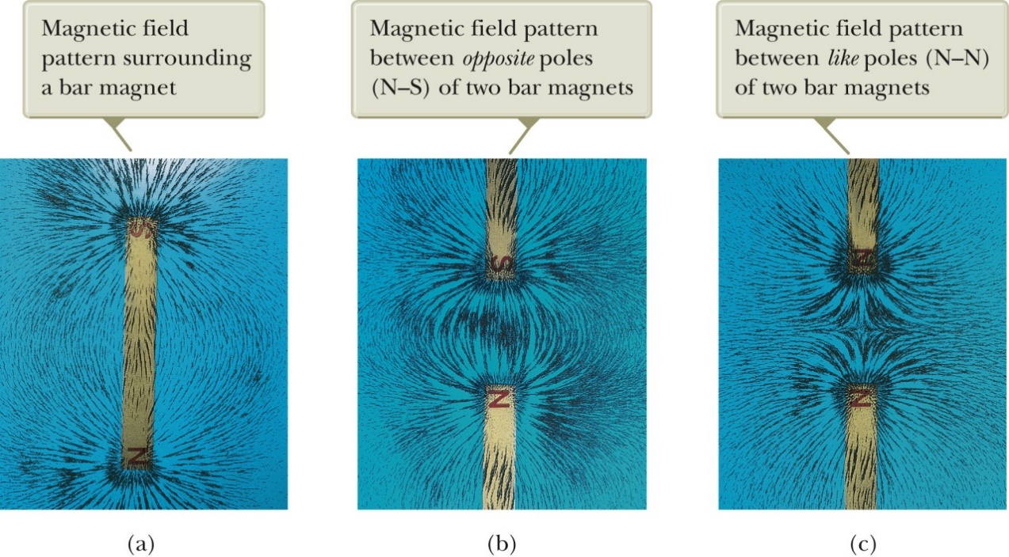
Magnetic field lines
The force one magnet exerts on an other can be described as the interaction between one magnet and the magnetic field of the other.
Can draw magnetic field lines (see right)
The direction of the magnetic field is tangent to a line at any point.
The number of lines per unit area is proportional to the magnitude (strength of the field.
Outside a magnet, lines point from the North to the South pole. (The direction in which the North pole of a compass needle would point. (Inside the field goes from South to North.)

Slide 5
An aside: The earth as a magnet
The earth has a magnetic field. Earth acts like a huge magnet in which the south pole of the earth’s magnet is north. (North pole of a compass needle points towards it.)
Magnetic poles are not at geographic poles; magnetic north pole is in Northern Canada. It moves with about 64 miles/year toward Northern Russia. Deviation between true north (rotation axis) and magnetic north is called magnetic declination.
The angle that the earth’s magnetic field makes with the horizontal at any point is referred to as the angle of dip.

Slide 6
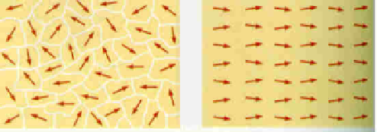
There are some materials that can be “permanently” magnetized.
- These are “permanent” magnets
They are usually made out of steel, or other material that can retain the orientation of its magnetic domains for a long time.
Not magnetized
Magnetized
(domains are aligned)

Slide 7
Demo: An electromagnet
Currents produce Magnetic Fields
Direction of current determines direction of magnet
Not permanent: current is off → magnet is gone
-
+
+
-

Slide 8
Magnetic field produced from current through a wire loop
We use right hand rule to find direction of field. Align thumb with current (positive charges) → fingers point in direction of field (North to South).
The higher the current and the more coils we have, the stronger the field (magnet)
+
N
S
N
S
-

Slide 9
Effect of Core: Aligned magnets create LARGE magnetic field
No Core!
Weak
Current on
With Core!
Strong
Current off

Slide 10
i-clicker-1
Does every magnet necessarily have a north and a south pole?
Yes
No
Not enough information given

Slide 11
How does an electric motor work?
stator
rotor
stator

Slide 12
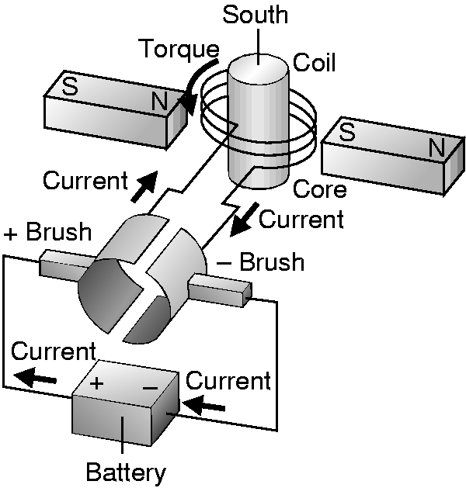
DC motor
How is the direction of the current switched??
Commutator

Slide 13
Chapter 11.2 Electric Power distribution
Demos and Objects
Concepts
Batteries = DC current
Households = AC current
Transformers
A current in a wire creates a magnetic field
A changing magnetic field creates a current.
Transformer
Loss of electrical power in a wire
P_{loss} = I²·R_{wire}
DC and AC current
Transformers
Transformers can step-up and step-down voltages
Distribution of power

Slide 14
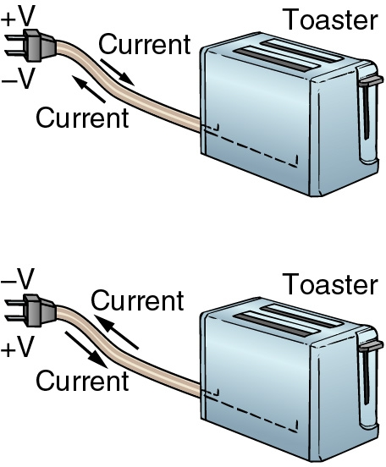
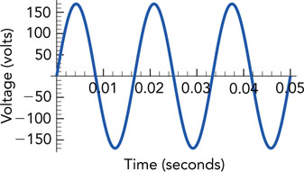
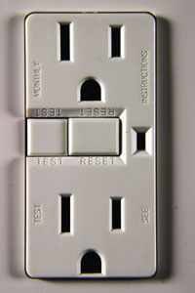
DC (direct current) and AC (alternating current)
Batteries produce DC
Household/power plant: AC
I
A typical 120-V AC, 15-Amp outlet.
The taller slots (right) are neutral, the smaller slots are hot, and the curved holes (center) are ground.

Slide 15
Electric circuit with a resistor
Current I
=
6 V
Symbol for battery
Current I
=
R
Symbol for resistor, R
6 V
At the battery, the current (charge carries) experience a voltage rise (here 6 V), at the resistor (the load), they experience a voltage drop. In a complete loop (circuit), the voltage rise and voltage drops add up to zero.

Slide 16
Ohm’s Law
The currents passing through most wires and other devices experience voltage drops
In an “ohmic device,” the voltage drop is proportional the current:
voltage drop = resistance · current
where resistance is constant for the device
V_{drop}= R·I
Notes:
Demonstration: Ohm’s law

Slide 17
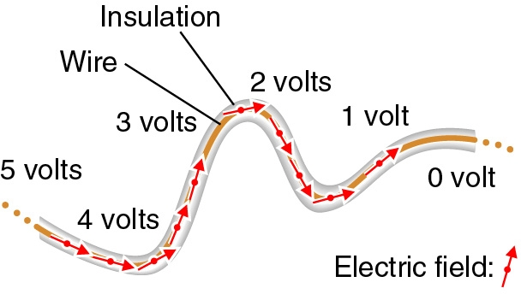
Resistance of a wire
Wires are not perfect and also have resistance.
The resistance of a wire is proportional to its length, L, and inversely proportional to its cross-sectional area, A.
The proportionality constant, ρ, is called the resistivity.
Typically metals (the best is silver ρ = 1.6 x 10⁻⁸ Ω·m) have a very low resistivity (are good conductors).
Insulators have a very high resistivity (glass: 10¹⁰ – 10¹⁴ Ω·m).
Resistance of wire:
So, wires have some resistance, and there is a potential drop along the wire

Slide 18
Power in Ohmic Devices
A calculation:
power consumption = voltage drop · current
voltage drop = resistance · current
power consumption = resistance · current²
Impact of the calculation:
Wires waste power as heat
Doubling current quadruples wasted power
P_{loss} = V_{drop}·I
P_{loss} = R_{wire}·I²
V_{drop}= R_{wire}·I
Notes:
Demonstration: 12 V Battery and Nichrome Wire.

Slide 19
i-clicker-1, -2:
Copper has a resistivity of 1.7·10⁻⁸ Ω·m. Iron has a resistivity of 5.6·10⁻⁸ Ω·m.
What is the resistance of a wire of 1000 m length and cross sectional area of 10⁻⁵m²?
A current of I = 1 A is flowing through the wire and then through an appliance of R = 5 Ω. How much power is lost in the wires and how much reaches the appliance?
Power loss copper:
A. 1.7 W
B. 2.3 W
C. 3.0 W
D. 5.0 W
E. 5.6 W
Power loss iron:
A. 1.7 W
B. 2.3 W
C. 3.0 W
D. 5.0 W
E. 5.6 W
Power in appliance:
A. 1.7 W
B. 2.3 W
C. 3.0 W
D. 5.0 W
E. 5.6 W

Slide 20
Power delivered:
P = V·I = V·I
Power lost in wire:
P_{loss} = R_{wire}·I²
To keep power losses in the long transmission wires as low as possible, deliver power at very high voltages and low currents

Slide 21
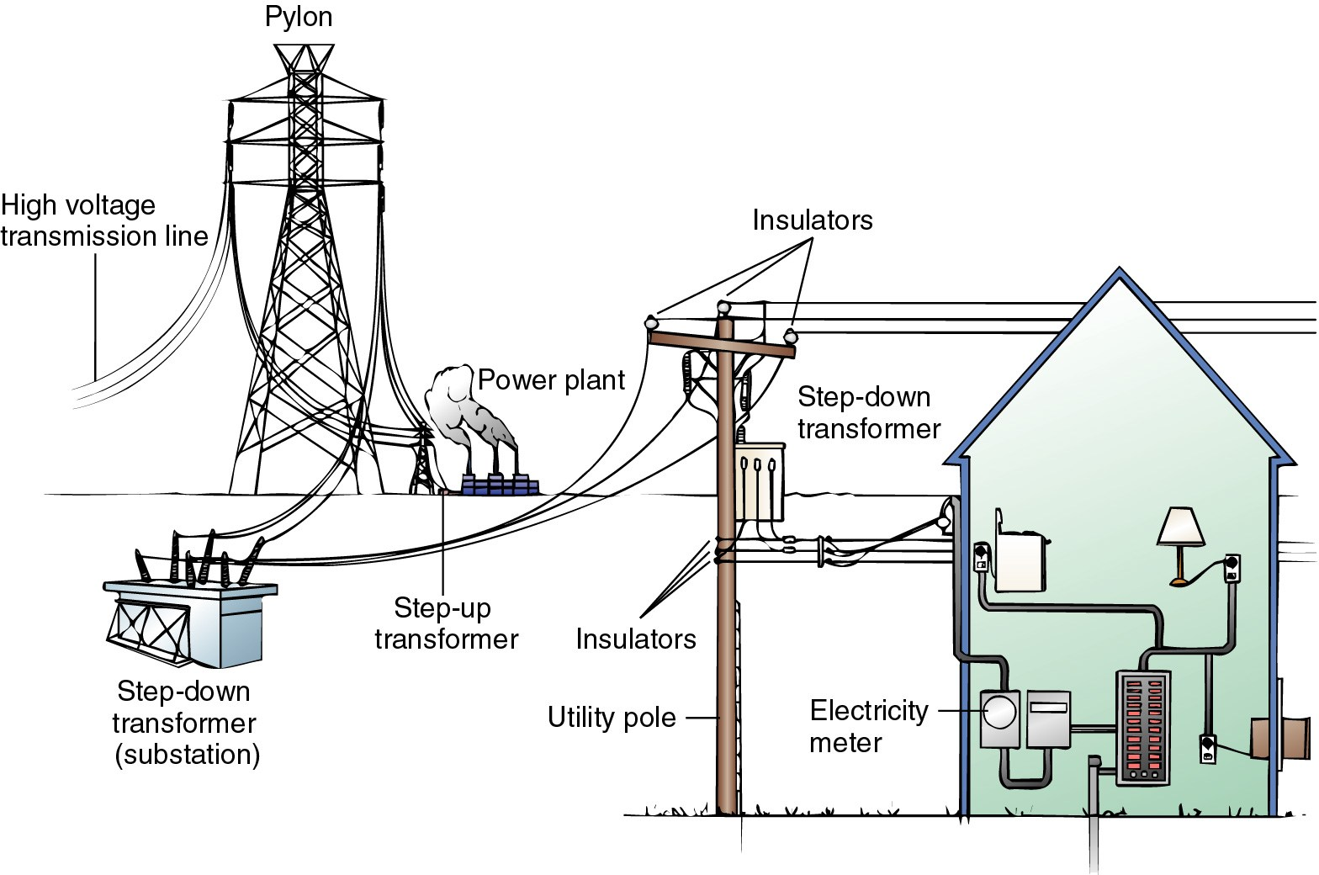

Slide 22
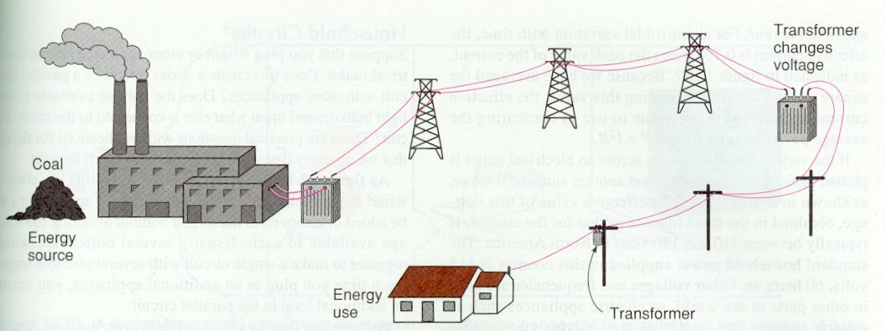
500,000V !!!
12,000V !
120V
How can we change voltages?

Slide 23
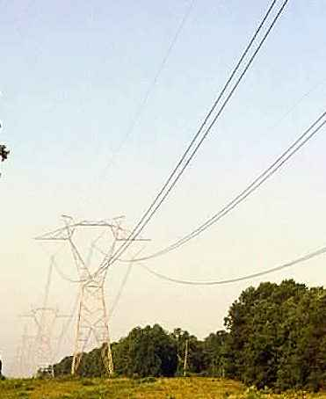
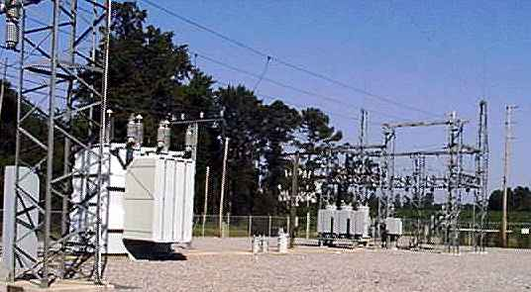
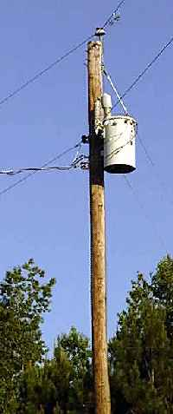
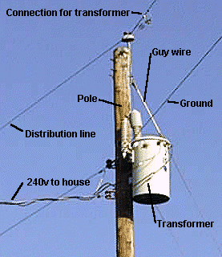
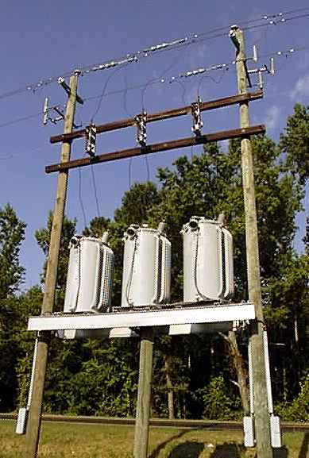
http://www.howstuffworks.com/power.htm

Slide 24
Observations About Power Distr.
Household power is AC (alternating current)
Power comes in voltages like 120V & 240V
Power is transmitted at “high voltage”
Power transformers are visible everywhere
Power sub-stations are visible on occasion

Slide 25
Power Transmission
Power delivered to a city is:
power delivered = current · voltage
Power wasted in transmission wires is:
power wasted = resistance · current²
For efficient power transmission:
Use low-resistance wires (thick, short copper)
Use low current and high voltage
Notes:
Demonstration: 12 V Battery and Nearby Light Bulb.
Demonstration: 12 V Battery and Long Thin Wires and Distant Light Bulb.
Demonstration: 12 V Battery and Long Thick Wires and Distant Light Bulb.

Slide 26
Voltage Hierarchy
High voltage is dangerous
High current is wasteful
Use the following hierarchy:
low voltage circuits in neighborhoods (120V)
medium voltage circuits in cities (12,000V)
high voltage circuits across the countryside (500,000V)
Use transformers to transfer power

Slide 27
Remember, Demo:
Currents produce Magnetic Fields
The direction of the current determines the direction of the poles
-
+
+
-
Effect of Core: Creates a LARGER magnetic field

Slide 28
INDUCTION
Changing Magnets produce Changing currents in metals!
N
-
+
S
S
+
-
N

Slide 29
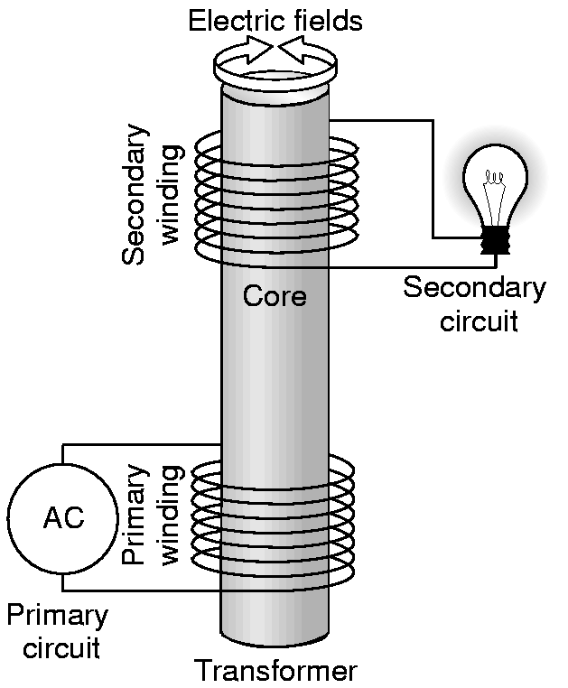
Changing Magnets produce Changing currents in metals!
INDUCTION

Slide 30
THREE STEPS for a Transformer:
Step 1: Changing Electric Current Produces Changing Magnetic Field
Step 1: Electric Current Produces Magnetic Field
Step 2: Changing Magnetic Field Travels through Core to Secondary Circuit
Step 2: Magnetic Field Travels through Core to Secondary Circuit
Step 3: Changing Magnetic Field in Core Produces Changing Current in secondary Circuit
Step 3: Magnetic Field in Core Produces Current in secondary Circuit

Slide 31
THREE STEPS for a Transformer:
Step 1: Changing Electric Current Produces Changing Magnetic Field
Step 2: Changing Magnetic Field Travels through Core to Secondary Circuit
Step 3: Changing Magnetic Field in Core Produces Changing Current in secondary Circuit

Slide 32
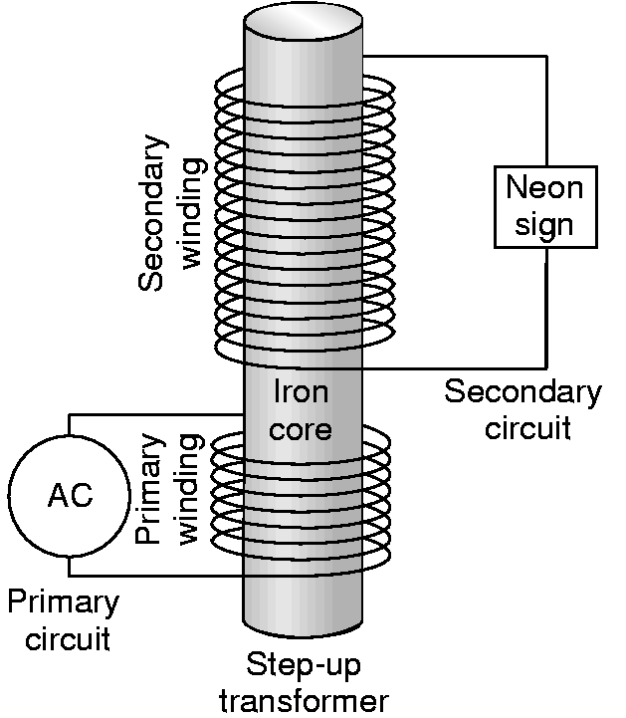
Making the Voltage Huge
N_{s} windings in secondary
Ratio of Voltages = Ratio of Windings
V_{s}/V_{p} = N_{s}/N_{p}
N_{p} windings in primary

Slide 33
How can we change voltages?
Example:
The power plant produces 1,000,000 W with a voltage of 10,000 V.
What current is flowing in the power plant wires?
The power is to be sent cross-country at a voltage of 500,000 V. How can this be done? What is the ratio of turns in the primary coil to turns in the secondary coil?
What current is flowing in the cross-country transmission lines?
If the wire has a resistance of 100 Ω, how much power is lost in the wires?
How much power would be lost if it were transmitted at 10,000V with a current of 100 A?
500,000V !!!

Slide 34
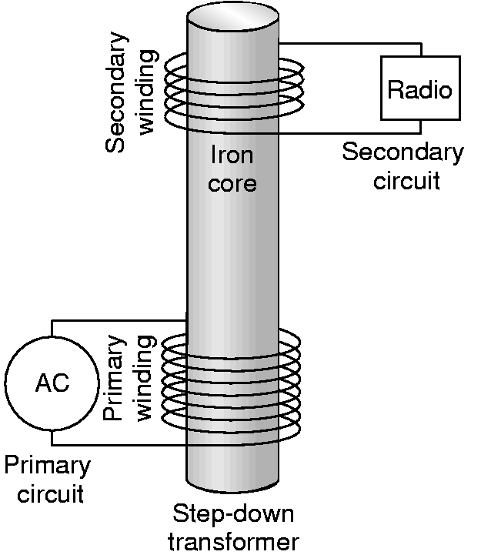
Making the Voltage Small Again
N_{s} windings in secondary
Ratio of Voltages = Ratio of Windings
V_{s}/V_{p} = N_{s}/N_{p}
N_{p} windings in primary

Slide 35
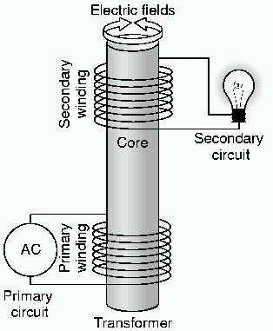
Transformer
Alternating current in one circuit induces an alternating current in a second circuit
Transfers power between the two circuits
Doesn’t transfer charge between the two circuits
Notes:
Demonstration: AC Electromagnet and Wire Loop with Lamp.

Slide 36
Current and Voltage
Power arriving in the primary circuit must equal power leaving the secondary circuit
Power is the product of voltage · current
A transformer can change the voltage and current while keeping power unchanged!
P… power
V … voltage
I … current
Subscripts:
p … primary
s … secondary

Slide 37
i-clicker-3, -4, -5:
Your new lab top computer consumes 90 W of power and it runs with a voltage of 20 V.
The outlet delivers power at 120 volt.
What is in the little black box that is on your power cord?
What is the ratio of windings in this transformer?
What is the current in the primary circuit (outlet) and the secondary circuit (computer)?
1. question:
A. Step-up transformer
B. Step-down transformer
C. Battery
D. Light bulb
E. Magic
2. Ratio:
A. 1:1
B. 3:1
C. 6:1
D. 10:1
E. 20:1
3. Current in secondary circuit:
A. 1.5 A
B. 2.5 A
C. 3.5 A
D. 4.5 A
E. 5.5 A

Slide 38
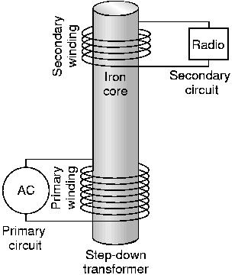
Step Down Transformer
Fewer turns in secondary circuit
Smaller voltage rise
A larger current at low voltage flows in the secondary circuit
Notes:
Demonstration: Transformer Demo - Step Down.

Slide 39
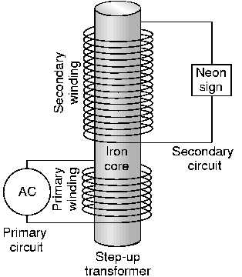
Step Up Transformer
More turns in secondary circuit
Larger voltage rise
A smaller current at high voltage flows in the secondary circuit
Notes:
Demonstration: Transformer Demo - Step Up (Jacob's Ladder).
Demonstration: Tesla Coil.
Demonstration: Glowball with Fluorescent Lamps.

Slide 40
i-clicker-5:
Electric power reaches the University via high voltage transmission lines. What fraction of the electric charges traveling on those transmission lines pass through this room?
About 1%
About 0.01%
Exactly 0.0%
Notes:
Demonstration: 12 V AC and Nearby Light Bulb.
Demonstration: 12 V AC and Long Thin Wires and Distant Light Bulb.
Demonstration: 12 V AC, Step-Up Transformer, Long Thin Wires, Step-Down Transformer, and Distant Light Bulb.

