Slide 1
Chapter 7.1 Announcements:
Homework7.1: due Tuesday, March. 26, in class
Exercises: 1, 4, 5, 6, 10, 11, 12, 31, 34, 36, 38, 39, 41
Problems: 1, 2, 3, 4
- Remember: Homework 5.1 is due Thursday, March. 21, in class
All grades will continue to be posted at: http://www.wfu.edu/~gutholdm/Physics110/phy110.htm
Listed by last four digits of student ID
Mid-semester grades based on: 10% HW, 15% lab, 5% i-clicker, 70% MT1
We’ll now cover only parts of each chapter (let me know if you want me to cover something that is not on the list and that interests you):
5.1 Balloons
7.1 Woodstoves
9.1 Clocks
9.2 Musical Instruments
10.3 Flashlights
11. Household Magnets & Electric Motor
11.2 Electric Power Distribution
15.1. Optics, cameras, lenses
16.1 Nuclear Weapons

Slide 2
Chapter 7.1 Woodstoves
Transfer of heat; thermal energy
Demos and Objects
Concepts
Thermal energy
Thermal energy = motion of molecules
Temperature scales
Heat
Flow of heat:
Conduction
Convection
Radiation
Candles
The sun
Heating things up
Burning

Slide 3
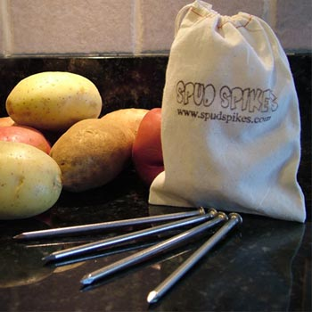
i-clicker-1
http://www.spudspikes.com/
When cooking a potato in a conventional oven it is useful to stick a nail in it, which makes it cook faster. This is because
A) the nail is a good radiator of heat.
B) the nail promotes convection in the potato.
C) the nail is a good conductor of heat.
D) the nail gets much hotter than anything in the oven.

Slide 4
Some more questions to think about
Why is it hotter above a candle than below it?
Why does the metal handle of a pot get hot after some time, while a plastic handle usually does not?
How does the heat from the sun get to us?
Is a black woodstove or a white woodstove more effective in heating a room?

Slide 5
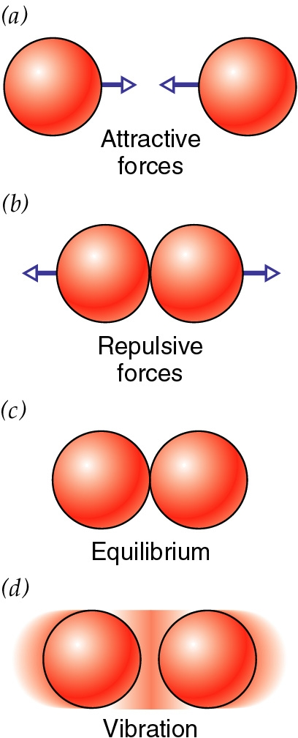
Thermal Energy
is disordered energy
is the kinetic and potential energies of atoms
gives rise to temperature (the hotter an object, the more thermal energy it has)
measured in joules (J)
does not include ordered energies:
kinetic energy of the whole object moving or rotating
potential energy of outside interactions

Slide 6
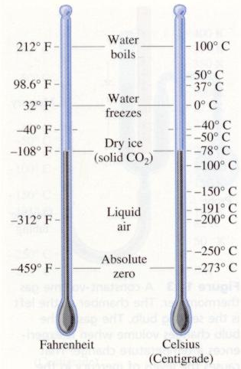
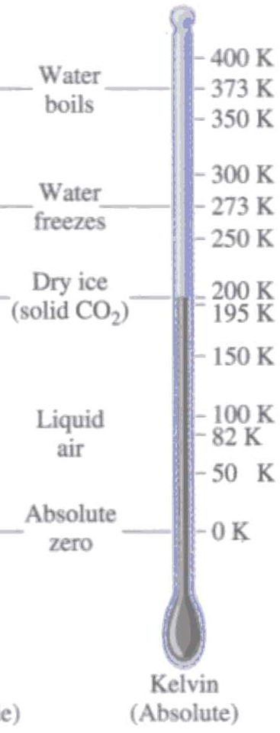
Temperature Scales
Reliable and quantifiable way of measuring how “hot” an object is.
How to convert from one temperature scale to another:
Where T_{C}, T_{F}, T is the temperature in Celsius (centigrade), Fahrenheit and Kelvin
Kelvin is the proper SI unit

Slide 7
Fahrenheit (1686-1736) established three fixed points on his thermometer.
0 degrees: temperature of an ice, water, and salt mixture.
32 degrees: water-ice combination stabilized at "the thirty-second degree."
96 degrees: “when the thermometer is held in the mouth or under the armpit of a living man in good health."
Celsius (1701-1704) established two fixed points on his thermometer.
0°C: representing the freezing point of water.
100°C: the boiling point of water.
Kelvin (1834-1907) used the same gradation as Celsius but set his zero point at absolute zero (no molecular motion of molecules).

Slide 8
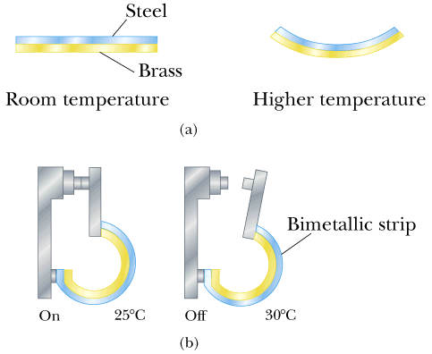
Brief Aside:
Thermal expansion of solids and liquids
When objects are heated up they typically expand. This is due to the increased motion of molecules at elevated temperatures.
Applications:
Thermometers (liquid expands)
Bimetallic strips

Slide 9
Heat
is the energy that flows between objects because of their difference in temperatures
Heat is thermal energy on the move
Technically: object’s don’t contain heat (the contain thermal energy)
Units of Heat
Since heat is energy transfer it has units of energy:
Joule (SI unit)
Also used:
1 calorie (1cal)
amount of energy to raise the temperature of 1 g of water from 14.4°C to 15°C
1 Calorie = 1000 calories
This unit is most often used in food (a sliver of cheese cake has 500 Calories).
1 cal = 4.186 J

Slide 10
How is the transferred thermal energy (heat) determined?
Heat ΔQ (change in thermal energy):
temperature of an object is raised by ΔT
object has mass m
object has specific heat c (material dependent)
Which one is hotter:
Metal
Water
equal
ΔQ = change in thermal energy
m = mass
c = specific heat
ΔT = change in Temp.
C = heat capacity
ΔQ = m c ΔT
ΔQ = C ΔT

Slide 11
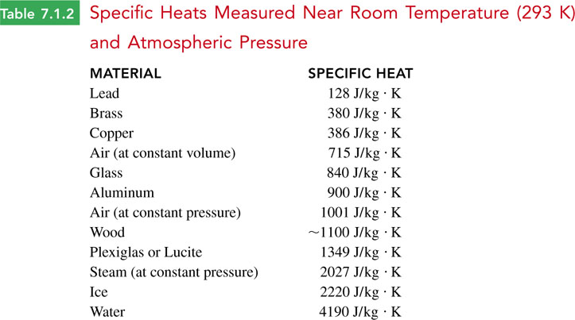
Specific heat: How much energy do you need to heat up 1 kg of that material by one degree K?

Slide 12
Examples and i-clicker-2 & -3:
You take one liter of water (1 kg) out of the fridge (0ºC) and want to boil (100ºC) it. How much energy will it take to do that?
You do the same with a 1 kg block of copper (0ºC →100ºC). How much energy will it take to do that?
1A. 0 J
1B. 100 J
1C. 4190 J
1D. 38,600 J
1E. 419,000 J
2A. 0 J
2B. 100 J
2C. 4190 J
2D. 38,600 J
2E. 418,000 J

Slide 13
Latent Heat and Phase transitions
(for lab, also see Chapter 7.2)
Whenever a substance undergoes a phase transition, energy is transferred into or out of the substance WITHOUT causing a change in temperature.
Common phase transitions:
Liquid to solid: freezing, latent heat of solidification
Solid to liquid: melting, latent heat of fusion
Liquid to gaseous: boiling, latent heat of vaporization
Gaseous to liquid: condensation, latent heat of condensation
Solid to gaseous: sublimation, latent heat of sublimation
Gaseous to solid: sublimation, latent heat of sublimation

Slide 14
Latent Heat and Phase transitions
(for lab, also see Chapter 7.2)
The heat required to change the phase of a given mass m of a pure substance is:
L… latent heat
i-clicker
You put a 10 g ice cube in your mouth. How much energy (in Cal) will your body loose to melt it? (The latent heat of melting for water is 334 kJ/kg).
A. ~1 Cal B. ~2 Cal C. ~3 Cal D. ~4 Cal D. ~5 Cal

Slide 15
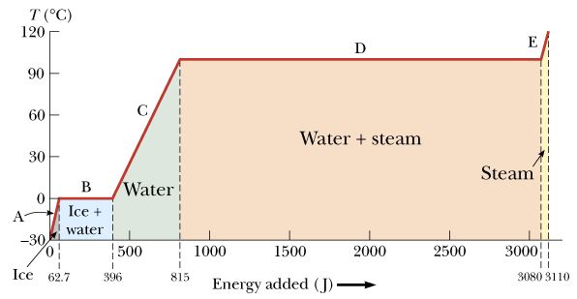
Latent Heat and Phase transitions
(for lab, also see Chapter 7.2)
Energy required to convert 1 g of ice, initially at -30°C to steam at 120 °C.

Slide 16
Heat and Temperature
Touching objects exchange thermal energy
Microscopically, energy flows both ways
On average, energy flows one way
Temperature predicts energy flow direction
Energy flows from hotter to colder
No flow → thermal equilibrium → same temp
Temperature turns out to be
average thermal kinetic energy per particle

Slide 17
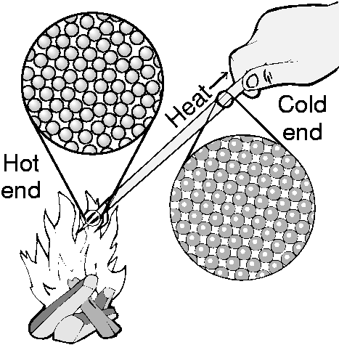
Three forms of heat transfer
All three transfer heat from hot to cold
Conduction
- heat flow through materials
2. Convection
- heat flow via moving fluids (air)
3. Radiation
- heat flow via light waves

Slide 18
Thermal Conductivity: The heat moves-not the atoms!
Examples:
___________________
___________________
___________________
Occurs only in connected or touching materials

Slide 19
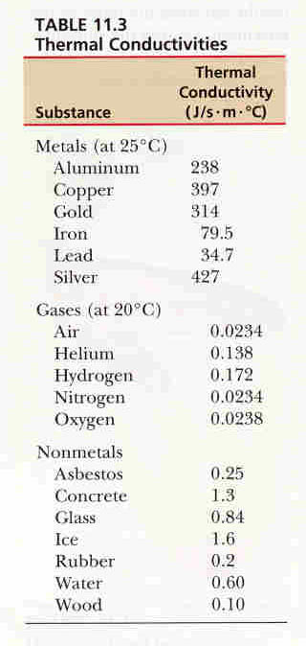
Thermal Conductivity depends on the material!
Best – metals
Middle – Insulators
Lowest - Gases
Also see Table 7.3.1 in book

Slide 20
Conduction
Heat flows through material but atoms don’t
In an insulator,
adjacent atoms jiggle one another
microscopic exchanges of energy; atoms do work
on average, heat flows from hot to cold atoms
In a conductor,
mobile electrons help carry heat long distances
heat flows quickly from hot to cold via electrons

Slide 21
Convection: Hot atoms (molecules) move toward cold region carrying thermal energy with them!
Examples:
___________________
___________________
___________________

Slide 22
Convection
Fluid transports heat stored in its atoms
Fluid warms up near a hot object
Fluid flows away, carrying thermal energy with it
Fluid cools down near a cold object
Overall, heat flows from hot to cold
Natural buoyancy drives convection
Warmed fluid rises away from hot object
Cooled fluid descends away from cold object

Slide 23
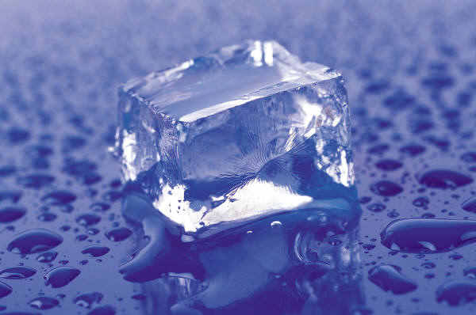
i-clicker-4
Why does an ice cube feel cold?
A) Heat from your hand enters the cube by convection.
B) Cold from the cube enters your hand by convection.
C) Heat from your hand enters the cube by conduction.
D) Cold from the cube enters your hand by conduction.

Slide 24
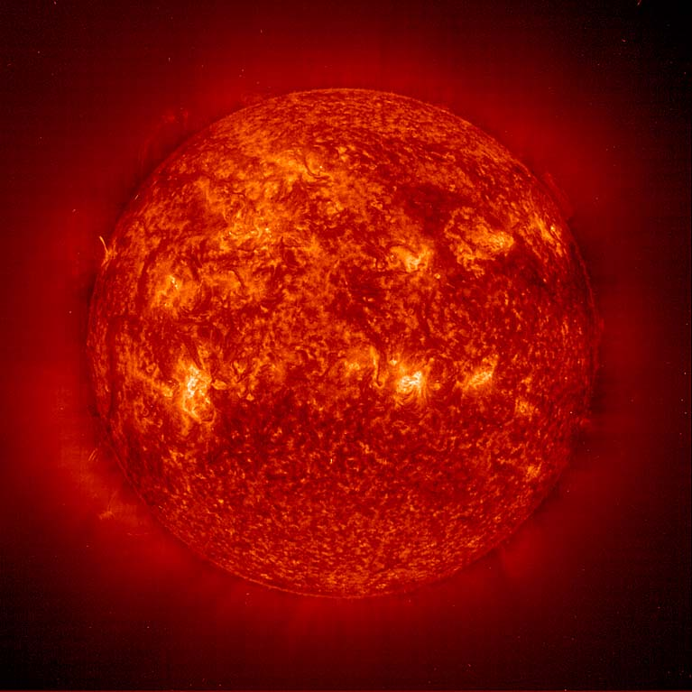
Radiation
Examples:
___________________
___________________
___________________
Heat transferred by electromagnetic waves (radio waves, microwaves, light, …)
Does not need a medium to travel!

Slide 25
Radiation
Heat transferred by electromagnetic waves (radio waves, microwaves, light, …)
Wave types depend on temperature
cold: radio wave, microwaves, infrared light
hot: infrared, visible, and ultraviolet light
Higher temperature → more radiated heat
Black emits and absorbs light best

Slide 26
i-clicker-5
The surface of the moon is exposed to full solar radiation because it has no atmosphere. Why then does the moon not heat up endlessly until it disintegrates?
A) Convection in the soil carries energy away.
B) Its temperature rises until it is able to radiate heat away into space as fast as it arrives from the sun.
C) It has disintegrated but the light just hasn’t reached us yet.
D) Because it is isolated from the sun by empty space, the sun's heat can't reach it (only light can) and they don't experience any changes in temperature.

Slide 27
Stefan-Boltzmann Law
The amount of heat a surface radiates is
P = e ^{x} σ ^{x} T⁴ ^{x} A
P - radiated power (energy per time)
e - emissivity (ranges from 0 (bad) to 1 (good)
0 is white, shiny or clear; 1 is black
σ - Stefan-Boltzman constant = 5.67·10⁻⁸ J/(s·m²·K⁴)
T - temperature in Kelvin
A - surface area

Slide 28
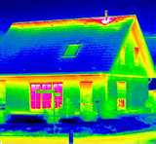
Radiation:
You can tell the temperature of a hot object from its color
(infrared)
Some cameras ‘can see’ infrared; see false color image at left

