Slide 1
Chapter 9.1 Announcements:
Homework 9.1: due Thursday, April 4, in class
Exercises: 1, 3, 4, 5, 6, 8
Problems: -
- Remember: Homework 7.1 is due Tuesday, March 26, in class
All grades will continue to be posted at: http://www.wfu.edu/~gutholdm/Physics110/phy110.htm
Listed by last four digits of student ID
We’ll now cover only parts of each chapter (let me know if you want me to cover something that is not on the list and that interests you):
  5.1 Balloons
  7.1 Woodstoves
  9.1 Clocks, harmonic oscillation
  9.2 Musical Instruments
  10.3 Flashlights
  11. Household Magnets & Electric Motor
  11.2 Electric Power Distribution
  15.1. Optics, cameras, lenses
  16.1 Nuclear Weapons

Slide 2
Midterm 2: Thursday, March 28
Material: Chapters 2.3, 3.1, 3.3, 5.1, 7.1
Same format as midterm 1
Practice Midterm will be posted on Web today
Bring a calculator
Important equations will be given on exam (know how to use them)

Slide 3
Chapter 9.1
Demos and Objects
Concepts
How do we keep time???
oscillations
harmonic motion
amplitude
frequency
period
natural resonance
harmonic oscillator
pendulum
mass on a spring
many objects do oscillations
tuning forks
oscillating bridges
oscillating sky scrapers

Slide 4

i-clicker-1
You’re standing at the end of a springboard, bouncing gently up and down without leaving the board’s surface. If you bounce harder (larger amplitude), the time it takes for each bounce will
become shorter
become longer
remain the same
How about if your friend walks up and bounces with you?

Slide 5
How do we keep time?
What is it good for, other than keeping appointments?

Slide 6
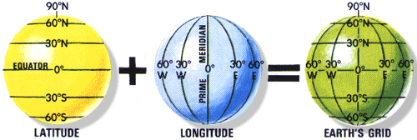
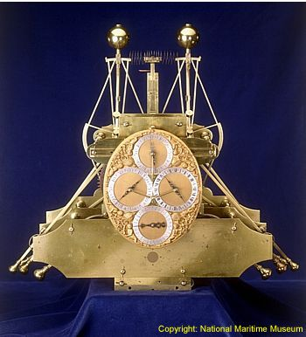
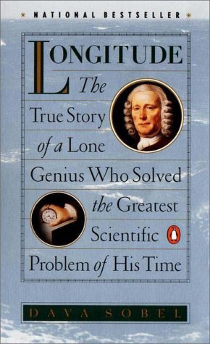
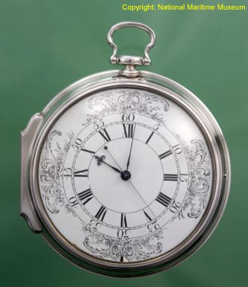
The Importance of Time: The Longitude Problem
Sea travel: By determining the time difference between a very accurate clock set at ‘home time’ and the local time (from sun), the longitudinal travel distance could be determined.
For example, a one hour time difference is 15º (= 1,038 miles) from home.
http://www.rog.nmm.ac.uk/museum/harrison/longprob.html
Harrison’s H1 1735
Harrison’s H4 1759

Slide 7
Repetitive Motions
An object with a stable equilibrium tends to oscillate about that equilibrium
This oscillation entails at least two types of energy – kinetic and a potential energy
Once the motion has been started, it repeats many times without further outside help

Slide 8
Some Specifics
Terminology
  Period – time of one full repetitive motion cycle
  Frequency – cycles completed per unit of time
  Amplitude – peak extent of repetitive motion
Application
  In an ideal clock, the repetitive motion’s period shouldn’t depend on its amplitude

Slide 9
We will mainly deal with:
Harmonic oscillator
Restoring force is proportional to displacement.
For those:
  The period does not depend on amplitude
Examples:
- pendulum, mass on a spring, diving board, torsional spring, anything that obeys Hooke’s law: F = -kx

Slide 10
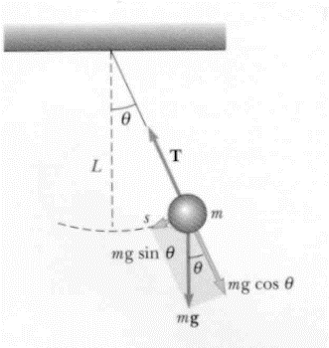
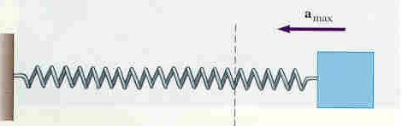
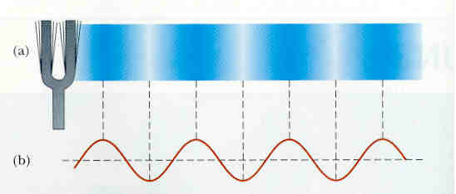
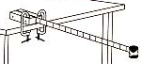
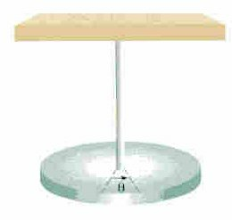
Harmonic oscillators
Pendulum
Stretching something
Rubberband, slinky
Bending something
Diving board, beam, building, tuning fork
Torsional pendulum
Torsional spring

Slide 11

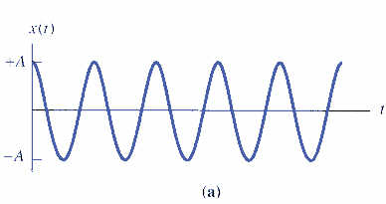
Pendulum
Period:
L - length of string
g - acc. due to gravity
x
Frequency:
t
T
For pendulum: T and f do not depend on mass (exception).

Slide 12
General Features of Oscillators (other than pendulum)
Period:
m - mass
k – spring constant
Frequency:
x
t
T
Most harmonic oscillators: T and f do depend on mass.

Slide 13
i-clicker-2; -3
2. A child is standing up on a swing (instead of sitting down). How will that affect the period of the motion
It will become shorter
It will become longer
It will remain the same
3. How about if your friend walks up and swings with you?
It will become shorter
It will become longer
It will remain the same
4. Question 3. if it were a bungee cord going up and down?

Slide 14
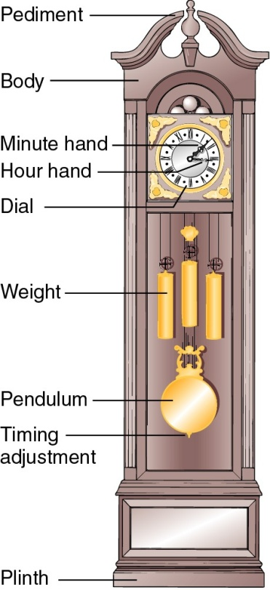
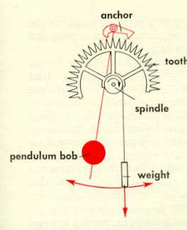
Pendulum Clocks
Pendulum is clock’s timekeeper
For accuracy, the pendulum
  pivot–center-of-gravity distance is
    temperature stabilized
    adjustable for local gravity effects
  streamlined to minimize air drag
  motion sustained, measured gently
Limitation: clock mustn't move

Slide 15
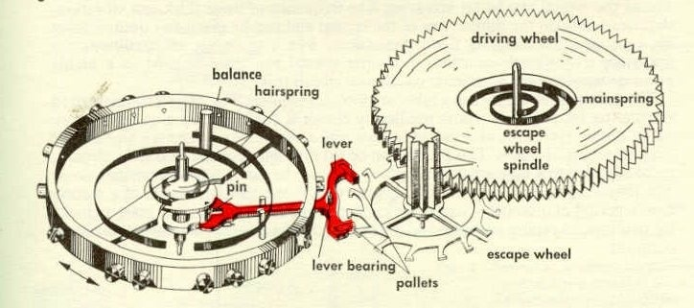
Balance Ring Clocks
A torsional spring causes a balanced ring to twist back and forth as a harmonic oscillator
Gravity exerts no torque about the ring’s pivot, so it has no influence on the period
Twisting sustained and measured with minimal effects on motion

Slide 16
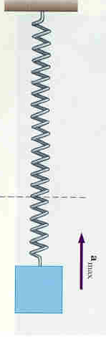
What is inside a Quartz Wristwatch?
i-clicker-4:
A.
B.
C.
Pendulum?
Spring?
Tuning Fork?

Slide 17

Quartz Oscillators
Crystalline quartz is a harmonic oscillator
  Crystal provides the inertial mass
  Stiffness provides restoring force
Oscillation decay is extremely slow
Fundamental accuracy is very high
Quartz is piezoelectric
  mechanical and electrical changes are coupled
  motion can be induced and measured electrically
Notes:
Demonstration: Tuning fork Vibrating

Slide 18
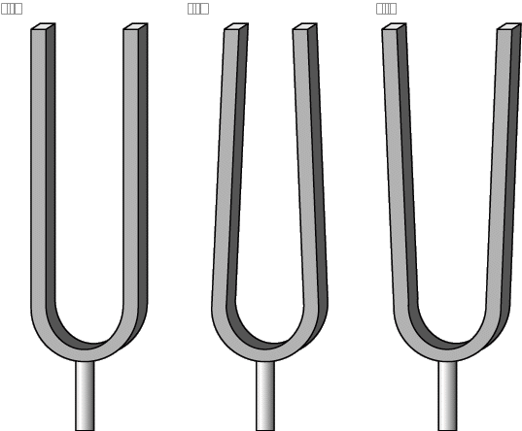
Quartz Clocks
Electronic system starts crystal vibrating
Vibrating crystal triggers electronic counter
Nearly insensitive to gravity, temperature,
pressure, and acceleration
Slow vibration decay
leads to precise period
Tuning-fork shape yields
slow, efficient vibration
Notes:
Demonstration: Show quartz tuning fork from Quartz clock

