Slide 1
Announcements:
Midterm 2 coming up Monday Nov. 12 , (two evening times, 5-6 pm or 6-7 pm), Olin 101.
Material: Chapters 6 – 14 (through HW 14.1 (pressure)).
I’ll provide key equations (last page of exam).
You are allowed to use a non-programmable calculator
I will put practice exams on our class web page (http://www.wfu.edu/~gutholdm/Physics113/phy113.html)
I’ll also update all grades by tomorrow

Slide 2
Chapter 14: Fluid mechanics
Reading assignment: Chapter14.1 -14.6
Homework 14.1 (due Friday, Nov. 9): QQ1, OQ1, 1’ 1, 9, 11
Homework 14.2 (due Thursday, Nov. 15): OQ4, OQ6, OQ7, AE5, 8, 25, 26, 28, 29
Fluids flow.
Fluids are a collection of randomly arranged molecules held together by weak cohesive forces. This is unlike crystals (solids) which arrange orderly on a lattice)
Pressure, Pascal’s law
Buoyant forces and Archimedes Principle
Continuity equation
Bernoulli’s equation

Slide 3
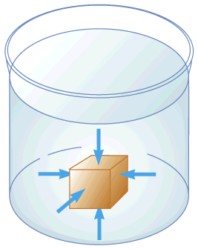
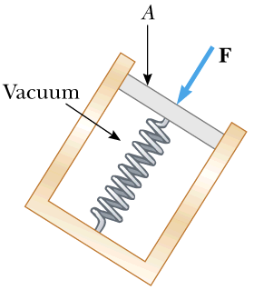
Pressure
F… force
A… area
Unit of pressure:
1 Pascal; 1Pa = 1 N/m²

Slide 4

Black board example 14.1
Pressure
You hold a thumb tack between your index finger and thumb with a force of 10 N. The needle has a point that is 0.1mm in radius whereas the flat end has a radius of 5 mm.
What is the force experienced by our finger; what is the force experienced by your thumb.
Your thumb holds the pointy end. What is the pressure on the thumb; what is the pressure on your finger.

Slide 5
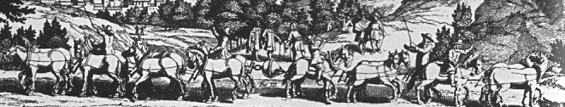
Black board example 14.2
Air pressure & Madgeburg spheres
In 1654, Otto von Guericke gave the citizens of Magdeburg a remarkable lesson in the force of the atmospheric pressure. He machined two hollow hemispheres, (R =0.25 m, A_{cross}= 0.2 m²) so they fit snuggly into a sealed sphere. He pumped the air out of it. Then he put sixteen horses, eight on each side, to the task of pulling the halves apart. If the atmospheric pressure is 1.0·10⁵ Pa, what force is required to pull the hemispheres apart?
A) ~10,000 N B) ~20,000 N C) ~30,000 N D) ~40,000 N

Slide 6
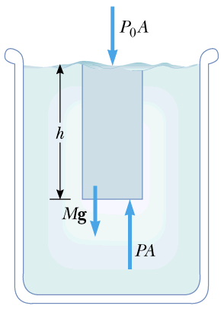
Variation of pressure with depth
The pressure P at a depth h below the surface of a liquid open to the atmosphere is greater then the atmospheric pressure, P₀ by an amount ρ⋅g⋅h.
i.e. added pressure corresponds to weight of fluid column of height h.

Slide 7

Black board example 14.3
Pressure under water
Crew members attempt to escape from a damaged submarine 100 m below the surface.
What force must be applied to a pop-out hatch, which is 1.2 m by 0.6 m to push it out at that depth?
(Assume atmospheric pressure inside the submarine and a density of sea water ρ = 1025 kg/m³).
What is the weight of the air column above your head (assuming a surface area of about 100 cm²?
How come our heads don’t cave in?

Slide 8
A word about pressure measurements:
Absolute pressure P:
absolute pressure, including atmospheric pressure
Gauge pressure P_{G}:
difference between absolute pressure and atmospheric pressure → pressure above atmospheric pressure
→ pressure measured with a gauge for which the atmospheric pressure is calibrated to be zero.

Slide 9
Pascal’s law: A change in the pressure applied to a fluid is transmitted undiminished to every point of the fluid and to the walls of the container.

Slide 10
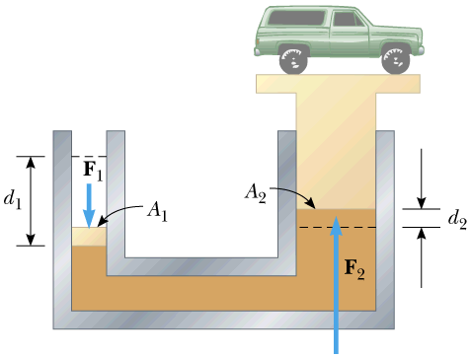
Hydraulic press
Application of Pascal’s law
- Force F₁ is applied to area A₁
Pressure P in columns: P = F₁/A₁ = F₂/A₂
Force F₂ on area A₂ is greater than F₁ by a factor A₂/A₁!!

Slide 11
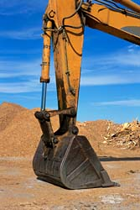
Black board example 14.4
Hydraulic press, i-clicker
The piston of a hydraulic lift has a cross sectional area of 3.00 cm², and its large piston has a cross-sectional area of 200 cm².
What force must be applied to the small piston for it to raise a 15,000 N car?
A) ~225 N B) ~ 900 N C) 1200 N D) ~7,500 N E) ~15,000 N
(b) Could your body weight (600 N) provide the force?
Quick Quiz
How can backhoe shovels generate the huge forces needed to slice through dirt as if it were warm butter?

Slide 12
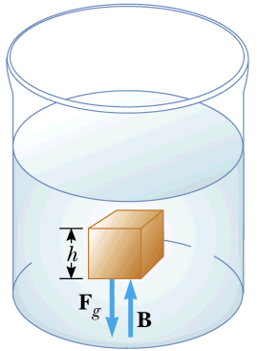
Buoyant forces and Archimedes's Principle
Archimedes’s principle:
The magnitude of the buoyant force is equals the weight of the fluid displaced by the object.
This force arises from the different pressures at the top and the bottom surface of the object submerged in the fluid.
Note: Archimedes’ principle can also be applied to balloons floating in air (air can be considered a liquid)

Slide 13
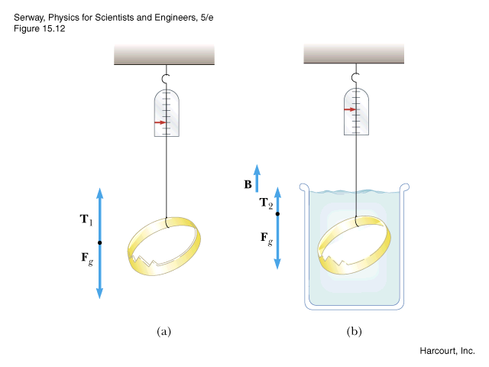
Black board example 14.5
Archimedes’s principle
A 1kg iron cube weighs 9.80 N in air. (Ignore buoyant force in air.)
How much does it weigh in water?
The density of iron is 7.86·10³ kg/m³. The density of water is 1.00·10³ kg/m³.
For example:
Aluminum: 2700 kg/m³ Air: 1.29 kg/m³
Lead: 11,300 kg/m³ Helium: 0.18 kg/m³
Water: 998 kg/m²
Reminder:
Density ρ = mass/unit volume

Slide 14
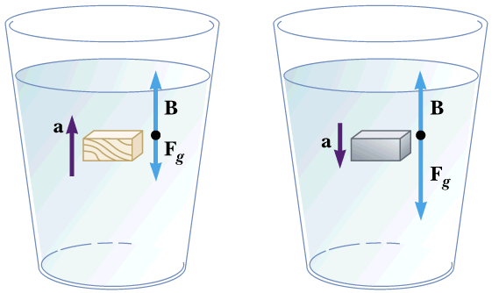
Buoyant forces and Archimedes's Principle
For totally submerged objects (see previous example):
If density of object is less than density of fluid: Object rises (accelerates up)
If density of object is greater than density of fluid: Object sinks. (accelerates down).
Floating objects.
Buoyant force (weight of displaced liquid) is balanced by gravitational force.
Black board example 14.6
Archimedes’s principle
A Styrofoam slab has a thickness of 10.0 cm and a density of 300 kg/m³. When a 75.0 kg swimmer is resting on it the slab floats in water with its top at the same level as the water’s surface.
Find the area of the slab.

Slide 15
In the following section we assume:
the flow of fluids is laminar (not turbulent)
  → There are now vortices, eddies, turbulences. Water layers flow smoothly over each other.
the fluid has no viscosity (no friction).
  → (Honey has high viscosity, water has low viscosity)

Slide 16
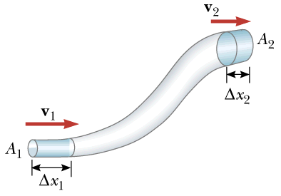
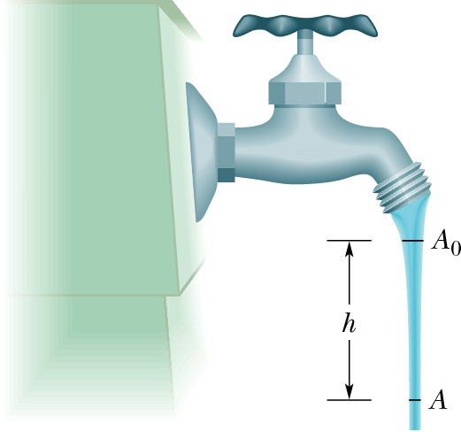
Equation of continuity
For fluids flowing in a “pipe”, the product of area and velocity is constant (big area → small velocity).
Why does the water emerging from a faucet “neck down” as it falls?

Slide 17
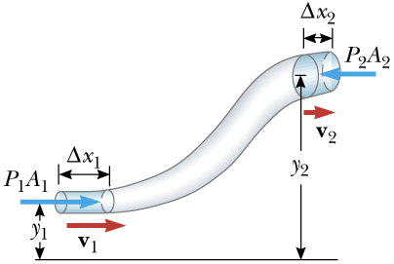
Bernoulli’s equation
Conservation of energy

Slide 18
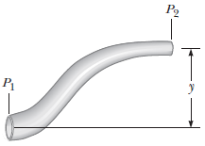
Black board example 14.7
Bernoulli’s law
Water moves through a constricted pipe in steady, ideal flow. At the lower point shown in the figure above, the pressure is P₁ = 1.80×10⁴ Pa, and the pipe diameter is 4.0 cm (A₁ = 1.26×10⁻³ m²). At another point y = 0.30 m higher, the pressure is P₂ = 1.25×10⁴ Pa and the pipe diameter is 2.00 cm (A₂ = 3.14×10⁻⁴ m²).
(a) Find the speed of flow in the lower section.
(b) Find the speed of flow in the upper section.

