Slide 1
PHY 113 A General Physics I
9-9:50 AM MWF Olin 101
Plan for Lecture 1:
Welcome & overview
Class structure & announcements
Chapter 1 – measurement & units

Slide 2

PHY 113 A General Physics I
9-9:50 AM MWF Olin 101
Instructor: Natalie Holzwarth (Olin 300)
Course Webpage: http://www.wfu.edu/~natalie/f12phy113
Webpage for Webassign system:
http://www.webassign.net/
You will also need an
i-clicker device for each class
A scientific calculator will be needed for homework and exams

Slide 3
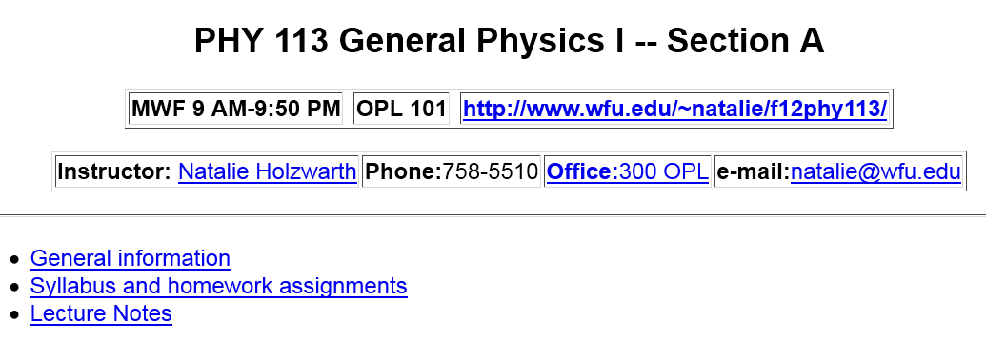
Where to find information about the course on the web:

Slide 4
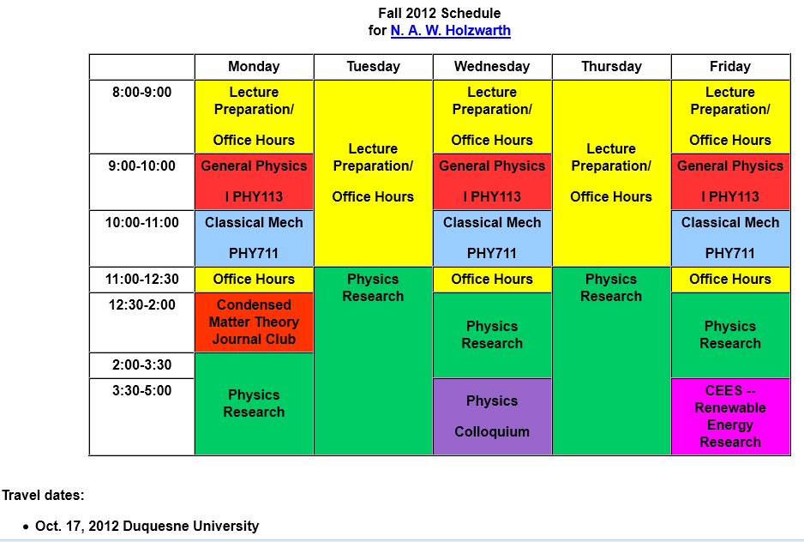

Slide 5
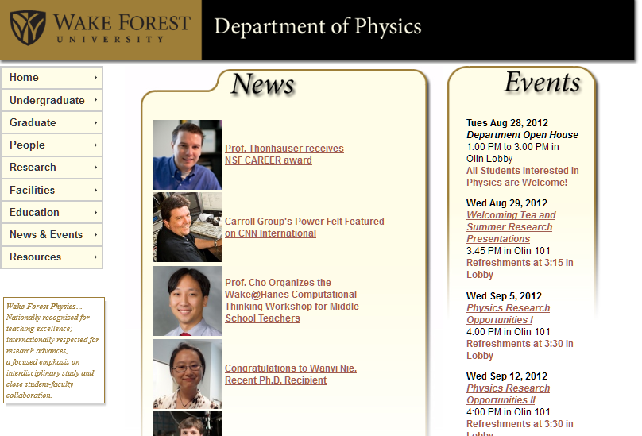
Comment about Physics Colloquia

Slide 6
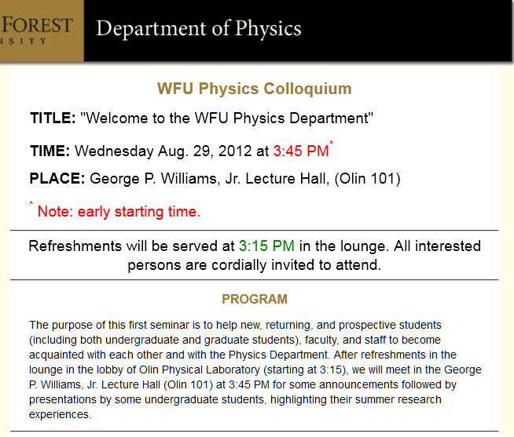

Slide 7
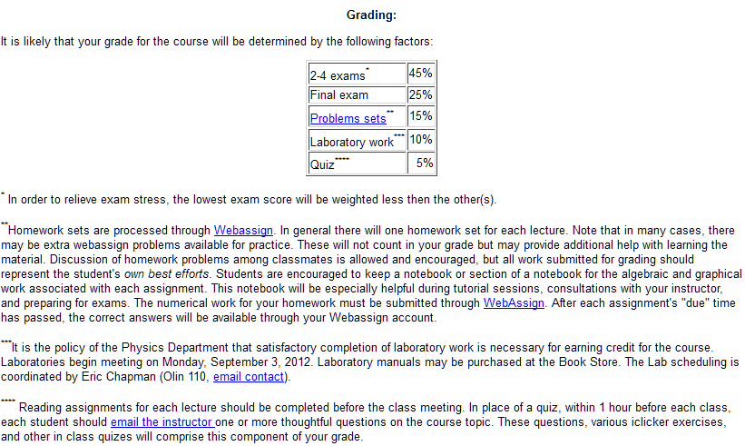
Course organization:

Slide 8
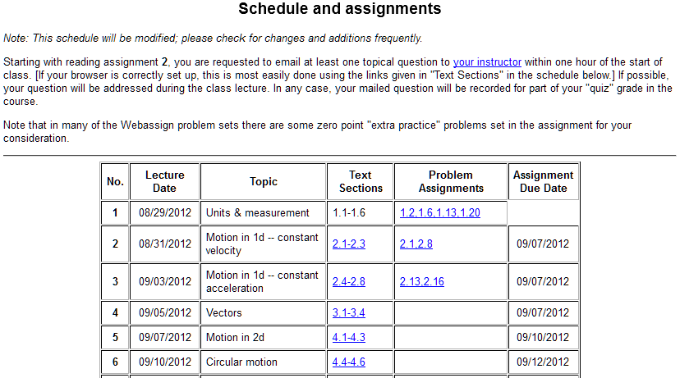

Slide 9

www.webassign.net

Slide 10
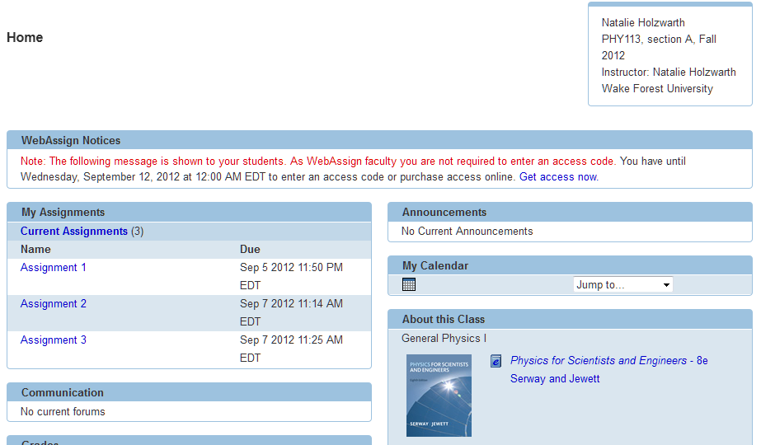

Slide 11
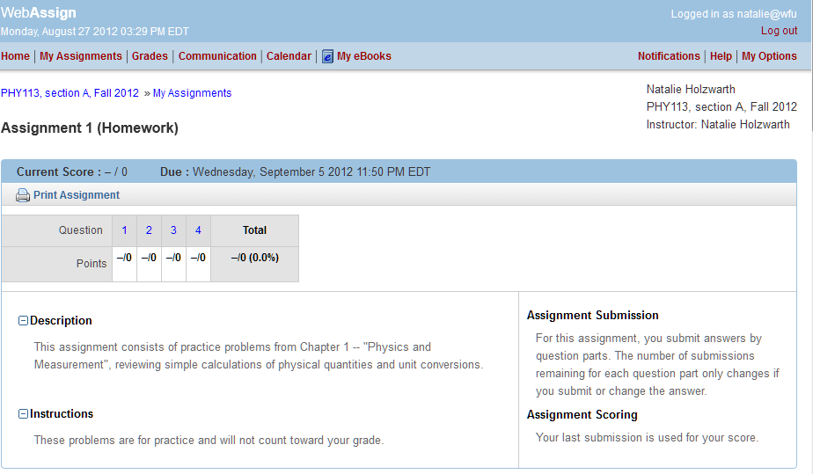

Slide 12
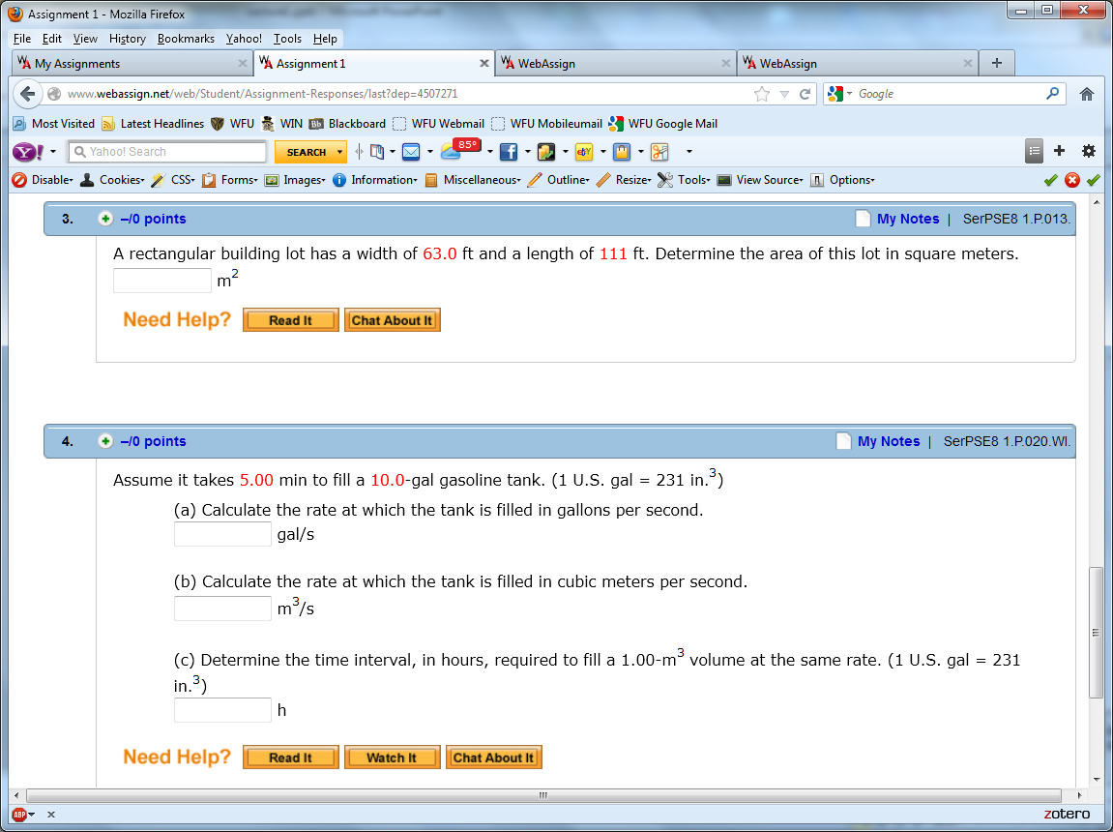
W=63 ft
Problem solving steps
Visualize problem – labeling variables
Determine which basic physical principle(s) apply
Write down the appropriate equations using the variables defined in step 1.
Check whether you have the correct amount of information to solve the problem (same number of knowns and unknowns).
Solve the equations.
Check whether your answer makes sense (units, order of magnitude, etc.).
L=111 ft
area = width * length
A = W * L
OK

Slide 14
i-clicker exercises:
Which of the following options do you prefer for the number of exams in the course?
  4 exams
  3 exams
  2 exams
Which of the following options do you prefer for the exam times?
  Exams within class time (50 minutes)
  Exams offered outside of class time

Slide 15
Preferences for tutorial:
A. Prefer tutorials for our section only
B. Prefer general tutorials for all sections
C. Other
Preferences for tutorial times: (Sunday – Thursday)
A. 5-7 PM
B. 6-8 PM
C. 7-9 PM
D. 8-10 PM
E. Other

Slide 16
➔ PHY 113 Labs will start Monday Sept. 3rd and run through the week of Nov. 29th. There will be no labs during Thanksgiving week.
➔ PHY 113 Tutorial sessions will also start next week.

Slide 17
General advice on how to learn physics:
Physics is built on basic principles (“laws”) from which all results can be derived (deduced)
Focus your attention on understanding the basic principles
Practice using these basic principles to solve problems
Memorization is of little use in the study and practice of physics
Note: In general, the best way to learn physics is to practice problem solving. One benefit of learning physics is the development of general problem solving skills. Note that memorization of the text and lecture material is rarely useful.
As you are working problems, you may wish to construct a sheet of paper containing the basic equations you use. This basic equation sheet (8.5 in x 11 in) can be used during exams.

Slide 18
Problem solving skills
Math skills
Equation Sheet
Advice:
Keep basic concepts and equations at the top of your head.
Practice problem solving and math skills
Develop an equation sheet that you can consult.

Slide 19
Problem solving steps
  Visualize problem – labeling variables
  Determine which basic physical principle(s) apply
  Write down the appropriate equations using the variables defined in step 1.
  Check whether you have the correct amount of information to solve the problem (same number of knowns and unknowns).
  Solve the equations.
  Check whether your answer makes sense (units, order of magnitude, etc.).

Slide 20
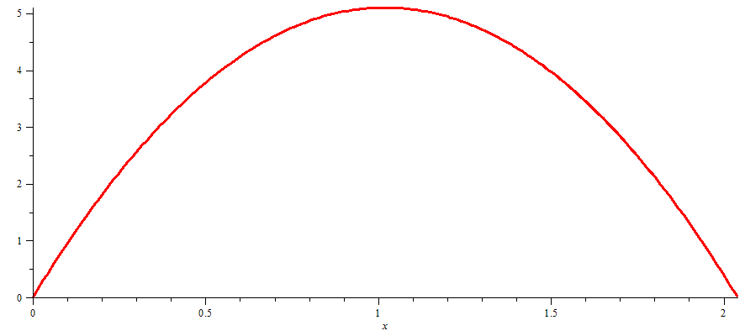
The Zeroth Law of Physics
All physical phenomena can be analyzed using fundamental “laws” which are stated in terms of basic concepts and represented in terms of mathematical expressions and equations.
y (m)
x (m)

Slide 21
Why would a physicist (or anyone else) want to know that the ball follows a parabolic trajectory?
  Because it tests the basic principles of physics.
  Because it can help a golfer get a hole in one.
  Because it shows that gravity is affecting the motion of the ball.
  Because it shows a contrast with straight line motion.
  Because it makes you look smart.

Slide 22
Measurement units
Standard units “SI” (by international agreement in 1960)
length – meter
mass -- kilogram
time -- second

Slide 23
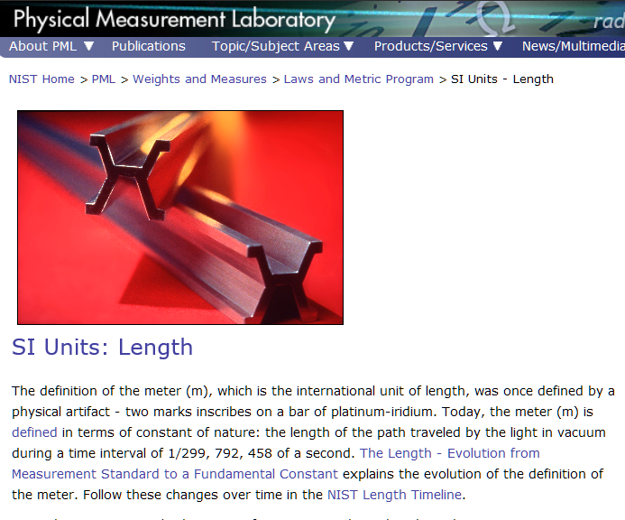
http://www.nist.gov/pml/wmd/metric/length.cfm

Slide 24
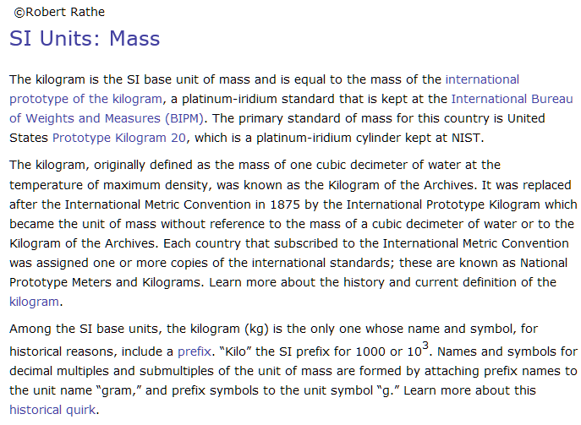
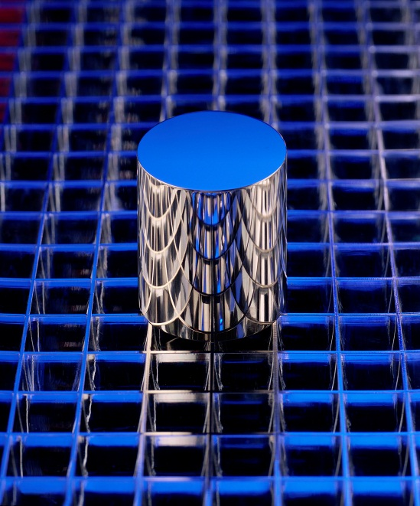
http://www.nist.gov/pml/wmd/metric/mass.cfm

Slide 25
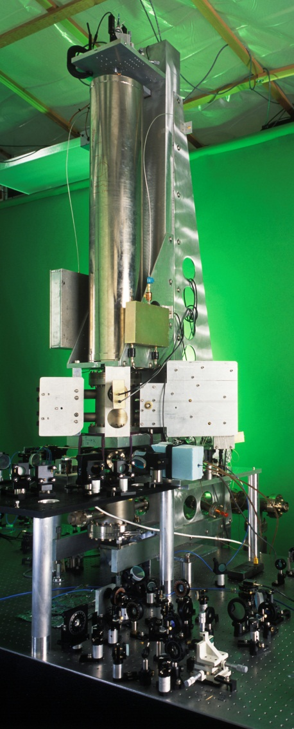
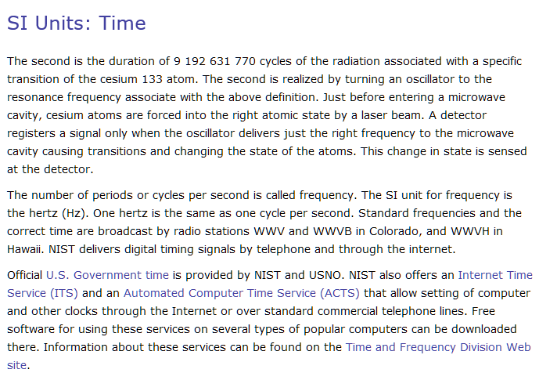
http://www.nist.gov/pml/wmd/metric/time.cfm

Slide 26
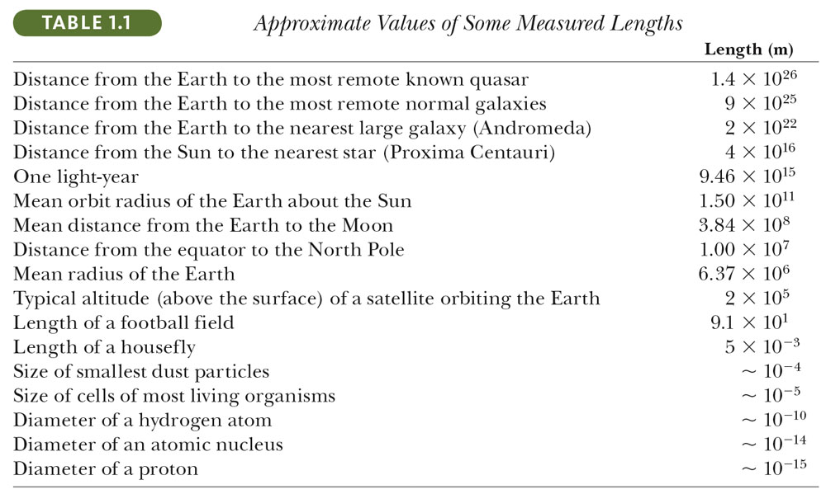

Slide 27
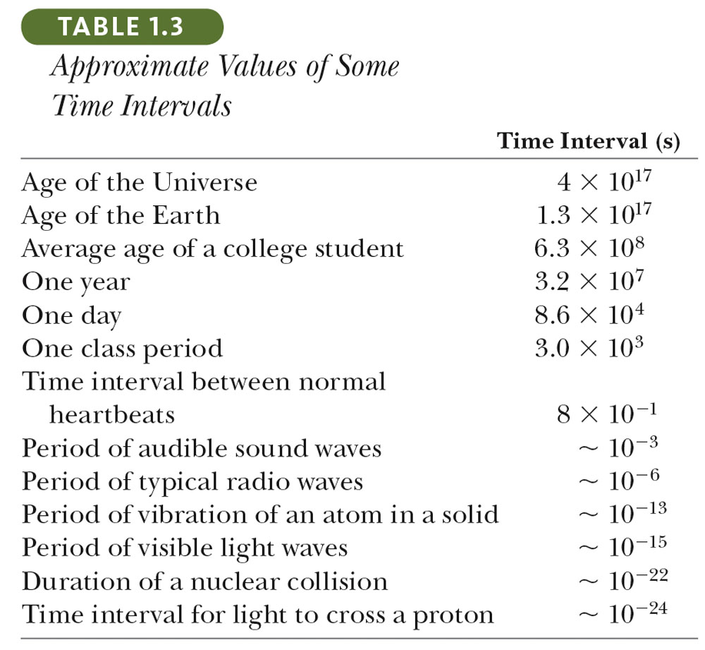

Slide 28
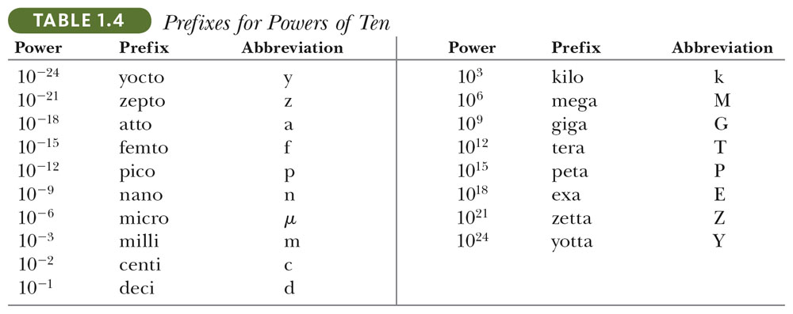
Terrible example: 10¹² bull

Slide 29
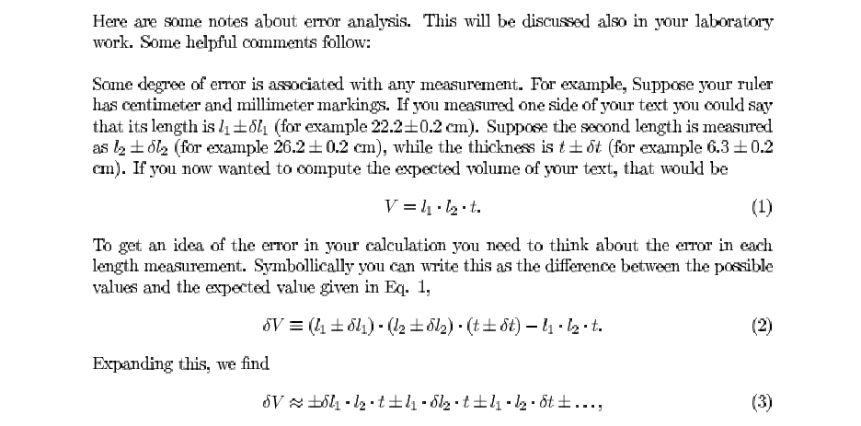
Comments about “error analysis”

Slide 30
