Slide 1
PHY 113 A General Physics I
9-9:50 AM MWF Olin 101
Plan for Lecture 10:
Chapter 6 -- Newton’s Laws continued
Newton’s Laws and centripetal acceleration
Newton’s Laws and resistive forces
Notes:
Problems 1.1,1.6,1.10,1.11

Slide 3
iclicker exercise:
Exam feedback:
Too hard
Too easy
Neutral

Slide 4
Recall: Uniform circular motion:
animation from http://mathworld.wolfram.com/UniformCircularMotion.html

Slide 5
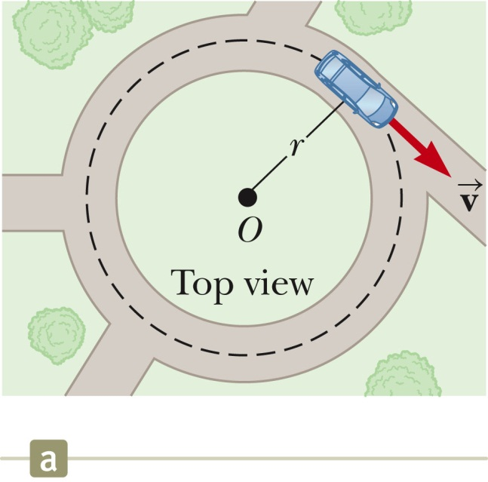
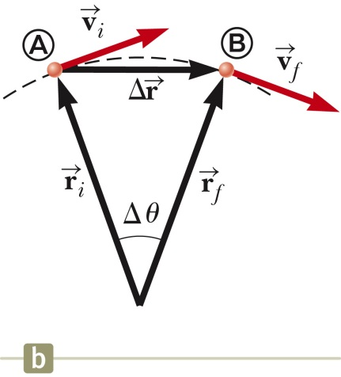
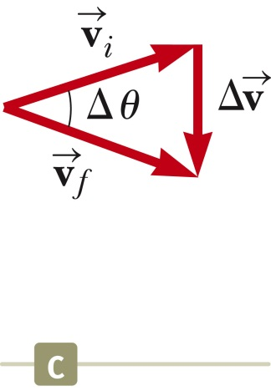
Uniform circular motion – continued

Slide 6
Uniform circular motion – continued
r
In terms of time period T for one cycle:
In terms of the frequency f of complete cycles:

Slide 7
Uniform circular motion and Newton’s second law
r
iclicker exercise:
For uniform circular motion
Newton’s laws are repealed
There is a force pointing radially outward from the circle
There is a force pointing radially inward to the circle

Slide 8
Example of uniform circular motion:
http://earthobservatory.nasa.gov/Features/OrbitsCatalog/page1.php

Slide 9
Example of uniform circular motion:
Consider the moon in orbit about the Earth

Slide 10
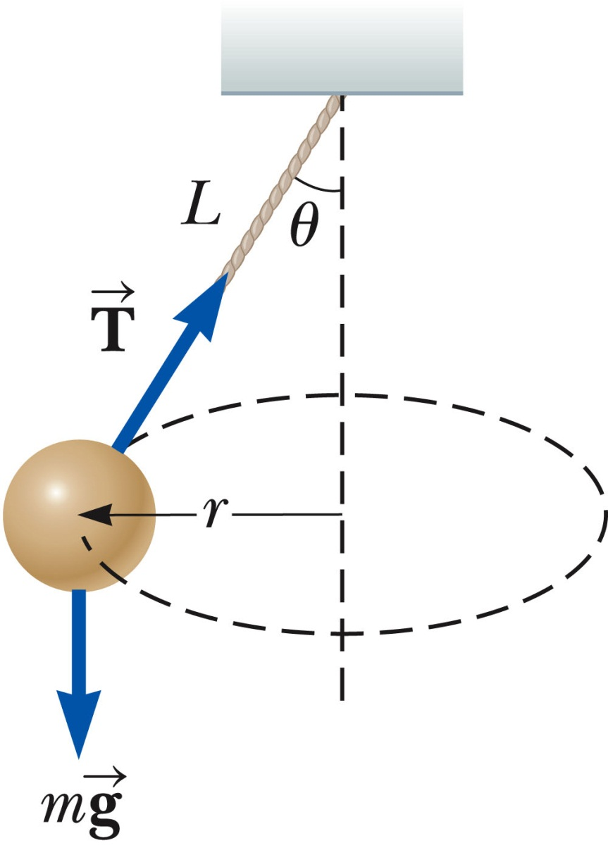
Example of uniform circular motion:

Slide 11
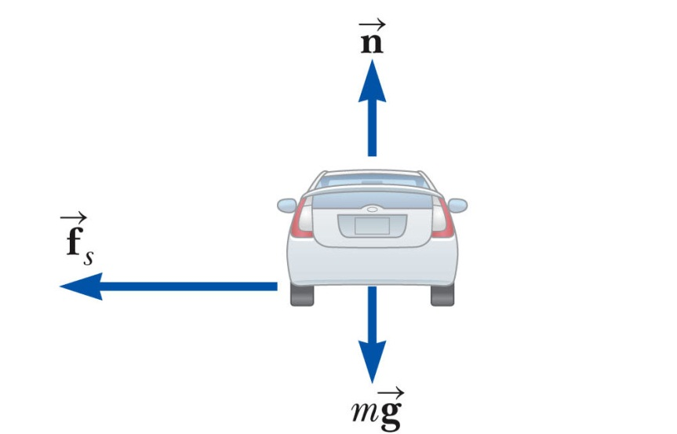
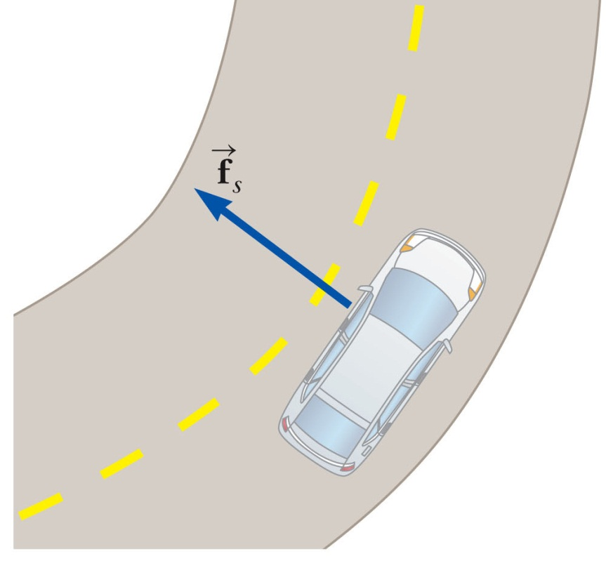
Example of uniform circular motion:

Slide 12
Curved road continued:

Slide 13
Mass on a swing:
iclicker exercise:
Which of these statements about the tension T in the rope is true?
T is the same for all θ.
T is smallest for θ=0.
T is largest for θ=0.
L
θ
T
mg

Slide 14
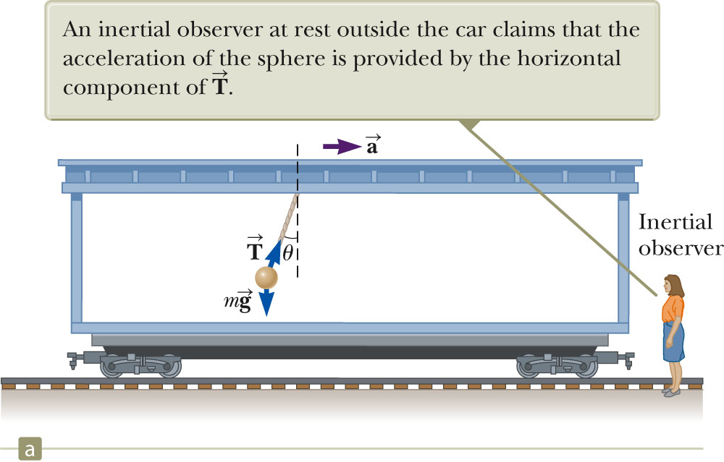
Newton’s law in accelerating train car

Slide 15
Models of air friction forces
bv
mg

