Slide 1
PHY 113 A General Physics I
9-9:50 AM MWF Olin 101
Plan for Lecture 11:
Chapter 7 -- The notion of work
Definition of work
Examples of work
Potential energy and work; conservative forces
Comments about Exam 1
Notes:
Problems 1.1,1.6,1.10,1.11

Slide 3
Comments about Exam 1
Scores 70 ≤ G ≤ 100
Please keep working hard, even if your score is 90 ≤ G ≤ 100
Please make an appointment to see me if your score is 70 ≤ G ≤ 90
Solutions will be posted on the web on the course website (you will have to login with your WFU login and password)

Slide 4
Energy ➔ work, kinetic energy
Force ➔ effects acceleration
A related quantity is Work
F
dr
r_{i}
r_{j}

Slide 5
Definition of vector “dot” product
θ

Slide 6
Definition of vector “dot” product
θ

Slide 7
Definition of vector “dot” product -- continued
θ
Note that the result of a vector dot product is a scalar.

Slide 8
F
Definition of work:
dr
r_{i}
r_{j}

Slide 9
Units of work:
work = force · displacement = (N · m) = (joule)
Only the component of force in the direction of the displacement contributes to work.
Work is a scalar quantity.
If the force is not constant, the integral form must be used.
Work can be defined for a specific force or for a combination of forces

Slide 10
iclicker question: A ball with a weight of 5 N follows the trajectory shown. What is the work done by gravity from the initial r_{i} to final displacement r_{f}?
2.5m
r_{f}
r_{i}
1m
1m
10 m
(A) 0 J (B) 7.5 J (C) 12.5 J (D) 50 J

Slide 11
Gravity does negative work:
Gravity does positive work:
r_{i}
r_{f}
mg
mg
r_{i}
r_{f}
W=−mg(r_{f}−r_{i})>0
W=−mg(r_{f}−r_{i})<0

Slide 12
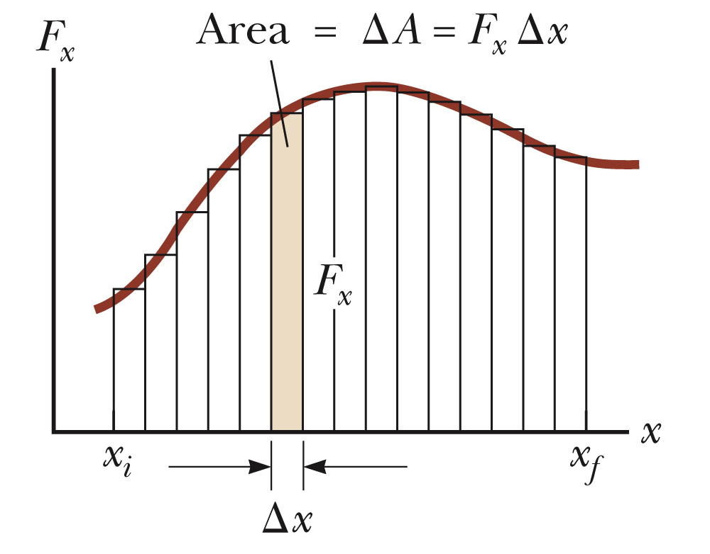
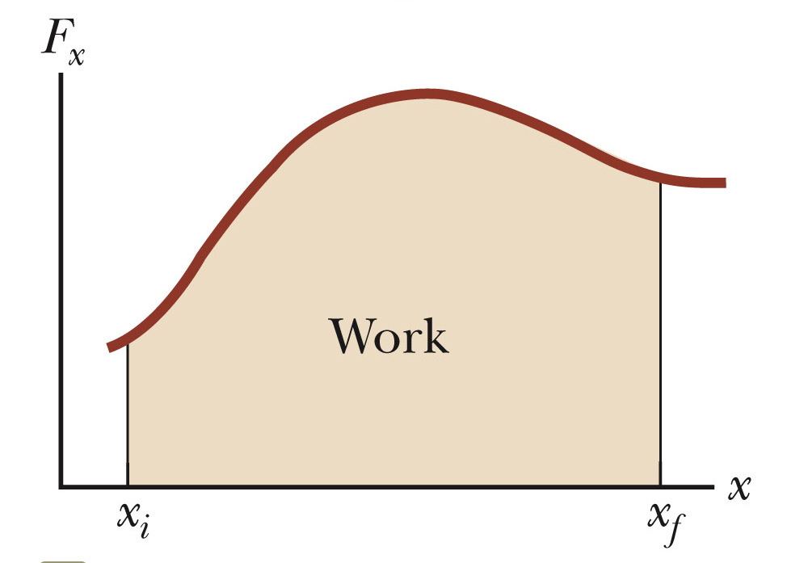
Work done by a variable force:

Slide 13
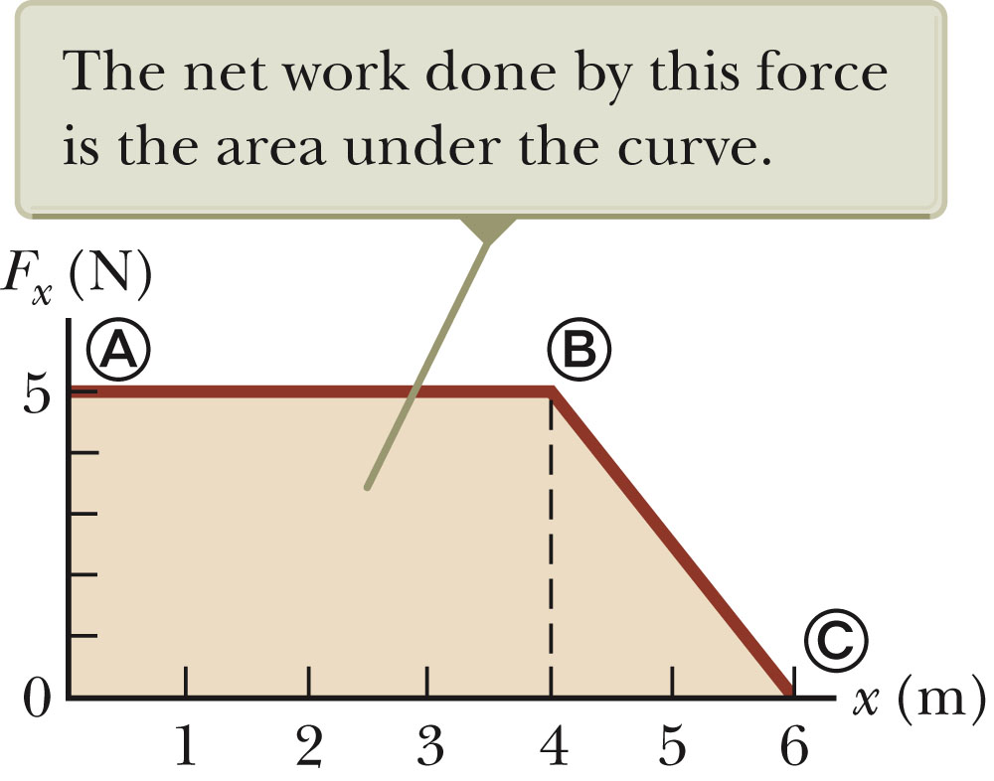
Example:

Slide 14
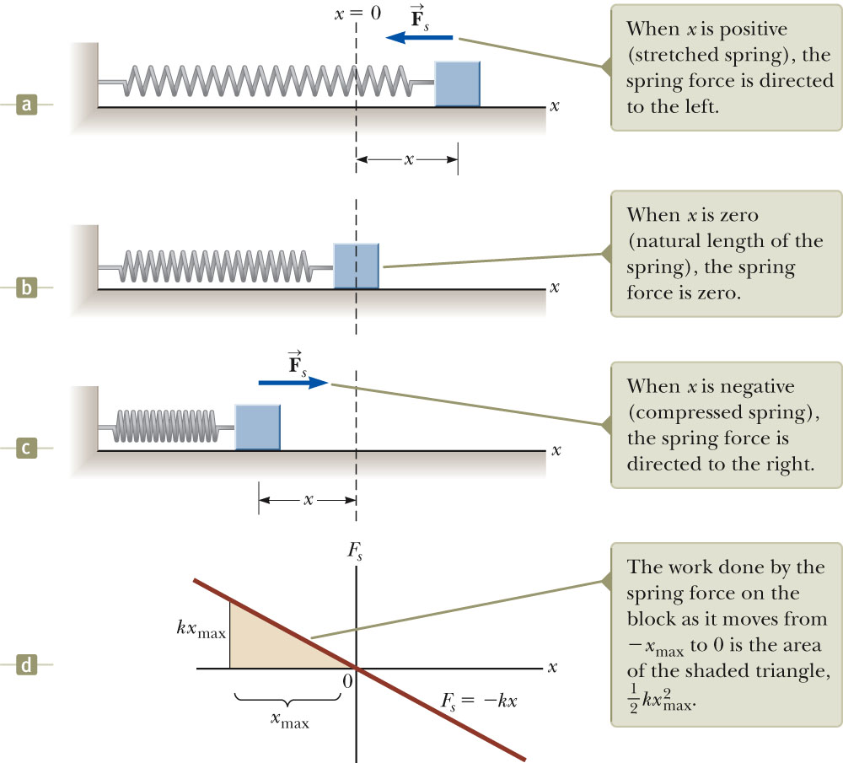
Example – spring force: F_{x} = - kx

Slide 15
F
Positive work
x
Negative work

Slide 16
Detail:

Slide 17
More examples:
Suppose a rope lifts a weight of 1000N by 0.5m at a constant upward velocity of 4.9m/s. How much work is done by the rope?
(A) 500 J (B) 750 J (C) 4900 J (D) None of these
Suppose a rope lifts a weight of 1000N by 0.5m at a constant upward acceleration of 4.9m/s². How much work is done by the rope?
(A) 500 J (B) 750 J (C) 4900 J (D) None of these

Slide 18
iclicker exercise:
Why should we define work?
Because professor like to torture students.
Because it is always good to do work
Because it will help us understand motion.
Because it will help us solve the energy crisis.
Next time we will discuss the Work-Kinetic energy theorem.

Slide 19
n
F_{P}
θ
f_{k}
mg
x_{i}
x_{f}
Assume F_{P} sinθ <<mg
Work of gravity?
0
Work of F_{P}?
F_{P} cos θ (x_{f}-x_{i})
−μ_{k}n (x_{f}-x_{i})=−μ_{k}(mg- F_{P} sin θ) (x_{f}-x_{i})
Work of f_{k}?

Slide 20
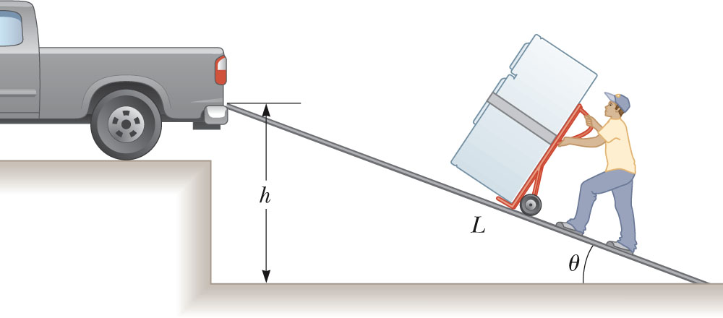
A man must lift a refrigerator of weight mg to a height h to get it to the truck.
For which method does the man do more work:
Vertically lifting the refrigerator at constant speed to height h?
Moving the refrigerator up the ramp of length L at constant speed with h=L sin θ.

Slide 21
iclicker exercise:
Which of the following statements about friction forces are true.
Friction forces always do positive work.
Friction forces always do negative work.
Friction forces can do either positive or negative work.

