Slide 1
PHY 113 A General Physics I
9-9:50 AM MWF Olin 101
Plan for Lecture 12:
Chapter 7 -- The notion of work
Kinetic energy and the Work-Kinetic energy theorem
Potential energy and work; conservative forces
Notes:
Problems 1.1,1.6,1.10,1.11

Slide 6
Note: Because of the special lecture, the tutorial this evening will be moved to Olin 104 after 6:30 PM.

Slide 7
Back to work:
F
dr
r_{i}
r_{j}

Slide 8
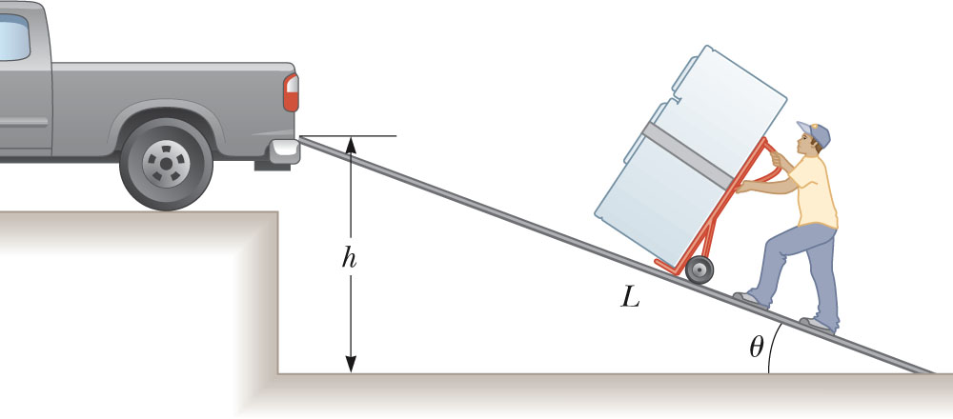
A man must lift a refrigerator of weight mg to a height h to get it to the truck.
iclicker exercise:
For which method does the man do more work:
Vertically lifting the refrigerator at constant speed to height h?
Moving the refrigerator up the ramp of length L at constant speed with h=L sin θ.

Slide 9
Multiple forces on block moving from x_{i} to x_{f}
n
F_{P}
θ
f_{k}
mg
x_{i}
x_{f}
Assume F_{P} sinθ <<mg
Work of gravity?
0
Work of F_{P}?
F_{P} cos θ (x_{f}-x_{i})
−μ_{k}n (x_{f}-x_{i})=−μ_{k}(mg- F_{P} sin θ) (x_{f}-x_{i})
Work of f_{k}?

Slide 10
iclicker exercise:
Which of the following statements about friction forces are true.
Friction forces always do positive work.
Friction forces always do negative work.
Friction forces can do either positive or negative work.

Slide 11
Why is work a useful concept?
Consider Newton’s second law:
F_{total} = m a ➔ F_{total} · dr= m a · dr
W_{total} = ½ m v_{f}² - ½ m v_{i}²
Kinetic energy (joules)

Slide 12
Introduction of the notion of Kinetic energy
Some more details:
Consider Newton’s second law:
F_{total} = m a ➔ F_{total} · dr= m a · dr
➔W_{total} = ½ m v_{f}² - ½ m v_{i}²
Kinetic energy (joules)

Slide 13
Kinetic energy: K = ½ m v²
units: (kg) (m/s)² = (kg m/s²) m
N m = joules
Work – kinetic energy relation:
W_{total} = K_{f} – K_{i}

Slide 14
Kinetic Energy-Work theorem
Example: A ball of mass 10 kg, initially at rest falls a height of 5m. What is its final velocity?
i
0
h
f

Slide 15
A block, initially at rest at a height h, slides down a frictionless incline. What is its final velocity?
Example
h=0.5m
h
0

Slide 16
Example
A mass m initially at rest and attached to a spring compressed a distance x=-|x_{i}|, slides on a frictionless surface. What is the velocity of the mass when x=0 ?
k
0

Slide 17
Special case of “conservative” forces
➔conservative ⬅➔ non-dissipative

Slide 18
k

Slide 19
iclicker exercise:
Why would you want to write the work as the difference between two “potential” energies?
Normal people wouldn’t.
It shows a lack of imagination.
It shows that the work depends only on the initial and final displacements, not on the details of the path.

Slide 20
Work-Kinetic Energy Theorem for conservative forces:

Slide 21
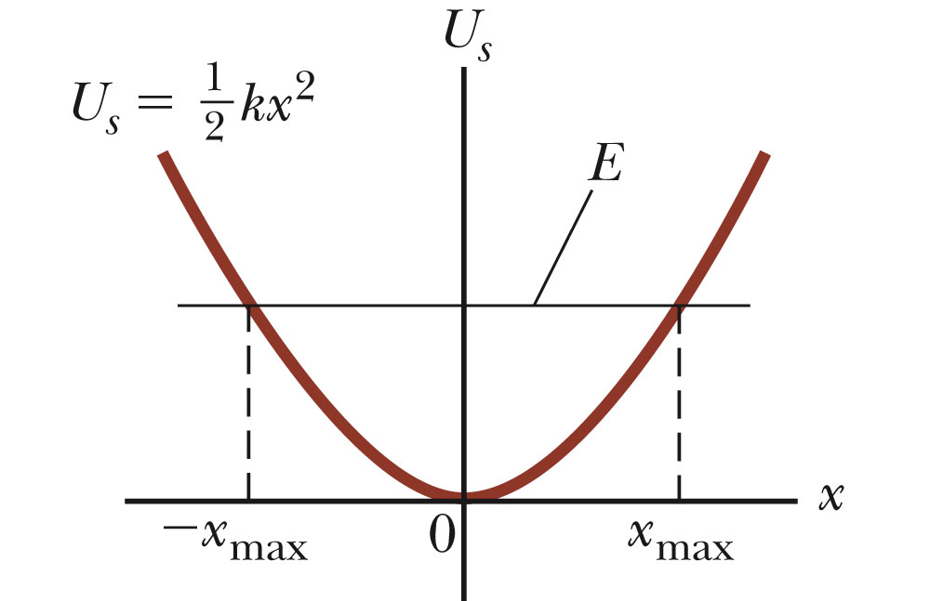
Energy diagrams

Slide 22
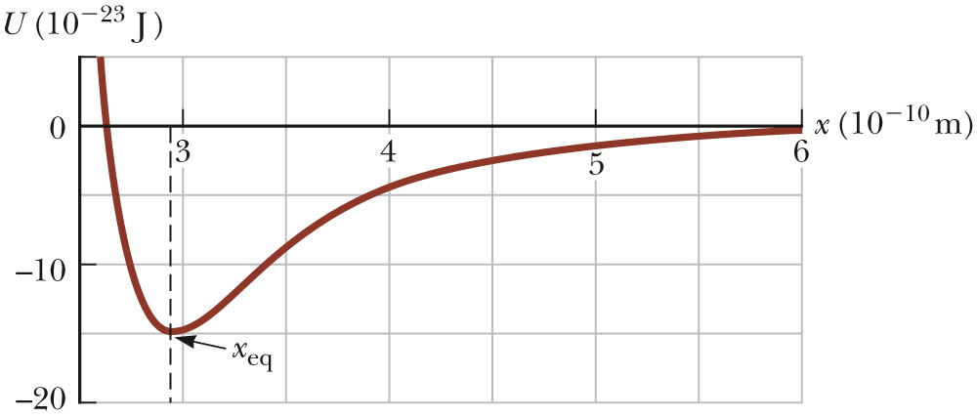
Example: Model potential energy function U(x) representing the attraction of two atoms

