Slide 1
PHY 113 A General Physics I
9-9:50 AM MWF Olin 101
Plan for Lecture 13:
Chapter 8 -- Conservation of energy
Potential and kinetic energy for conservative forces
Energy and non-conservative forces
Power
Notes:
Problems 1.1,1.6,1.10,1.11

Slide 3
Note: Because of PHY 114 exams on Sunday and Monday, the tutorials those nights will be moved from Olin 101 – check for signs – this week only.

Slide 5
A block, initially at rest at a height h, slides down a frictionless incline. What is its final velocity?
Example
i
h=0.5m
h
f

Slide 6
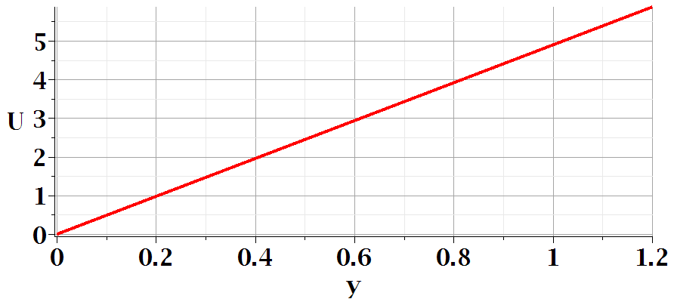
Energy diagram
E
K
U
y_{f}
y_{i}

Slide 7
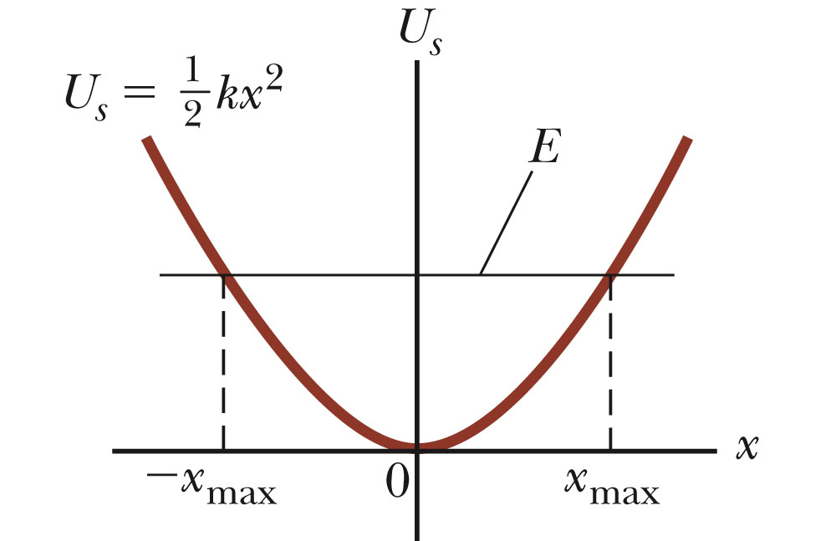
Energy diagrams

Slide 8
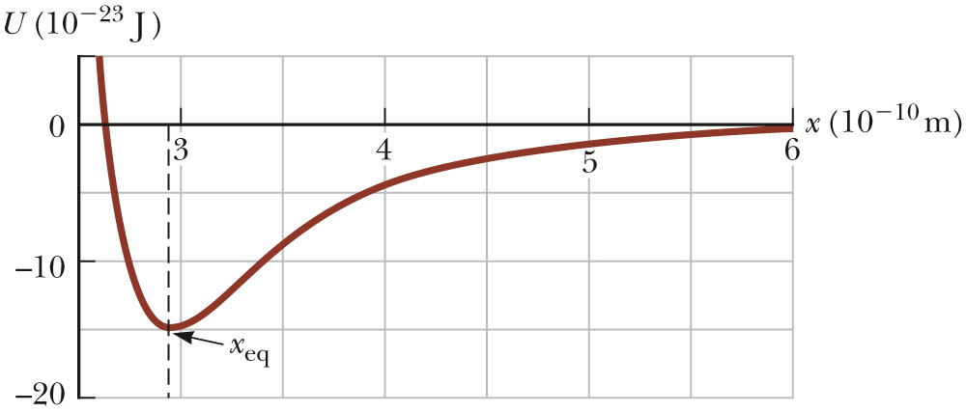
Example: Model potential energy function U(x) representing the attraction of two atoms

Slide 9
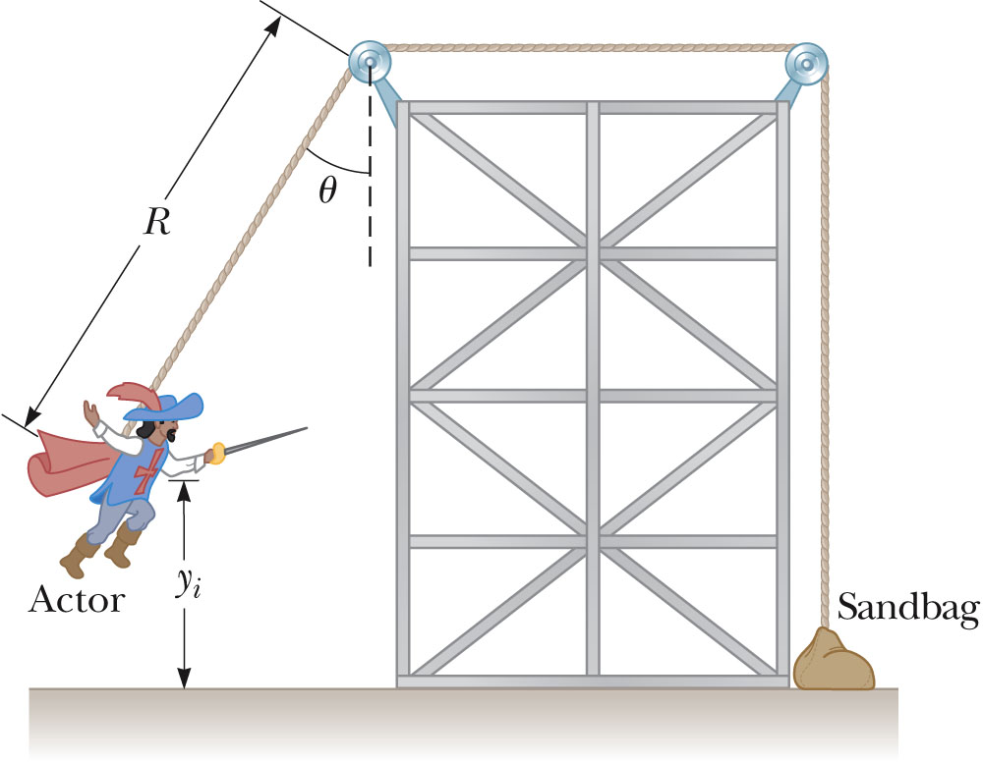
Example:
Simplified version:
(Assume that the sandbag is massive enough to provide the tension in the rope and R=3m.) If the actor starts at v_{i}=0 and θ=60º, what is v_{f}?
0
0

Slide 10
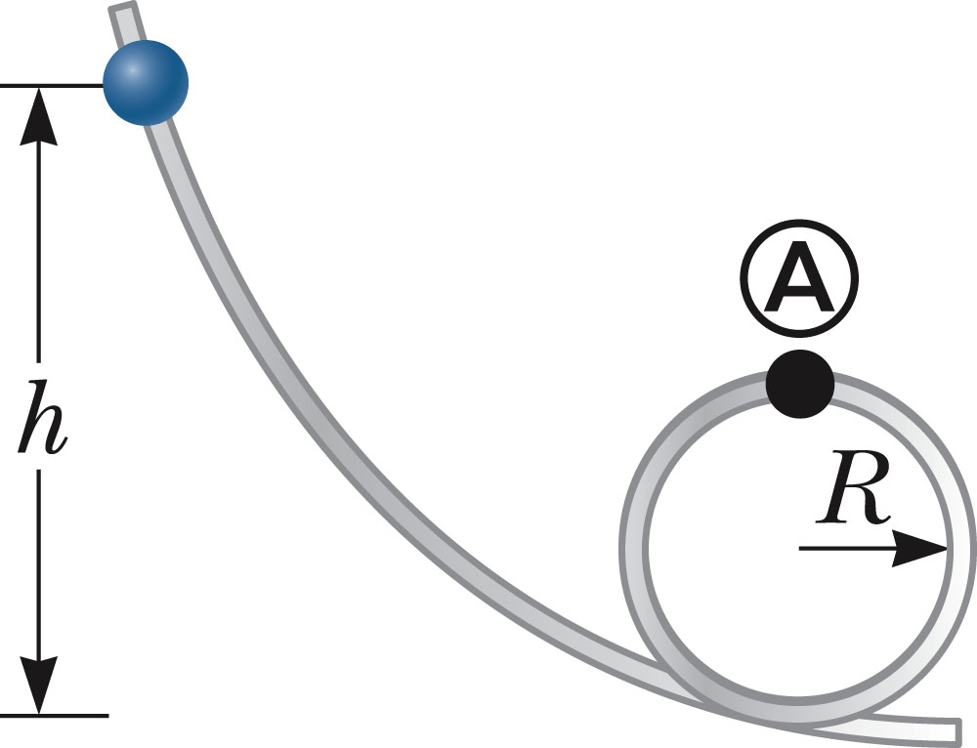
Example: Mass sliding on frictionless looping track
iclicker exercise:
In order for the ball completes the loop at A, what must the value of h?
h=R
h=2R
h>2R
Not enough information.
i

Slide 11
Example: Mass sliding on frictionless looping track
i
0
0

Slide 12
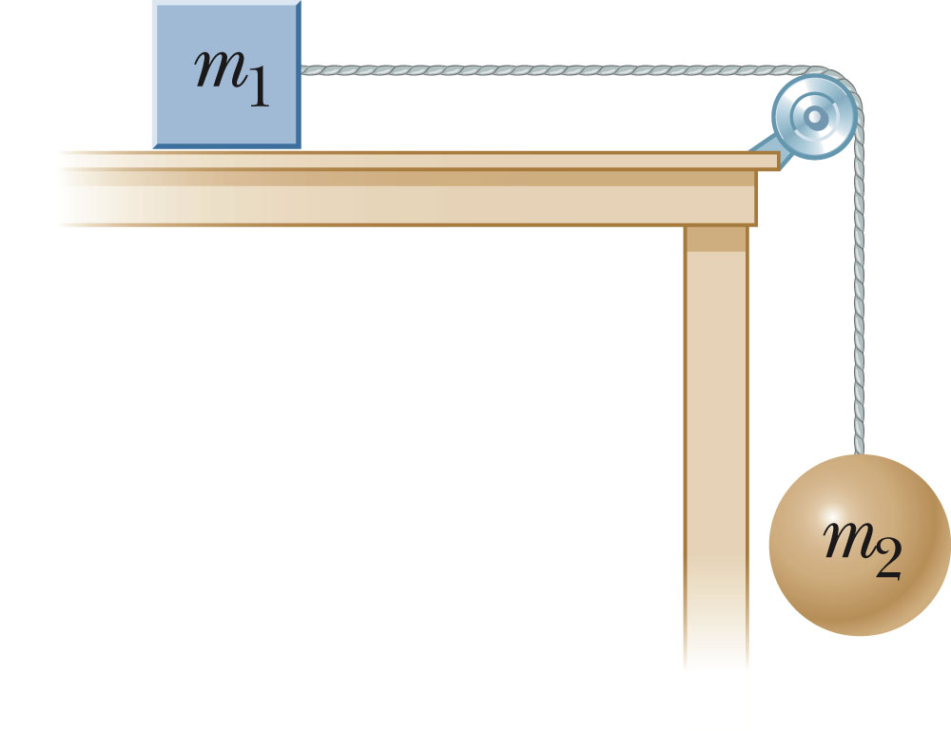
Another example; first without friction
Mass m₁ (=0.2kg) slides horizontally on a frictionless table and is initially at rest. What is its velocity when it moves a distance Δx=0.1m (and m₂ (=0.3kg) falls Δy=0.1m)?
iclicker exercise:
What is the relationship of the final velocity of m₁ and m₂?
They are equal
m₂ is faster than m₁.
m₁ is faster than m₂.

Slide 13
Another example; first without friction
T
Mass m₁ (=0.2kg) slides horizontally on a frictionless table and is initially at rest. What is its velocity when it moves a distance Δx=0.1m (and m₂ (=0.3kg) falls Δy=0.1m)?
T
m₂ g
0

Slide 14
Another example; now with friction
T
f
Mass m₁ (=0.2kg) slides horizontally on a table with kinetic friction and is initially at rest. What is its velocity when it moves a distance Δx=0.1m (and m₂ (=0.3kg) falls Δy=0.1m)?
T
m₂ g
0

Slide 16
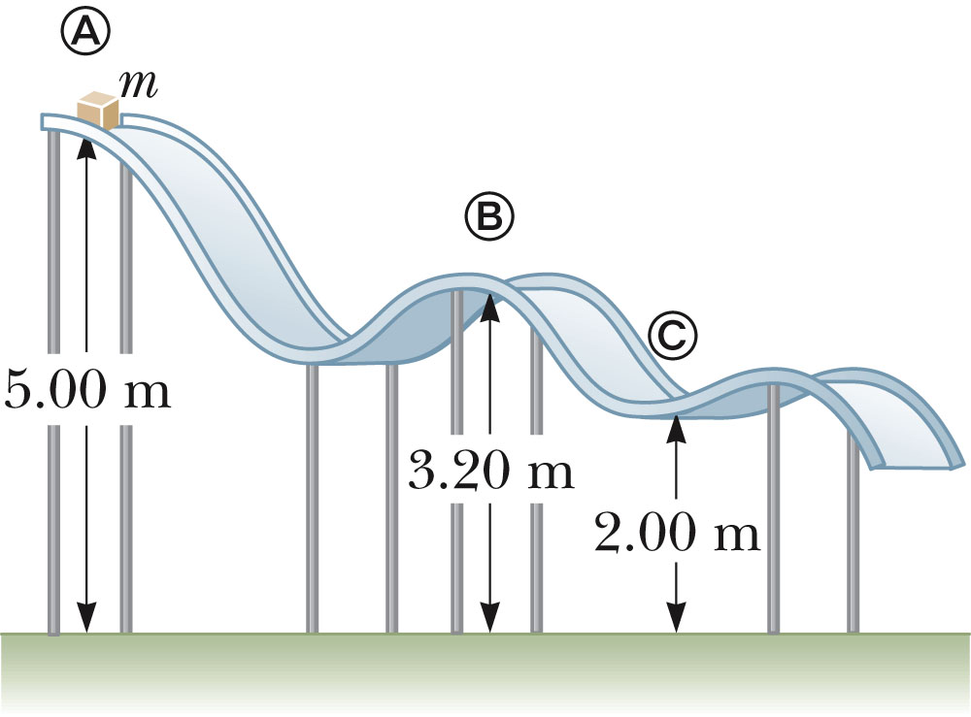
iclicker exercise:
Assume a mass m starts at rest at A and moves on the frictionless surface as shown. At what position is the speed the largest?
A
B
C
none of these.

Slide 17
Power

Slide 18
