Slide 1
PHY 113 A General Physics I
9-9:50 AM MWF Olin 101
Plan for Lecture 14:
Chapter 9 -- Linear momentum
Impulse and momentum
Conservation of linear momentum
Examples – collision analysis
Notes:
Problems 1.1,1.6,1.10,1.11

Slide 3
Note: Because of PHY 114 exams on Sunday and Monday, the tutorials those nights will be moved from Olin 101 – check for signs – this week only.

Slide 4
Summary of physics “laws”

Slide 5
Another way to look at Newton’s second law:
iclicker question:
Why would you want to define linear momentum?
To impress your friends.
To exercise your brain.
It might be helpful.
To distinguish it from angular momentum.

Slide 6
Relationship between Newton’s second law and linear momentum:

Slide 7
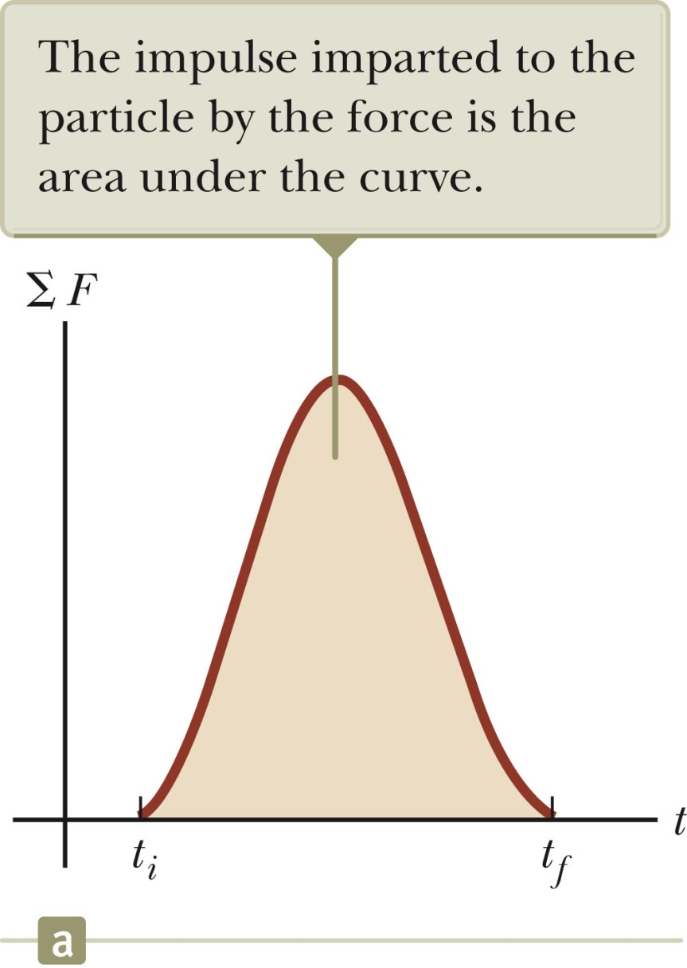

Slide 8
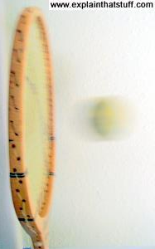
Suppose that a tennis ball with mass m=0.057 kg approaches a tennis racket at a speed of 45m/s. What is the impulse the racket must exert on the ball to return the ball in the opposite direction at the same speed. Assume that the motion is completely horizontal.

Slide 9
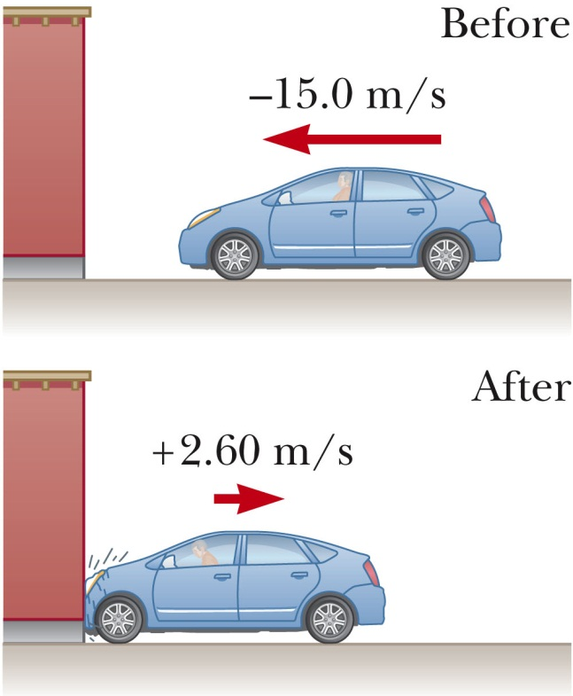
Example: A 1500 kg car collides with a wall, with
v_{i}= -15m/s and v_{f}=2.6m/s. What is the impulse exerted on the car?

Slide 10
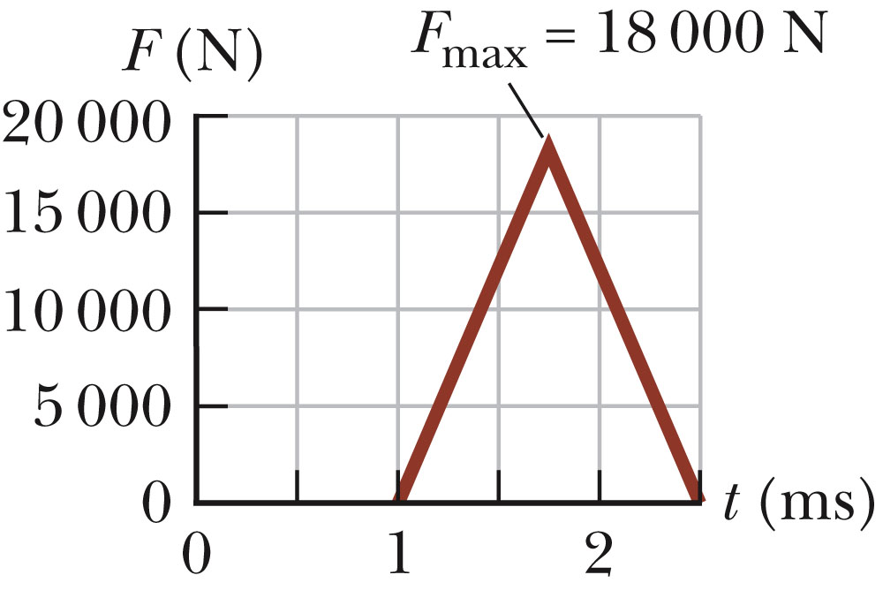
Example of graphical representation of F(t)

Slide 11
Physics of composite systems

Slide 12
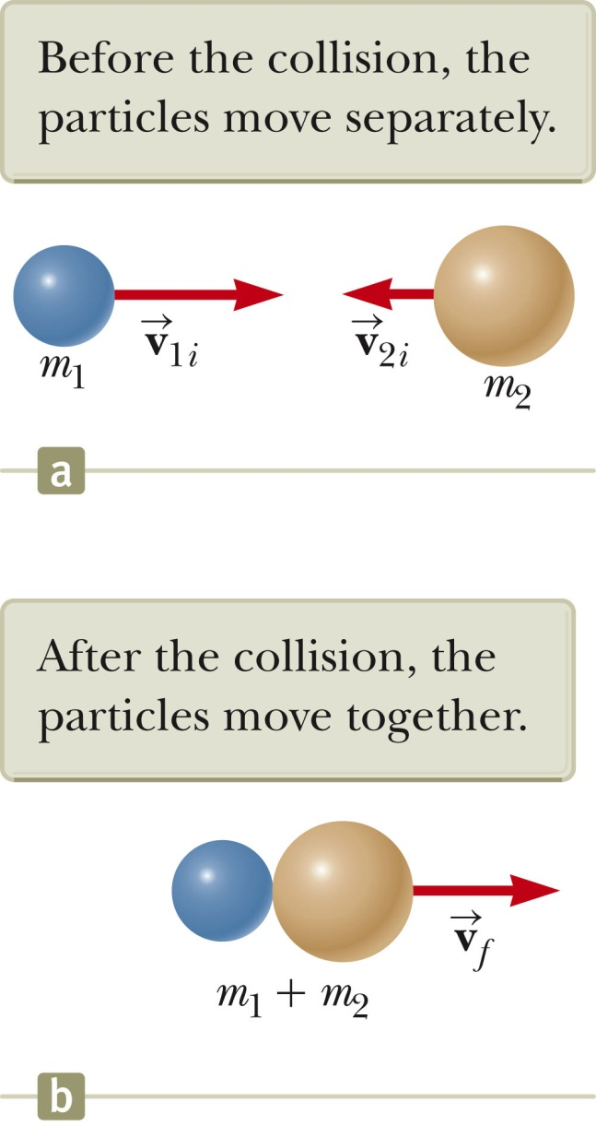
Example – completely inelastic collision; balls moving on a frictionless surface

Slide 13
Energy loss in this example:

Slide 14
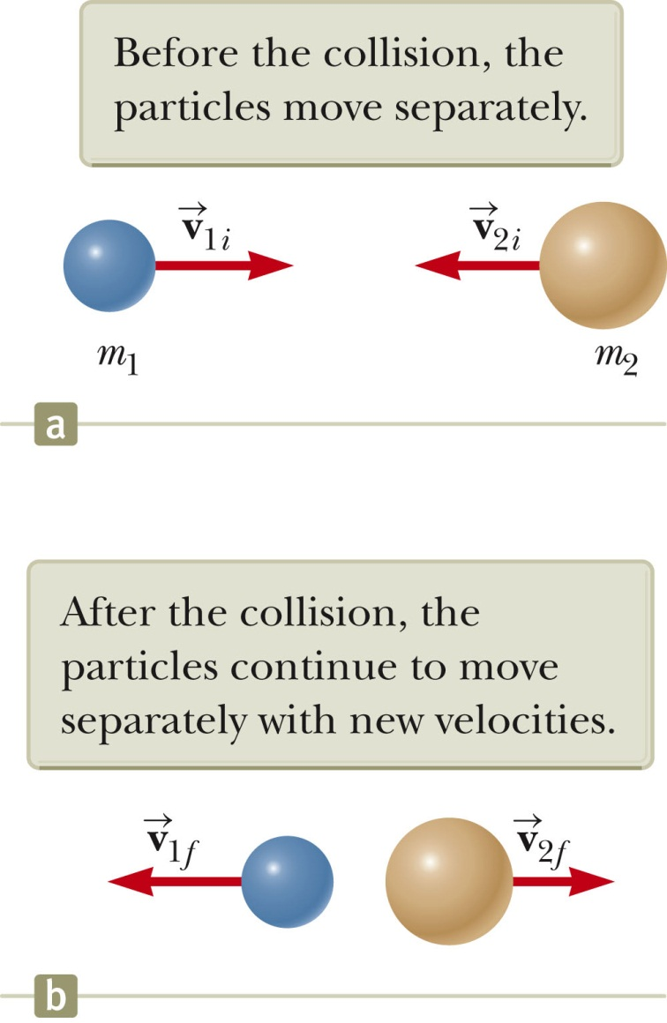
Example – completely elastic collision; balls moving on a frictionless surface

Slide 15
Completely elastic collision; numerical example:

Slide 16
iclicker exercise:
We have assumed that there is no net force acting on the system. What happens if there are interaction forces between the particles?
Analysis still applies
Analysis must be modified

Slide 17
Example from homework:

Slide 18
Example from homework:
before
v_{f}
after

