Slide 1
PHY 113 A General Physics I
9-9:50 AM MWF Olin 101
Plan for Lecture 14:
Chapter 9 -- Linear momentum
Impulse and momentum in two dimensions
Center of mass
Collision analysis in two dimensions
Notes:
Problems 1.1,1.6,1.10,1.11

Slide 3
Relationship between Newton’s second law and linear momentum for a single particle:

Slide 4
Physics of composite systems

Slide 5
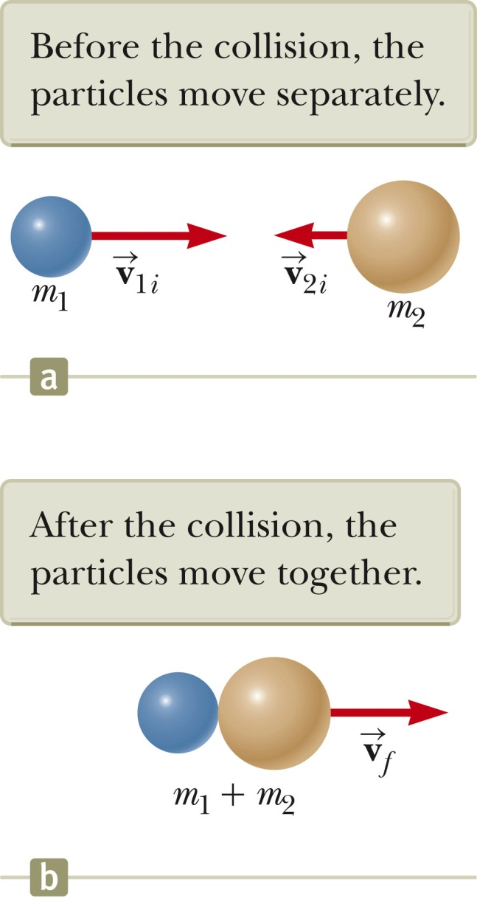
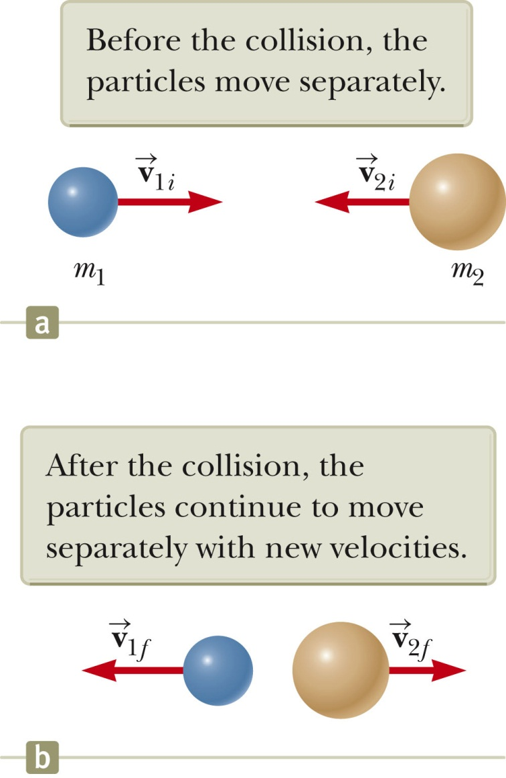
Examples of completely one-dimensional (head-on) collision; balls moving on a frictionless surface
inelastic:
elastic:

Slide 6
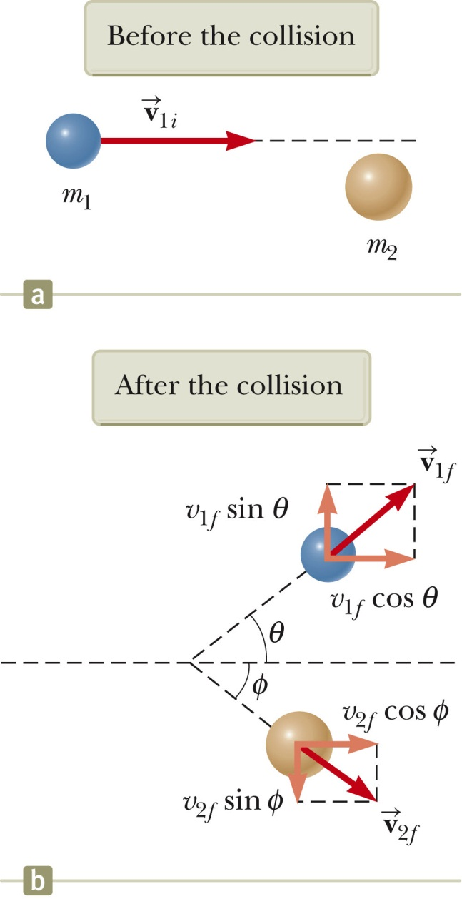
Examples of two-dimensional collision; balls moving on a frictionless surface

Slide 7
Examples of two-dimensional collision; balls moving on a frictionless surface

Slide 8
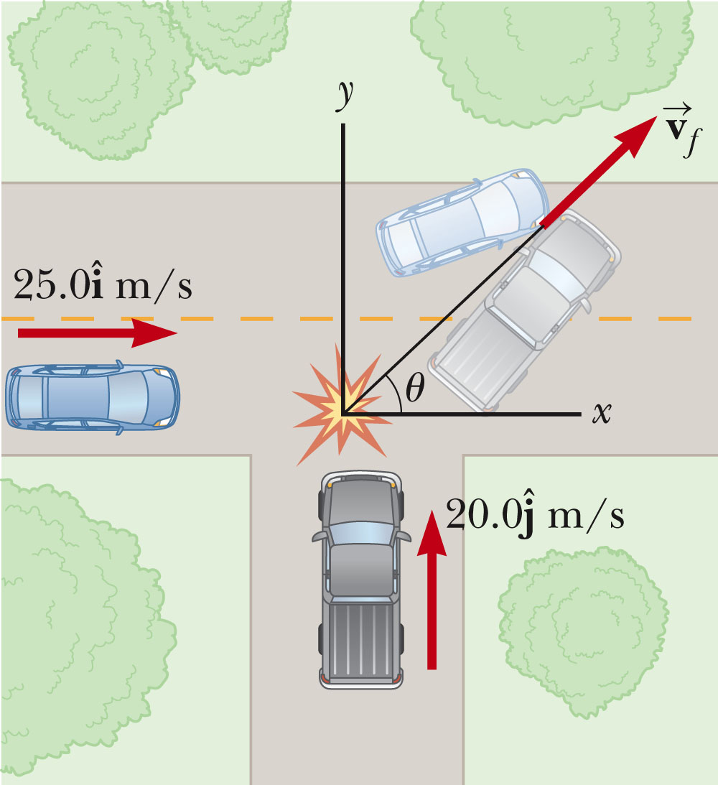
Example: two-dimensional totally inelastic collision
m₁=1500kg
m₂=2500kg

Slide 9
iclicker exercise:
Can this analysis be used to analyze a real collision?
Of course! The laws of physics must be obeyed.
Of course NOT! In physics class we only deal with idealized situations which never happen.

Slide 10
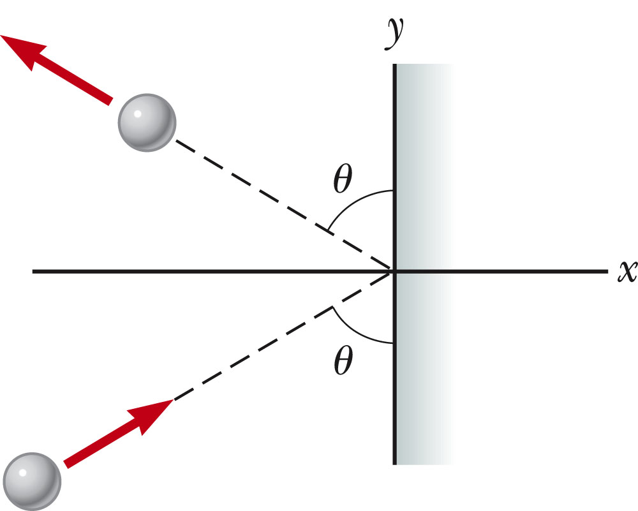
Another example of 2-dimensional elastic collision:
v_{f}
m
v_{i}
m

Slide 11
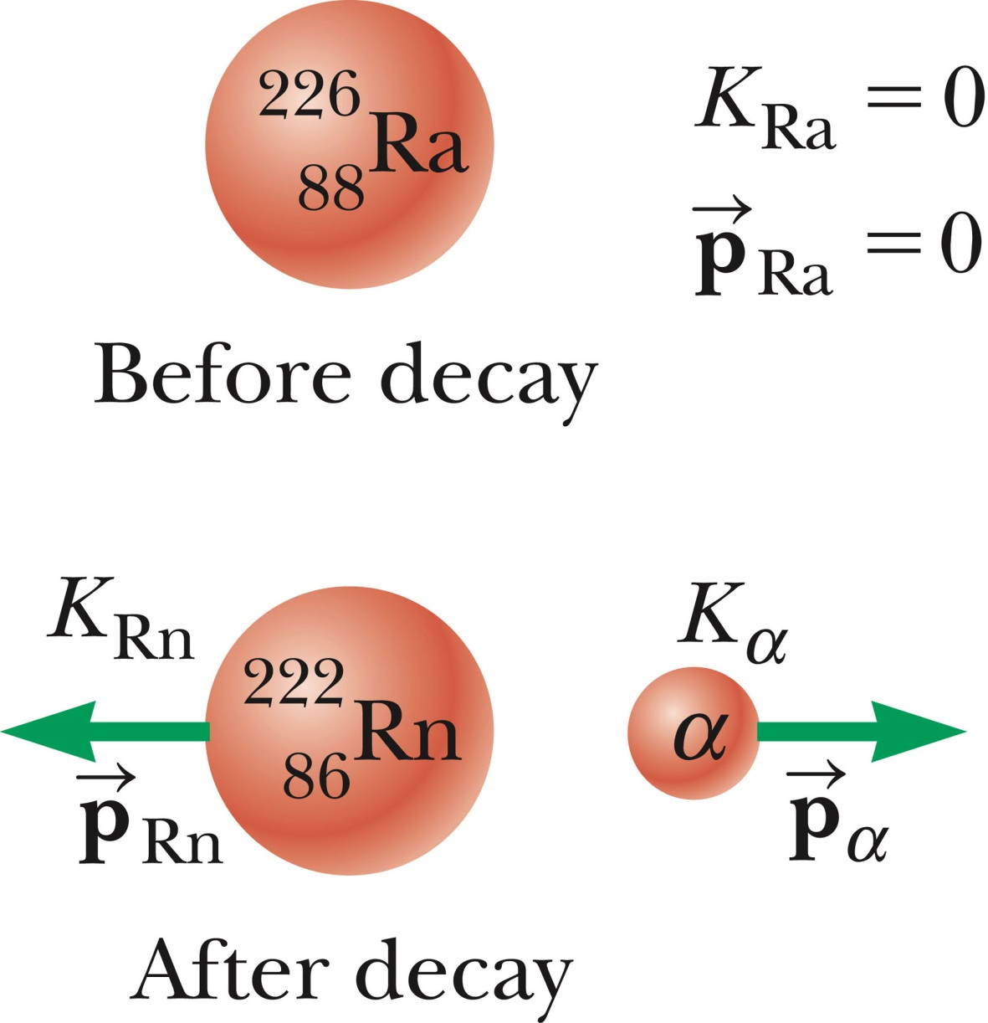
Energy analysis of a simple nuclear reaction :
Q=4.87 MeV

Slide 12
Energy analysis of a simple reaction :
Q=4.87 MeV

Slide 13
The notion of the center of mass and the physics of composite systems

Slide 15
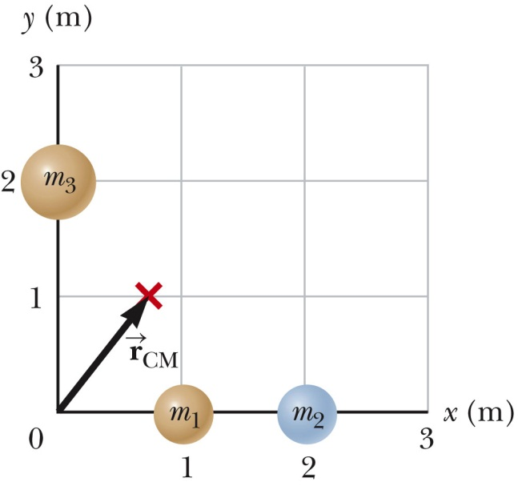
Finding the center of mass

Slide 16
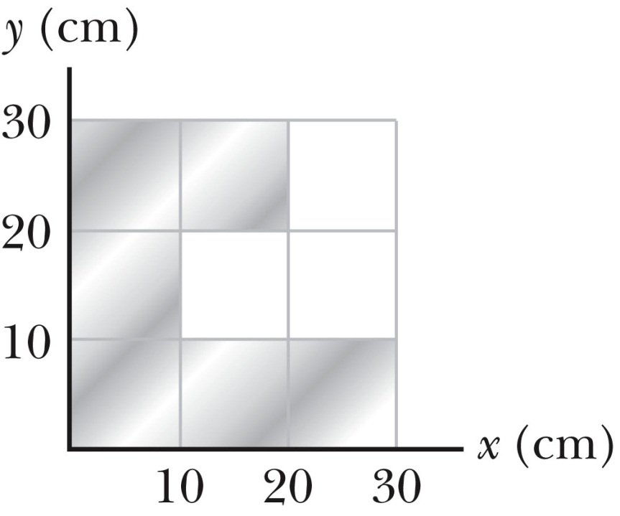
Finding the center of mass
For a solid object composed of constant density material, the center of mass is located at the center of the object.

