Slide 1
PHY 113 A General Physics I
9-9:50 AM MWF Olin 101
Plan for Lecture 17:
Chapter 10 – rotational motion
Angular variables
Rotational energy
Moment of inertia
Notes:
Problems 1.1,1.6,1.10,1.11

Slide 3
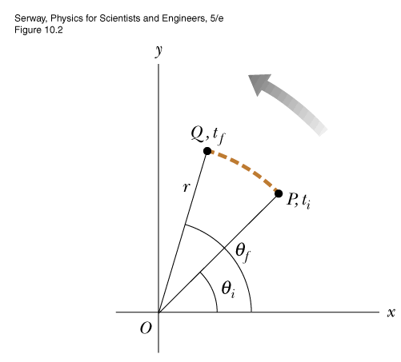
Angular motion
angular “displacement” ➔ θ(t)
angular “velocity” ➔
angular “acceleration” ➔
“natural” unit == 1 radian
Relation to linear variables: s_{θ} = r (θ_{f}-θ_{i})
v_{θ} = r ω
a_{θ} = r α
s

Slide 4
r₁
v₁=r₁ω
ω
r₂
v₂=r₂ω
Special case of constant angular acceleration: α = α₀:
ω(t) = ω_{i} + α₀ t
θ(t) = θ_{i} + ω_{i} t + ½ α₀ t²
( ω(t))² = ω_{i}² + 2 α₀ (θ(t) - θ_{i} )

Slide 5
A wheel is initially rotating at a rate of f=30 rev/sec.
R

Slide 6
A wheel is initially rotating at a rate of f=30 rev/sec. Because of a constant angular deceleration, the wheel comes to rest in 3 seconds.
R

Slide 7
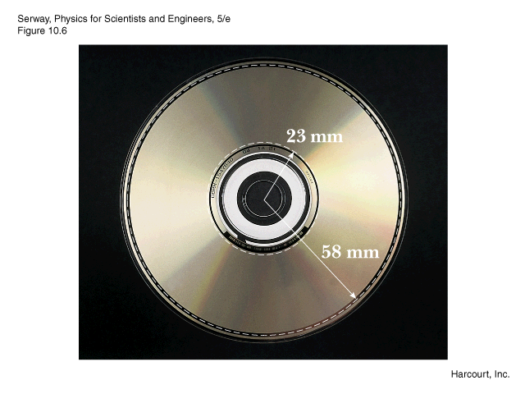
Example: Compact disc motion
ω₁
ω₂
In a compact disk, each spot on the disk passes the laser-lens system at a constant linear speed of v_{θ} = 1.3 m/s.
ω₁=v_{θ}/r₁=56.5 rad/s
ω₂=v_{θ}/r₂=22.4 rad/s
What is the average angular acceleration of the CD over the time interval Δt=4473 s as the spot moves from the inner to outer radii?
α = (ω₂-ω₁)/Δt =-0.0076 rad/s²

Slide 8
Object rotating with constant angular velocity (α = 0)
ω
R
v=Rω
v=0
Kinetic energy associated with rotation:
“moment of inertia”

Slide 9
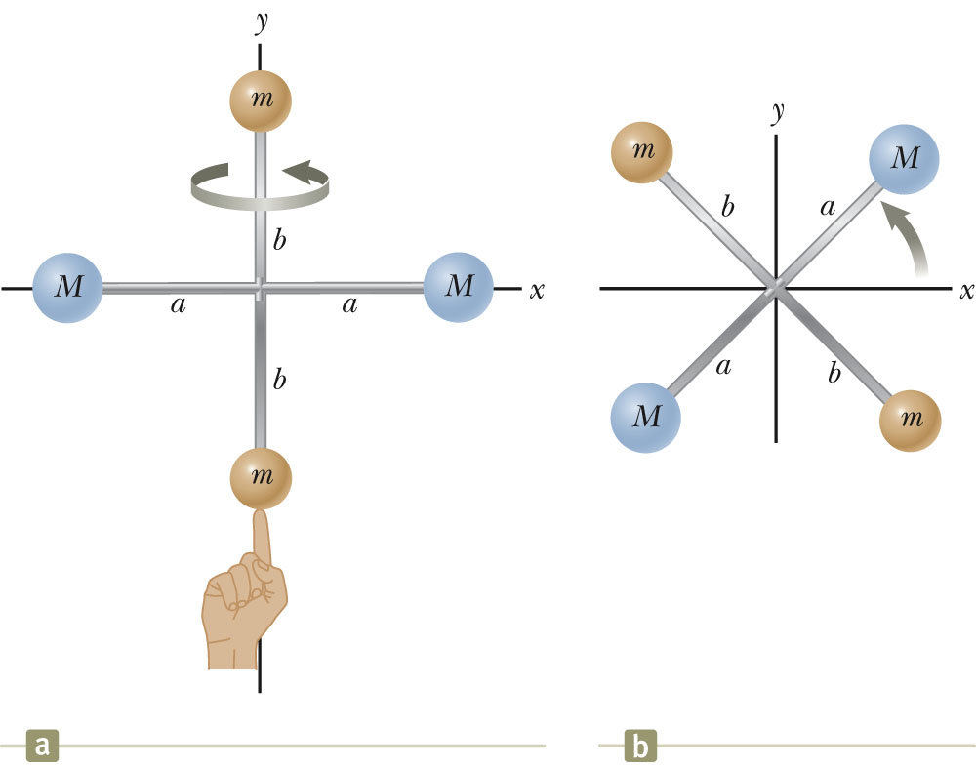
Moment of inertia:
iclicker exercise: Which case has the larger I?
A. a B. b

Slide 10
Moment of inertia:

Slide 11
Note that the moment of inertia depends on both
The position of the rotational axis
The direction of rotation
m
m
m
m
d
d
d
d
I=2md²
I=m(2d)²=4md²

Slide 12
iclicker question:
Suppose each of the following objects each has the same total mass M and outer radius R and each is rotating counter-clockwise at an constant angular velocity of ω=3 rad/s. Which object has the greater kinetic energy?
(a) (Solid disk)
(b) (circular ring)

Slide 13
Various moments of inertia:
R
R
R
solid sphere:
I=2/5 MR²
solid rod:
I=1/3 MR²
solid cylinder:
I=1/2 MR²

Slide 14
Calculation of moment of inertia:
Example -- moment of inertia of solid rod through an axis perpendicular rod and passing through center:
R

Slide 15
Note that any solid object has 3 moments of inertia; some times two or more can be equal
j
i
k
iclicker exercise:
Which moment of inertia is the smallest?
(A) i (B) j (C) k

Slide 16
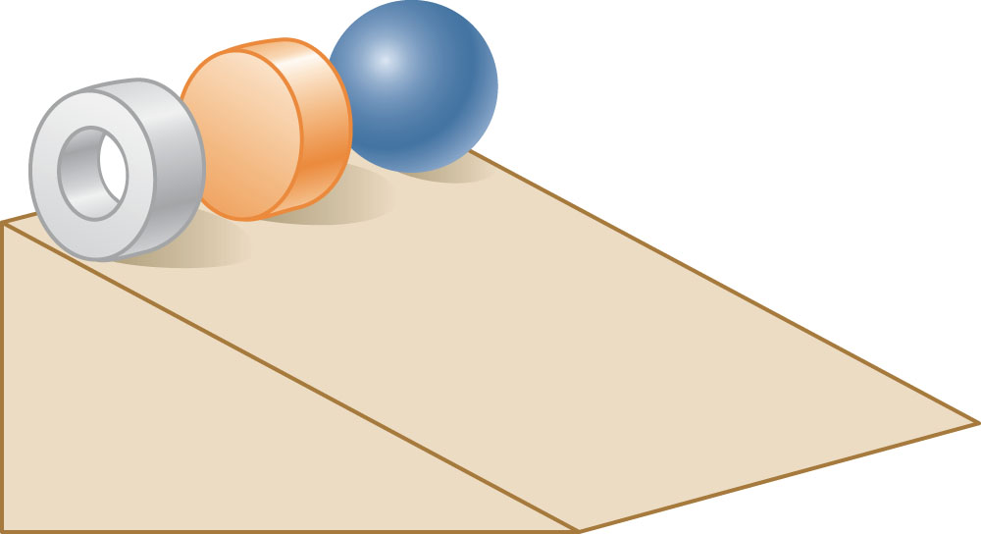
iclicker exercise:
Three round balls, each having a mass M and radius R, start from rest at the top of the incline. After they are released, they roll without slipping down the incline. Which ball will reach the bottom first?
B
C
A

Slide 17
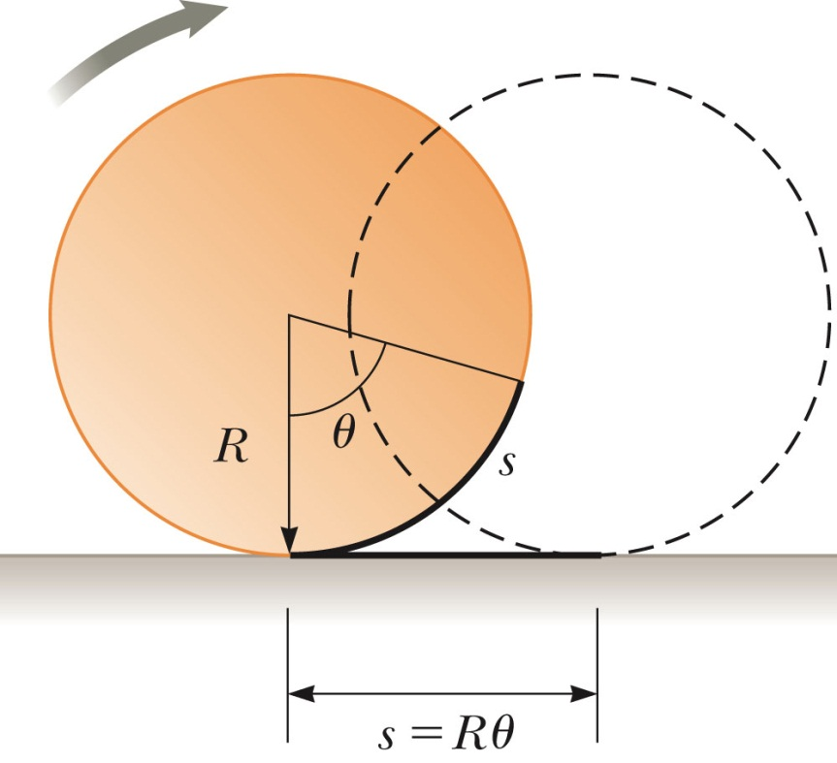

Slide 18
iclicker exercise:
Three round balls, each having a mass M and radius R, start from rest at the top of the incline. After they are released, they roll without slipping down the incline. Which ball will reach the bottom first?
B
C
A

