Slide 1
PHY 113 A General Physics I
9-9:50 AM MWF Olin 101
Plan for Lecture 18:
Chapter 10 – rotational motion
Torque
Conservation of energy including both translational and rotational motion
Notes:
Problems 1.1,1.6,1.10,1.11

Slide 3
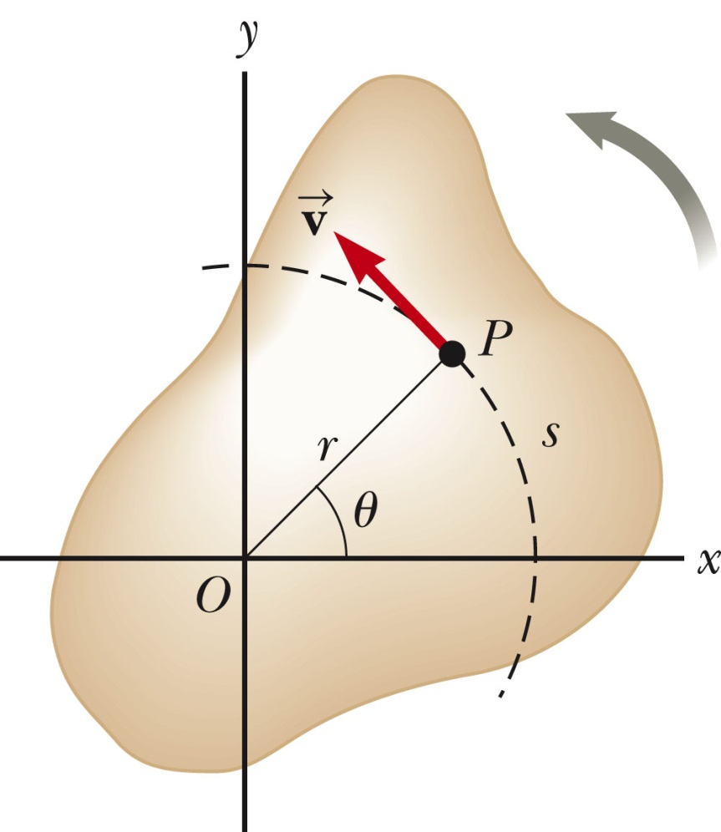
Review of rotational energy associated with a rigid body

Slide 4
Note that for a given center of rotation, any solid object has 3 moments of inertia; some times two or more can be equal
j
m
d
d
m
i
k
iclicker exercise:
Which moment of inertia is the smallest?
(A) i (B) j (C) k
I_{B}=2md²
I_{C}=2md²
I_{A}=0

Slide 5
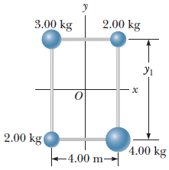
From Webassign:

Slide 6
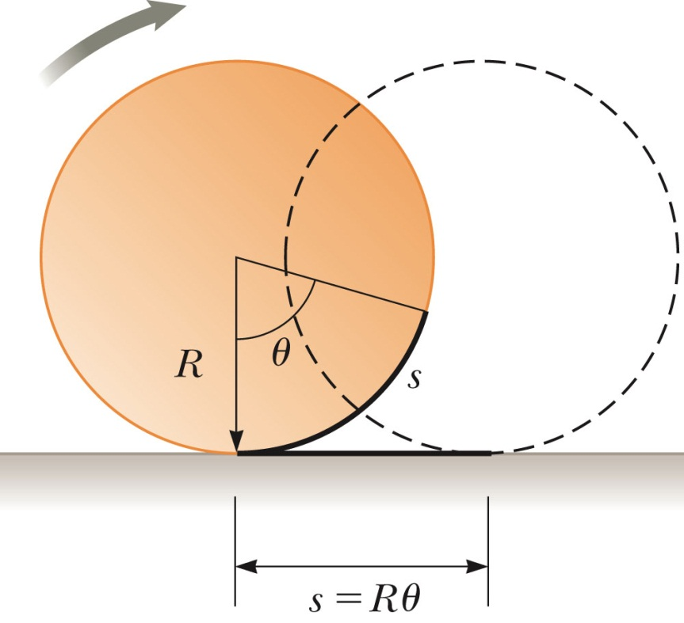
CM
CM

Slide 7
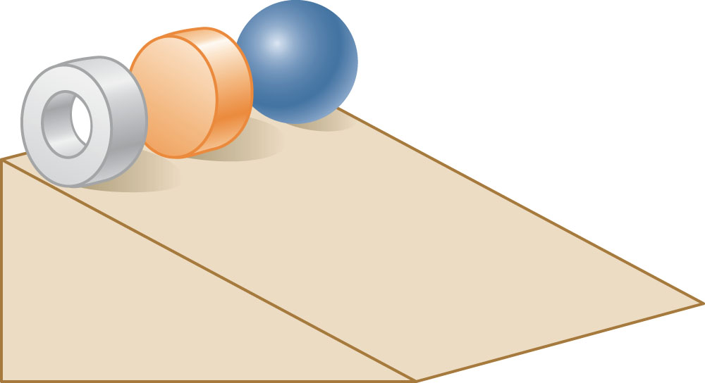
iclicker exercise:
Three round balls, each having a mass M and radius R, start from rest at the top of the incline. After they are released, they roll without slipping down the incline. Which ball will reach the bottom first?
B
C
A

Slide 8
θ
r
How to make objects rotate.
Define torque:
τ = r x F
τ = rF sin θ
F sin θ
θ
F
Note: We will define and use the “vector cross product” next time. For now, we focus on the fact that the direction of the torque determines the direction of rotation.

Slide 9
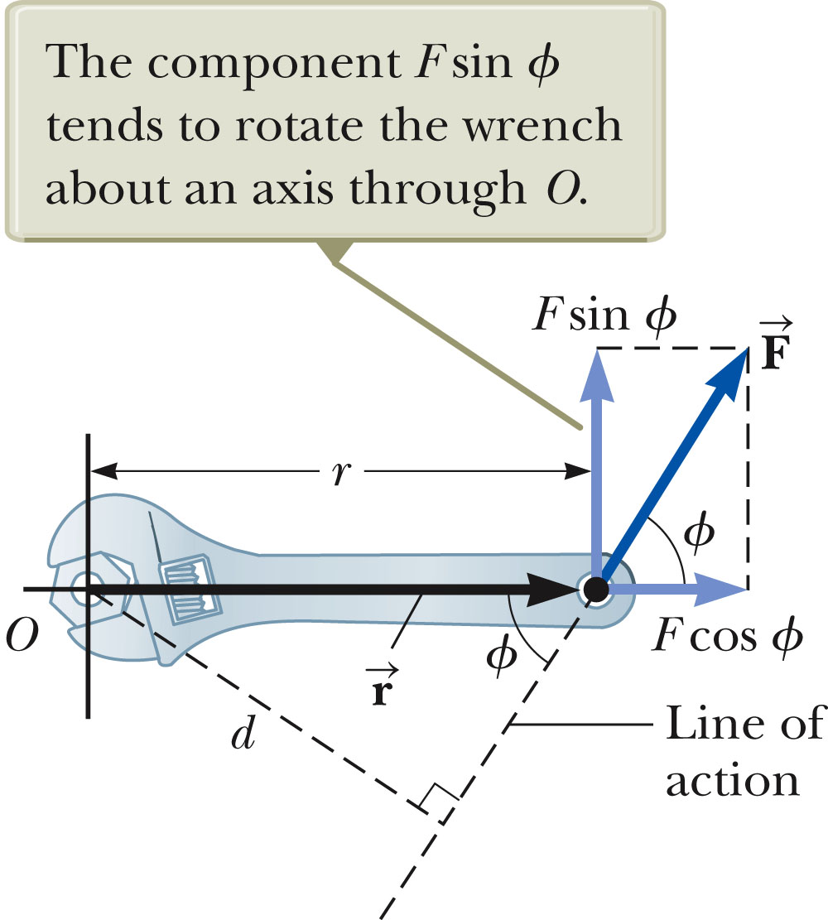
Another example of torque:

Slide 10
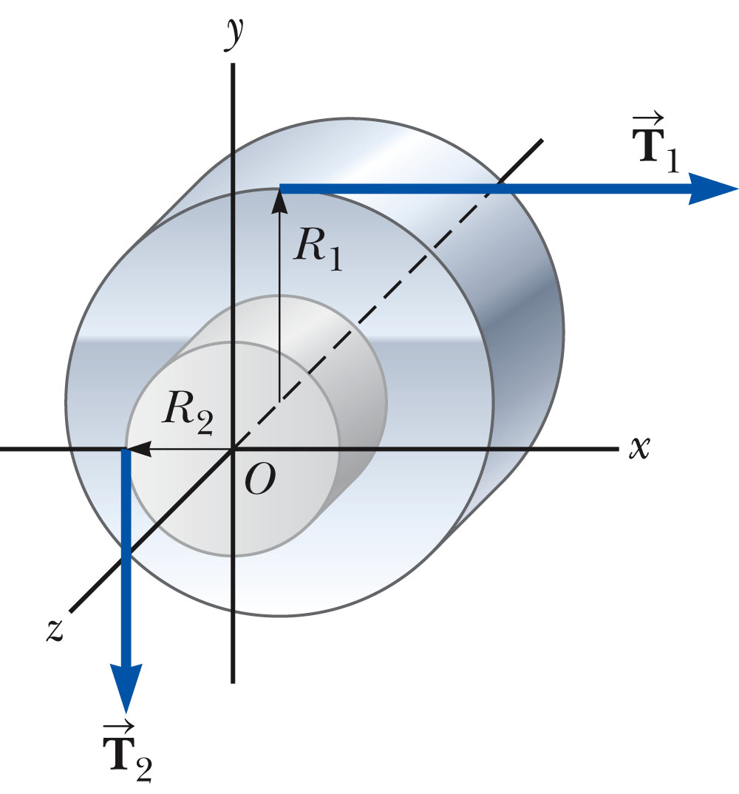

Slide 11
Newton’s second law applied to center-of-mass motion
Newton’s second law applied to rotational motion
r_{i}
d_{i}
m_{i}
F_{i}

Slide 12
An example:
A horizontal 800 N merry-go-round is a solid disc of radius 1.50 m and is started from rest by a constant horizontal force of 50 N applied tangentially to the cylinder. Find the kinetic energy of solid cylinder after 3 s.
F
R
K = ½ I ω² τ = Ι α ω = ω_{i} + αt = αt
In this case I = ½ m R² and τ = FR

Slide 13
Re-examination of “Atwood’s” machine
T₁-m₁g = m₁a
T₂-m₂g = -m₂a
τ =T₂R – T₁R = I α = I a/R
R
I
T₂
T₁
T₁
T₂

Slide 14
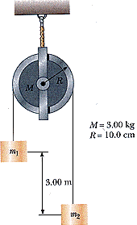
Another example: Two masses connect by a frictionless pulley having moment of inertia I and radius R, are initially separated by h=3m. What is the velocity v=v₂= -v₁ when the masses are at the same height? m₁=2kg; m₂=1kg; I=1kg m² ; R=0.2m .
h
m₁
m₂
v₁
h/2
v₂

Slide 15
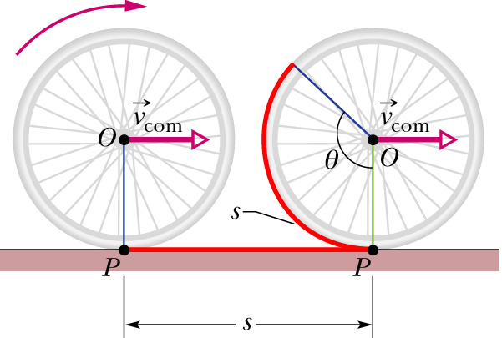
Rolling motion reconsidered:
Kinetic energy associated with rotation:
Distance to axis of rotation
Rolling:

Slide 16
Note that rolling motion is caused by the torque of friction:
Newton’s law for torque:
F
f_{s}

Slide 17
Bicycle or automobile wheel:
τ
f_{s}

Slide 18
iclicker exercise:
What happens when the bicycle skids?
Too much torque is applied
Too little torque is applied
The coefficient of kinetic friction is too small
The coefficient of static friction is too small
More than one of these

