Slide 1
PHY 113 A General Physics I
9-9:50 AM MWF Olin 101
Plan for Lecture 19:
Chapter 11 – angular momentum
Vector cross product
Angular momentum of a rotating rigid object
Conservation of angular momentum
Notes:
Problems 1.1,1.6,1.10,1.11

Slide 3
Previously:
θ
r
How to make objects rotate.
Define torque:
τ = r x F
τ = rF sin θ
F sin θ
θ
F

Slide 5
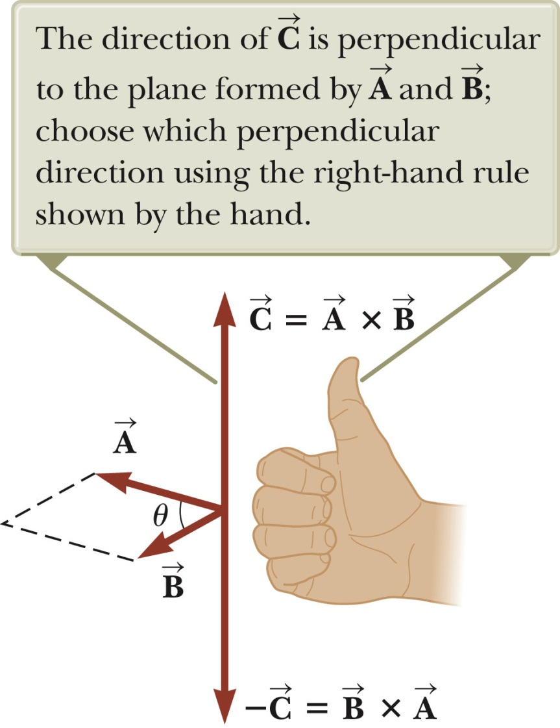
Vector cross product; right hand rule

Slide 6
For unit vectors:
k
j
i

Slide 7
More details of vector cross products:

Slide 8
iclicker exercise:
What is the point of vector products
To terrify physics students
To exercise your right hand
To define an axial vector
To keep track of the direction of rotation

Slide 9
From Newton’s second law:
iclicker exercise:
Is this
Wrong?
Approximately right?
Exactly right?

Slide 10
From Newton’s second law – continued – conservation of angular momentum:

Slide 11
Torque and angular momentum
Define angular momentum:
For composite object: L = Iω
Newton’s law for torque:
In the absence of a net torque on a system,
angular momentum is conserved.

Slide 12
iclicker exercise:
A student sits on a rotatable stool holding a spinning bicycle wheel with angular momentum L_{i}. What happens when the wheel is inverted?
counterclockwise
The student will remain at rest.
The student will rotate counterclockwise.
The student will rotate clockwise.

Slide 13
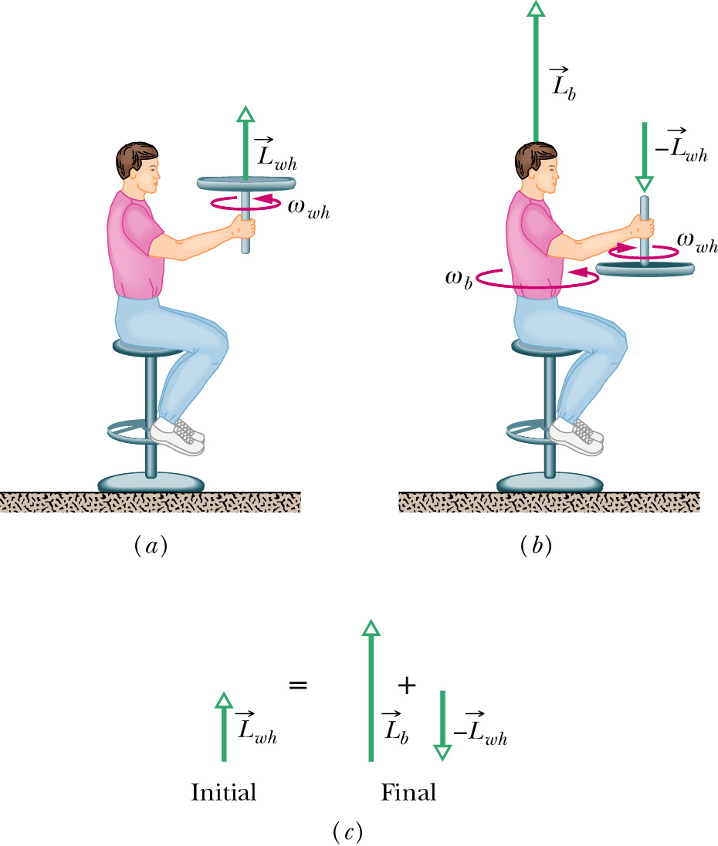
More details:

Slide 14
Other examples of conservation of angular momentum
ω₁
ω₂
m
m
m
m
d₁
d₁
d₂
d₂
I₁=2md₁²
I₂=2md₂²
I₁ω₁=I₂ω₂ ➔ω₂=ω₁ I₁/I₂

Slide 15
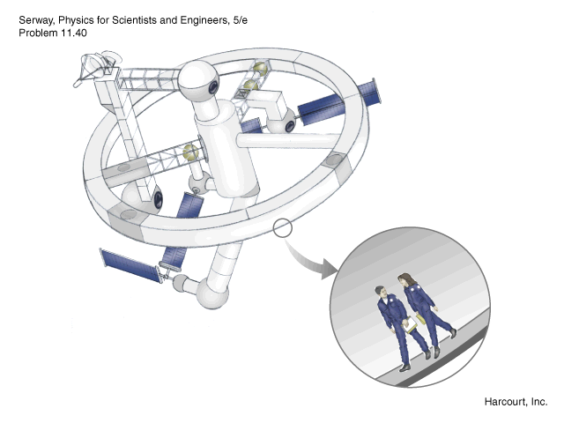
What about centripetal acceleration?
ω
a_{r} = v²/R = ω² R

Slide 16
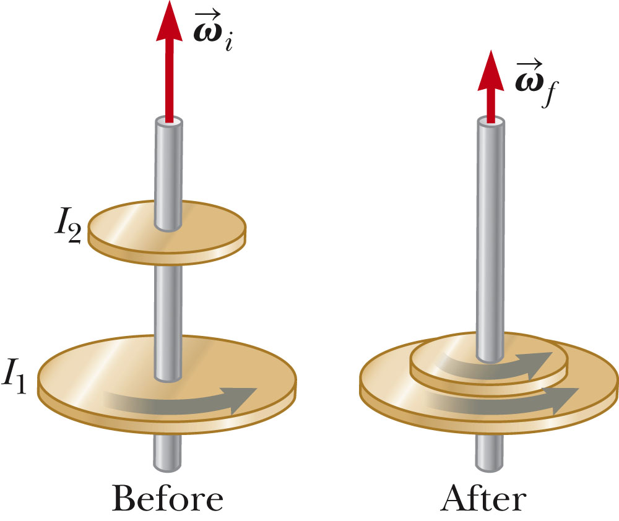
Webassign problem:
A disk with moment of inertia I₁ is initially rotating at angular velocity ω_{i}. A second disk having angular momentum I₂, initially is not rotating, but suddenly drops and sticks to the second disk. Assuming angular moment to be conserved, what would be the final angular velocity ω_{f}?

