Slide 1
PHY 113 A General Physics I
9-9:50 AM MWF Olin 101
Plan for Lecture 2:
Some announcements
Chapter 2 – Motion in one dimension
Position, time, velocity
General examples
Constant velocity
Notes:
Problems 1.1,1.6,1.10,1.11

Slide 2
Some updates/announcements
According to the class vote -- changes to exam schedule:

Slide 3
Some updates/announcements
According to class vote – changes to exam schedule:

Slide 4
Tentative list of exam dates:
Wednesday, September 19, 2012
Monday, October 8, 2012
Friday, November 2, 2012
Wednesday, November 28, 2012

Slide 5
iclicker exercises:
Webassign Experiences so far
Have not tried it
Cannot login
Can login
Have logged in and have completed one or more example problems.
Textbook Experiences
Have no textbook (yet)
Have complete physical textbook
Have electronic version of textbook
Have Volume I physical textbook
Textbook is on order

Slide 6
Starting September 3, 2012
Schedule for Physics 113 Tutorials
5-7 PM in Olin 101
Sunday | Monday | Tuesday | Wednesday | Thursday | Friday
Loah Stevens | Jiajie Xiao | Jiajie Xiao | Stephen Baker | Stephen Baker | Loah Stevens
First Webassign sets “due” on Friday, Sept. 7th
PHY 113 Labs start September 3, 2012
(Please see Eric Chapman in Olin 110 chapmaek@wfu.edu for all of your laboratory concerns)

Slide 7
Motion in one-dimension
 | t(s) | x(m)
A | 0 | 30
B | 10 | 52
C | 20 | 38
D | 30 | 0
E | 40 | -37
F | 50 | -53

Slide 8
Graphical representation of position (displacement) x(t)
t (s)

Slide 9
Comment:
Your text mentions the notion of a “scalar quantity” in contrast to a “vector quantity” which will be introduced in Chapter 3. In most contexts, a scalar quantity – like one-dimensional distance or displacement can be positive or negative.
Another comment:
Your text describes the time rate of change of displacement as “velocity” which, in one-dimension is a signed scalar quantity. In general “speed” is the magnitude of velocity – a positive scalar quantity.

Slide 10
Graphical representation of position (displacement): x(t) ➔ time rate of change of displacement = velocity: v(t)
t (s)

Slide 11
Instantaneous velocity
v_{B}
v_{C}
v_{A}
v_{D}
v_{E}
v_{F}
t (s)

Slide 12
Demonstration of tangent line limit

Slide 13
Average velocity versus instantaneous velocity

Slide 14
Average velocity
iclicker exercise:
This results is:
Exact
Approximate

Slide 15
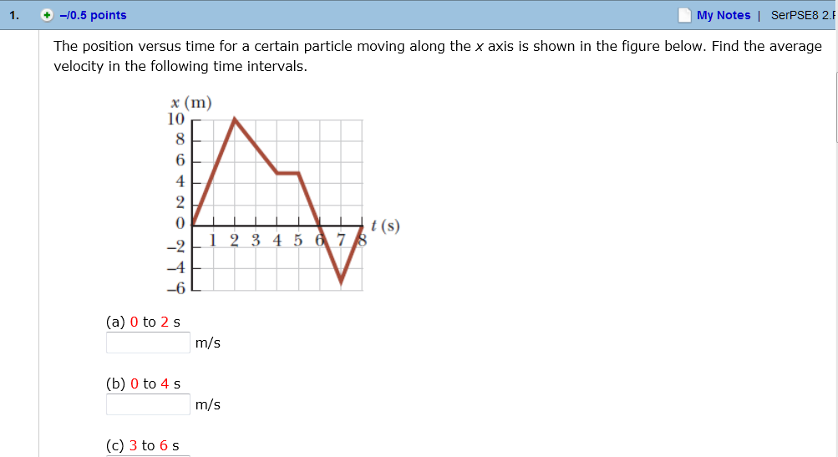
Webassign Example

Slide 16
Instantaneous velocity using calculus

Slide 17
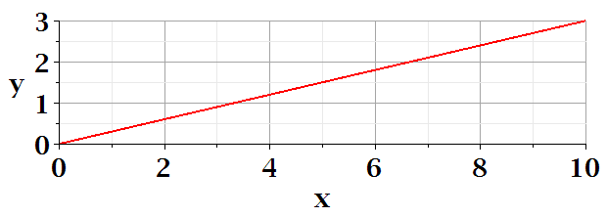
Anti-derivative relationship
x
t

