Slide 1
PHY 113 A General Physics I
9-9:50 AM MWF Olin 101
Plan for Lecture 20:
Chapter 12 – Static equilibrium
  Balancing forces and torques; stability
  Center of gravity
  Note: May not have time to cover elastic properties of materials
Notes:
Problems 1.1,1.6,1.10,1.11

Slide 2
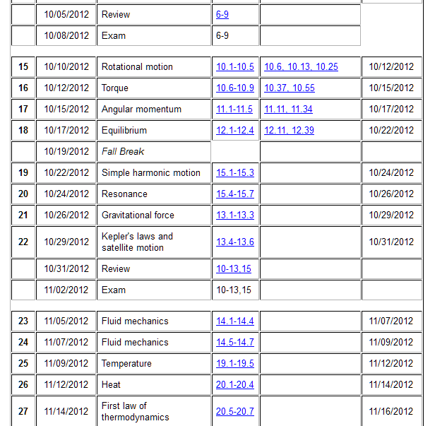

Slide 3
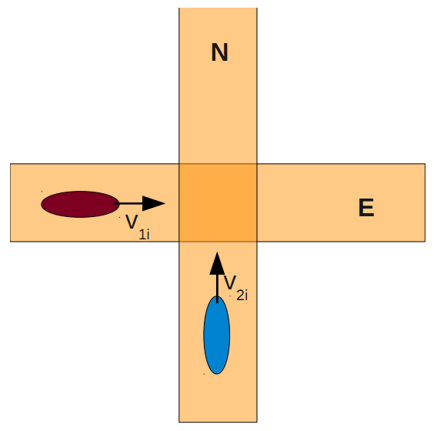
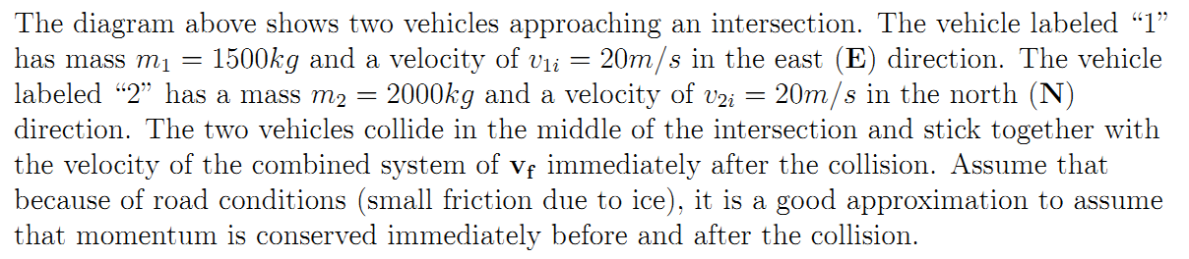
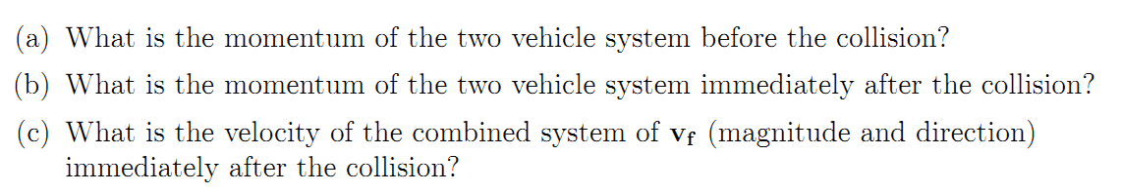
Comment on exam question #4

Slide 4
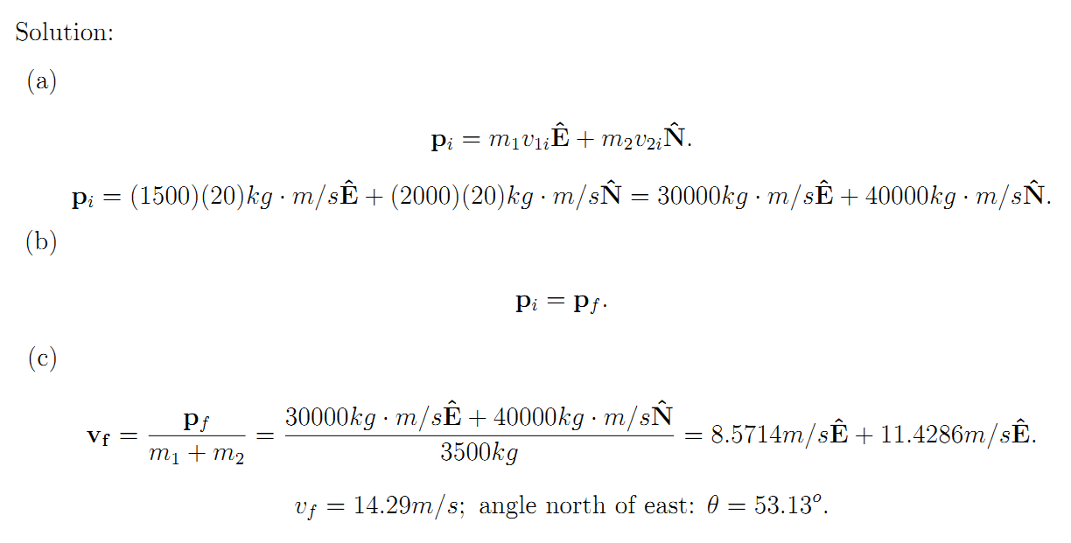

Slide 5
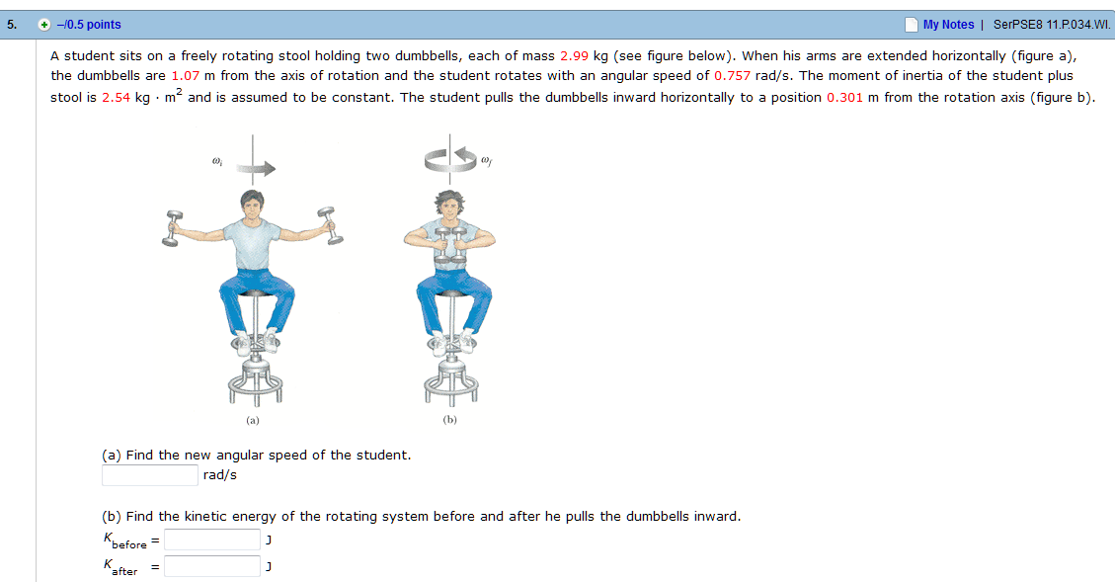
From Webassign #17 (11.34)

Slide 6
Conditions for stable equilibrium

Slide 7
Stability of “rigid bodies”
N
m_{i}g

Slide 8
Center-of-mass
Torque on an extended object due to gravity (near surface of the earth) is the same as the torque on a point mass M located at the center of mass.
m_{i}
r_{i}
r_{CM}

Slide 9
Notion of equilibrium:
Notion of stability:
T- mg cos θ = 0
−mg sin θ = −ma_{θ}
F=ma ➔
r
θ
T
τ=I α ➔
r mg sin θ = mr² α = mra_{θ}
Example of stable equilibrium.
mg(-j)

Slide 10
Unstable equilibrium:
Support above CM:
Support below CM:
r
θ
T
mg(-j)

Slide 11
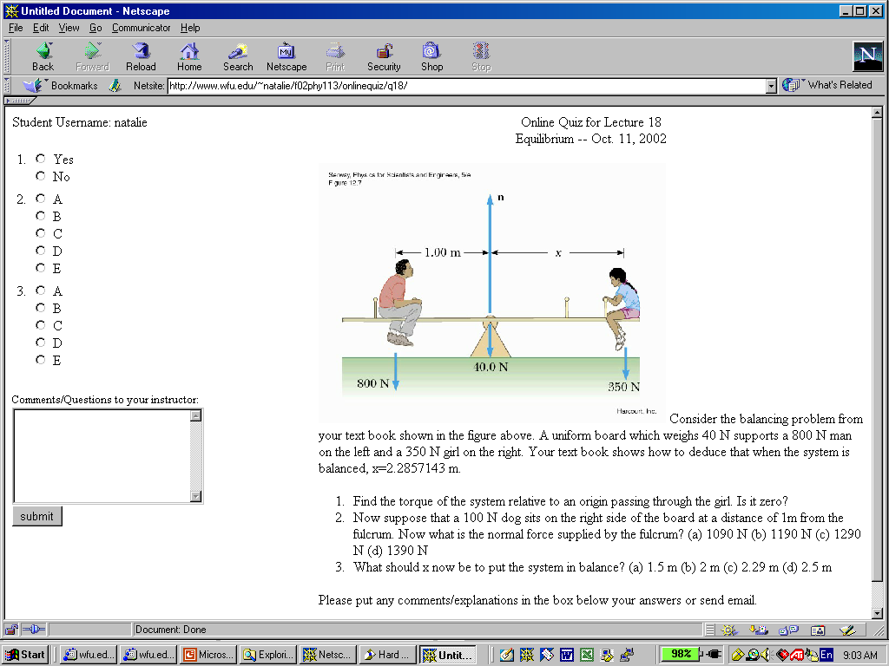
Analysis of stability:

Slide 12
X
**

Slide 13
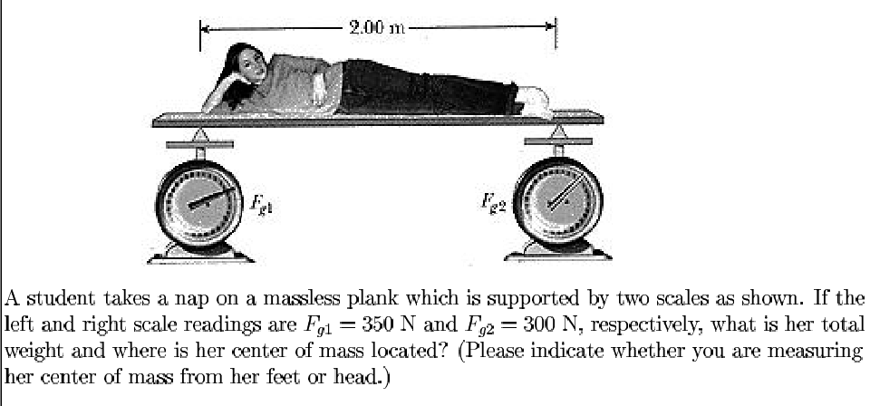

Slide 14
R_{CM}
F_{g1}
X
**
mg

Slide 15
iclicker question:
F₁
F₂
L/3
Mg
mg
L
Consider the above drawing of the two supports for a uniform plank which has a total weight Mg and has a weight mg at its end. What can you say about F₁ and F₂?
F₁ and F₂ are both up as shown.
F₁ is up but F₂ is down.
F₁ is down but F₂ is up.

Slide 16
F₁
F₂
X
**
L/3
Mg
mg
L

Slide 17
iclicker question:
The fact that we found F₁<0 means:
  We set up the problem incorrectly
  The analysis is correct, but the direction of F₁ is opposite to the arrow
  Physics makes no sense
iclicker question:
What would happen if we analyzed this problem by placing the pivot point at F₁ ?:
  The answer would be the same.
  The answer would be different.
  Physics makes no sense

Slide 18
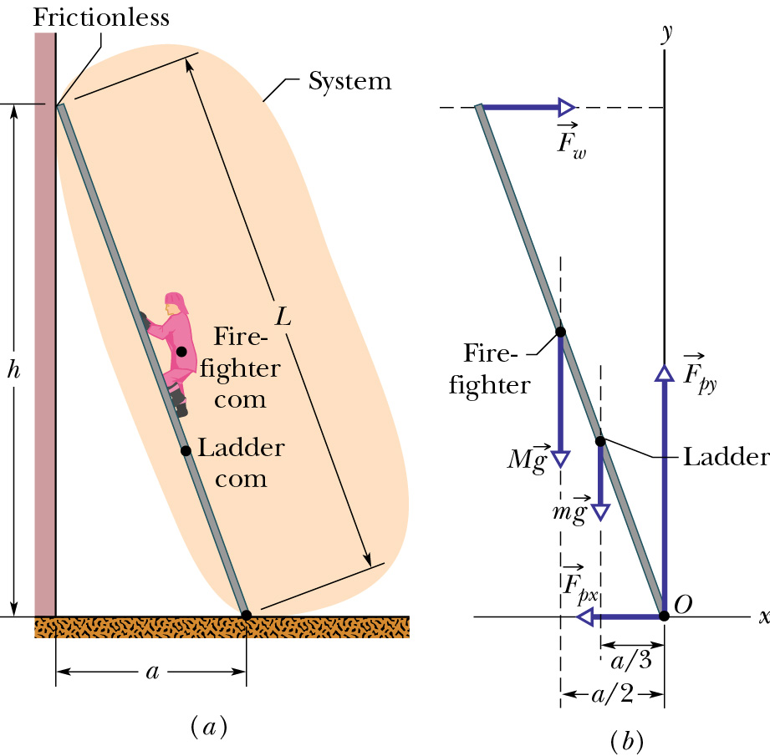

Slide 19
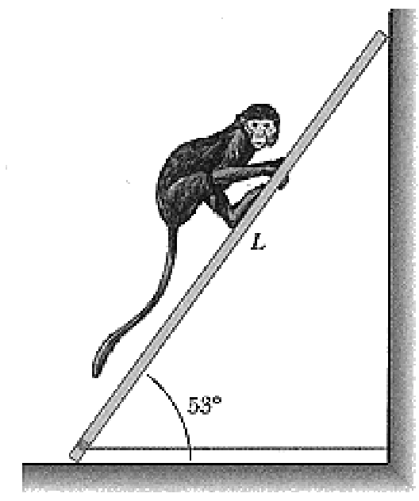
F_{wall}
Mg = 120 N
mg = 98 N
T < 110 N
mg
Mg
N
T

