Slide 1
PHY 113 A General Physics I
9-9:50 AM MWF Olin 101
Plan for Lecture 21:
Chapter 15 – Simple harmonic motion
Object attached to a spring
Displacement as a function of time
Kinetic and potential energy
Pendulum motion
Notes:
Problems 1.1,1.6,1.10,1.11

Slide 3
iclicker exercise:
Why did your textbook develop a whole chapter on oscillatory motion?
Because the authors like to torture students.
Because it is different from Newton’s laws and needs many pages to explain.
Because it is an example of Newton’s laws and needs many pages to explain.
iclicker exercise:
Simple harmonic motion has a characteristic time period T. What determines T?
The characteristics of the physical system.
The initial displacements or velocities.
It is not possible to know T.

Slide 4
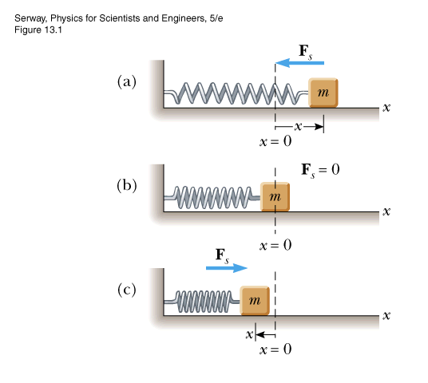
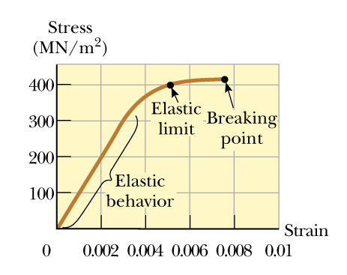
Behavior of materials:
Hooke’s law
F_{s} = -k(x-x₀)
Young’s modulus
x₀ =0

Slide 5
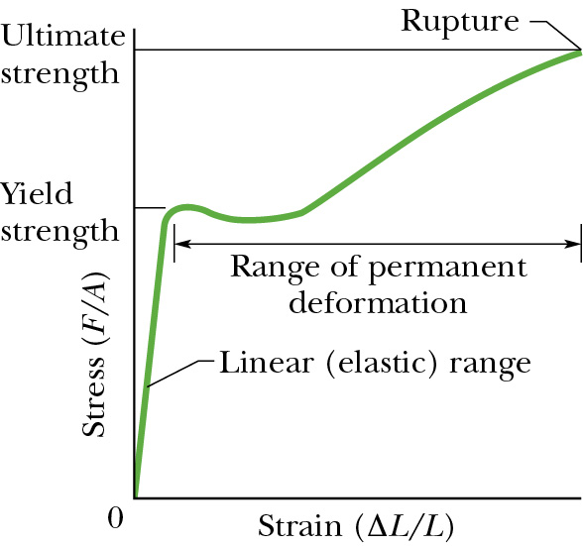
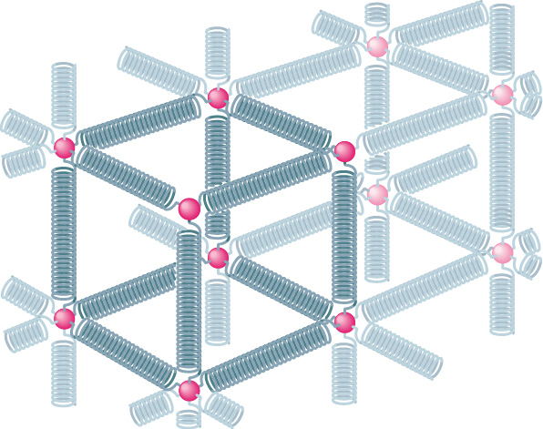
Microscopic picture of material with springs representing bonds between atoms
Measurement of elastic response:
k

Slide 6
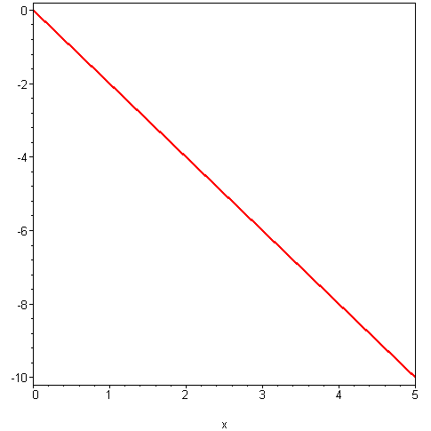
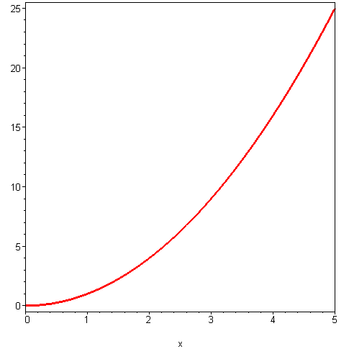
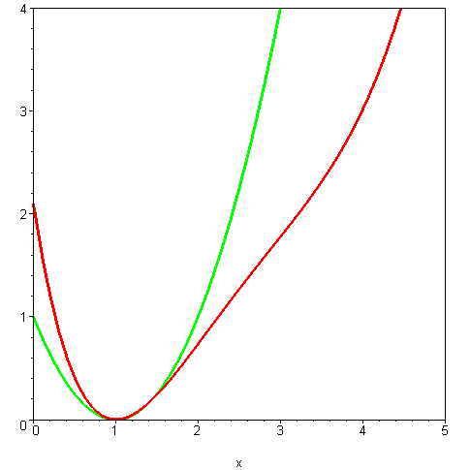
Form of Hooke’s law for
ideal system:
Potential energy associated
with Hooke’s law:
U_{s} = ½ k x²
F_{s} = -kx
F_{s} (N)
U_{s} (J)
x
x
U_{s} = ½ k (x-1)²
General potential energy curve:
U (J)
U(x)
x

Slide 7
In addition to the spring-mass system, Hooke’s law approximates many physical systems near equilibrium.

Slide 8
Motion associated with Hooke’s law forces
Newton’s second law:
F = -k x = m a
➔ “second-order” linear differential equation

Slide 9
How to solve a second order linear differential equation:
Earlier example – constant force F₀ ➔ acceleration a₀
x(t) = x₀ +v₀t + ½ a₀ t²
2 constants (initial values)

Slide 10
Hooke’s law motion:
Forms of solution:
where:
2 constants (initial values)

Slide 11
Verification:
Differential relations:
Therefore:

Slide 13
iclicker exercise:
Which of the following other possible guesses would provide a solution to Newton’s law for the mass-spring system:

Slide 16
“Simple harmonic motion” in practice
A block with a mass of 0.2 kg is connected to a light spring for which the force constant is 5 N/m and is free to oscillate on a horizontal, frictionless surface. The block is displaced 0.05 m from equilibrium and released from rest. Find its subsequent motion.
ω =
x(t)= A cos (ωt+φ) x(0) = A cos (φ) = 0.05 m
v(t)=-Aωsin (ωt+φ) v(0)=-Aωsin (φ) = 0 m/s
➔ φ = 0 and A = 0.05 m

Slide 17
iclicker exercise:
A certain mass m on a spring oscillates with a characteristic frequency of 2 cycles per second. Which of the following changes to the mass would increase the frequency to 4 cycles per second?
(a) 2m (b) 4m (c) m/2 (d) m/4

Slide 18
Summary --
Simple harmonic motion:
Note that:
Conveniently evaluated in radians
Constants

Slide 19
Energy associated with simple harmonic motion

Slide 20
Energy associated with simple harmonic motion

Slide 21
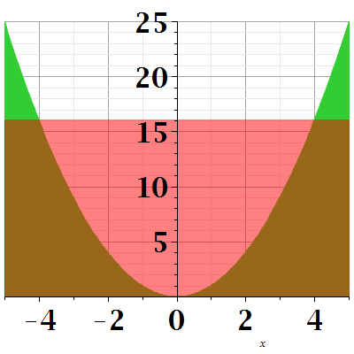
Energy diagram:
U(x)=1/2 k x²
E=1/2 k A²
K
x
A

Slide 22
Effects of gravity on spring motion
x=0

Slide 23
Simple harmonic motion for a pendulum:
L
Θ
Approximation for small Θ:

Slide 24
Pendulum example:
Suppose L=2m, what is the period of the pendulum?
L
Θ

