Slide 1
PHY 113 A General Physics I
9-9:50 AM MWF Olin 101
Plan for Lecture 22:
Chapter 15 – Simple harmonic motion
Object attached to a spring and pendulum motion
Resonance phenomena
Note: We will not thoroughly cover damping and the analogy to circular motion.
Notes:
Problems 1.1,1.6,1.10,1.11

Slide 3
Comment on final exam

Slide 5
Energy associated with simple harmonic motion

Slide 6
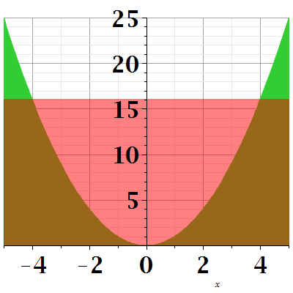
Energy diagram:
U(x)=1/2 k x²
E=1/2 k A²
K
x
A

Slide 7
Simple harmonic motion for a pendulum:
L
Θ
Approximation for small Θ:

Slide 8
Pendulum example:
Suppose L=2m, what is the period of the pendulum?
L
Θ

Slide 9
iclicker exercise:
What happens if Θ is too large?
The frequency of oscillation will no longer be constant
The pendulum will no longer oscillate
Energy will be lost even if air friction is negligible

Slide 10
The notion of resonance:
Suppose F=-kx+F₀ sin(Ωt)
According to Newton:

Slide 11
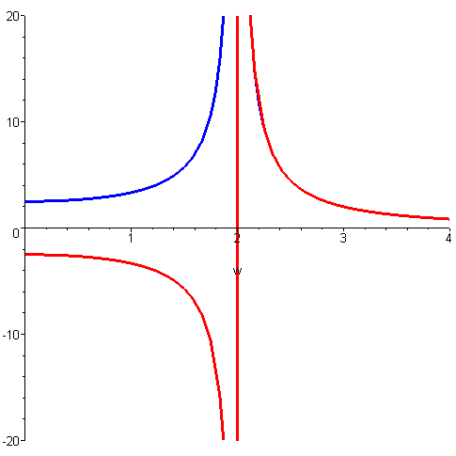
Physics of a “driven” harmonic oscillator:
“driving” frequency
“natural” frequency
(mag)
(Ω=2rad/s)
ω

Slide 12
F(t)=1 N sin (3t)
Examples:
Suppose a mass m=0.2 kg is attached to a spring with k=1.81N/m and an oscillating driving force as shown above. Find the steady-state displacement x(t).
Note: If k=1.90 N/m then:

Slide 13
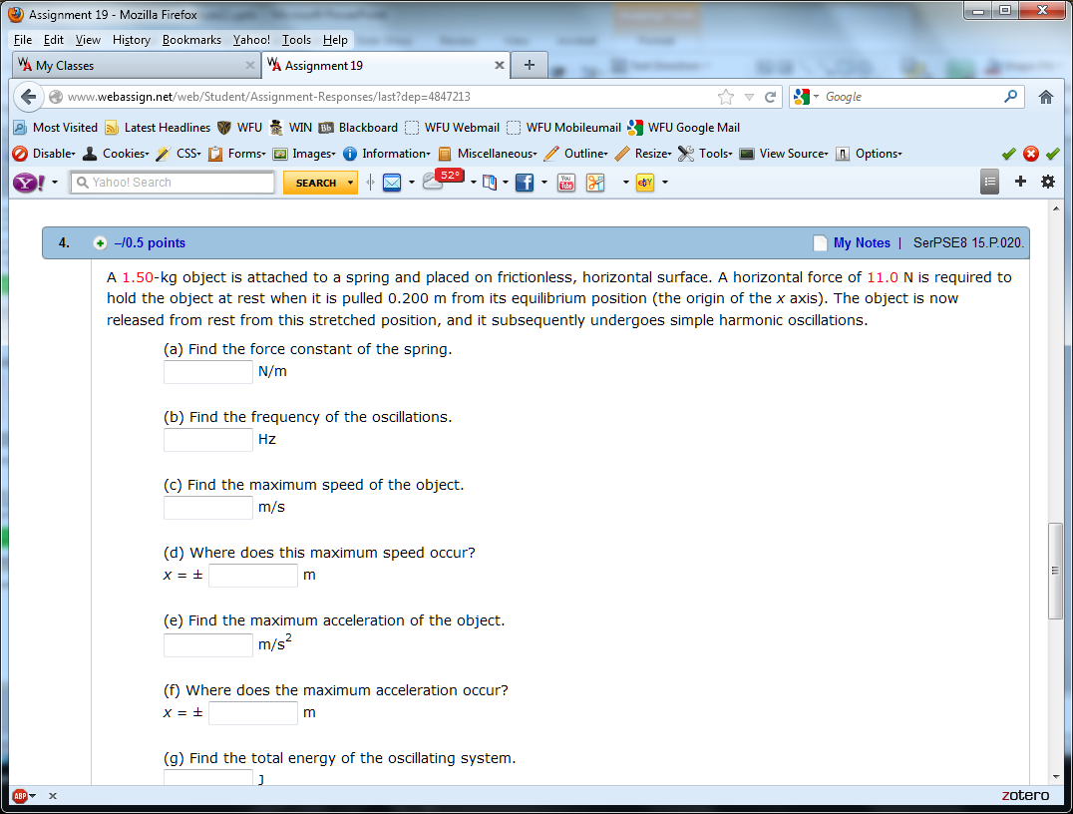
Examples:
From Assignment 19

Slide 16
More examples:
From Assignment 20

Slide 18
Tacoma Narrows bridge resonance
Images from Wikipedia
Rebuilt bridge in Tacoma WA

Slide 19
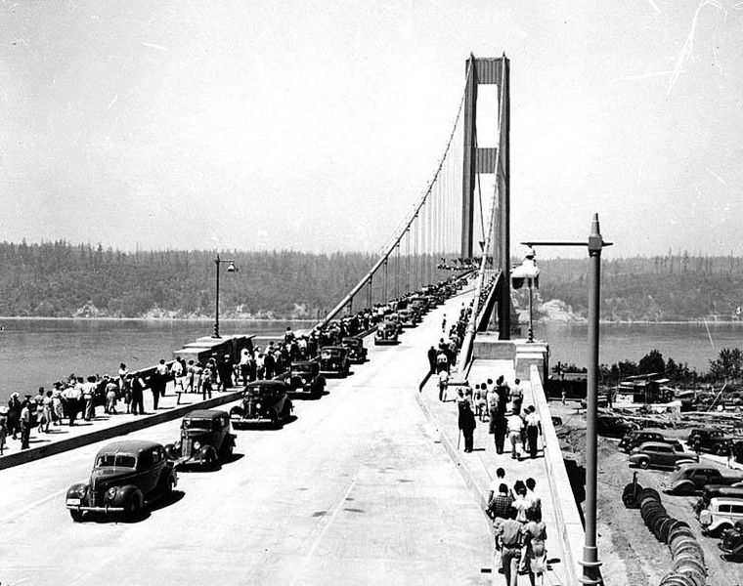
Bridge in July, 1940

Slide 20
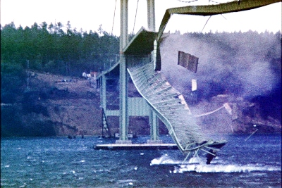
Collapse of bridge on Nov. 7, 1940
http://en.wikipedia.org/wiki/Tacoma_Narrows_Bridge_%281940%29

