Slide 1
PHY 113 A General Physics I
9-9:50 AM MWF Olin 101
Plan for Lecture 23:
Chapter 13 – Fundamental force of gravity
Relationship with g near earth’s surface
Orbital motion due to gravity
Kepler’s orbital equation
Note: We will probably not emphasize elliptical orbits in this chapter.
Notes:
Problems 1.1,1.6,1.10,1.11

Slide 3
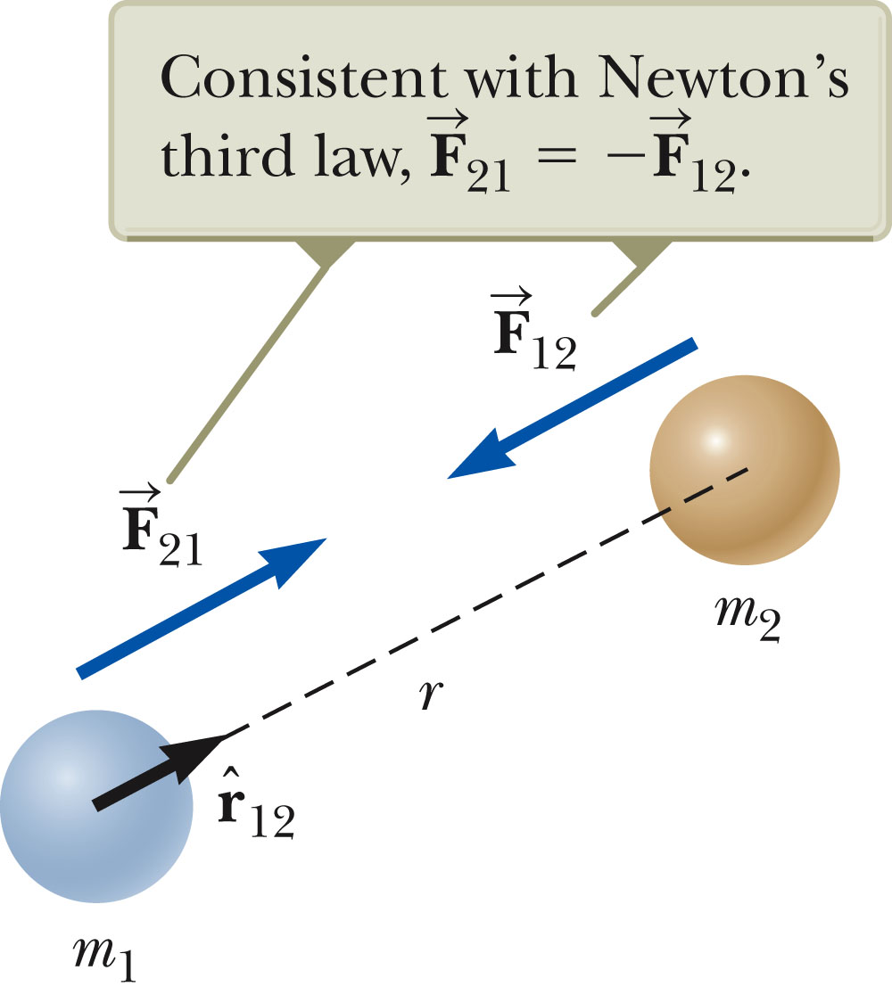
Universal law of gravitation
➔ Newton (with help from Galileo, Kepler, etc.) 1687

Slide 4
Newton’s law of gravitation: m₂ attracts m₁ according to:
y
m₁
r₂−r₁
G=6.67 x 10⁻¹¹ N m²/kg²
m₂
r₁
r₂
x

Slide 5
Vector nature of Gravitational law:
y
m₃
d
m₁
m₂
x
d

Slide 6
Gravitational force of the Earth
R_{E}
m

Slide 7
Question:
Suppose you are flying in an airplane at an altitude of 35000ft~11km above the Earth’s surface. What is the acceleration due to Earth’s gravity?
a/g = 0.997

Slide 8
Attraction of moon to the Earth:
Acceleration of moon toward the Earth:
F = M_{M} a ➔ a = 1.99x20²⁰ N/7.36x10²²kg =0.0027 m/s²

Slide 9
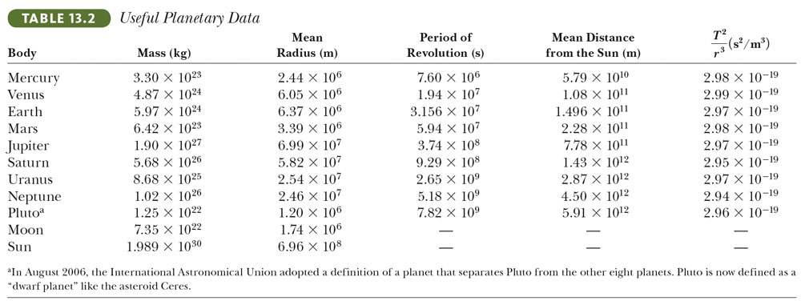

Slide 10
Gravity on the surface of the moon
Gravity on the surface of mars

Slide 11
iclicker question:
In estimating the gravitational acceleration near the surfaces of the Earth, Moon, or Mars, we used the full mass of the planet or moon, ignoring the shape of its distribution. This is a reasonable approximation because:
The special form of the gravitational force law makes this mathematically correct.
Most of the mass of the planets/moon is actually concentrated near the center of the planet/moon.
It is a very crude approximation.

Slide 12
Stable circular orbit of two gravitationally attracted objects (such as the moon and the Earth)
R_{EM}
F
v
a

Slide 13
iclicker question:
In the previous discussion, we saw how the moon orbits the Earth in a stable circular orbit because of the radial gravitational attraction of the moon and Newton’s second law: F=ma, where a is the centripetal acceleration of the moon in its circular orbit. Is this the same mechanism which stabilizes airplane travel? Assume that a typical cruising altitude of an airplane is 11 km above the Earth’s surface and that the Earth’s radius is 6370 km.
(a) Yes (b) No

Slide 14
Stable (??) circular orbit of two gravitationally attracted objects (such as the airplane and the Earth)
R_{Ea}
F
v
a

Slide 15
Newton’s law of gravitation:
Earth’s gravity:
Stable circular orbits of gravitational attracted objects:
R_{E}
m
R_{EM}
F
v
M_{M}
a

Slide 16
More details
If we examine the circular orbit more carefully, we find that the correct analysis is that the stable circular orbit of two gravitationally attracted masses is about their center of mass.
m₂
R₂
R₁
m₁

Slide 17
Radial forces on m₁:
m₂
R₂
R₁
m₁
T₂ ?

Slide 18
iclicker question:
What is the relationship between the periods T₁ and T₂ of the two gravitationally attracted objects rotating about their center of mass? (Assume that m₁ < m₂.)
(A) T₁=T₂ (B) T₁<T₂ (C) T₁>T₂
m₂
R₂
R₁
m₁

Slide 19
m₂
R₂
R₁
m₁

Slide 20
iclicker questions:
How is it possible that all of these relations are equal?
Magic.
Trick.
Algebra.

Slide 21
What is the physical basis for stable circular orbits?
Newton’s second law?
Conservation of angular momentum? L = (const)
Note: Gravitational forces exert no torque

Slide 22
v₂
m₂
R₂
R₁
L₁=m₁v₁R₁
L₂=m₂v₂R₂
v₁
m₁
Question:
How are the magnitudes of L₁ and L₂ related?
Note: More generally, stable orbits can be elliptical.

Slide 23
Satellites orbiting earth (approximately circular orbits):
R_{E} ~ 6370 km
Examples:
Satellite | h (km) | T (hours) | v (mi/h)
Geosynchronous | 35790 | ~24 | 6900
NOAA polar orbitor | 800 | ~1.7 | 16700
Hubble | 600 | ~1.6 | 16900
Inter. space station* | 390 | ~1.5 | 17200

Slide 24
Planets in our solar system – orbiting the sun
Planet | Mass (kg) | Distance to Sun (m) | Period of orbit (years)
Mercury | 3.30x10²³ | 5.79x10¹⁰ | 0.24
Venus | 4.87x10²⁴ | 1.08x10¹¹ | 0.61
Earth | 5.97x10²⁴ | 1.496x10¹¹ | 1.00
Mars | 6.42x10²³ | 2.28x10¹¹ | 1.88
Jupter | 1.90x10²⁷ | 7.78x10¹¹ | 11.85
Saturn | 5.68x10²⁶ | 1.43x10¹² | 29.43

