Slide 1
PHY 113 A General Physics I
9-9:50 AM MWF Olin 101
Plan for Lecture 24:
Chapter 13 – Fundamental force of gravity
Form of gravitation force law
Gravitational potential energy
Conservation of energy
Energy associated with orbital motion
Note: We will not focus attention on elliptical orbits, black holes, and dark matter
Notes:
Problems 1.1,1.6,1.10,1.11

Slide 3
iclicker question:
Concerning prepartion for Friday’s exam –
I’m good (OK with studying on my own and with the help of the already scheduled tutorials)
I would likely attend an extra class reviewing session (probably Tuesday or Thursday)
I would like to make an individual appointment to go over my specific questions
None of these.
iclicker followup question:
Concerning extra review session –
I could attend on Tuesday afternoon
I could attend on Thursday afternoon

Slide 4
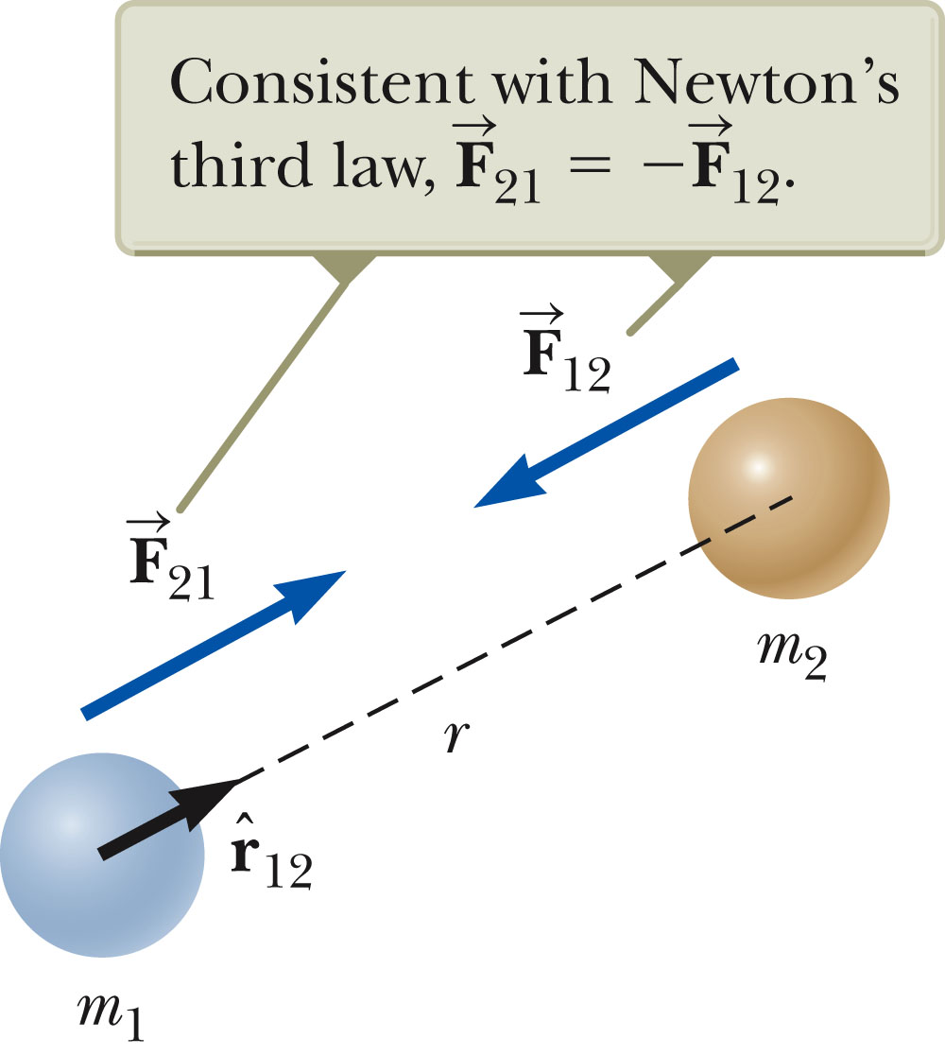
Review: Universal law of gravitation
➔ Newton (with help from Galileo, Kepler, etc.) 1687

Slide 5
Review: Gravitational force of the Earth
R_{E}
m
Note: Earth’s gravity acts as a point mass located at the Earth’s center.

Slide 6
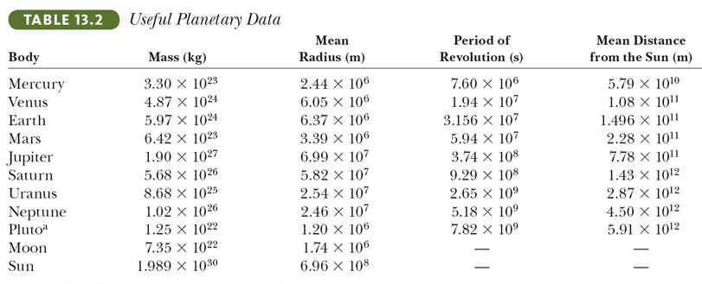

Slide 7
Review: Circular orbital motion about center of mass
v₂
m₂
R₂
R₁
CM
v₁
m₁

Slide 8
Review: Circular orbital motion about center of mass
m₂
R₁
v₁
m₁

Slide 9
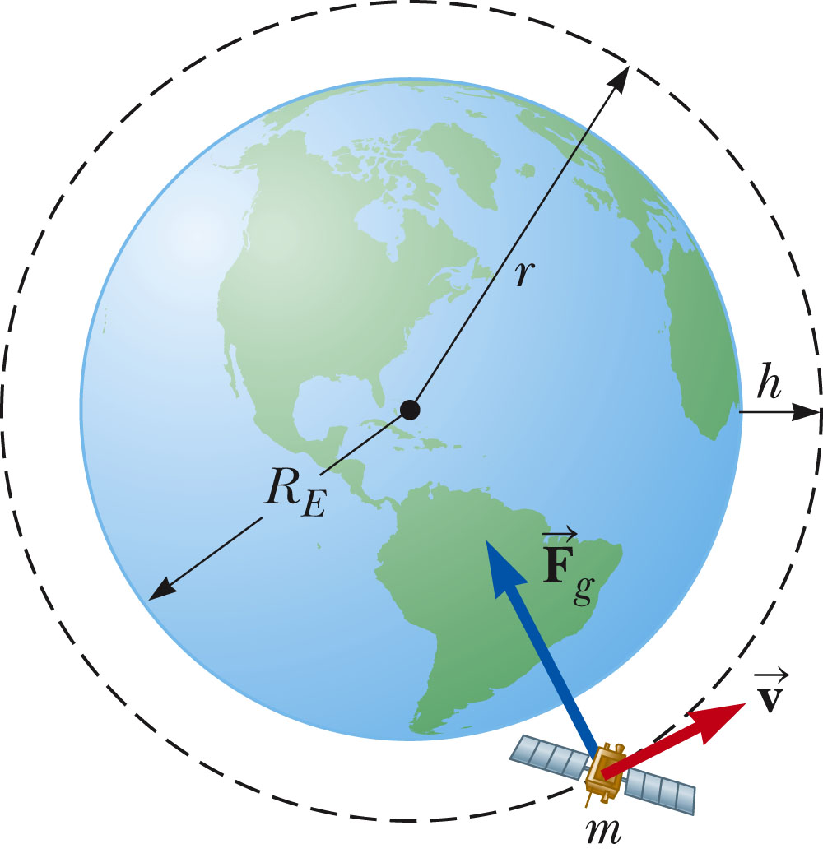
Example: Satellite in circular Earth orbit

Slide 10
Work of gravity:
r_{i}
r_{f}

Slide 11
Gravitational potential energy
Example:

Slide 12
U=mgh
h
iclicker exercise:
We previously have said that the gravitational potential of an object of mass m at a height h is
U=mgh. How is this related to
No relation
They are approximately equal
They are exactly equal

Slide 13
h
Near the surface of the Earth
U=mgh is a good approximation
to the gravitation potential.
g

Slide 14
iclicker exercise:
How much energy kinetic energy must be provided to an object of mass m=1000kg, initially on the Earth’s surface to outer space?
This is rocket science and not a fair question.
It is not possible to escape the Earth’s gravitational field.
We can estimate the energy by simple conservation of energy concepts.

Slide 15
Total energy of a satellite in a circular Earth orbit

Slide 16
Total energy of a satellite in a circular Earth orbit
iclicker question:
Compared to the energy needed to escape the Earth’s gravitational field does it take
more
less
energy to launch a satellite to orbit the Earth?

Slide 18
Energy involved with changing orbits
h’

Slide 19
From Webassign:

