Slide 1
PHY 113 A General Physics I
9-9:50 AM MWF Olin 101
Plan for Lecture 25:
Review: Chapters 10-13, 15
Advice on how to prepare for exam
Review of rotational motion, angular momentum, static equilibrium, simple harmonic motion, universal gravitational force law
Notes:
Problems 1.1,1.6,1.10,1.11

Slide 3
Format of Friday’s exam
What to bring:
Clear, calm head
Equation sheet (turn in with exam)
Scientific calculator
Pencil or pen
(Note: labtops, cellphones, and other electronic equipment must be off or in sleep mode.)
Timing:
May begin as early as 8 AM; must end ≤ 9:50 AM
Probable exam format
4-5 problems similar to homework and class examples; focus on Chapters 10-13 & 15 of your text.
Full credit awarded on basis of analysis steps as well as final answer

Slide 4
Examples of what to include on equation sheet
Given information on exam | Suitable for equation sheet
Universal or common constants (such as g, G, M_{E}, M_{S}, R_{E}…) | Basic equations from material from earlier Chapters: Newton’s laws, energy, momentum, center of mass
Particular constants (such as k,m,I… ) | Simple derivative and integral relationships, including trigonometric functions
Unit conversion factors such as Hz and rad/s | Definition of moment of inertia, torque, angular momentum, rotational kinetic energy
 | Newton’s law for rotational motion; combination of rotational and center of mass motion
 | Equations describing simple harmonic motion and driven harmonic motion
 | Newton’s universal gravitation force law and corresponding gravitational potential energy
 | Gravitational stable circular orbits

Slide 5
Possible extra review session on Thursday:
iclicker question:
Which of the following possible times would work with your schedules (vote for one)?
2 PM
3 PM
4 PM
Prefer to meet individually or in small groups in my office (Olin 300).

Slide 6
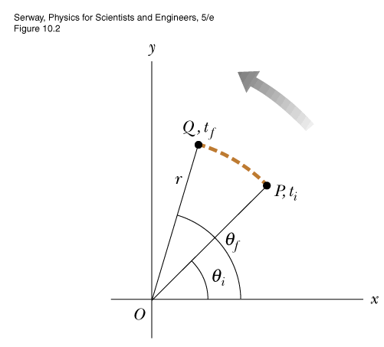
Rotations: Angular variables
angular “displacement” ➔ θ(t)
angular “velocity” ➔
angular “acceleration” ➔
“natural” angular unit = radian
Relation to linear variables:
s_{θ} = r (θ_{f}-θ_{i})
v_{θ} = r ω
a_{θ} = r α
s

Slide 7
Object rotating with constant angular velocity (α = 0)
ω
v_{i}=r_{i}ω
m_{i}
R
v=Rω
v=0
Kinetic energy associated with rotation:
“moment of inertia”

Slide 8
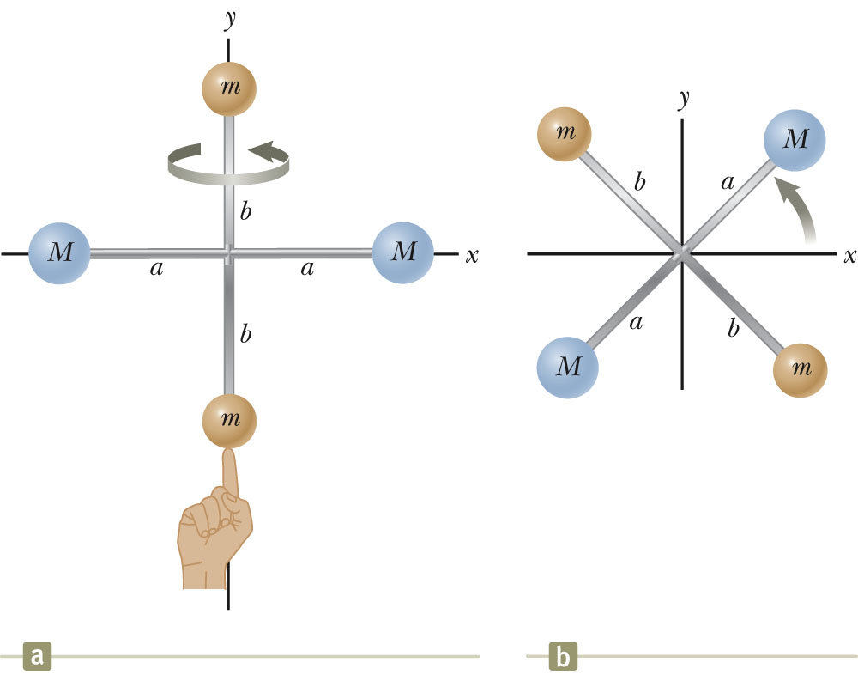
Moment of inertia:

Slide 9
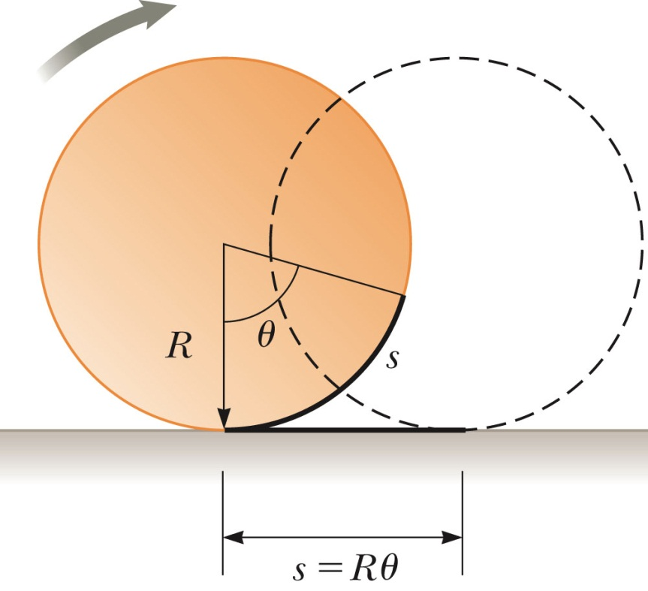

Slide 10
θ
r
How to make objects rotate.
Define torque:
τ = r x F
τ = rF sin θ
F sin θ
θ
F
Note: We will define and use the “vector cross product” next time. For now, we focus on the fact that the direction of the torque determines the direction of rotation.

Slide 11
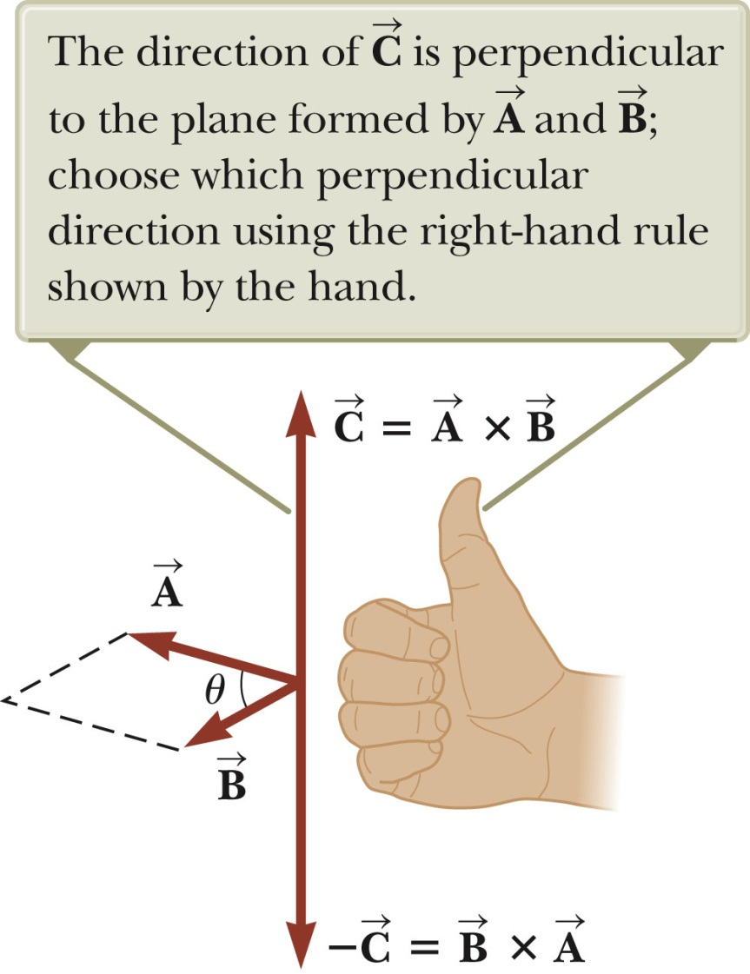
Vector cross product; right hand rule

Slide 12
Note that rolling motion is caused by the torque of friction:
Newton’s law for torque:
F
f_{s}

Slide 13
Torque and Newton’s second law:

Slide 14
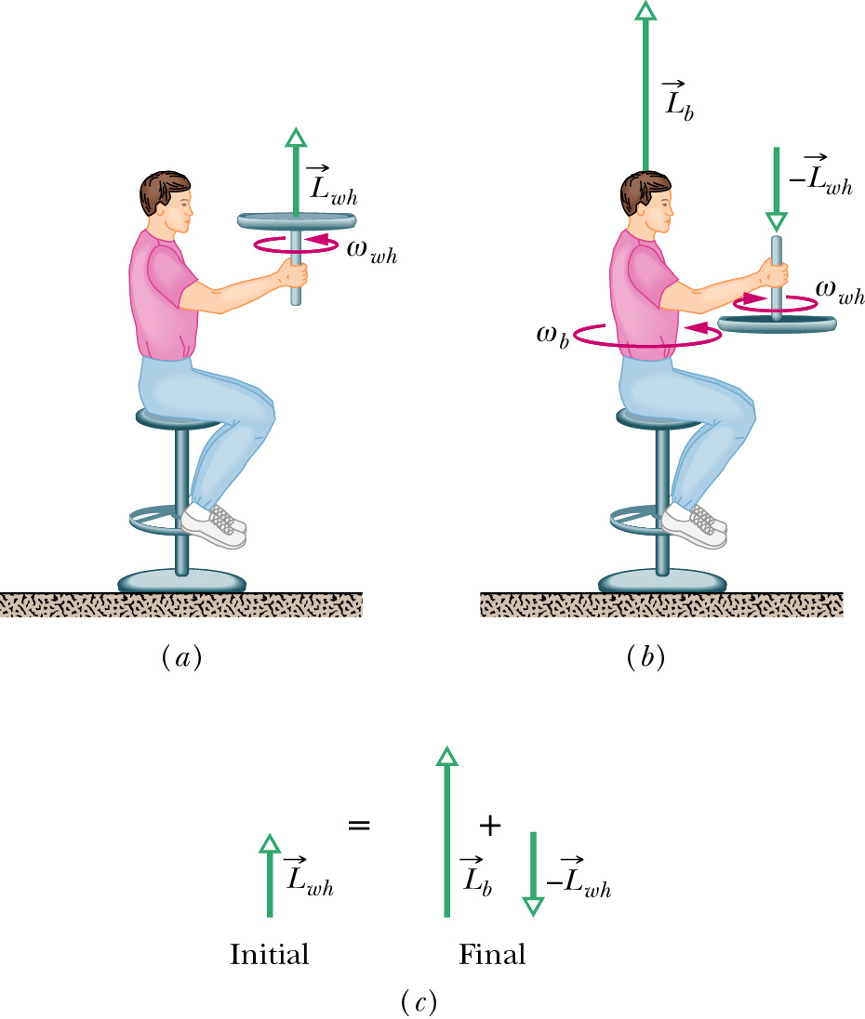
Example of conservation of angular momentum:

Slide 15
Another example of conservation of angular momentum
ω₁
ω₂
m
m
m
m
d₁
d₁
d₂
d₂
I₁=2md₁²
I₂=2md₂²
I₁ω₁=I₂ω₂ ➔ω₂=ω₁ I₁/I₂
➔ ω₂=ω₁ (d₁/d₂)²

Slide 16
Conditions for stable equilibrium

Slide 17
Example:
X
**

Slide 18
Simple harmonic motion:

Slide 19
Summary --
Simple harmonic motion:
Note that:
Conveniently evaluated in radians
Constants

Slide 20
Energy associated with simple harmonic motion

Slide 21
Simple harmonic motion for a pendulum:
L
Θ
Approximation for small Θ:

Slide 22
The notion of resonance:
Suppose F=-kx+F₀ sin(Ωt)
According to Newton:

Slide 23
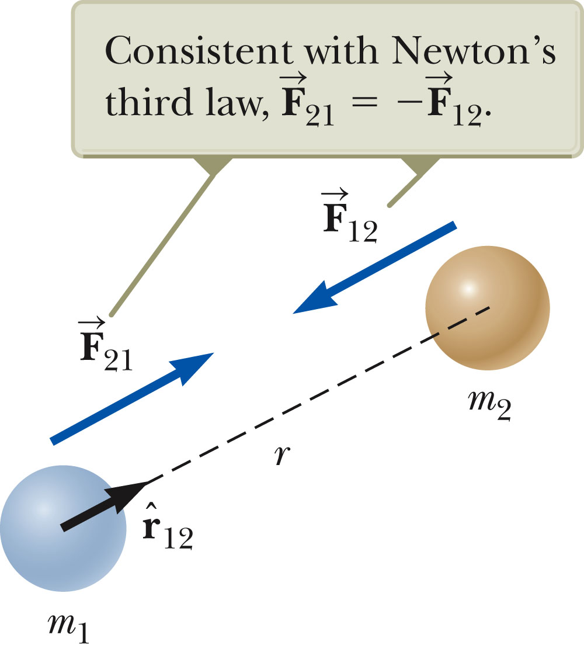
Universal law of gravitation
➔ Newton (with help from Galileo, Kepler, etc.) 1687

Slide 24
Review: Gravitational force of the Earth
R_{E}
m
Note: Earth’s gravity acts as a point mass located at the Earth’s center.

Slide 25
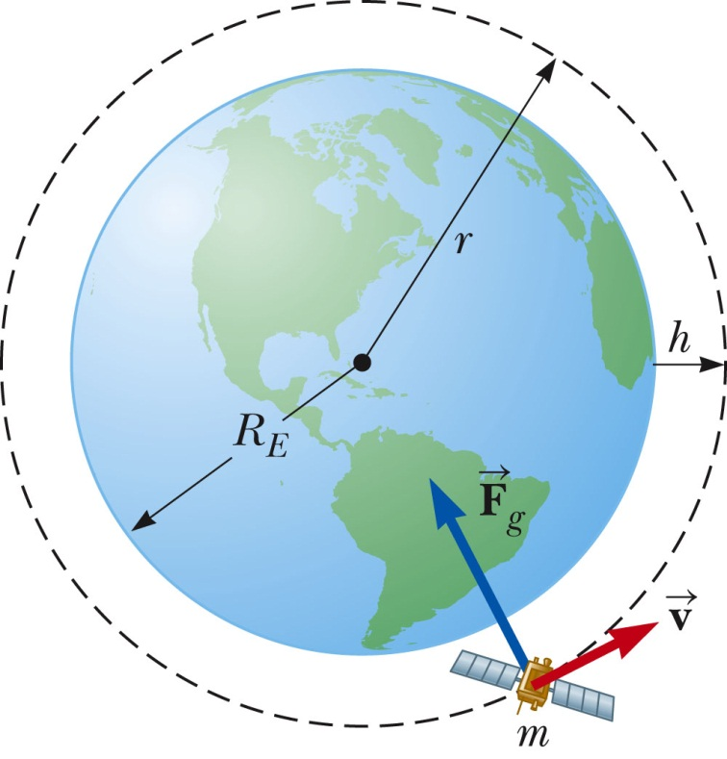
Example: Satellite in circular Earth orbit

Slide 26
Gravitational potential energy
Example:

