Slide 1
PHY 113 A General Physics I
9-9:50 AM MWF Olin 101
Plan for Lecture 26:
Chapter 14: The physics of fluids
Density and pressure
Variation of pressure with height
Buoyant forces
Notes:
Problems 1.1,1.6,1.10,1.11

Slide 3
The physics of fluids.
Fluids include liquids (usually “incompressible) and gases (highly “compressible”).
Fluids obey Newton’s equations of motion, but because they move within their containers, the application of Newton’s laws to fluids introduces some new forms.
Pressure: P=force/area 1 (N/m²) = 1 Pascal
Density: ρ =mass/volume 1 kg/m³ = 0.001 gm/ml
Note: In this chapter P≡pressure (NOT MOMENTUM)

Slide 4
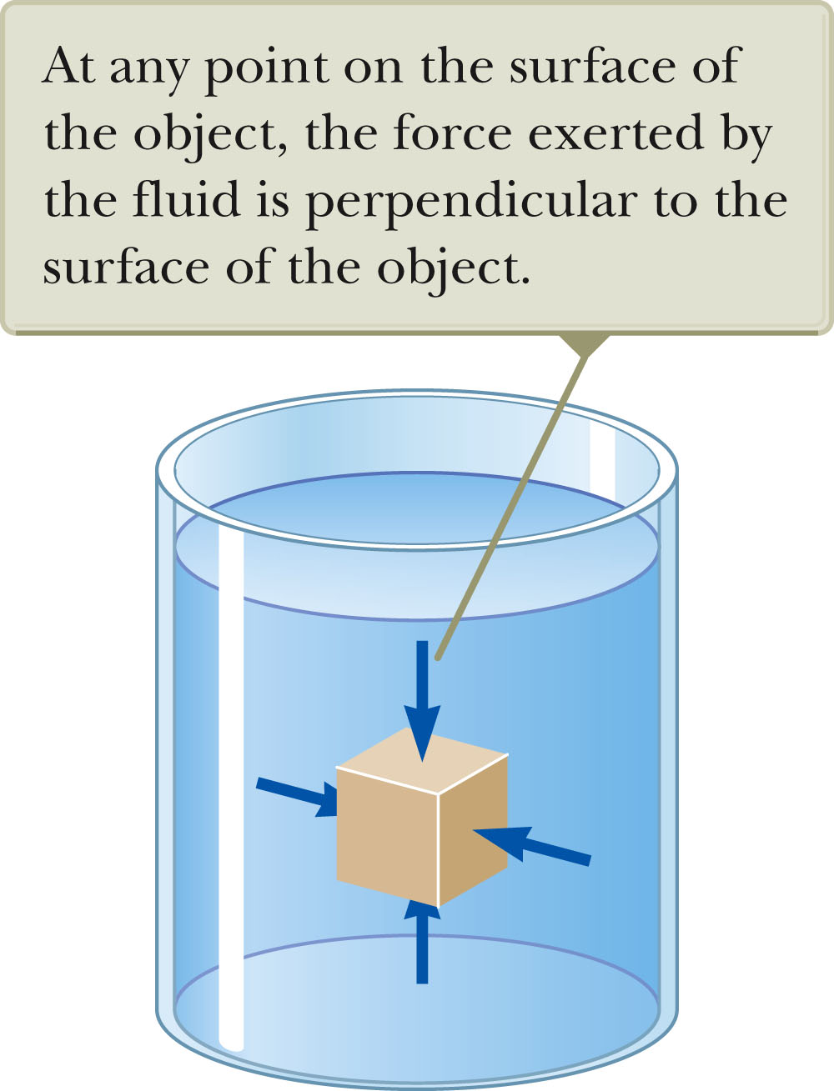
Pressure
Note: since P exerted by a fluid acts in all directions, it is a scalar parameter

Slide 5
Example of pressure calculation
High heels (http://www.flickr.com/photos/moffe6/3771468287/lightbox/)
F

Slide 6
Pressure exerted by air at sea-level
1 atm = 1.013x10⁵ Pa
Example: What is the force exerted by 1 atm of air pressure on a circular area of radius 0.08m?
F = PA = 1.013x10⁵ Pa x π(0.08m)²
= 2040 N
P_{atm}

Slide 7
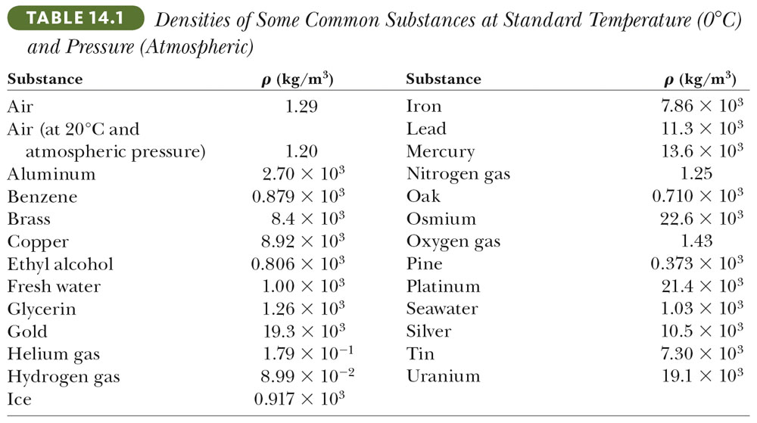
Density = Mass/Volume

Slide 8
Relationship between density and pressure in a fluid
Effects of the weight of a fluid:
P(y+Δy)
ρgΔy = mg/A
y
P(y)
Note: In this formulation +y is defined to be in the up direction.

Slide 9
For an “incompressible” fluid (such as mercury):
ρ = 13.585 x 10³ kg/m³ (constant)
Example:
ρ = 13.595 x 10³ kg/m³

Slide 10
Barometric pressure readings
Historically, pressure was measured in terms of inches of mercury in a barometer
ρ = 13.595 x 10³ kg/m³

Slide 11
Weather report:

Slide 12
Question: Consider the same setup, but replace fluid with water (ρ = 1000 kg/m³). What is h?
iclicker equation:
Will water barometer have h:
Greater than mercury.
Smaller than mercury.
The same as mercury.
ρ = 1000 kg/m³

Slide 13
Question: Consider the same setup, but replace fluid with water (ρ = 1000 kg/m³). What is h?
ρ = 1000 kg/m³

Slide 14
iclicker question:
A 0.5 m cylinder of water is inverted over a piece of paper. What will happen
The water will flow out of the cylinder and make a mess.
Air pressure will hold the water in the cylinder.

Slide 15
General relationship between P and ρ:

Slide 16
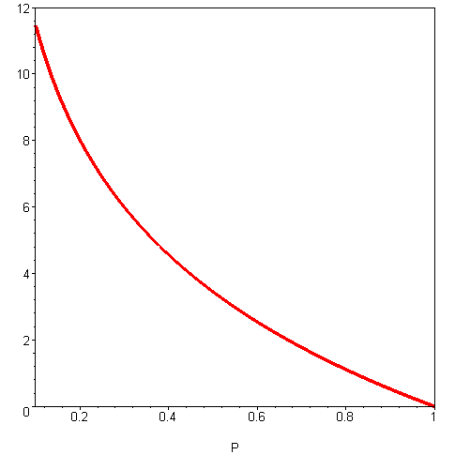
Approximate relation of pressure to height above sea-level
y-y₀(mi)
P (atm)

Slide 17
iclicker question:
Have you personally experienced the effects of atmospheric pressure variations?
By flying in an airplane
By visiting a high-altitude location (such as Denver, CO etc.)
By visiting a low-altitude location (such as Death Valley, CA etc.)
All of the above.
None of the above.

Slide 18
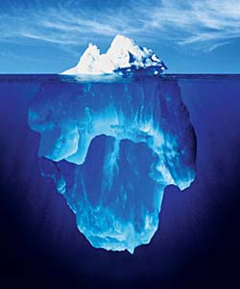
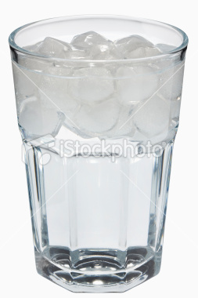
Buoyant forces in fluids
(For simplicity we will assume that the fluid is incompressible.)
Image from the web of a floating iceberg.
Image from the web of a glass of ice water

Slide 19
Buoyant force for fluid acting on a solid:
F_{B}=ρ_{fluid}V_{displaced}g
F_{B} − mg = 0
ρ_{fluid}V_{submerged}g − ρ_{solid}V_{solid}g = 0
A
Δy
mg

Slide 20
Summary:
Some densities:
ice ρ = 917 kg/m³
fresh water ρ = 1000 kg/m³
salt water ρ = 1024 kg/m³

Slide 21
iclicker question:
Suppose you have a boat which floats in a fresh water lake, with 50% of it submerged below the water. If you float the same boat in salt water, which of the following would be true?
More than 50% of the boat will be below the salt water.
Less than 50% of the boat will be below the salt water.
The submersion fraction depends upon the boat's total mass and volume.
The submersion fraction depends upon the barometric pressure.

Slide 22
Archimede’s method of finding the density of the King’s “gold” crown
W_{water}
W_{air}

Slide 23
Summary:
Application of Newton’s second law to fluid (near Earth’s surface)

Slide 24
iclicker question:
Suppose that a caterer packed some food in an air tight container with a flexible top at sea-level. This food was loaded on to an airplane with a cruising altitude of ~6 mi above the earth’s surface. Assuming that the airplane cabin is imperfectly pressurized, what do you expect the container to look like during the flight?
(A) (B) (C)

Slide 25
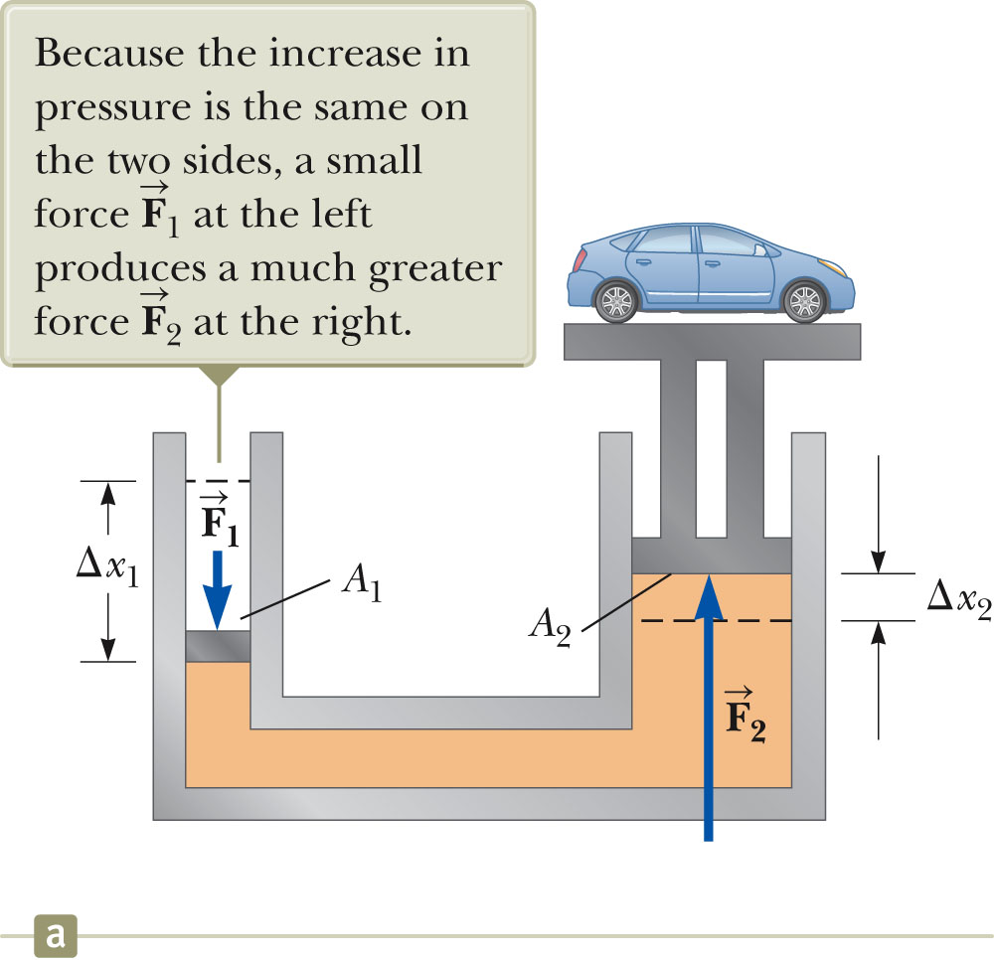
Example:
Hydraulic press
incompressible fluid
A₁Δx₁=A₂Δx₂
F₁/A₁= F₂/A₂

Slide 27
