Slide 1
PHY 113 A General Physics I
9-9:50 AM MWF Olin 101
Plan for Lecture 27:
Chapter 14: The physics of fluids
Review of static fluids
Bernoulli’s equation
Notes:
Problems 1.1,1.6,1.10,1.11

Slide 3
Review of equations describing static fluids in terms of pressure P and density ρ:

Slide 4
Buoyant force
F_{top}
A
Δy
F_{bottom}

Slide 5
Scale reading due to buoyant force:
T
F_{B}
mg

Slide 6
Scale reading due to buoyant force:
T
F_{B}
mg

Slide 7
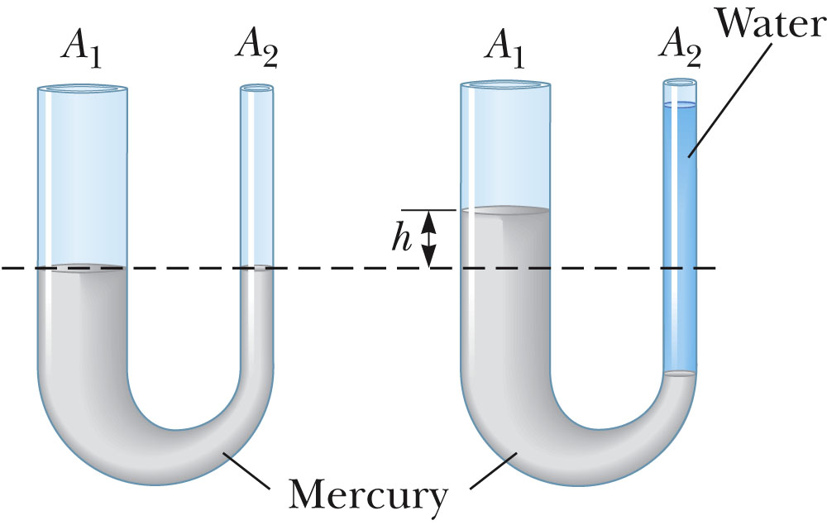

Slide 8
Δy
Δz

Slide 10
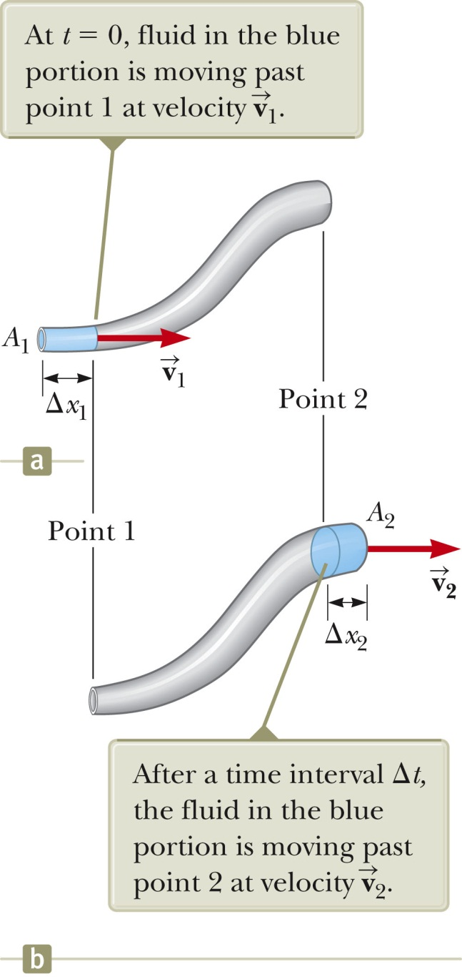
Fluid dynamics (for incompressible fluids)

Slide 11
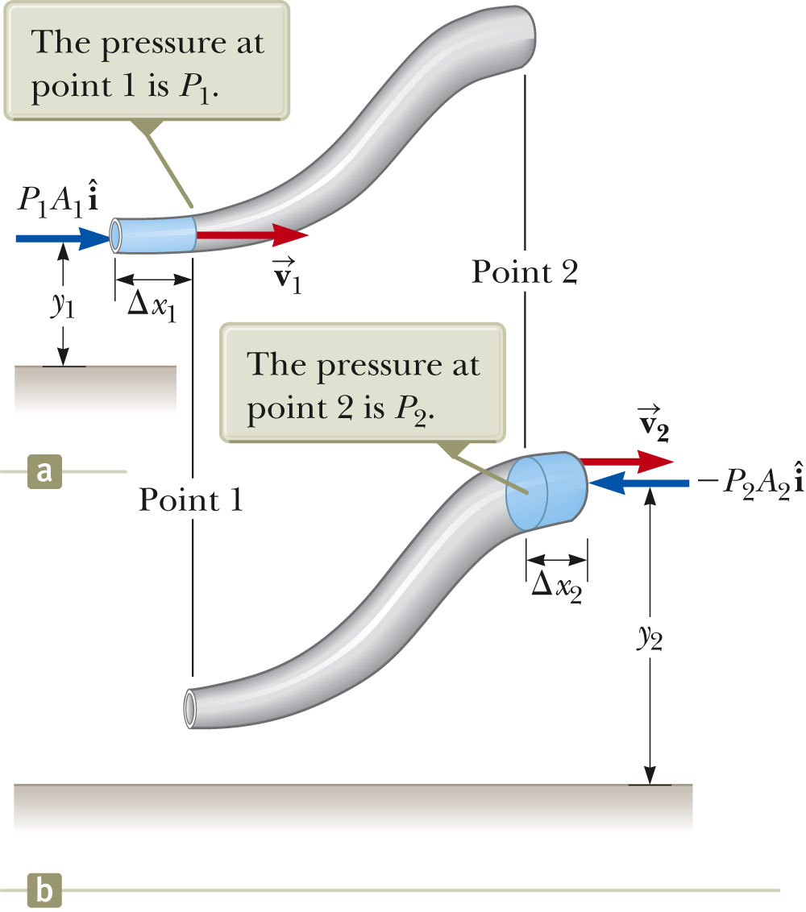
Approximate energy conservation in fluid dynamics ➔ Bernoulli’s equation

Slide 12
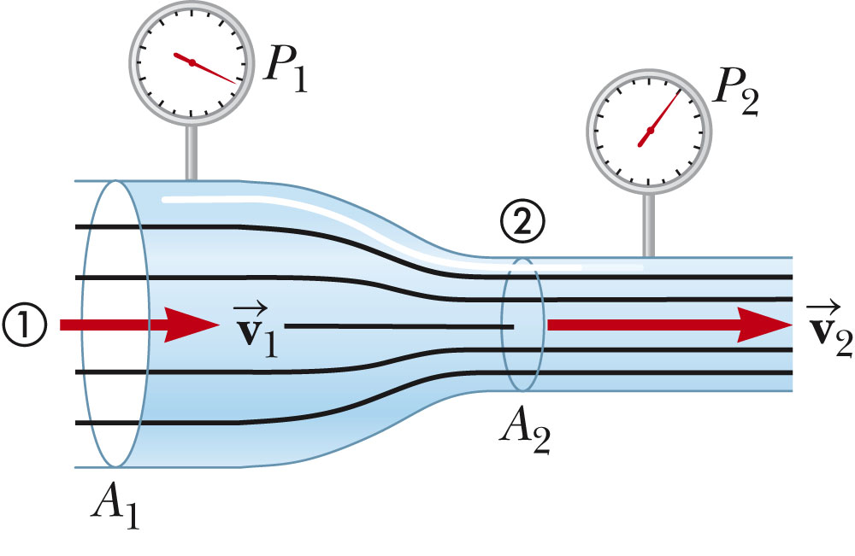
Bernoulli’s equation:

Slide 13
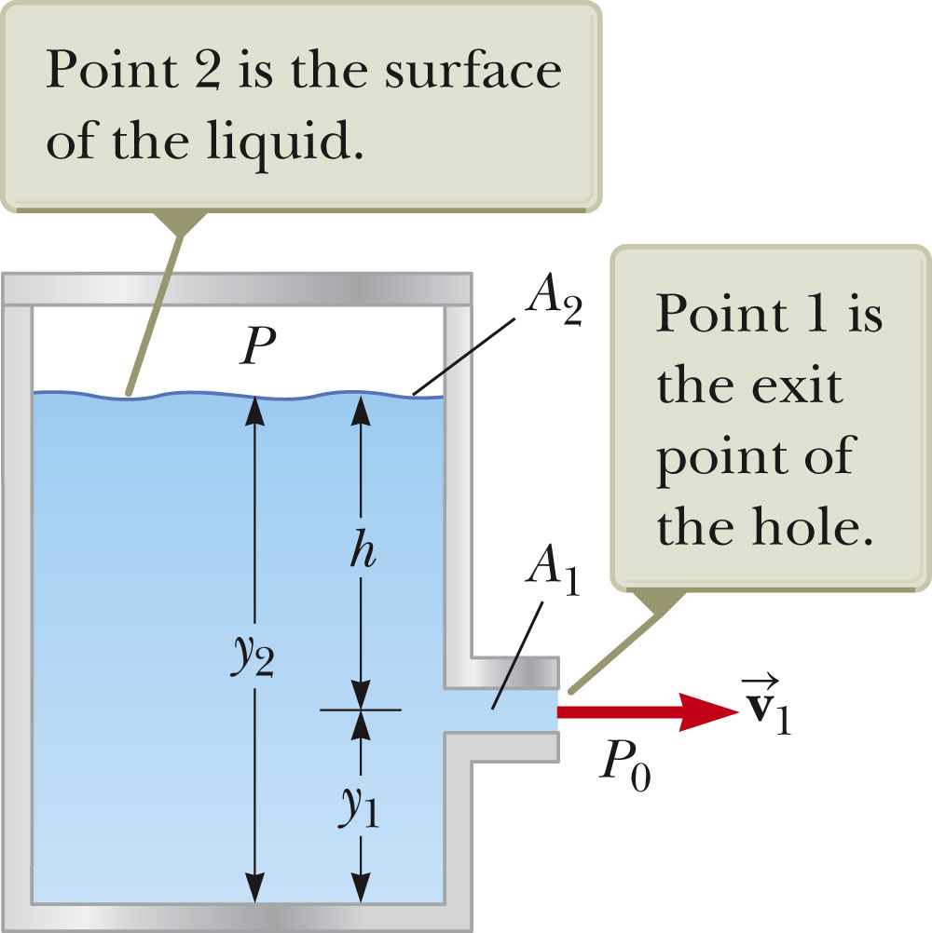
Bernoulli’s equation:

Slide 14
Possibilities:
Fire extinguisher
➔P>>P₀

Slide 15
Possibilities:
Open top:
➔P=P₀

Slide 16
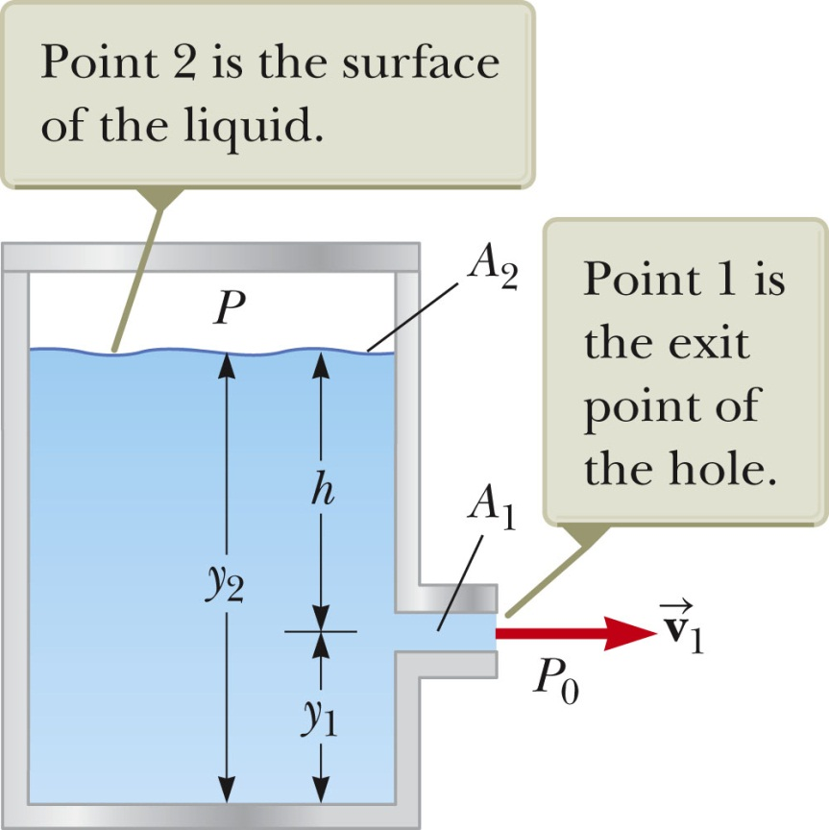
iclicker question:
Notice that if P<<P₀, v₁ could become very small. How might this happen?
Put an air-tight lid on the top.
Remove the lid on the top.
This will never happen.

Slide 17
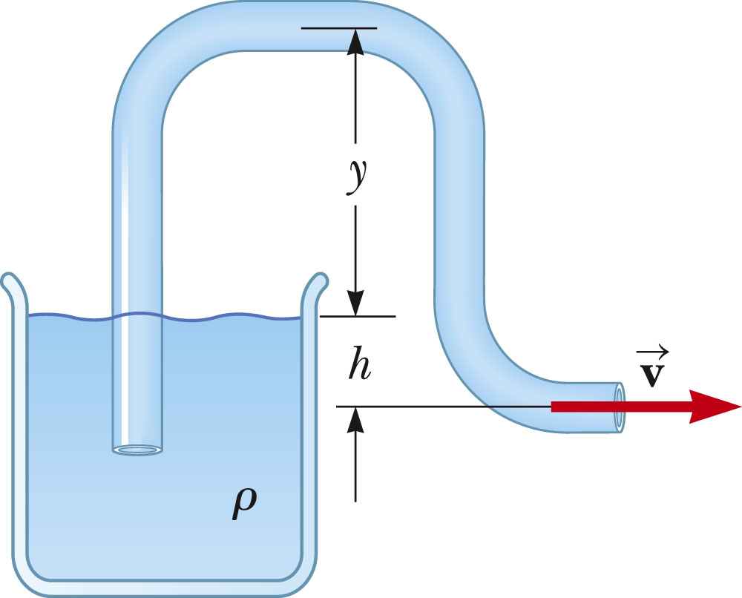
Siphon

Slide 18
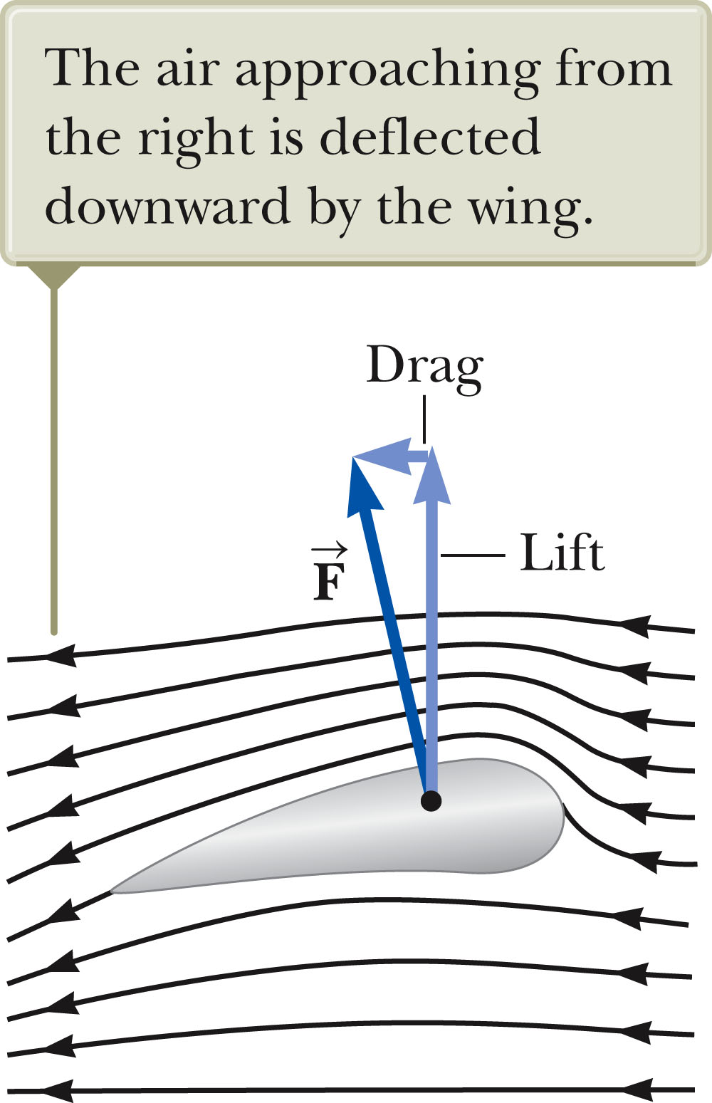
Simplistic statement:
v₁, P₁
v₂, P₂

