Slide 1
PHY 113 A General Physics I
9-9:50 AM MWF Olin 101
Plan for Lecture 28:
Chapter 19:
The notion of temperature
Comments on Exam 3
Temperature equilibrium
Temperature scales
Temperature in ideal gases
Notes:
Problems 1.1,1.6,1.10,1.11

Slide 3
Temperature
Dictionary definition: temperature – a measure of the the warmth or coldness of an object or substance with reference to some standard value. The temperature of two systems is the same when the systems are in thermal equilibrium.
“Zeroth” law of thermodynamics:
If objects A and B are separately in thermal equilibrium with a third object C, then objects A and B are in thermal equilibrium with each other.
Not equilibrium:
Equilibrium:
T₁
T₂
T₃

Slide 4
Constant temperature “bath”
At equilibrium:
T
T

Slide 5
Temperature scales T_{F}=9/5 T_{C} + 32
Kelvin scale:
T = T_{C} + 273.15º
T ≥ 0

Slide 6
iclicker question:
Suppose you find yourself in a hotel in Europe or Canada. Which Celsius temperature would you set the thermostat for comfort?
-20ºC
+20ºC
+40ºC
+60ºC
+80ºC

Slide 7
There is a lowest temperature:
T₀ = -273.15º C = 0 K
Kelvin (“absolute temperature”) scale
T_{C} = -273.15 + T_{K}
Example –
Room temperature = 68º F = 20º C = 293.15 K

Slide 8
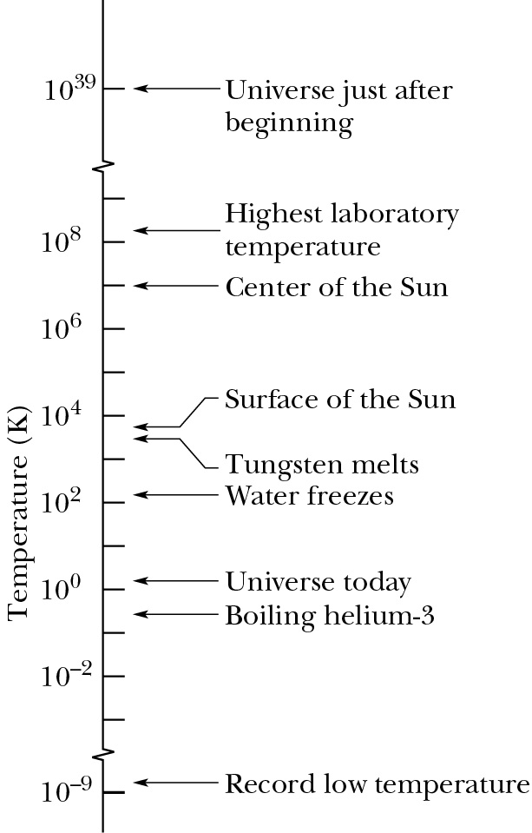

Slide 9
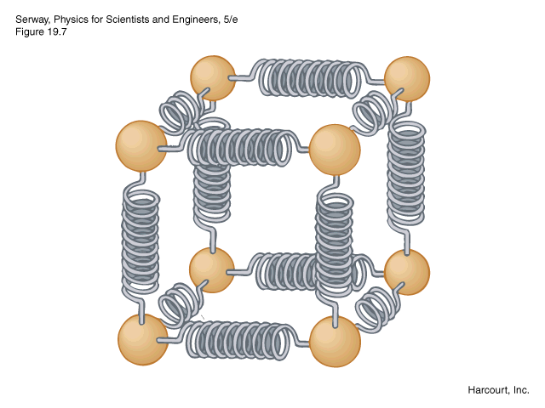
Effects of temperature on matter
Solids and liquids
Model of a solid composed of atoms and bonds
Thermal exansion:
ΔL = α L_{i} ΔT
ΔL
L_{i} (equilibrium bond length at T_{i})

Slide 10
Typical expansion coefficients at T_{C} = 20º C:
Linear expansion: ΔL = α L_{i} ΔT
Steel: α = 11 x 10⁻⁶/ ºC
Concrete: α = 12 x 10⁻⁶/ ºC
Volume expansion:
V=L³ ➔ ΔV = 3α V_{i} ΔT = β V_{i} ΔT
Alcohol: β = 1.12 x 10⁻⁴/ ºC
Air: β = 3.41 x 10⁻³/ ºC

Slide 11
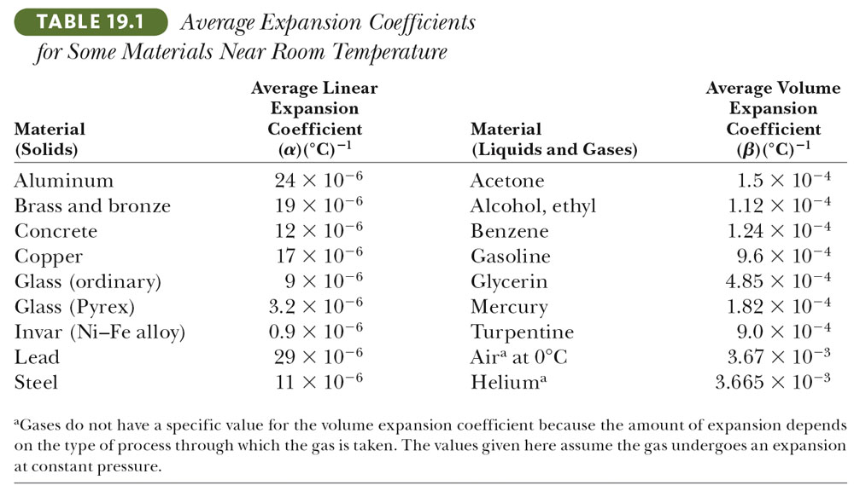

Slide 12
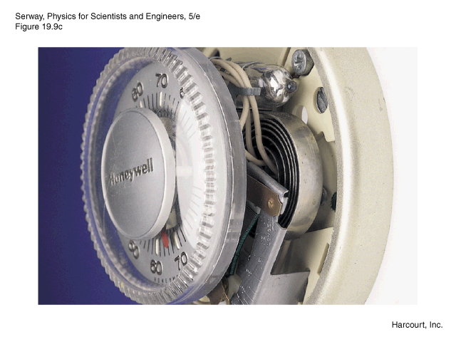
Brass
Steel

Slide 13
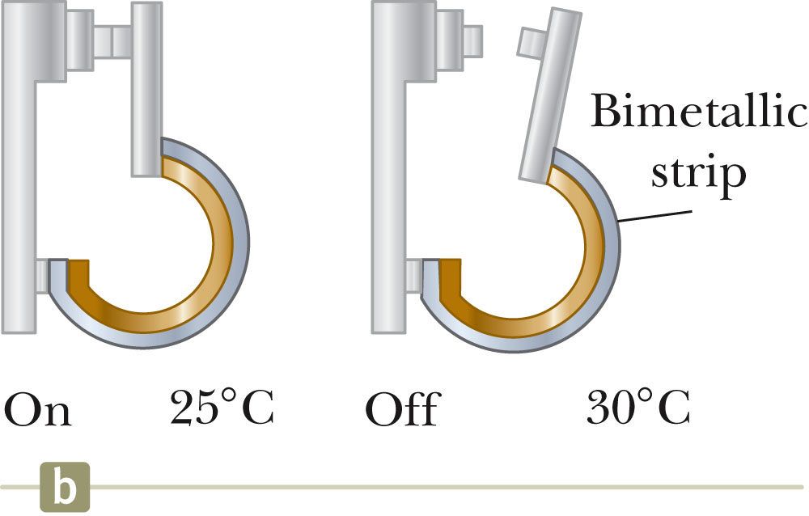
Switch in thermostat
Modern thermostats use electrical circuits to detect temperature

Slide 14
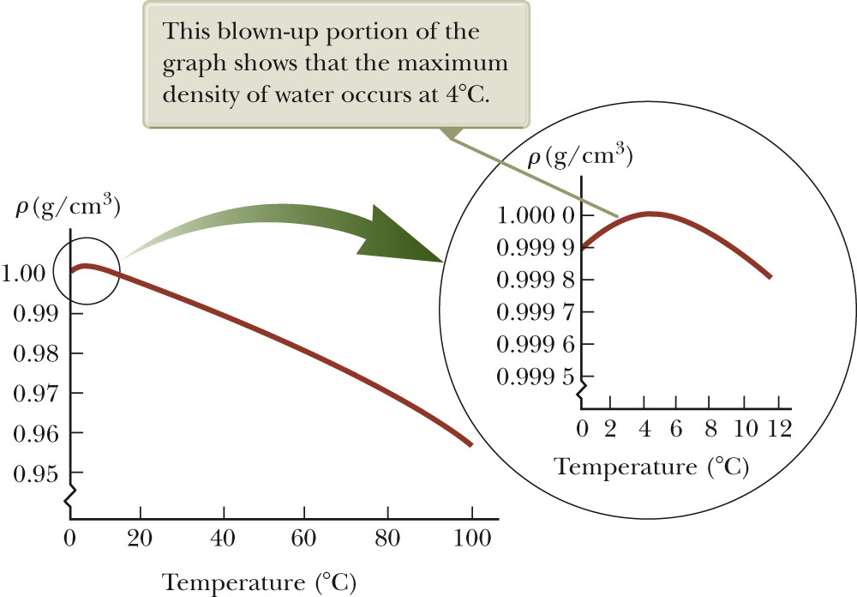
Effects of temperature on materials – continued
strange case of water:

Slide 15
Effects of temperature on materials – continued -- ideal gas “law” (thanks to Robert Boyle (1627-1691), Jacques Charles (1746-1823), and Gay-Lussac (1778-1850)
8.314 J/(mol K)
temperature in K
volume in m³
# of moles
pressure in Pascals
1 mole corresponds to 6.022 x 10²³ molecules

Slide 16
P₀ =12.6 atm
T₀ =27.5ºC
n₀
P=?
T=81.0ºC
n=n₀/3

Slide 17
Comments about Exam 3
iclicker question:
Possible review of Exam 3 material
I would like to attend a review class session to go over the exam
I would like to meet individually or in a small group to go over the exam
I would like to forget the exam and take my chances that it is possible to live a full life without knowing about rotations, equilibrium, simple harmonic motion, and gravity

