Slide 1
PHY 113 A General Physics I
9-9:50 AM MWF Olin 101
Plan for Lecture 29:
Chapter 20:
Thermodynamic heat and work
Heat and internal energy
Specific heat; latent heat
Work
Notes:
Problems 1.1,1.6,1.10,1.11

Slide 3
iclicker question:
Concerning review session for Exam 3
I would like to have a group review session early this week
I would like to meet individually with NAWH or with a small group to go over the exam
I am good
iclicker question:
Scheduling of group review session for Exam 3
Monday (today) at 2 PM
Monday (today) at 4 PM
Tuesday at 2 PM
Tuesday at 4 PM
Wednesday a 2 PM

Slide 4
In this chapter T ≡ temperature
in Kelvin or Celsius units

Slide 5
Heat – Q -- the energy that is transferred between a “system” and its “environment” because of a temperature difference that exists between them.
Sign convention:
Q<0 if T₁ < T₂
Q>0 if T₁ > T₂
T₁
T₂
Q

Slide 6
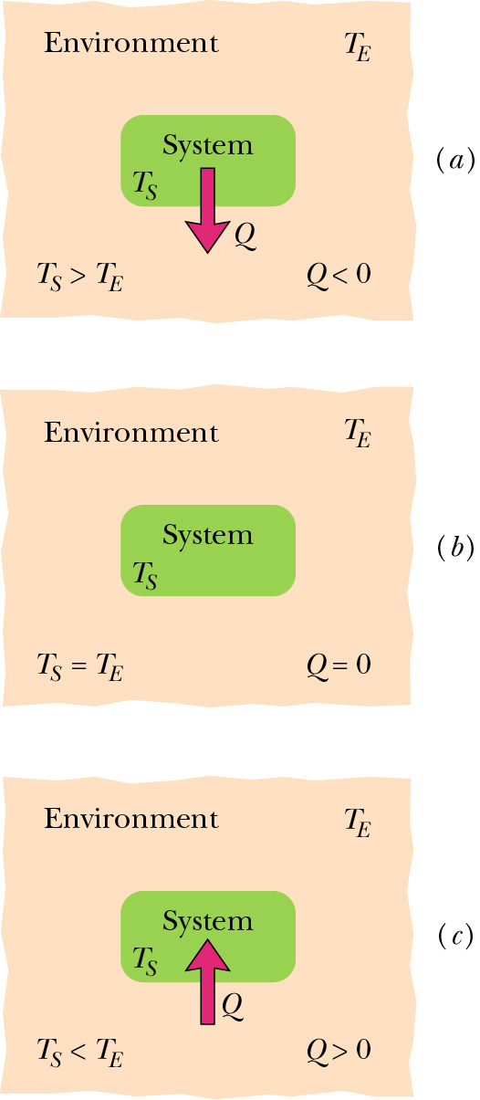
Heat withdrawn from system
Thermal equilibrium – no heat transfer
Heat added to system

Slide 7
Units of heat: Joule
Other units: calorie = 4.186 J
Kilocalorie = 4186 J = Calorie
Note: in popular usage, 1 Calorie is a measure of the heat produced in food when oxidized in the body

Slide 8
iclicker question:
According to the first law of thermodynamics, heat and work are related through the “internal energy” of a system and generally cannot be interconverted. However, we can ask the question: How many times does a person need to lift a 500 N barbell a height of 2 m to correspond to 2000 Calories (1 Calorie = 4186 J) of work?
4186
8372
41860
83720
None of these

Slide 9
Heat capacity: C = amount of heat which must be added to the “system” to raise its temperature by 1K (or 1º C).
Q = C ΔT
Heat capacity per mass: C=mc
Heat capacity per mole (for ideal gas): C=nC_{v}
C=nC_{p}

Slide 10
Some typical specific heats
Material | J/(kg·ºC) | cal/(g·ºC)
Water (15ºC) | 4186 | 1.00
Ice (-10ºC) | 2220 | 0.53
Steam (100ºC) | 2010 | 0.48
Wood | 1700 | 0.41
Aluminum | 900 | 0.22
Iron | 448 | 0.11
Gold | 129 | 0.03

Slide 11
iclicker question:
Suppose you have 0.3 kg of hot coffee (at 100 ºC). How much heat do you need to remove so that the temperature is reduced to 40 ºC? (Note: for water, c=1000 kilocalories/(kg ºC))
300 kilocalories (1.256 x 10⁶J)
12000 kilocalories (5.023 x 10⁷J)
18000 kilocalories (7.535 x 10⁷J)
30000 kilocalories (1.256 x 10⁸J)
None of these
Q=m c ΔT = (0.3)(1000)(100-40) = 18000 kilocalories

Slide 12
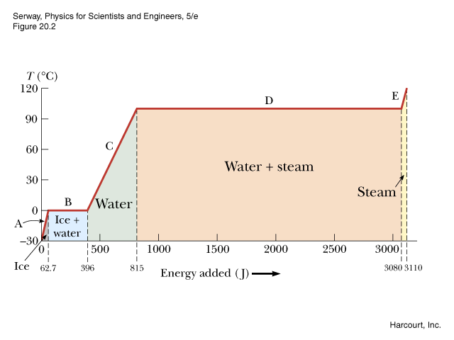
Heat and changes in phase of materials
Example: A plot of temperature versus Q added to
1g = 0.001 kg of ice (initially at T=-30ºC)
Q=2260J
Q=333J

Slide 13
m=0.001 kg
 | T_{i} | T_{f} | C/L | Q
A | -30 ºC | 0 ºC | 2.09 J/ºC | 62.7 J
B | 0 ºC | 0 ºC | 333 J | 333 J
C | 0 ºC | 100 ºC | 4.186 J/ºC | 418.6 J
D | 100 ºC | 100 ºC | 2260 J | 2260 J
E | 100 ºC | 120 ºC | 2.01 J/ºC | 40.2 J

Slide 14
Some typical latent heats
Material | J/kg
Ice ⇒Water (0ºC) | 333000
Water ⇒ Steam (100ºC) | 2260000
Solid N ⇒ Liquid N (63 K) | 25500
Liquid N ⇒ Gaseous N₂ (77 K) | 201000
Solid Al ⇒ Liquid Al (660ºC) | 397000
Liquid Al ⇒ Gaseous Al (2450ºC) | 11400000

Slide 15
iclicker question:
Suppose you have 0.3 kg of hot coffee (at 100 ºC) which you would like to convert to ice coffee (at 0 ºC). What is the minimum amount of ice (at 0 ºC) you must add? (Note: for water, c=4186 J/(kg ºC) and for ice, the latent heat of melting is 333000 J/kg. )
0.2 kg
0.4 kg
0.6 kg
1 kg
more

Slide 16
Review
Suppose you have a well-insulated cup of hot coffee (m=0.3kg, T=100ºC) to which you add 0.3 kg of ice (at 0ºC). When your cup comes to equilibrium, what will be the temperature of the coffee?

Slide 17
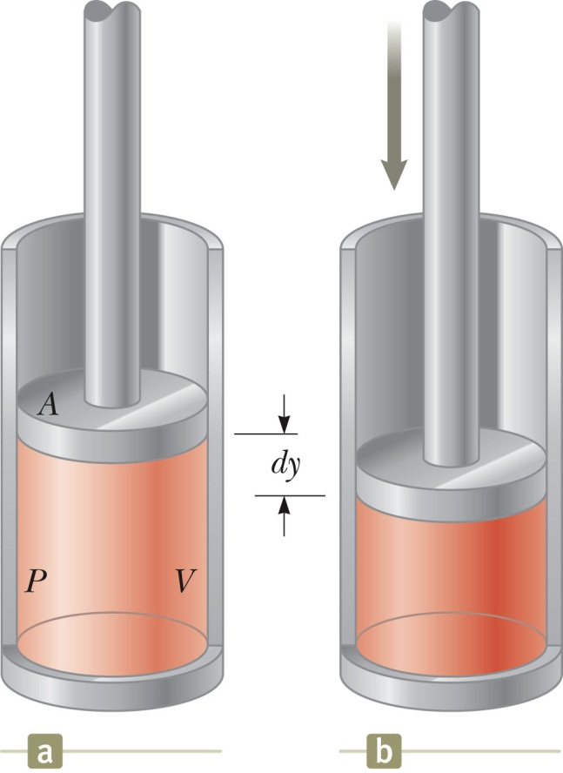
Work defined for thermodynamic process
In most text books, thermodynamic work is work done on the “system”
the “system”

Slide 18
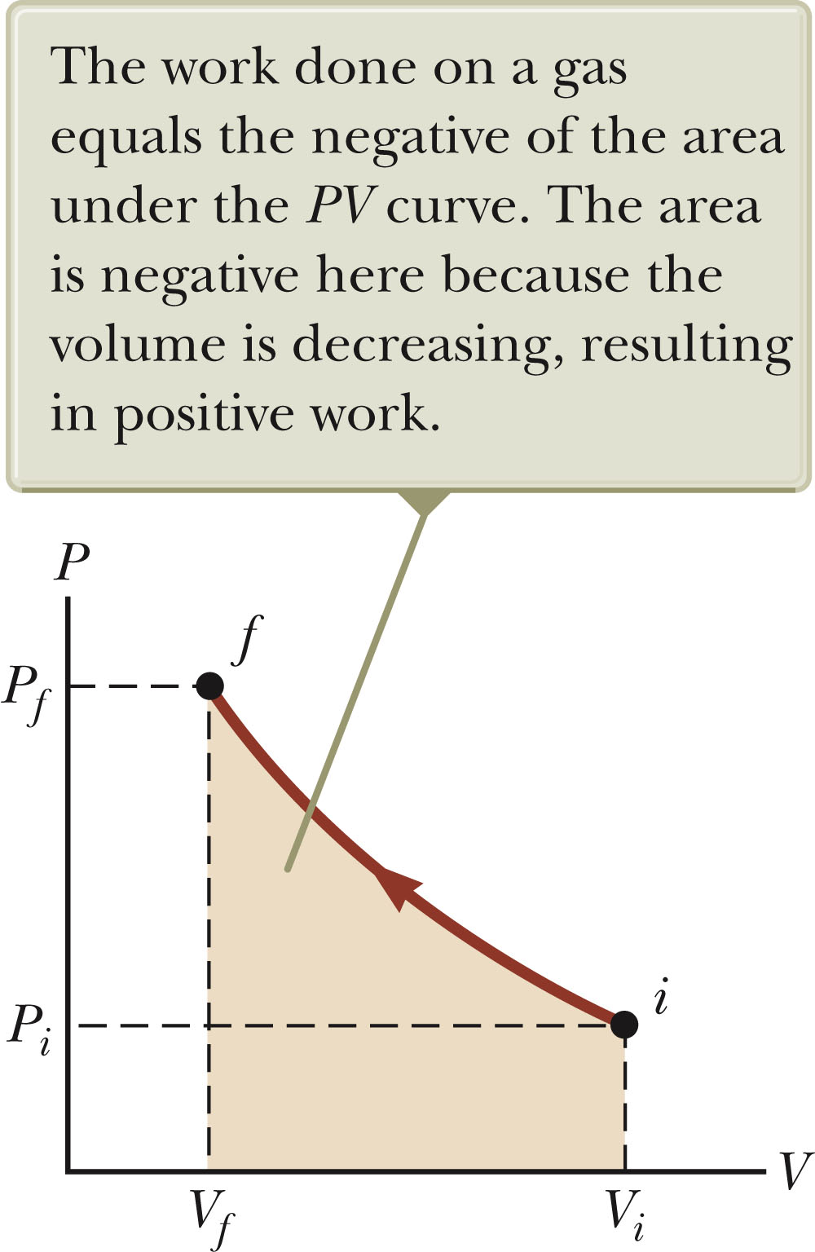

Slide 19
Thermodynamic work
Sign convention: W > 0 for compression
W < 0 for expansion

Slide 20
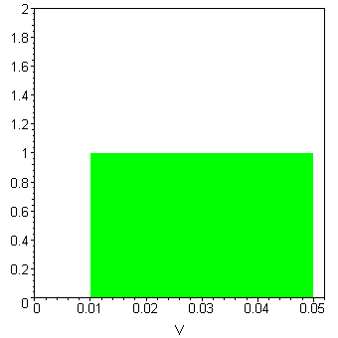
Work done on system --
“Isobaric” (constant pressure process)
P_{o}
P (1.013 x 10⁵) Pa
W= -P_{o}(V_{f} - V_{i})
V_{i}
V_{f}

Slide 21
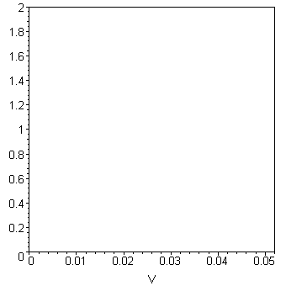
Work done on system --
“Isovolumetric” (constant volume process)
P_{f}
W=0
P (1.013 x 10⁵) Pa
P_{i}
V_{i}

Slide 22
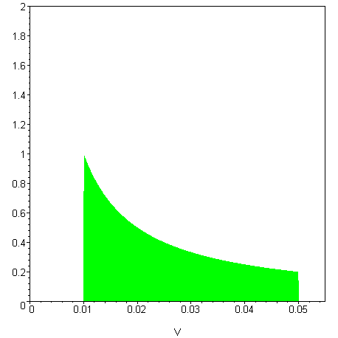
Work done on system which is an ideal gas
“Isothermal” (constant temperature process)
For ideal gas:
PV = nRT
P_{i}
P (1.013 x 10⁵) Pa
V_{i}
V_{f}

Slide 23
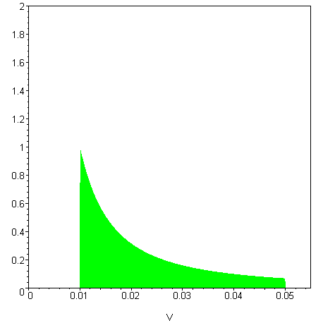
Work done on a system which is an ideal gas:
“Adiabatic” (no heat flow in the process process)
For ideal gas:
PV^{γ} = P_{i}V_{i}^{γ}
Q_{i→f} = 0
P_{i}
P (1.013 x 10⁵) Pa
V_{i}
V_{f}

