Slide 1
PHY 113 A General Physics I
9-9:50 AM MWF Olin 101
Plan for Lecture 3:
Some announcements
Chapter 2 – Motion in one dimension
Acceleration
Relationships between position, velocity, and acceleration
Notes:
Problems 1.1,1.6,1.10,1.11

Slide 2
Some updates/announcements

Slide 3
Starting September 3, 2012
Schedule for Physics 113 Tutorials
5-7 PM in Olin 101
Sunday | Monday | Tuesday | Wednesday | Thursday | Friday
Loah Stevens | Jiajie Xiao | Jiajie Xiao | Stephen Baker | Stephen Baker | Loah Stevens
First Webassign sets “due” on Friday, Sept. 7th
PHY 113 Labs start September 3, 2012
(Please see Eric Chapman in Olin 110 chapmaek@wfu.edu for all of your laboratory concerns)

Slide 4
Velocity

Slide 5
Instantaneous velocity using calculus

Slide 6
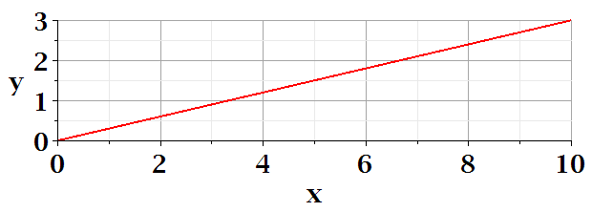
Anti-derivative relationship
x
t

Slide 7
Acceleration

Slide 8
Rate of acceleration
iclicker exercise
How many derivatives of position are useful for describing motion:
1 (dx/dt)
2 (d²x/dt²)
3 (dx³/dt³)
4 (dx⁴/dt⁴)
∞

Slide 9
Anti-derivative relationship

Slide 10
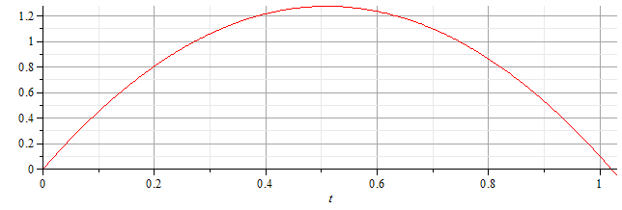
Examples
v(t)
x(t)

Slide 11
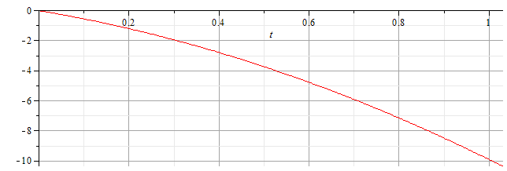
Examples
v(t)
x(t)

Slide 12
Summary

Slide 13
Another example
x(t)
v(t)

Slide 14
From webassign:

Slide 15
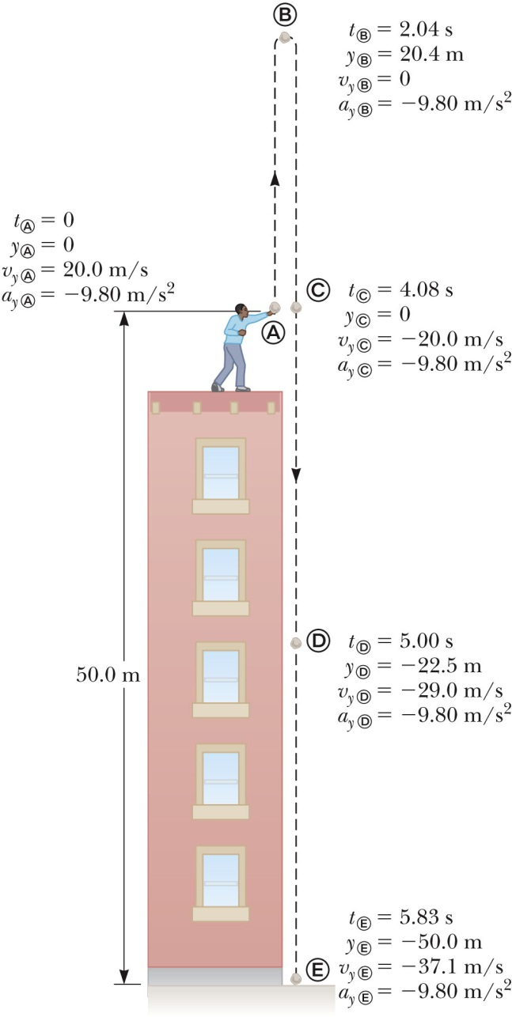
Special case: constant velocity due to earth’s gravity
In this case, the “one” dimension is the vertical direction with “up” chosen as positive:
a = -g = -9.8 m/s²
y(t) = y₀ + v₀t – ½ gt²
y₀ = 0 v₀ = 20 m/s
At what time t_{m} will the ball hit the ground
y_{m} = -50m ?
Solve: y_{m} = y₀ + v₀t_{m} – ½ gt_{m}²
quadratic equation
physical solution: t_{m} = 5.83 s

