Slide 1
PHY 113 A General Physics I
9-9:50 AM MWF Olin 101
Plan for Lecture 30:
Chapter 20: First law of thermodynamics
Concept of internal energy
Examples of thermodynamic processes
Note: We will not stress energy transfer processes in this class
Notes:
Problems 1.1,1.6,1.10,1.11

Slide 3
iclicker question:
Concerning review session for Exam 3 ??
yes
no

Slide 4
Thermodynamic processes:
Q: heat added to system (Q>0 if T_{E}>T_{S})
W: work done on system (W>0 if system expands

Slide 5
iclicker question:
What happens to the “system” when Q and W are applied?
Its energy increases
Its energy decrease
Its energy remains the same
Insufficient information to answer question

Slide 6
Internal energy of a system
E_{int}(T,V,P….)
The internal energy is a “state” property of the system, depending on the instantaneous parameters (such as T, P, V, etc.). By contrast, Q and W describe path-dependent processes.

Slide 7
First law of thermodynamics:
E_{i}
E_{f}
W
Q

Slide 8
Applications of first law of thermodyamics
System ➔ ideal gas
8.314 J/(mol K)
temperature in K
volume in m³
# of moles
pressure in Pascals

Slide 9
Ideal gas -- continued

Slide 10
iclicker question:
We are about to see several P-V diagrams. Why is this helpful?
It will help us analyze the thermodynamic work
Physicists like nice graphs
It is not actually helpful

Slide 11
Constant volume process on an ideal gas
P_{f} V_{f}=V_{i}
P
P_{i} V_{i}
V

Slide 12
Constant pressure process on an ideal gas
P
P_{i} V_{i}
P_{f} = P_{i} V_{f}
V

Slide 13
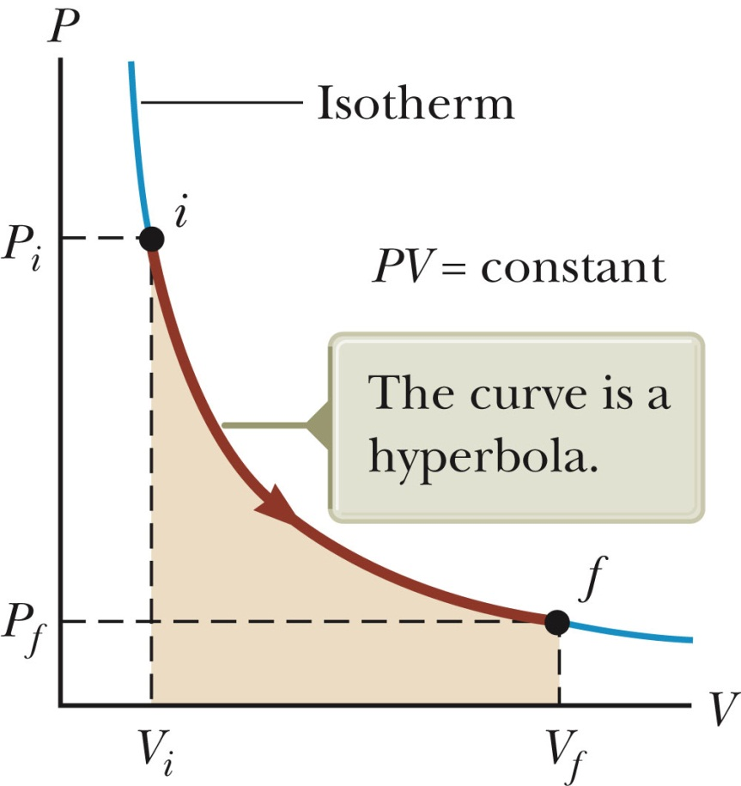
Constant temperature process on an ideal gas

Slide 14
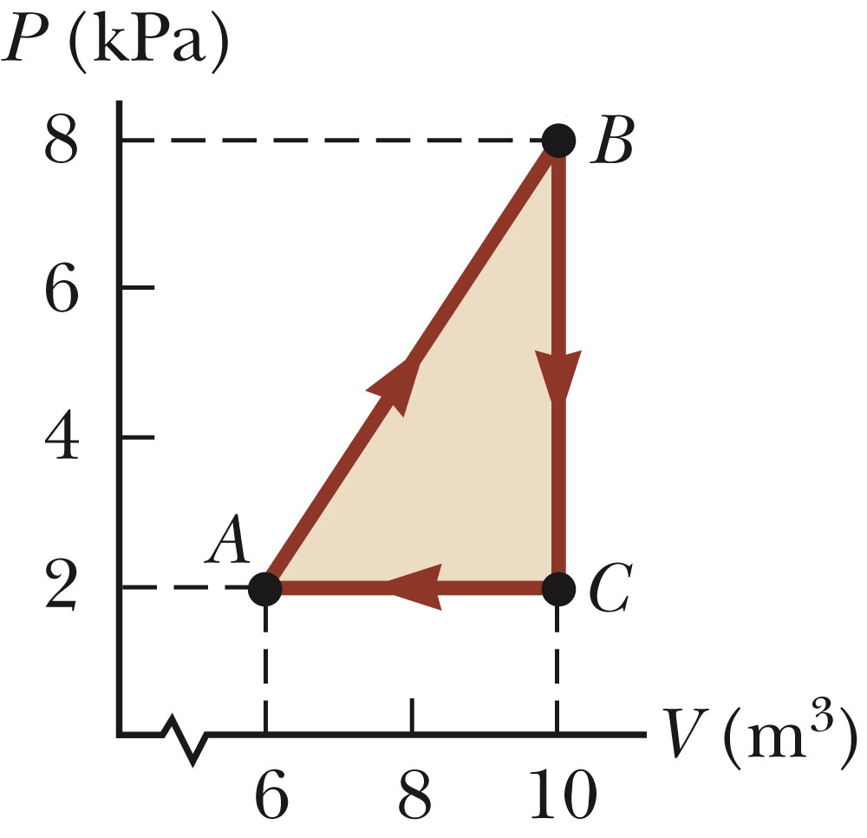
Consider the process described by A→B→C→A
iclicker exercise:
What is the net change in total energy?
0
12000 J
Who knows?

Slide 15
Consider the process described by A→B→C→A
iclicker exercise:
What is the net heat added to the system?
0
12000 J
Who knows?

Slide 16
Consider the process described by A→B→C→A
iclicker exercise:
What is the net work done on the system?
0
-12000 J
Who knows?

Slide 17
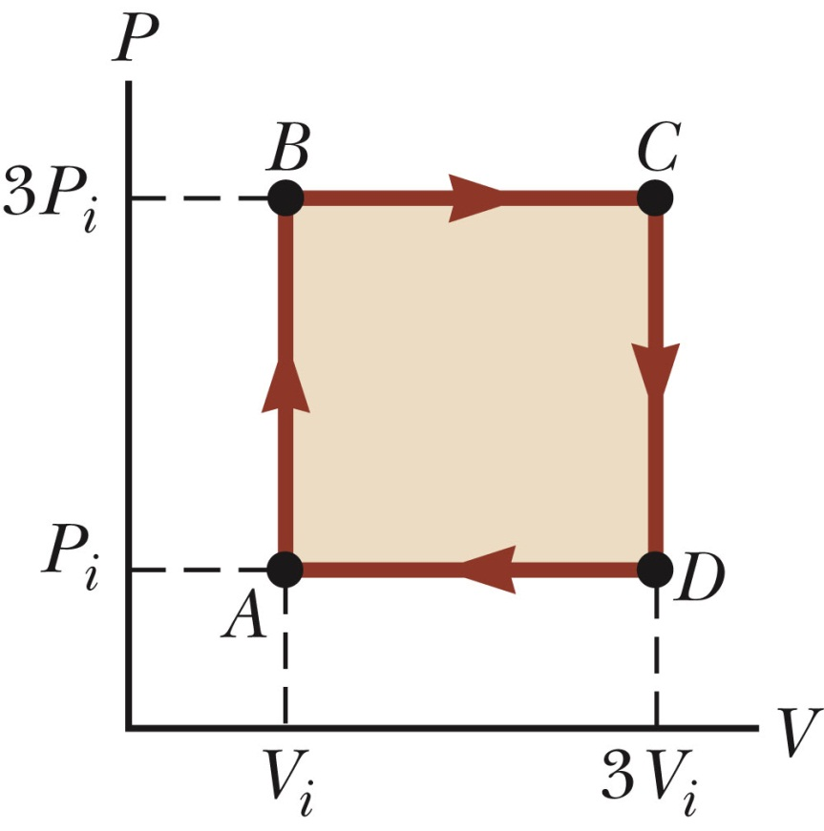
Webassign problem # 4:

