Slide 1
PHY 113 A General Physics I
9-9:50 AM MWF Olin 101
Plan for Lecture 31:
Chapter 21: Ideal gas equations
Molecular view of ideal gas
Internal energy of ideal gas
Distribution of molecular speeds in ideal gas
Notes:
Problems 1.1,1.6,1.10,1.11

Slide 3
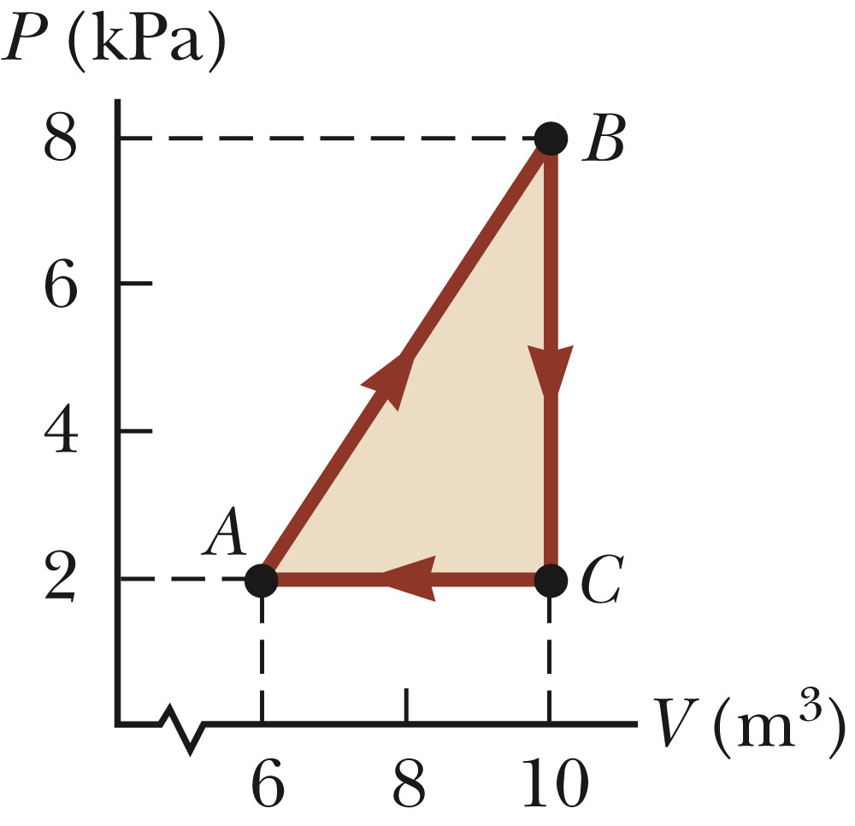
Review:
Consider the process described by A→B→C→A
iclicker exercise:
What is the net work done on the system in this cycle?
-12000 J
12000 J
0

Slide 4
Equation of “state” for ideal gas
(from experiment)
8.314 J/(mol K)
temperature in K
volume in m³
# of moles
pressure in Pascals

Slide 5
Ideal gas -- continued
Note that at this point, the above equation for E_{int} is completely unjustified…

Slide 6
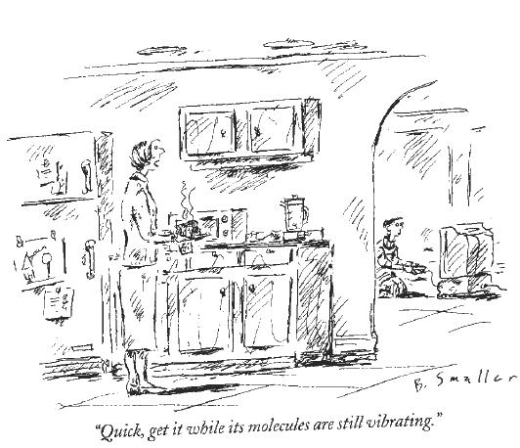
From The New Yorker Magazine, November 2003

Slide 7
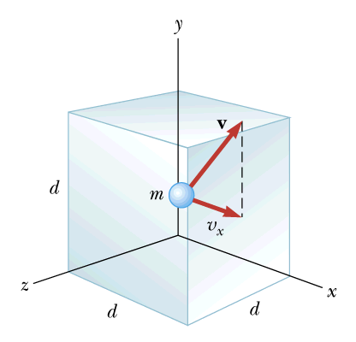
Microscopic model of ideal gas:
Each atom is represented as a tiny hard sphere of mass m with velocity v. Collisions and forces between atoms are neglected. Collisions with the walls of the container are assumed to be elastic.

Slide 8
What we can show is the pressure exerted by the atoms by their collisions with the walls of the container is given by:
Proof:
Force exerted on wall perpendicular to x-axis by an atom which collides with it:
-v_{ix}
v_{ix}
x
number of atoms
d
volume
average over atoms

Slide 10
iclicker question:
What should we call ?
Average kinetic energy of atom.
We cannot use our macroscopic equations at the atomic scale -- so this quantity will go unnamed.
We made too many approximations, so it is not worth naming/discussion.
Very boring.

Slide 12
Average atomic velocities:
(note <v_{i}>=0)
Relationship between average atomic velocities with T

Slide 13
For monoatomic ideal gas:
General form for ideal gas (including mono-, di-, poly-atomic ideal gases):

Slide 14
Big leap!
Internal energy of an ideal gas:
derived for monoatomic ideal gas
more general relation for polyatomic ideal gas
Gas | γ (theory) | γ (exp)
He | 5/3 | 1.67
N₂ | 7/5 | 1.41
H₂O | 4/3 | 1.30

Slide 15
Determination of Q for various processes in an ideal gas:
Example: Isovolumetric process – (V=constant ➔ W=0)
In terms of “heat capacity”:

Slide 16
Example: Isobaric process (P=constant):
In terms of “heat capacity”:
Note: γ = C_{P}/C_{V}

Slide 17
More examples:
Isothermal process (T=0)
➔ΔT=0 ➔ ΔE_{int} = 0 ➔ Q=-W

Slide 18
Even more examples:
Adiabatic process (Q=0)

Slide 19
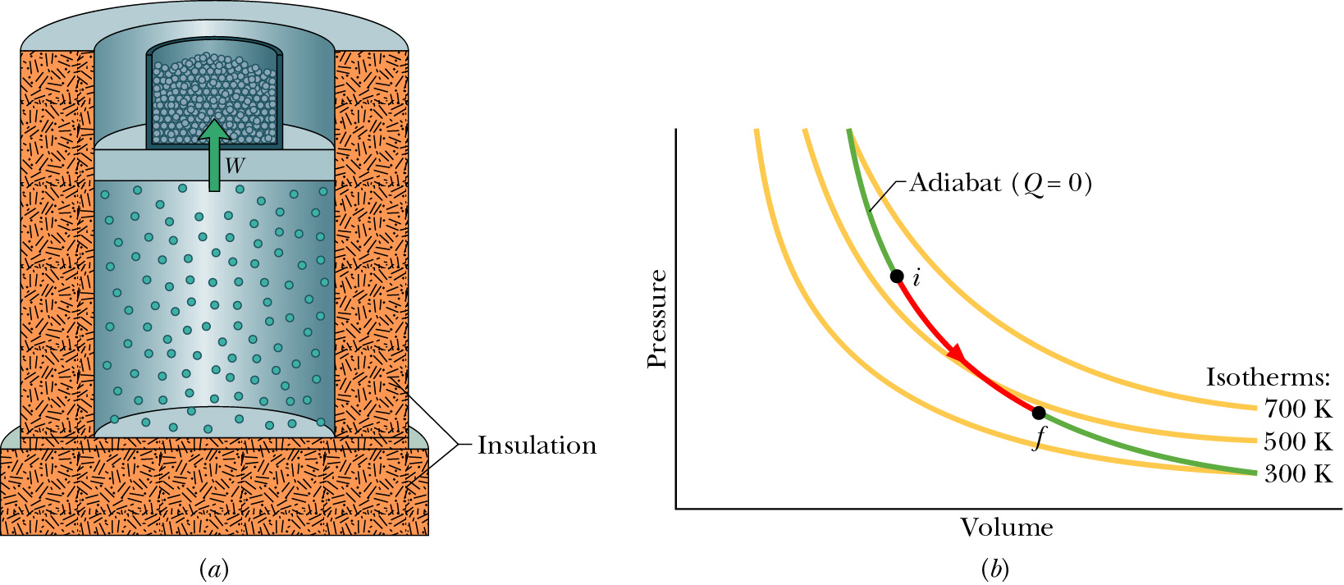

Slide 20
iclicker question:
Suppose that an ideal gas expands adiabatically. Does the temperature
(A) Increase (B) Decrease (C) Remain the same

Slide 21
Review of results from ideal gas analysis in terms of the specific heat ratio γ ≡ C_{P}/C_{V}:
For an isothermal process, ΔE_{int} = 0 ➔ Q=-W
For an adiabatic process, Q = 0

Slide 22
Note:
It can be shown that the work done by an ideal gas which has an initial pressure P_{i} and initial volume V_{i} when it expands adiabatically to a volume V_{f} is given by:

Slide 23
Examples process by an ideal gas:
P_{f}
B
C
 | A→B | B→C | C→D | D→A
Q
W | 0 | -P_{f}(V_{f}-V_{i}) | 0 | P_{i}(V_{f}-V_{i})
ΔE_{int}
P (1.013 x 10⁵) Pa
A
D
P_{i}
Efficiency as an engine:
e = W_{net/} Q_{input}
V_{i}
V_{f}

