Slide 1
PHY 113 A General Physics I
9-9:50 AM MWF Olin 101
Plan for Lecture 32:
Chapter 22: Heat engines
Thermodynamic cycles; work and heat efficiency
Carnot cycle
Otto cycle; diesel cycle
Note – in this class, we will not focus on entropy and the second law of thermodynamics
Notes:
Problems 1.1,1.6,1.10,1.11

Slide 3
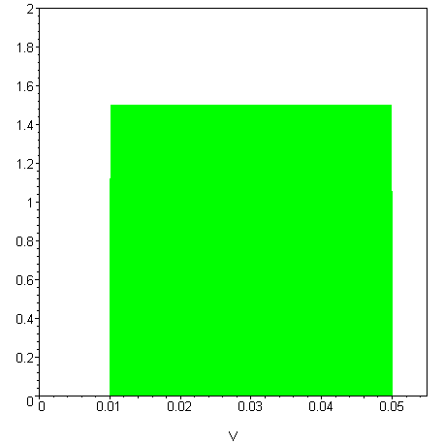
Thermodynamic cycles for designing ideal engines and heat pumps
http://auto.howstuffworks.com/engine1.htm
Engine process:
P_{f}
B
C
P (1.013 x 10⁵) Pa
A
D
P_{i}
V_{i}
V_{f}

Slide 4
Examples process by an ideal gas:
P_{f}
B
C
 | A→B | B→C | C→D | D→A
Q
W | 0 | -P_{f}(V_{f}-V_{i}) | 0 | P_{i}(V_{f}-V_{i})
ΔE_{int}
P (1.013 x 10⁵) Pa
A
D
P_{i}
V_{i}
V_{f}

Slide 5
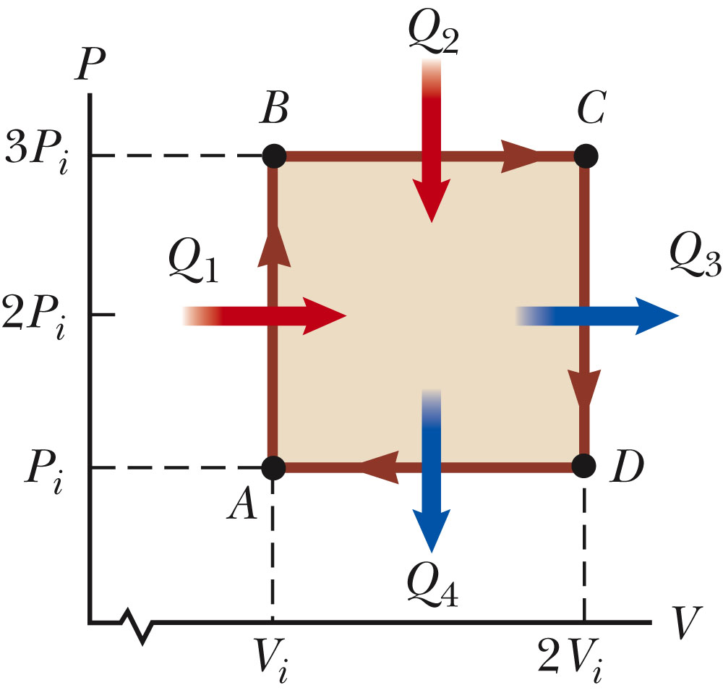
Example from homework

Slide 6
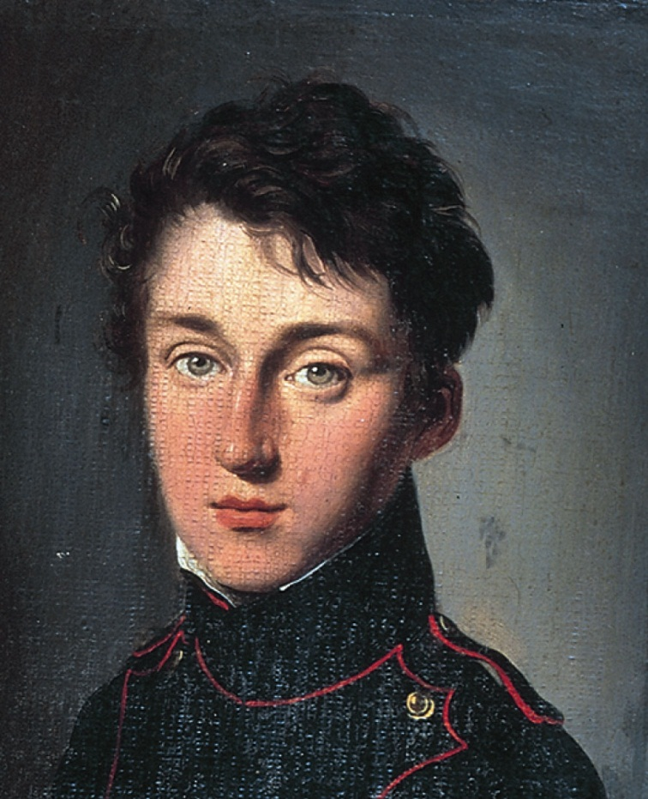
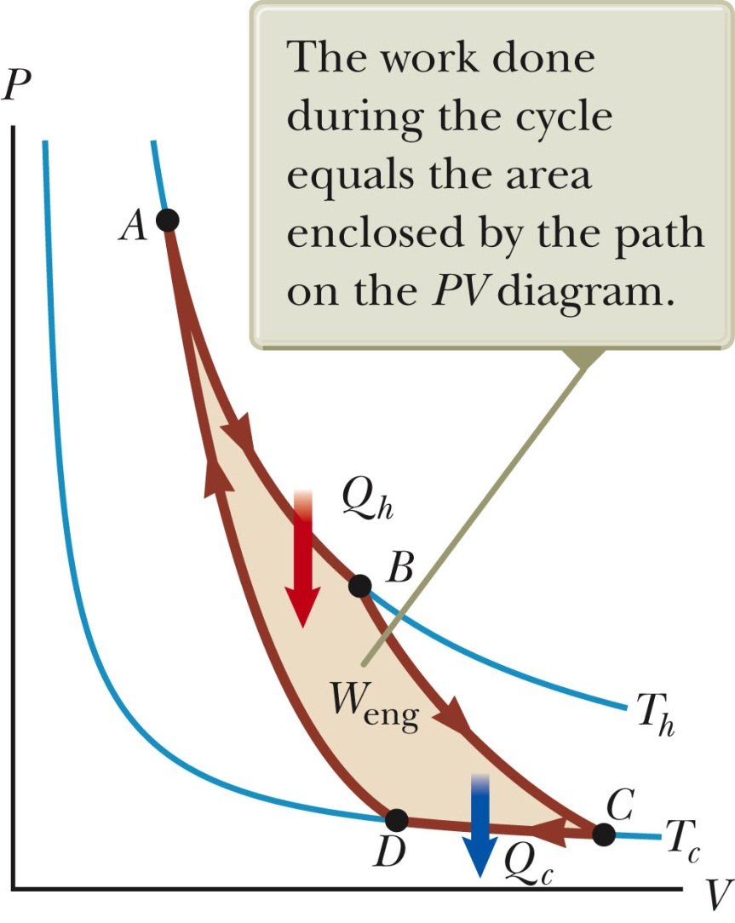
Most efficient thermodynamic cycle -- Carnot
Sadi Carnot 1796-1832

Slide 7
Carnot cycle:
A→B Isothermal at T_{h}
B→C Adiabatic
C→D Isothermal at T_{c}
D→A Adiabatic

Slide 8
iclicker exercise:
We discussed the efficiency of an engine as
Is this result
Special to the Carnot cycle
General to all ideal thermodynamic cycles
iclicker exercise:
We discussed the efficiency of an engine running with hot and cold reservoirs as
Is this result
Special to the Carnot cycle
General to all ideal thermodynamic cycles

Slide 10
iclicker exercise:
Why should we care about the Carnot cycle?
We shouldn’t
It approximately models some heating and cooling technologies
It provides insight into another thermodynamic variable -- entropy

Slide 11
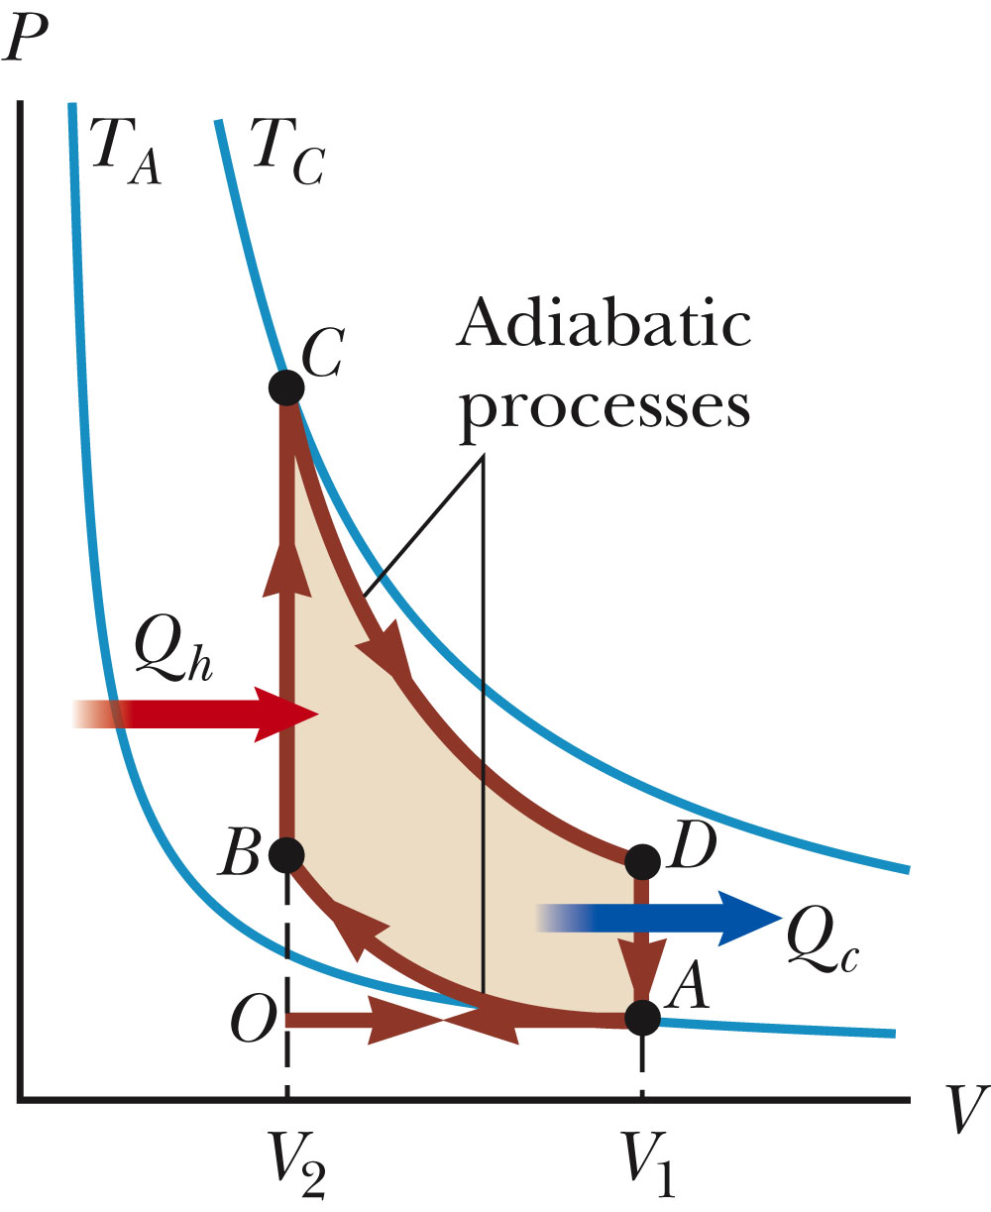
The Otto cycle

Slide 12
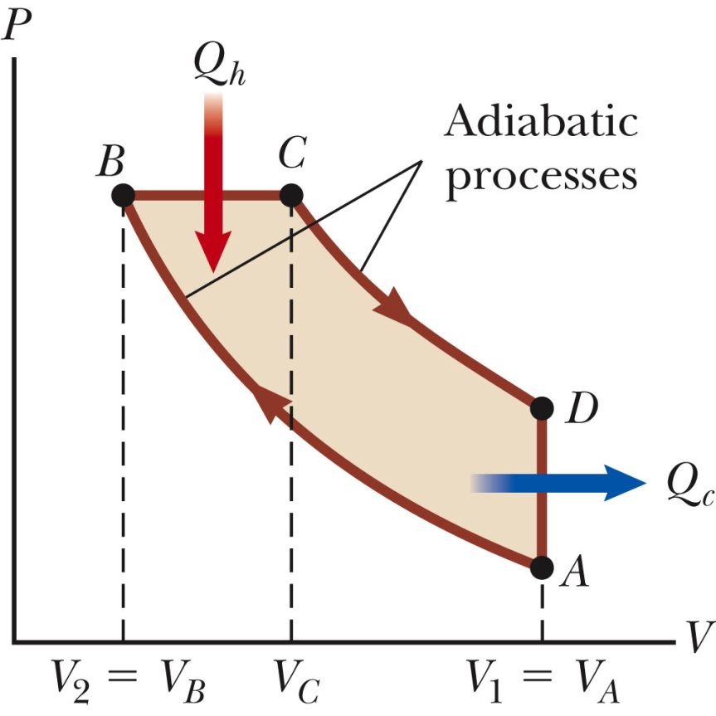
The Diesel cycle

Slide 14
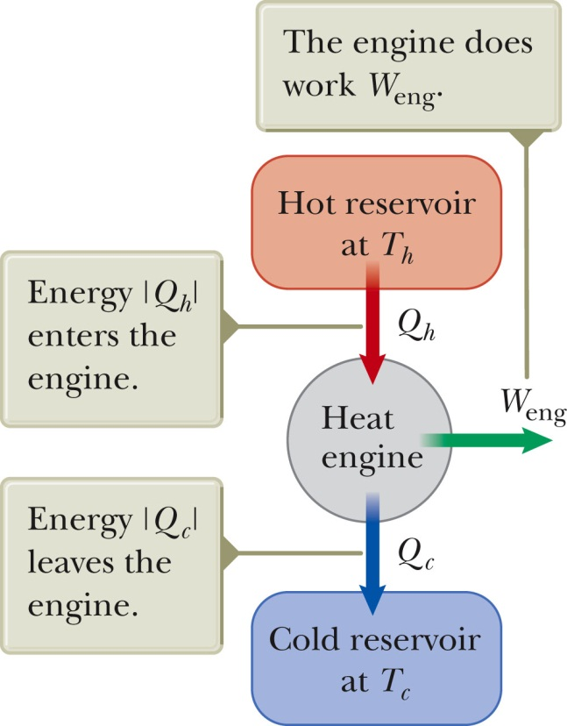
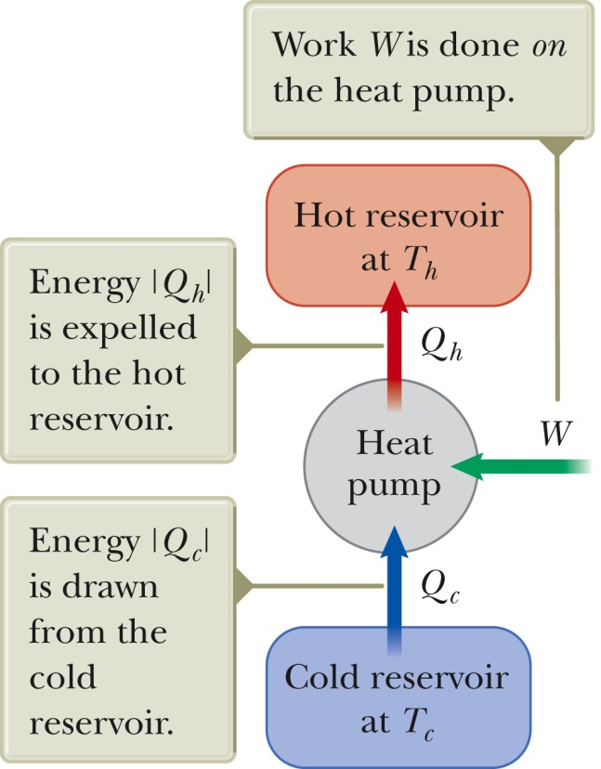
Engine vs heating/cooling designs

