Slide 1
PHY 113 A General Physics I
9-9:50 AM MWF Olin 101
Plan for Lecture 32:
Review of Chapters 14, 19-22
Advice about preparing for exam
Review of the physics of fluids and of thermodynamics
Example problems
Notes:
Problems 1.1,1.6,1.10,1.11

Slide 3
Format of Wednesday’s exam
What to bring:
Clear, calm head
Equation sheet (turn in with exam)
Scientific calculator
Pencil or pen
(Note: labtops, cellphones, and other electronic equipment must be off or in sleep mode.)
Timing:
May begin as early as 8 AM; must end ≤ 9:50 AM
Probable exam format
4 problems similar to homework and class examples; focus on Chapters 14 & 19-22 of your text.
Full credit awarded on basis of analysis steps as well as final answer

Slide 4
Examples of what to include on equation sheet
Given information on exam paper | Suitable for equation sheet
Universal or common constants (such as g, R, ..) | Basic physics equations from earlier Chapters: Newton’s laws, energy, momentum,…
Particular constants (density of fluid, heat capacity of fluid, latent heat for phase change …) | Relationship between pressure and force; fluid density; pressure within fluids; buoyant force; Bernoulli’s equation
Unit conversion factors such atm to Pa, Cal to J, ºC to K, … | Concept of temperature and its measurement scales; ideal gas law
 | Definition of thermodynamic heat and work; first law of thermodynamics
 | Molecular model of ideal gas law; internal energy of ideal gas
 | Thermodynamic cycles and their efficiency

Slide 5
General advice for preparing for exam
Prepare equation sheet, including basic equations* from each chapter
Work example problems from class notes, textbook examples, webassign, other sources using your equation sheet
During your review, you may develop new questions. Make an effort to get answers by consulting with your instructor, physics TA, etc.
*Note: One of the challenges is to distinguish the basic equations/concepts from particular examples

Slide 6
iclicker question:
Which of the following equations concerning the physics of fluids can be safely omitted from your equation sheet?

Slide 7
Problem solving steps
Visualize problem – labeling variables
Determine which basic physical principle(s) apply
Write down the appropriate equations using the variables defined in step 1.
Check whether you have the correct amount of information to solve the problem (same number of knowns and unknowns). Note: in some cases, there may be extra information not needed in the solution.
Solve the equations.
Check whether your answer makes sense (units, order of magnitude, etc.).

Slide 8
iclicker question:
I would like to have two extra review sessions one on Monday and one on Tuesday to go over the material
I would like to have one extra review session on Tuesday to go over the material
I would like to schedule individual or small group meetings in Olin 300 to go over the material
I am good

Slide 9
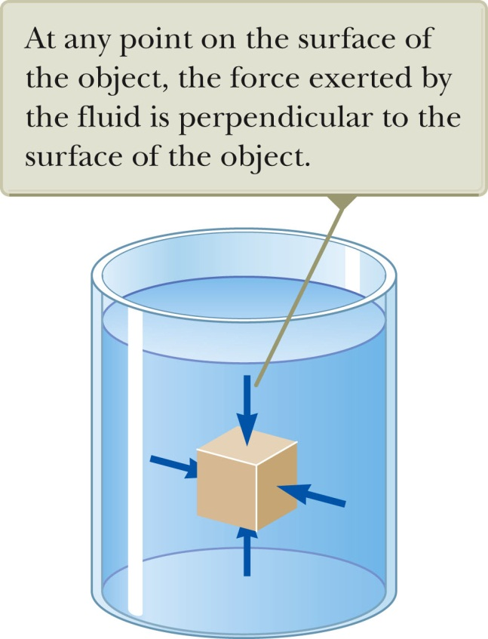
Review: Physics of fluids

Slide 10
Review: Physics of fluids -- continued
Pressure exerted by fluid itself due to gravity:
P(y+Δy)
ρgΔy = mg/A
y
P(y)
y₂
ρ
y₁

Slide 11
Review: Physics of fluids -- continued
Buoyant force
ρ_{fluid}
F_{B}
N
mg

Slide 12
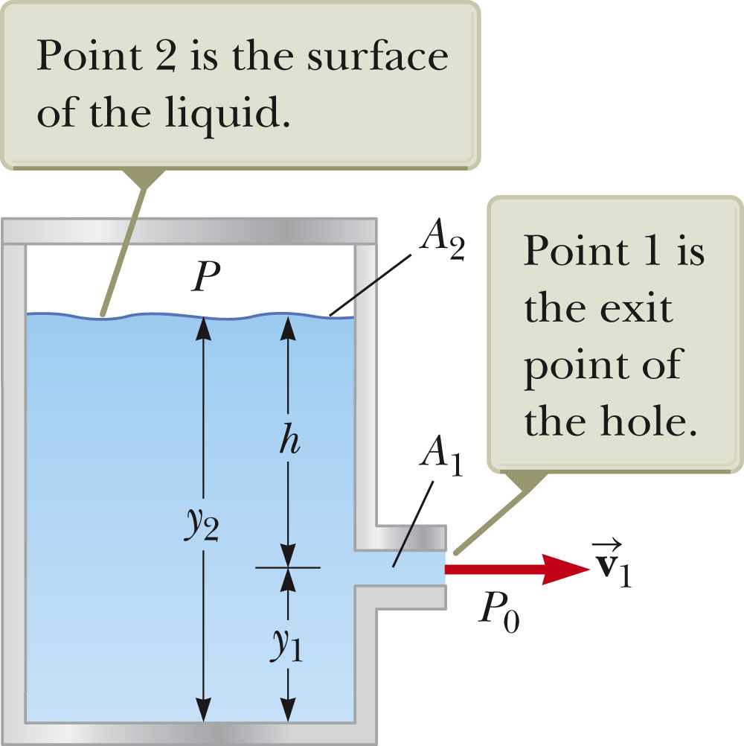
Review: Physics of fluids -- continued
Bernoulli’s equation
Continuity condition
P₂
=P₁

Slide 13
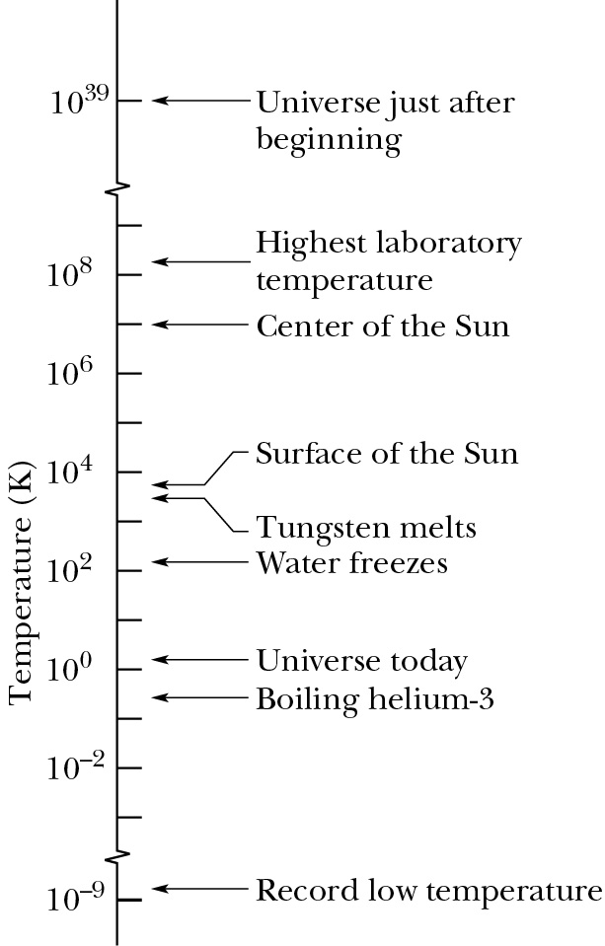
Review: Temperature -- notion of “absolute” Kelvin scale
T_{C}=T_{K}-273.15

Slide 14
Review: Ideal gas law
Effects of temperature on materials –ideal gas “law” (thanks to Robert Boyle (1627-1691), Jacques Charles (1746-1823), and Gay-Lussac (1778-1850)
8.314 J/(mol K)
temperature in K
volume in m³
# of moles
pressure in Pascals
1 mole corresponds to 6.022 x 10²³ molecules

Slide 15
Review: Notion of internal energy of a system
E_{int}(T,V,P….)
The internal energy is a “state” property of the system, depending on the instantaneous parameters (such as T, P, V, etc.).
ΔE_{int} can also include phase change of a material (solid←→liquid, liquid←→gas, etc.)

Slide 16
Review: First law of thermodynamics
E_{i}
E_{f}
Q
W
Q: heat added to system W: work on system

Slide 17
Review: First law of thermodynamics – continued
Examples with W=0 → ΔE_{int} = Q
Changing temperature in a given phase
Changing phase at given temperature

Slide 18
Review: First law of thermodynamics – continued

Slide 19
Review: First law of thermodynamics – continued
E_{int} for ideal gas

Slide 20
Review: First law of thermodynamics – continued
Translational kinetic energy for ideal gas molecules:

Slide 21
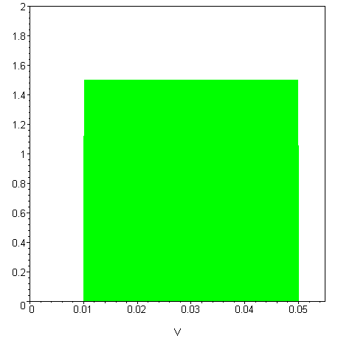
Review thermodynamic cycles for designing ideal engines and heat pumps
Engine process:
P_{f}
B
C
P (1.013 x 10⁵) Pa
A
D
P_{i}
V_{i}
V_{f}

Slide 22
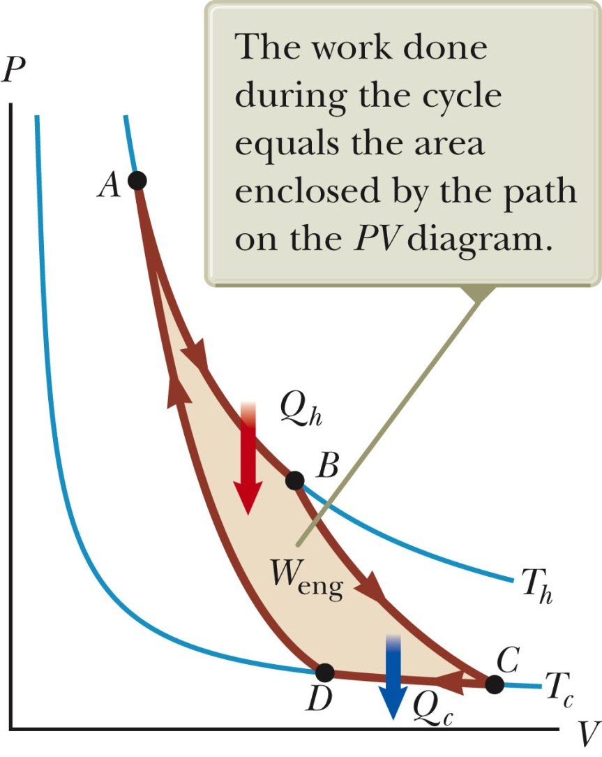
Review thermodynamic cycles -- Carnot cycle
A→B Isothermal at T_{h}
B→C Adiabatic
C→D Isothermal at T_{c}
D→A Adiabatic

Slide 23
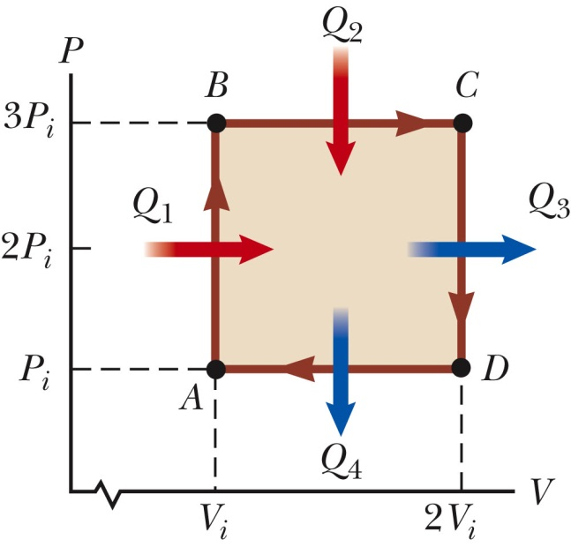
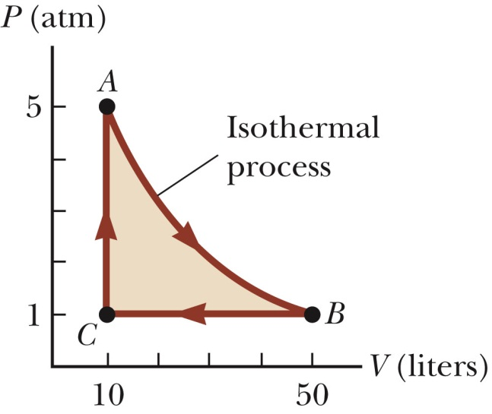
Review thermodynamic cycles – continued
Other examples of thermodynamic cycles
Thermodynamic work: W = –(shaded area)
For simple graph, can use geometry to calculate area; first law of thermo and ideal gas laws also apply.

