Slide 1
PHY 113 A General Physics I
9-9:50 AM MWF Olin 101
Plan for Lecture 34:
Chapter 16 – Physics of wave motion
Examples of wave motion
What determines the wave velocity
Properties of periodic waves
Notes:
Problems 1.1,1.6,1.10,1.11

Slide 3
The phenomenon of wave motion
The wave equation
Wave variable
What does the wave equation mean?
Examples
Mathematical solutions of wave equation and descriptions of waves
position time

Slide 4
Example: Water waves
Source: http://www.eng.vt.edu/fluids/msc/gallery/gall.htm
Needs more sophistocated analysis:

Slide 5
Mechanical waves occur in continuous media. They are described by a value (y) which changes in both time (t) and position (x) and are characterized by a wave velocity c: y=y(x-ct) or y=y(x+ct)

Slide 6
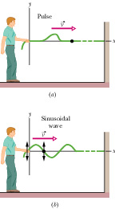
Waves on a string:
Typical values for c:
3x10⁸ m/s light waves
~1000 m/s wave on a string
343 m/s sound in air

Slide 7
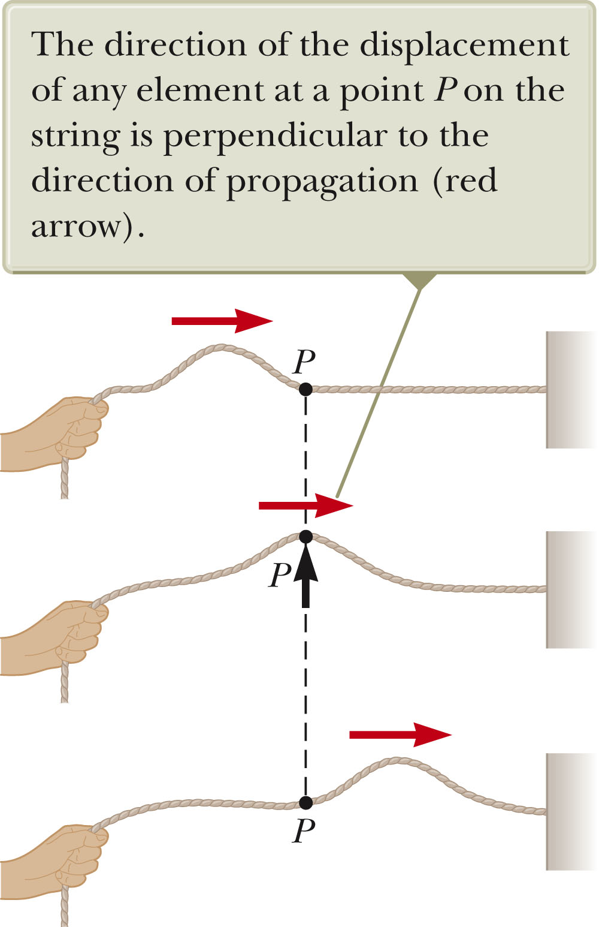
Transverse wave:

Slide 8
Longitudinal wave:

Slide 9
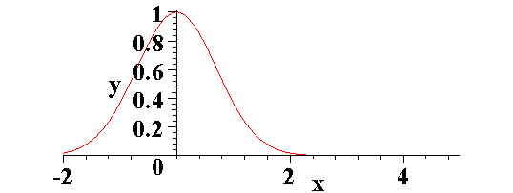
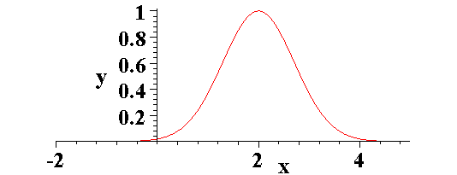
General traveling wave –
t = 0
t > 0

Slide 10
iclicker question:
t=0
t=1 s
t=2s

Slide 11
Basic physics behind wave motion --
example: transverse wave on a string with tension T and mass per unit length μ
Δy
θ_{B}
Δx
y

Slide 12
The wave equation:
Solutions: y(x,t) = f (x ± ct)
function of any shape

Slide 13
Examples of solutions to the wave equation:
Moving “pulse”:
Periodic wave:
phase factor
“wave vector”
not spring constant!!!

Slide 14
phase (radians)
Periodic traveling waves:
velocity (m/s)
period (s); T = 1/f
wave length (m)
Amplitude

Slide 15
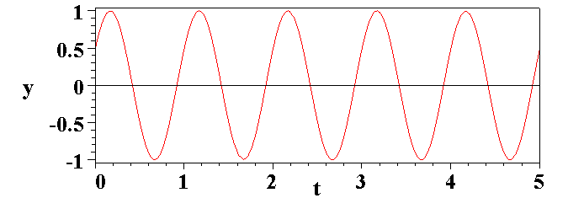
Snapshot of periodic wave at t=t₀
λ
f λ = c
Time plot of periodic wave at x=x₀
1/f

Slide 16
Combinations of waves (“superposition”)
“Standing” wave:

Slide 17
Summary of wave properties:

