Slide 1
PHY 113 A General Physics I
9-9:50 AM MWF Olin 101
Plan for Lecture 35:
Chapter 17 & 18 – Physics of wave motion
Standing waves
Sound waves
Doppler effect
Notes:
Problems 1.1,1.6,1.10,1.11

Slide 3
Combinations of waves (“superposition”)
“Standing” wave:

Slide 4
“Standing” wave:
iclicker exercise:
Why is this superposition result important?
Physics instructors like to torture their students.
While the trigonometric relation is always true, it is rarely useful for describing real situations.
It can describe the motion of a guitar string.

Slide 6
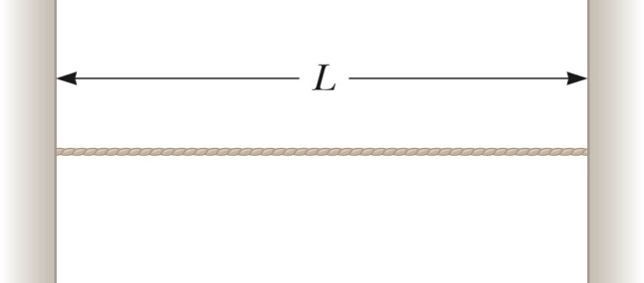
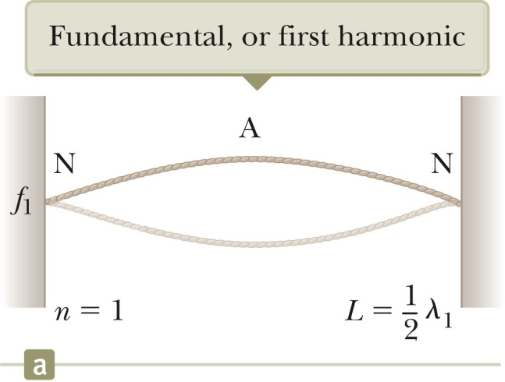
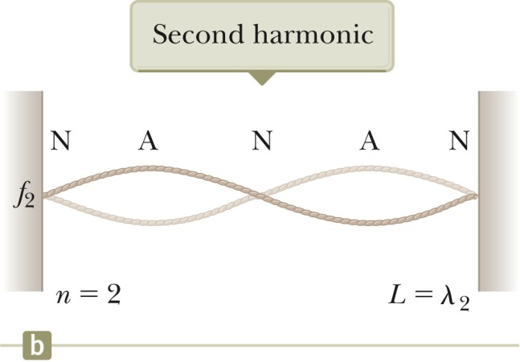
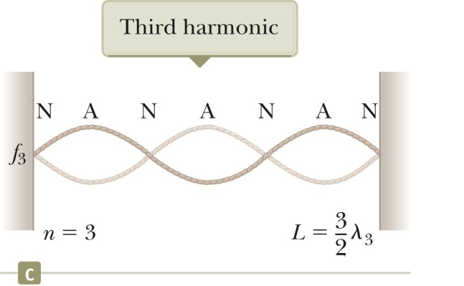

Slide 7
iclicker question:
Which of the following statements are true about the string motions described above?
The human ear can directly hear the string vibrations.
The human ear could only hear the string vibration if it occurs in vacuum.
The human ear can only hear the string vibration if it produces a sound wave in air.

Slide 8
Comments about waves in materials:
Solid materials can support both transverse and longitudinal wave motion
Fluids, especially gases can support only longitudinal wave motion

Slide 9
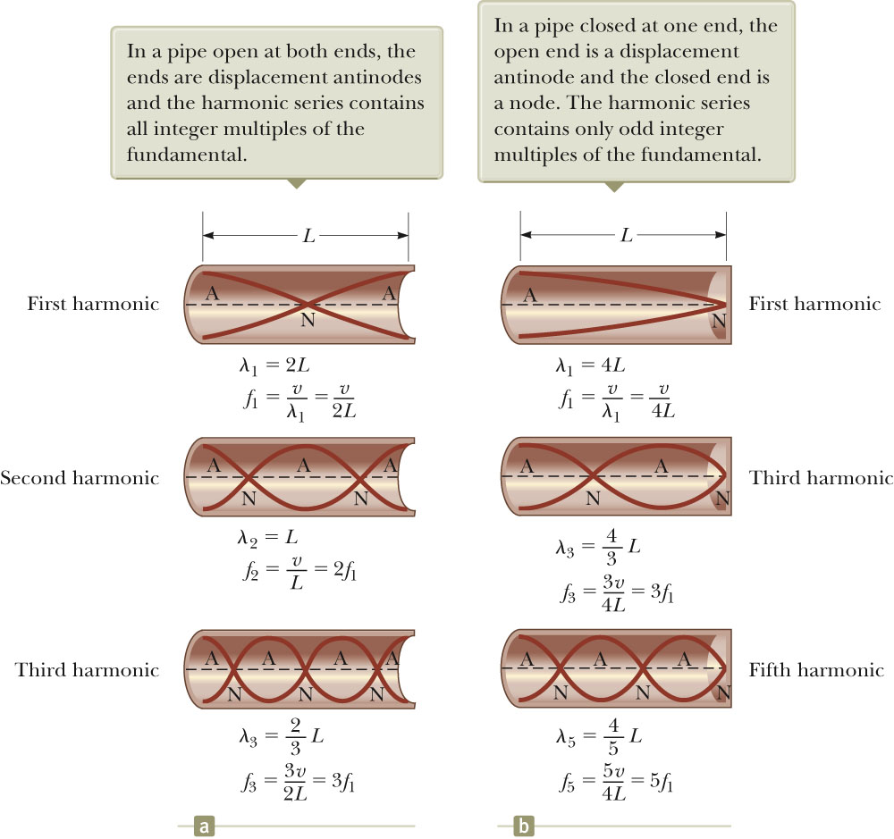
Standing waves in air:

Slide 10
Coupling standing wave resonances in materials with sound:
iclicker question:
Suppose an “A” is played on a guitar string. The standing wave on the string has a frequency (f_{g}), wavelength (λ_{g}) and speed (c_{g}) . Which properties of the resultant sound wave are the same as wave on the guitar string?
Frequency f_{s}
Wavelength λ_{s}
Speed c_{s}
A-C
None of these

Slide 11
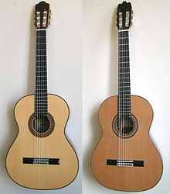
coupling to
sound

Slide 12
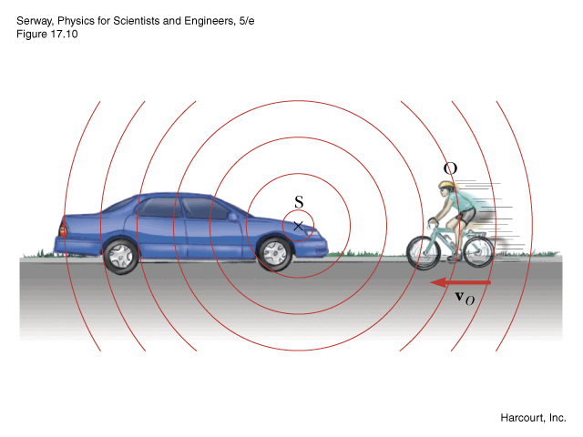
The “Doppler” effect v=sound velocity
observer moving, source stationary
observer
source
v_{S}=0
d

Slide 13
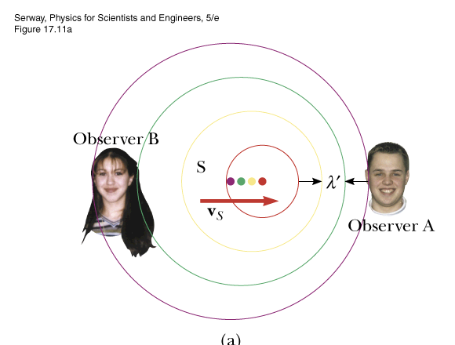
The “Doppler” effect v=sound velocity
observer stationary, source moving
d
toward
away

Slide 14
Example:
toward
away
Velocity of sound:
v = 343 m/s

Slide 15
iclicker question
Is Doppler radar described by the equations given above for sound Doppler?
yes (B) no
Is “ultra sound” subject to the sound form of the Doppler effect?
(A) yes (B) no

Slide 16
toward
away
Relative velocity of source toward observer

