Slide 1
PHY 113 A General Physics I
9-9:50 AM MWF Olin 101
Plan for Lecture 36:
Review – Part I
General advice about how to study
Some comments on sound and waves
Review of past exam questions
Review – Part II (Friday)
Systematic review of PHY 113 topics
Notes:
Problems 1.1,1.6,1.10,1.11

Slide 3
Comments on final exam for PHY 113
Date: Thursday, Dec. 13, 2012 at 9 AM
Place: Olin 101
Format: Similar to previous exams; covering material in Lectures 1-37, Chapters 1-22 (no time pressure)
Focus: Basic physics concepts; problem-solving techniques
Bring:
Clear head
Calculator
Pencils, pens
Up to 4 equation sheets

Slide 4
iclicker question:
What is the purpose of the final exam in PHY 113
No purpose – just pain and suffering
To improve my grade in the course
It is a college tradition that must be maintained
To check that I have actually learned the material
To encourage students to review the course material and solidify my learning

Slide 5
Comments on waves and sound
Standing wave resonances for strings or pipes
Relationship between wave speed, frequency, and wavelength
Doppler effect

Slide 6
Formation of standing waves; beautiful trigonometric identity:
“Standing” wave: (λf=c)

Slide 7
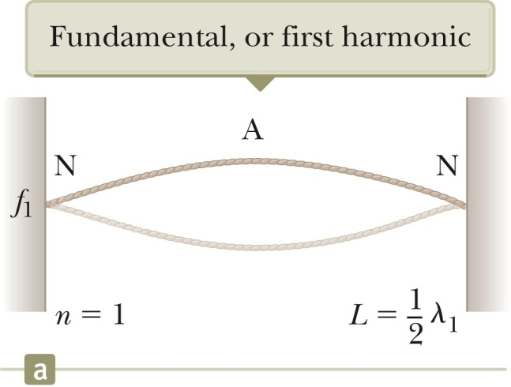
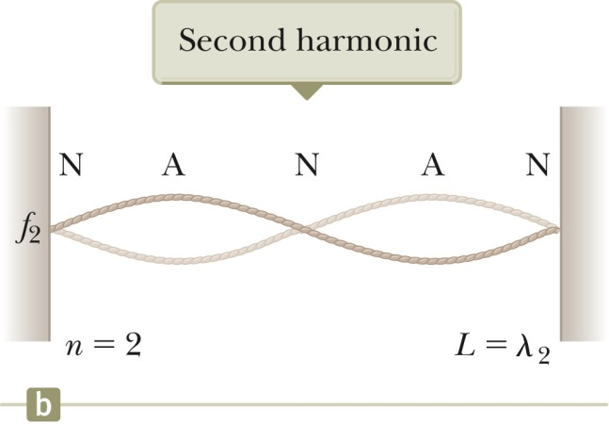
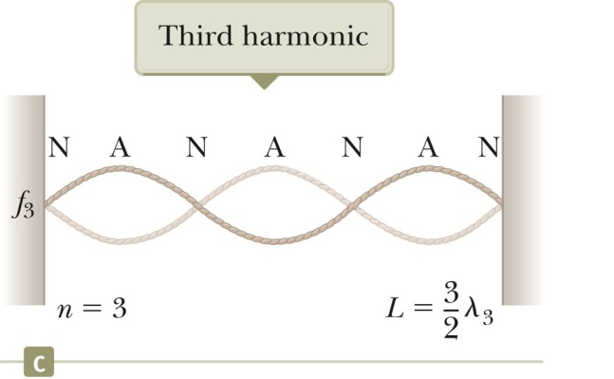

Slide 8
Musical scale (chromatic)

Slide 9
Standing waves in air c=343 m/s:

Slide 10
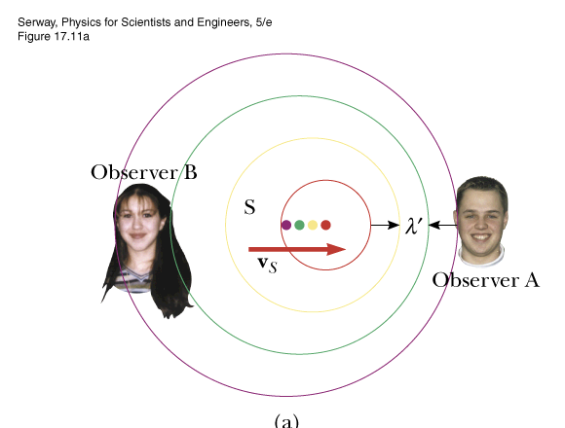
The “Doppler” effect v=sound velocity
observer stationary, source moving
d
toward
away

Slide 11
toward
away
Relative velocity of source toward observer

Slide 12
iclicker question:
The previous calculation for “radar” Doppler was:
Encouraging me to speed because it is impossible to detect such a small frequency difference
Full of admiration that Doppler radar equipment can detect such a small frequency difference
Not relevant to actual “radar” Doppler -- still need to be careful not to speed
iclicker question:
The fallacy in the previous analysis was
Incorrect value of f_{s}
Incorrect value of v (speed of light)
Calculator error

Slide 13
Relative velocity of source toward observer

Slide 16
Review questions from Exam 4:

Slide 17
Review questions from Exam 4:

Slide 18
Review questions from Exam 4:

Slide 19
Review questions from Exam 4:

Slide 20
Review questions from Exam 3:

Slide 21
Review questions from Exam 3:

Slide 22
Review questions from Exam 2:

Slide 23
Review questions from Exam 2:

Slide 24
Review questions from Exam 2:

