Slide 1
PHY 113 A General Physics I
9-9:50 AM MWF Olin 101
Plan for Lecture 37:
Review – Part II
General advice about how to study
Systematic review of PHY 113 topics
Review of past exam questions
Notes:
Problems 1.1,1.6,1.10,1.11

Slide 2
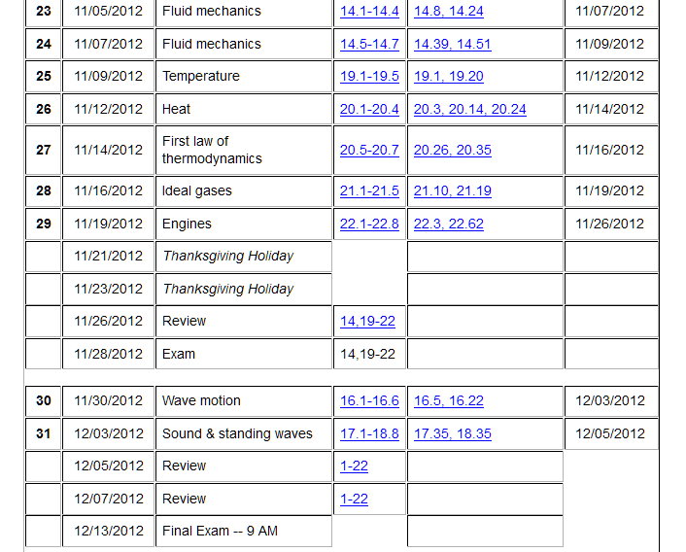

Slide 3
Comments on final exam for PHY 113
Date: Thursday, Dec. 13, 2012 at 9 AM
Place: Olin 101
Format: Similar to previous exams; covering material in Lectures 1-37, Chapters 1-22 (no time pressure)
Focus: Basic physics concepts; problem-solving techniques
Bring:
        Clear head
        Calculator
        Pencils, pens
        Up to 4 equation sheets

Slide 4
General advice for preparing for exam
  Prepare equation sheet, including basic equations* from each chapter
  Work example problems from class notes, textbook examples, webassign, other sources using your equation sheet
  During your review, you may develop new questions. Make an effort to get answers by consulting with your instructor, physics TA, etc.
*Note: One of the challenges is to distinguish the basic equations/concepts from particular examples

Slide 5
Problem solving steps
  Visualize problem – labeling variables
  Determine which basic physical principle(s) apply
  Write down the appropriate equations using the variables defined in step 1.
  Check whether you have the correct amount of information to solve the problem (same number of knowns and unknowns).
  Solve the equations.
  Check whether your answer makes sense (units, order of magnitude, etc.).

Slide 6
Problem solving skills
Math skills
Equation Sheet
Advice:
Keep basic concepts and equations at the top of your head.
Practice problem solving and math skills
Develop an equation sheet that you can consult.

Slide 7
What to include on equation sheet -- from Exam 1
Given information on exam | Suitable for equation sheet
Universal constants (such as g=9.8m/s²) | Trigonometric relations
Particular constants (such as μ_{s}, μ_{k}) | Simple derivative and integral relationships
Unit conversion factors if needed | General relationships of position, velocity, acceleration
 | Particular formulas for trajectory motion
 | Expression for centripetal acceleration
 | Expressions for model friction forces

Slide 8
What to include on equation sheet -- from Exam 2
Given information on exam | Suitable for equation sheet
Universal constants (such as g=9.8m/s²) | Trigonometric relations and definition of dot product
Particular constants (such as μ_{s}, μ_{k}) | Simple derivative and integral relationships
Unit conversion factors if needed | Definition of work, potential energy, kinetic energy
 | Work-kinetic energy theorem
 | Relationship between force, potential energy, and work for conservative systems
 | Relationship of impulse and momentum; conservation of momentum
 | Elastic and inelastic collisions
 | Center of mass

Slide 9
What to include on equation sheet – from Exam 3
Given information on exam | Suitable for equation sheet
Universal or common constants (such as g, G, M_{E}, M_{S}, R_{E}…) | Basic equations from material from earlier Chapters: Newton’s laws, energy, momentum, center of mass
Particular constants (such as k,m,I… ) | Simple derivative and integral relationships, including trigonometric functions
Unit conversion factors such as Hz and rad/s | Definition of moment of inertia, torque, angular momentum, rotational kinetic energy
 | Newton’s law for rotational motion; combination of rotational and center of mass motion
 | Equations describing simple harmonic motion and driven harmonic motion
 | Newton’s universal gravitation force law and corresponding gravitational potential energy
 | Gravitational stable circular orbits

Slide 10
What to include on equation sheet – from Exam 4
Given information on exam paper | Suitable for equation sheet
Universal or common constants (such as g, R, ..) | Basic physics equations from earlier Chapters: Newton’s laws, energy, momentum,…
Particular constants (density of fluid, heat capacity of fluid, latent heat for phase change …) | Relationship between pressure and force; fluid density; pressure within fluids; buoyant force; Bernoulli’s equation
Unit conversion factors such atm to Pa, Cal to J, ºC to K, … | Concept of temperature and its measurement scales; ideal gas law
 | Definition of thermodynamic heat and work; first law of thermodynamics
 | Molecular model of ideal gas law; internal energy of ideal gas
 | Thermodynamic cycles and their efficiency

Slide 11
What to include on equation sheet – from Wave Motion
Given information on exam paper | Suitable for equation sheet
Particular constants (speed of wave … ) | The wave equation and forms of its solution
 | Traveling wave ⬅➔ standing wave
 | Standing wave frequencies on a string; standing wave frequencies in a pipe
 | Relationship between standing wavelength on a string and the corresponding wavelength of sound
 | The Doppler effect

Slide 12
iclicker question:
How have you found the equation sheet in past exams?
  Not really helpful; did not use it during the exam
  Very helpful during exam
  A bad idea altogether
iclicker question:
For those of you who find the equation sheet helpful, how do you expect to prepare your sheets for the final exam
  I will just bring the 4 sheets I have used in the past and add a few equations from wave motion
  I will prepare new sheets

Slide 13
Review materials
  Past lecture notes
  Past exams
  Webassign
  Your textbook
Links to past reviews:
  Exam 1 review
  Exam 2 review
  Exam 3 review
  Exam 4 review

Slide 14
iclicker exercise:
How do you use the posted lecture notes?
  I have never used them outside of class
  They are not even helpful in class
  They are only helpful in class
  I find them somewhat useful outside of class

Slide 15
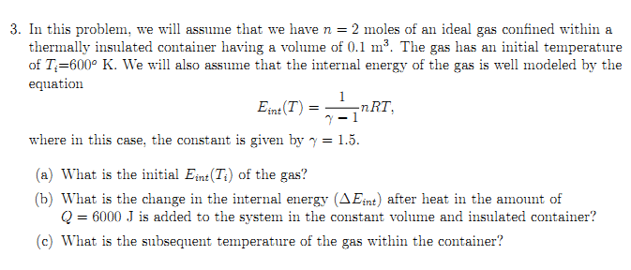
Review questions from Exam 4:

Slide 16
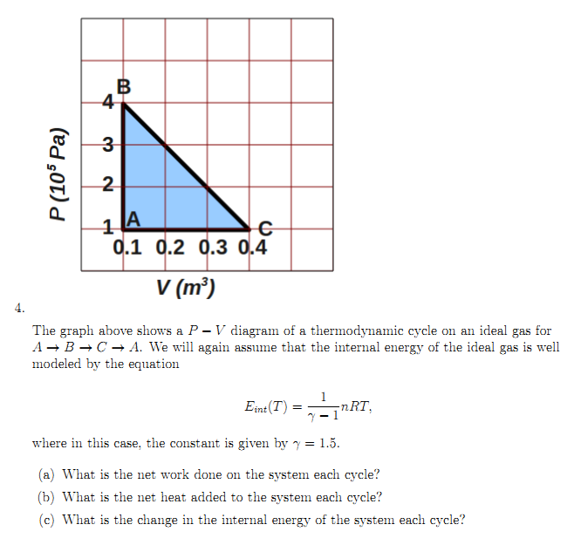
Review questions from Exam 4:

Slide 17
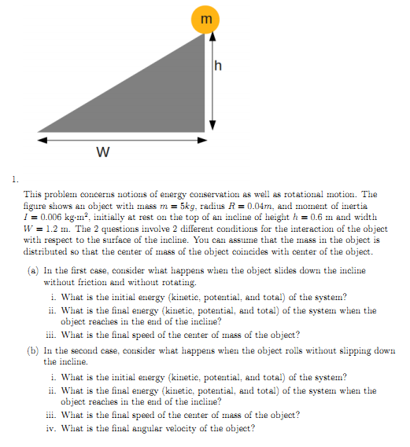
Review questions from Exam 3:

Slide 18
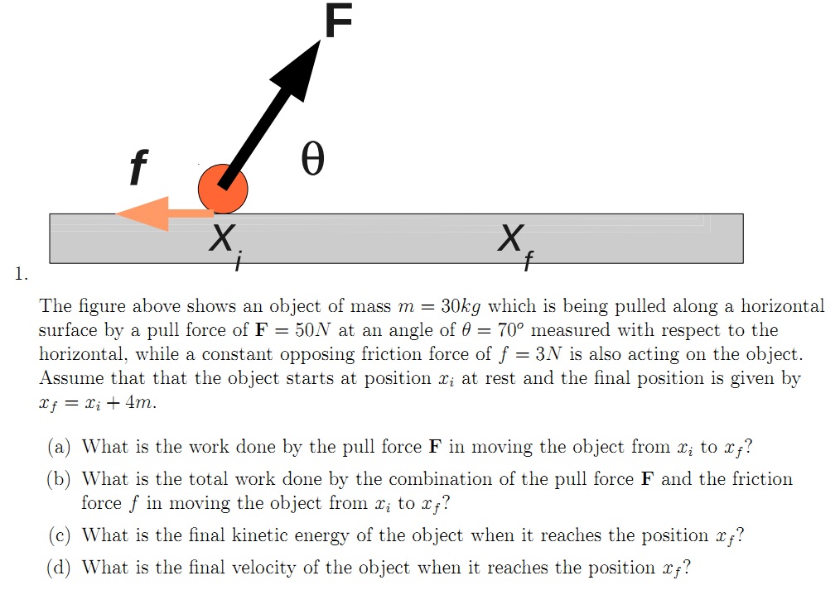
Review questions from Exam 2:

Slide 19
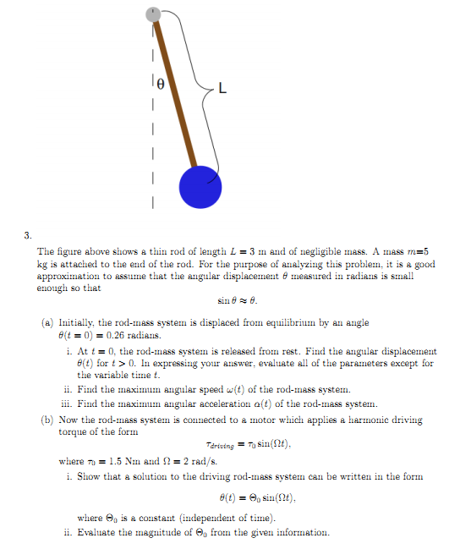
Review questions from Exam 3:

Slide 20
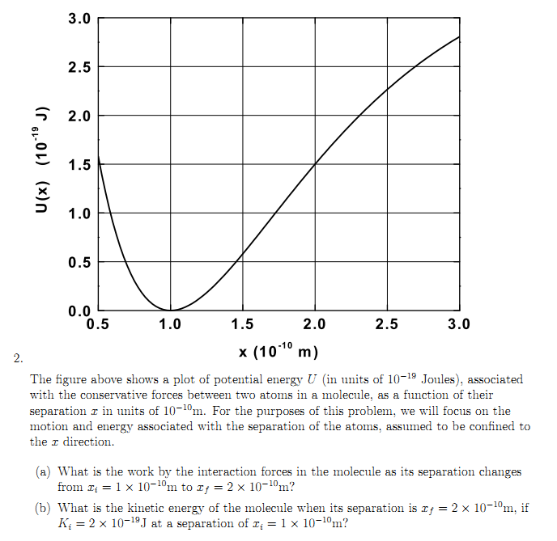
Review questions from Exam 2:

Slide 21
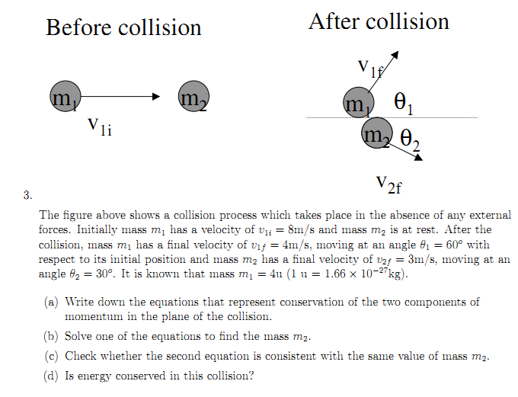
Review questions from Exam 2:

Slide 22
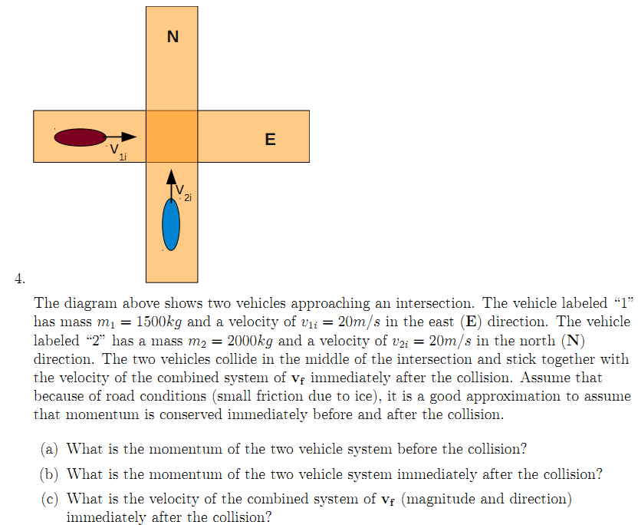
Review questions from Exam 2:

Slide 23
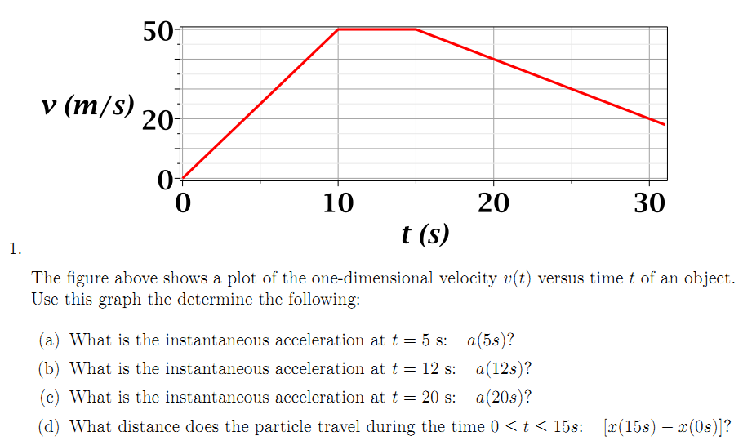
Review questions from Exam 1:

Slide 24
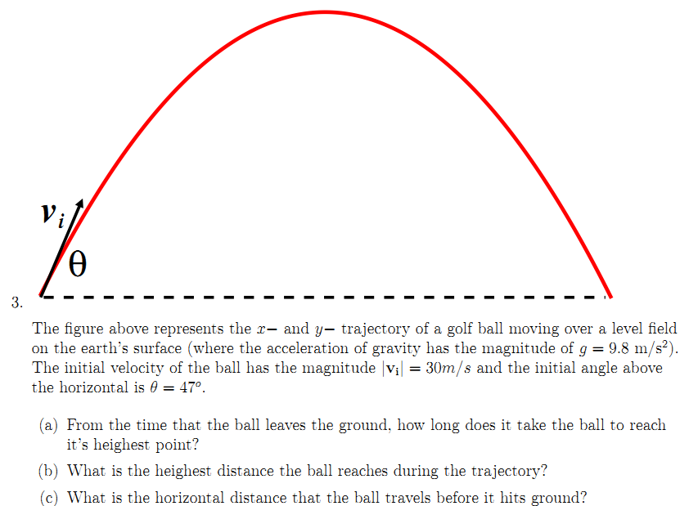
Review questions from Exam 1:

Slide 25
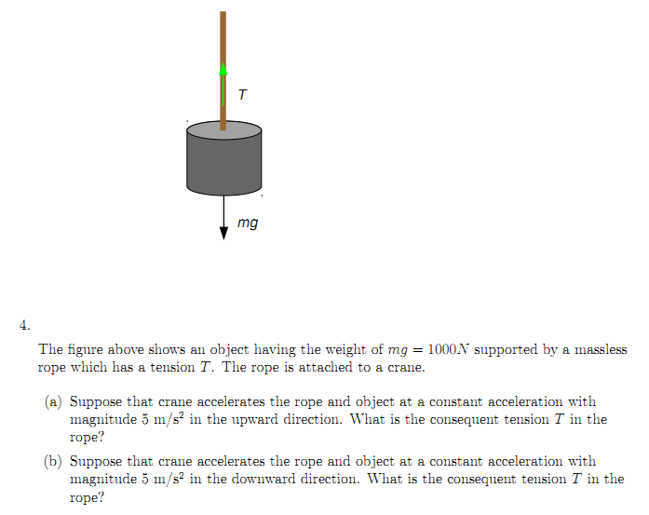
Review questions from Exam 1:

