Slide 1
PHY 113 A General Physics I
9-9:50 AM MWF Olin 101
Plan for Lecture 4:
Chapter 3 – Vectors
Abstract notion of vectors
Displacement vectors
Other examples
Notes:
Problems 1.1,1.6,1.10,1.11

Slide 2
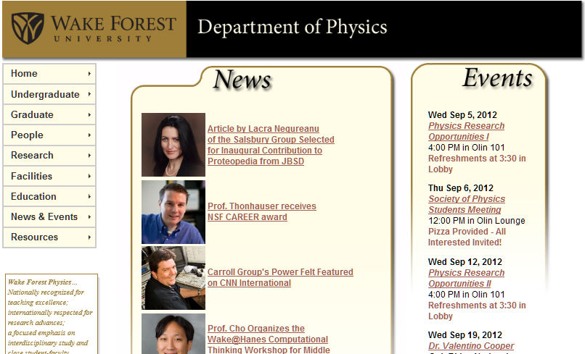

Slide 4
iclicker question
Have you attended a tutoring session yet?
Have you attended a lab session yet?
Have you attended both tutoring and lab sessions?

Slide 5
iclicker question
Have you changed your webassign password yet?
yes
no
Mathematics Review -- Appendix B Serwey & Jewett
iclicker question
Have you used this appendix?
Have you used the appendix, and find it helpful?
Have you used the appendix, but find it unhelpful?

Slide 6
Mathematics Review -- Appendix B Serwey & Jewett
c
a
θ
b

Slide 7
Definition of a vector
A vector is defined by its length and direction.
Addition, subtraction, and two forms of multiplication can be defined
In practice, we can use trigonometry or component analysis for quantitative work involving vectors.
Abstract vectors are useful in physics and mathematics.

Slide 8
Vector addition:
a + b
b
a
Vector subtraction:
a
a – b
-b

Slide 9
Some useful trigonometric relations
(see Appendix B of your text)
c
β
α
Law of cosines:
a² = b² + c² - 2bc cos α
b² = c² + a² - 2ca cos β
c² = a² + b² - 2ab cos γ
a
b
γ
Law of sines:

Slide 10
Vector components:
a_{y}
a_{x}

Slide 11
Suppose you are given the length of the vector a as shown. How can you find the components?
ψ
a_{x}=a cos θ, a_{y}=a sin θ
a_{x}=a sin ψ, a_{y}=a cos ψ
Neither of these
Both of these
a = 1 m
a_{y}
θ
a_{x}

Slide 12
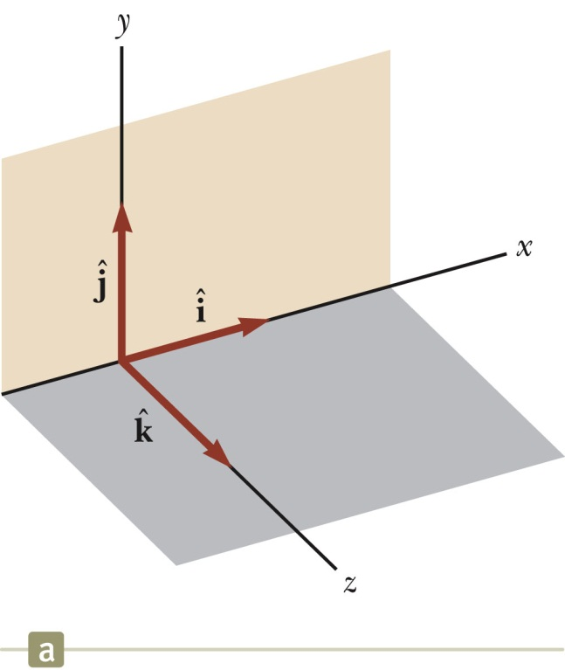
Vector components; using trigonometry
A
An orthogonal coordinate system

Slide 13
Vector components:
b_{y}
b_{x}
a_{y}
a_{x}

Slide 14
Examples
Vectors | Scalars
Position r | Time t
Velocity v | Mass m
Acceleration a | Volume V
Force F | Density m/V
Momentum p | Vector components

Slide 15
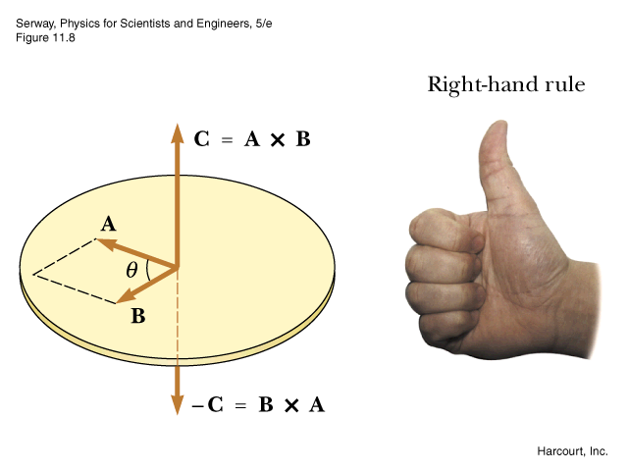
Vector components
Vector multiplication
“Dot” product
“Cross” product

Slide 16
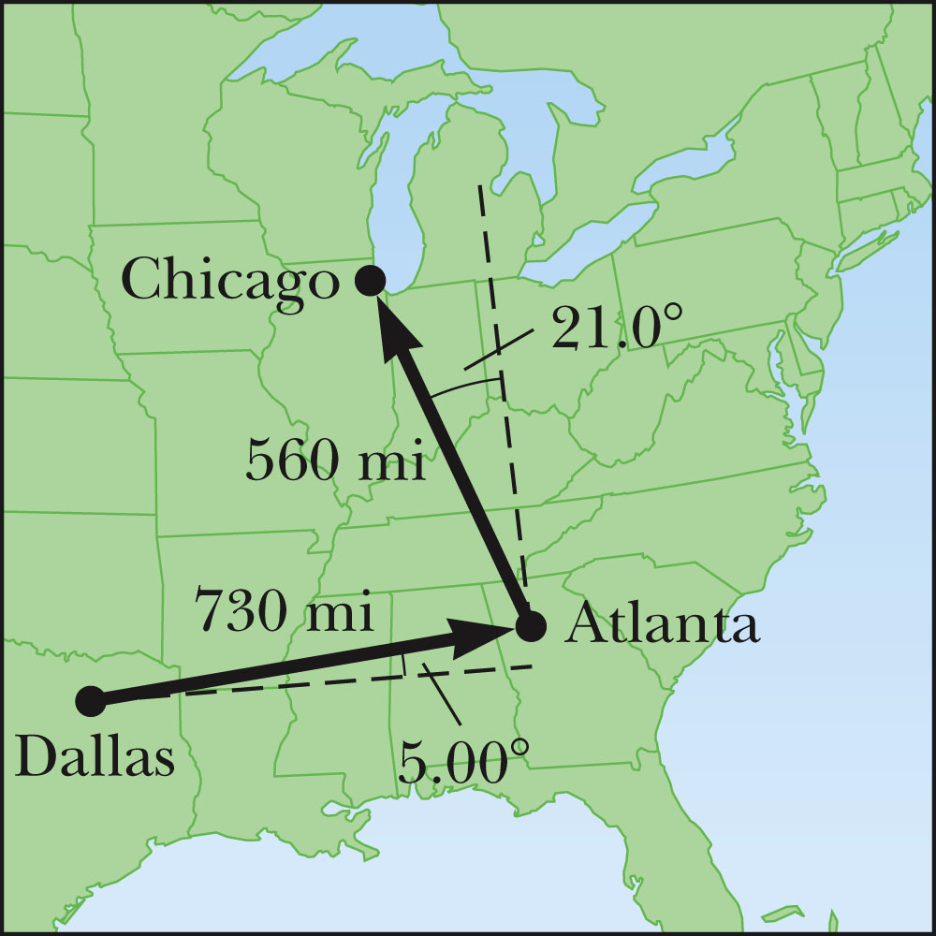
Example of vector addition:
b
a + b
a

Slide 17
a + b
b
γ
a

Slide 18
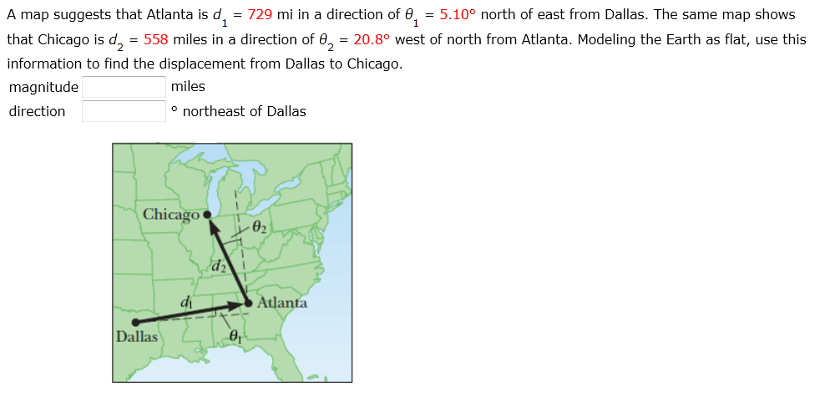
Webassign version:
Note: In this case the angle φ is actually measured as north of east.
φ

Slide 19
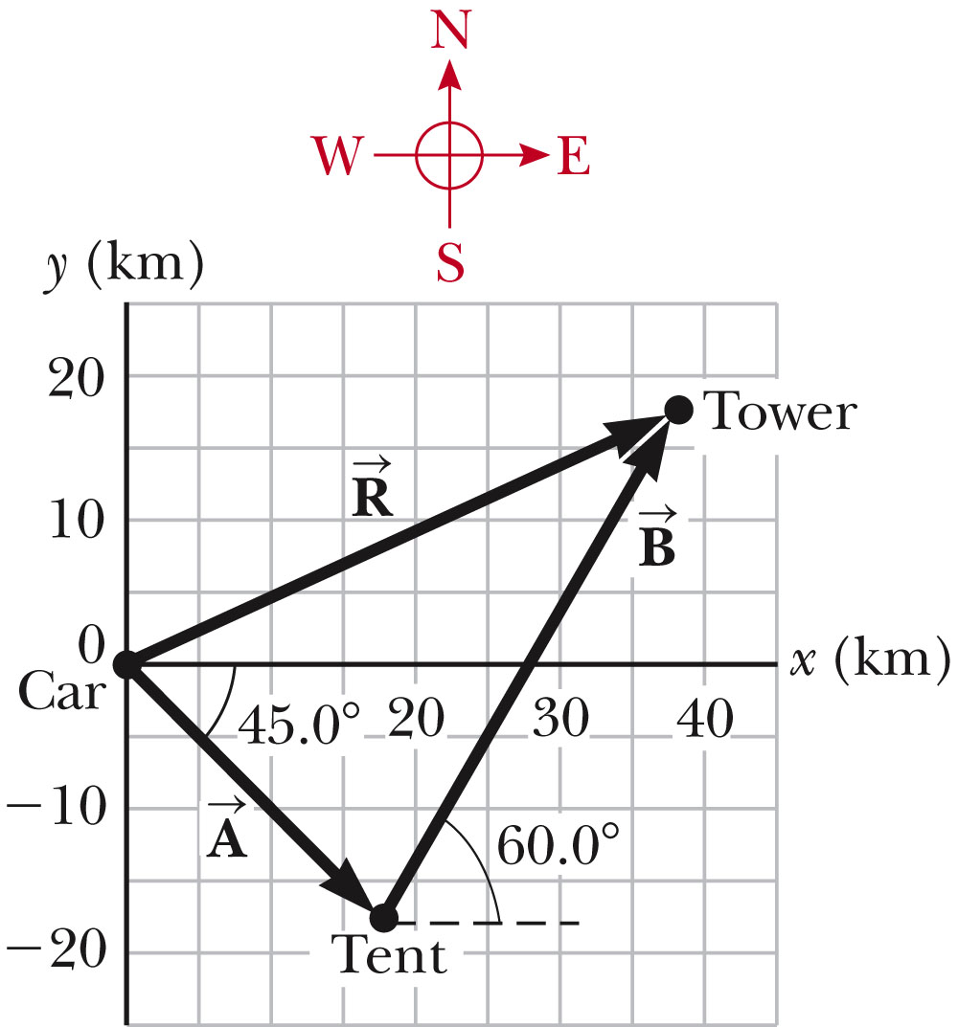
Another example:

