Slide 1
PHY 113 A General Physics I
9-9:50 AM MWF Olin 101
Plan for Lecture 5:
Chapter 4 – Motion in two dimensions
Position, velocity, and acceleration in two dimensions
Two dimensional motion with constant acceleration
Notes:
Problems 1.1,1.6,1.10,1.11

Slide 2
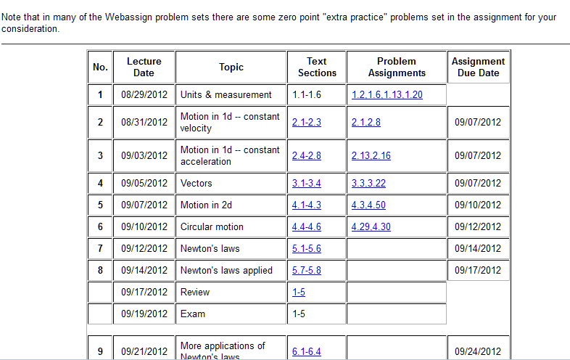

Slide 3
In the previous lecture, we introduced the abstract notion of a vector. In this lecture, we will use that notion to describe position, velocity, and acceleration vectors in two dimensions.
iclicker exercise:
Why spend time studying two dimensions when the world as we know it is three dimensions?
Because it is difficult to draw 3 dimensions.
Because in physics class, 2 dimensions are hard enough to understand.
Because if we understand 2 dimensions, extension of the ideas to 3 dimensions is trivial.
On Fridays, it is good to stick to a plane.

Slide 4
j
vertical direction (up)
horizontal
direction
i

Slide 5
Vectors relevant to motion in two dimenstions
Displacement: r(t) = x(t) i + y(t) j
Velocity: v(t) = v_{x}(t) i + v_{y}(t) j
Acceleration: a(t) = a_{x}(t) i + a_{y}(t) j

Slide 6
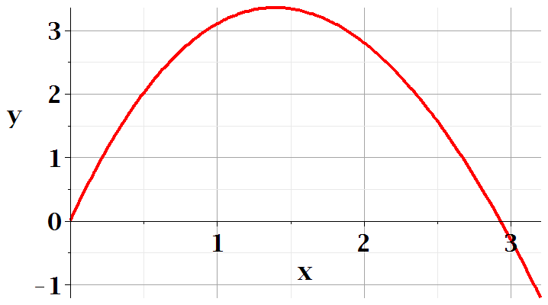
Visualization of the position vector r(t) of a particle
r(t₂)
r(t₁)

Slide 7
Visualization of the velocity vector v(t) of a particle
v(t)
r(t₂)
r(t₁)

Slide 8
Visualization of the acceleration vector a(t) of a particle
v(t₁)
v(t₂)
r(t₂)
r(t₁)
a(t₁)

Slide 9
Animation of position vector components associated with trajectory motion

Slide 10
Animation of velocity vector and its components associated with trajectory motion

Slide 11
Animation of acceleration vector associated with motion along a path

Slide 12
Projectile motion (near earth’s surface)
j
vertical direction (up)
horizontal
direction
i

Slide 13
Projectile motion (near earth’s surface)

Slide 14
Projectile motion (near earth’s surface)

Slide 15
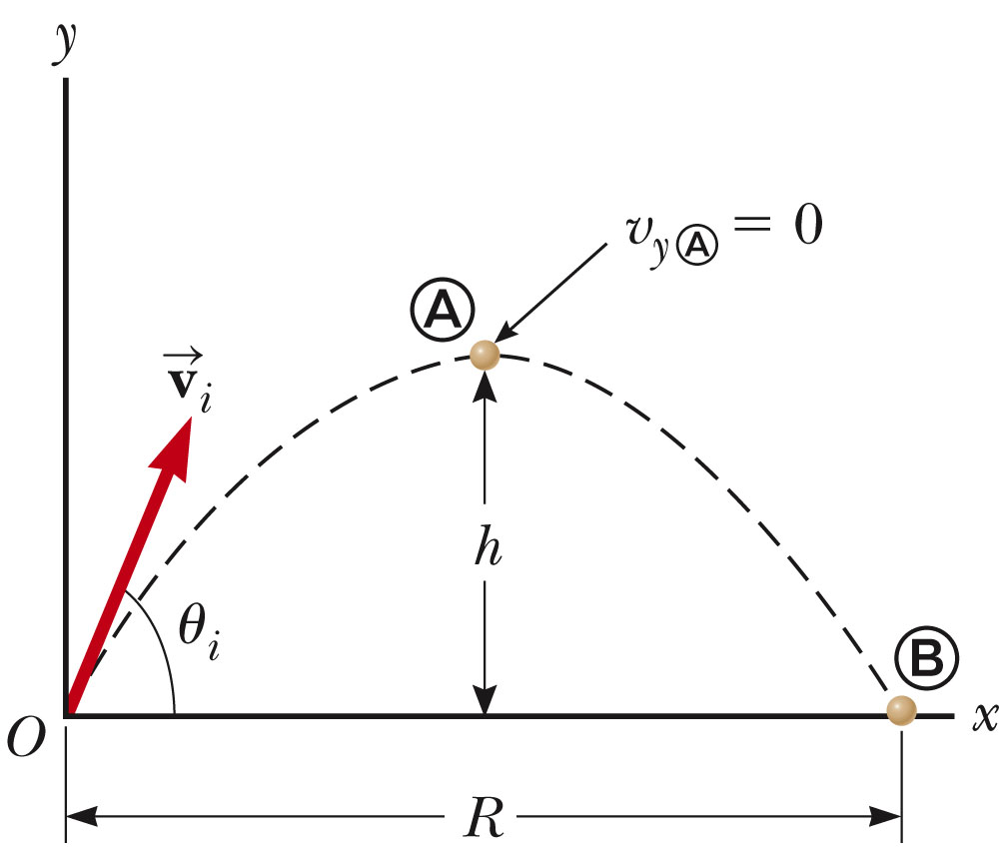
Projectile motion (near earth’s surface)

Slide 16
Projectile motion (near earth’s surface)
Trajectory equation in vector form:
Trajectory equation in component form:
Aside: The equations for position and velocity written in this way are call “parametric” equations. They are related to each other through the time parameter.

Slide 17
Projectile motion (near earth’s surface)
Trajectory equation in component form:
Trajectory path y(x); eliminating t from the equations:

Slide 18
Projectile motion (near earth’s surface)
Summary of results
iclicker exercise:
These equations are so beautiful that
They should be framed and put on the wall.
They should be used to perfect my tennis/golf/basketball/soccer technique.
They are not that beautiful.

Slide 19
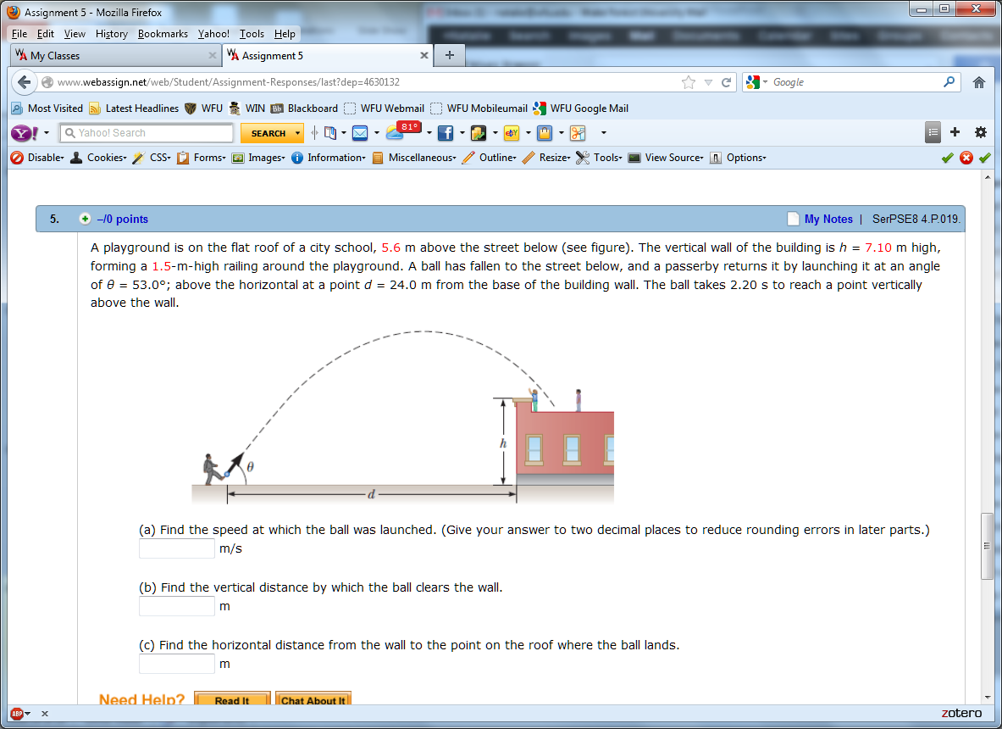
h=7.1m
θ_{i}=53º
d=24m=x(2.2s)

Slide 20
Problem solving steps
Visualize problem – labeling variables
Determine which basic physical principle(s) apply
Write down the appropriate equations using the variables defined in step 1.
Check whether you have the correct amount of information to solve the problem (same number of known relationships and unknowns).
Solve the equations.
Check whether your answer makes sense (units, order of magnitude, etc.).
h=7.1m
θ_{i}=53º
d=24m=x(2.2s)

Slide 21
h=7.1m
θ_{i}=53º
d=24m=x(2.2s)

