Slide 1
PHY 113 A General Physics I
9-9:50 AM MWF Olin 101
Plan for Lecture 6:
Chapter 4 – Motion in two dimensions, especially circular motion
Review of one and two dimensional motion
Circular motion
Notes:
Problems 1.1,1.6,1.10,1.11

Slide 3
Review
Position x(t), Velocity y(t), Acceleration a(t) in one dimension:
Special case of constant acceleration a(t)=a₀:

Slide 4
Review – continued:
Special case of constant acceleration a(t)=a₀:
initial
velocity
initial
position

Slide 5
Summary of equations –
one-dimensional motion with constant acceleration
iclicker question:
Why did I show you part of the derivation of the last equation?
Because professors like to torture physics students
Because you will need to be able to prove the equation yourself
Because the “proof” helps you to understand the meaning of the equation
All of the above
None of the above

Slide 6
Review: Motion in two dimensions:
j
vertical direction (up)
horizontal
direction
i

Slide 7
Vectors relevant to motion in two dimenstions
Displacement: r(t) = x(t) i + y(t) j
Velocity: v(t) = v_{x}(t) i + v_{y}(t) j
Acceleration: a(t) = a_{x}(t) i + a_{y}(t) j

Slide 8
Projectile motion (constant acceleration)
(reasonable approximation near Earth’s surface)
j
vertical direction (up)
horizontal
direction
i

Slide 9
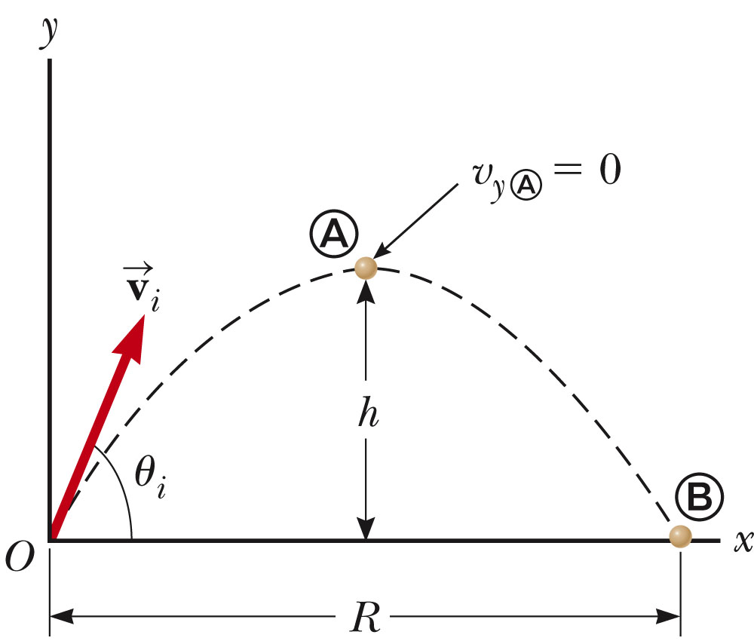
Projectile motion (near earth’s surface)

Slide 10
Projectile motion (near earth’s surface)
Summary of component functions

Slide 11
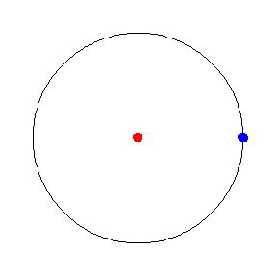
Uniform circular motion – another example
of motion in two-dimensions
animation from http://mathworld.wolfram.com/UniformCircularMotion.html

Slide 12
iclicker question:
Assuming that the blue particle is moving at constant speed around the circle what can you say about its acceleration?
There is no acceleration
There is acceleration tangent to the circle
There is acceleration in the radial direction of the circle
There is not enough information to conclude that there is acceleration or not

Slide 13
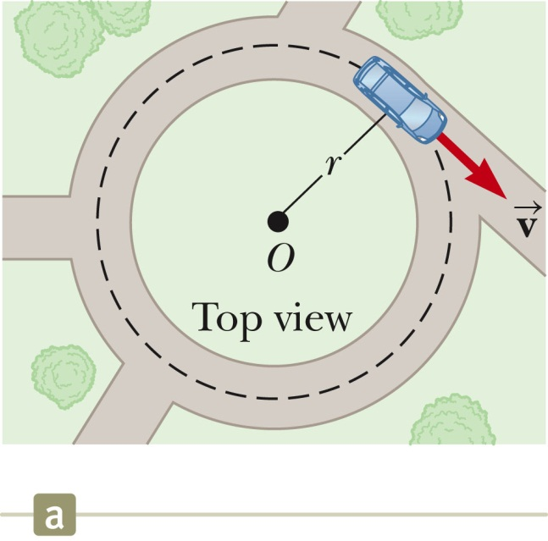
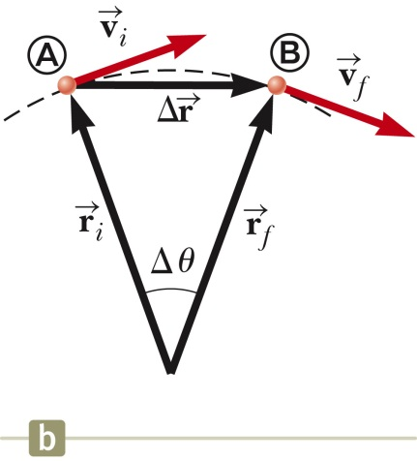
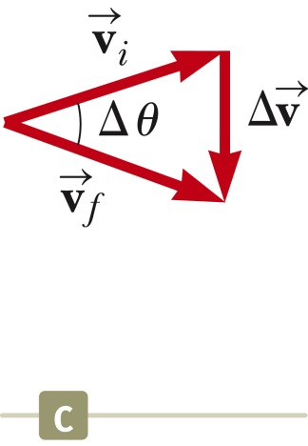
Uniform circular motion – continued

Slide 14
Uniform circular motion – continued
r
In terms of time period T for one cycle:
In terms of the frequency f of complete cycles:

