Slide 1
PHY 113 A General Physics I
9-9:50 AM MWF Olin 101
Plan for Lecture 7:
Chapter 5 – NEWTON’S GENIUS
  Concept of force
  Relationship between force and acceleration
Notes:
Problems 1.1,1.6,1.10,1.11

Slide 2
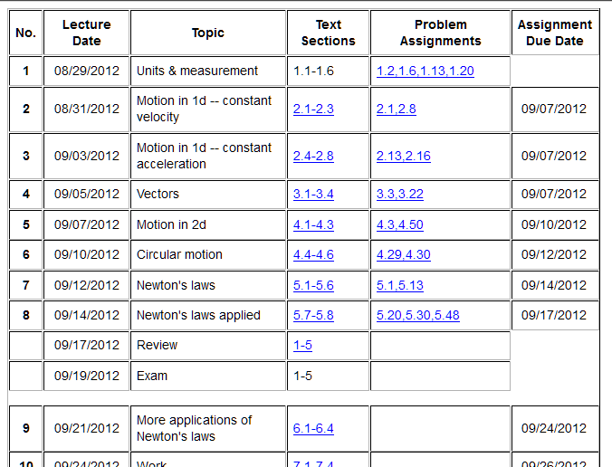

Slide 3
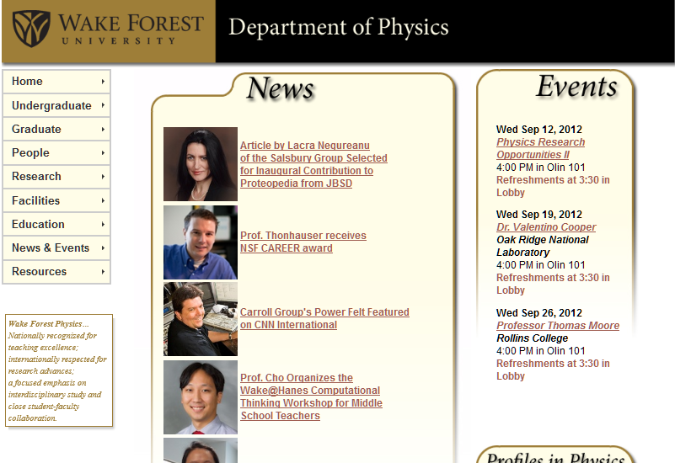

Slide 4
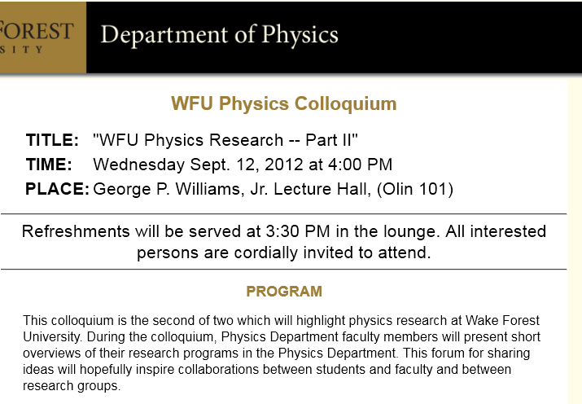

Slide 5
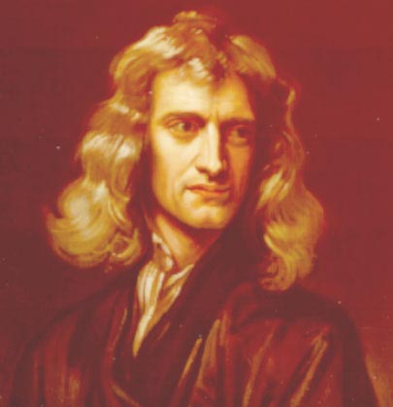
Isaac Newton, English physicist and mathematician
(1642—1727)
In the absence of a net force, an object remains at constant velocity or at rest.
In the presence of a net force F, the motion of an object of mass m is described by the form F=ma.
F₁₂ =– F₂₁.
http://www.newton.ac.uk/newton.html

Slide 6
Detail: “Inertial” frame of reference
Strictly speaking, Newton’s laws work only in a reference frame (coordinate system) that is stationary or moving at constant velocity. In a non-inertial (accelerating) reference frame, there are some extra contributions.
iclicker question:
Are we (here in Winston-Salem)
  In an inertial frame of reference (exactly)
  In a non-inertial frame of reference
Newton’s laws are only approximately true in Winston-Salem, but the corrections are very small.

Slide 7


Slide 8
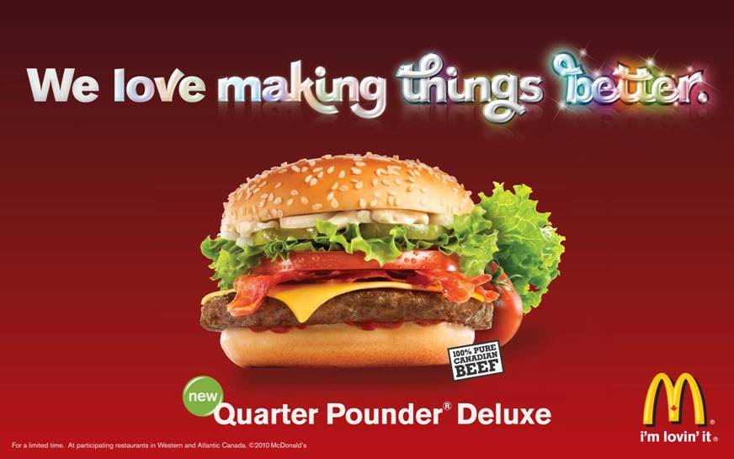
Example force – weight
1 lb = 4.45 N
1 N = 0.225 lb
Newton

Slide 9
Gravitational mass versus inertial mass –
The concept of mass (“inertial” mass m) is distinct from the concept of weight mg. In fact the gravitation “constant” g varies slightly throughout the globe. Of course the weight of mass m on the surface of the moon is considerable different than its weight on earth.

Slide 10
Isaac Newton, English physicist and mathematician
(1642—1727)
In the absence of a net force, an object remains at constant velocity or at rest.
In the presence of a net force F, the motion of an object of mass m is described by the form F=ma.
F₁₂ =– F₂₁.
http://www.newton.ac.uk/newton.html

Slide 11
Examples
F_{tension}= T j
F_{gravity}=-mg j
F=F_{net}=F_{tension}+F_{gravity}=(T-mg) j =0

Slide 12
Examples
F_{tension}= T j
F_{gravity}=-mg j
F_{gravity}=-mg j
F=F_{net}=F_{gravity}=(-mg) j = ma
F=F_{net}=F_{tension}+F_{gravity}=(T-mg) j =0
a=-gj

Slide 13
iclicker question:
An object having a mass of 2 kg is moving at constant velocity of 3 m/s in the upward direction near the surface of the Earth. What is the net force acting on the object?
  0 N.
  6 N in the upward direction.
  25.6 N in the upward direction.
  19.6 N in the downward direction.

Slide 14
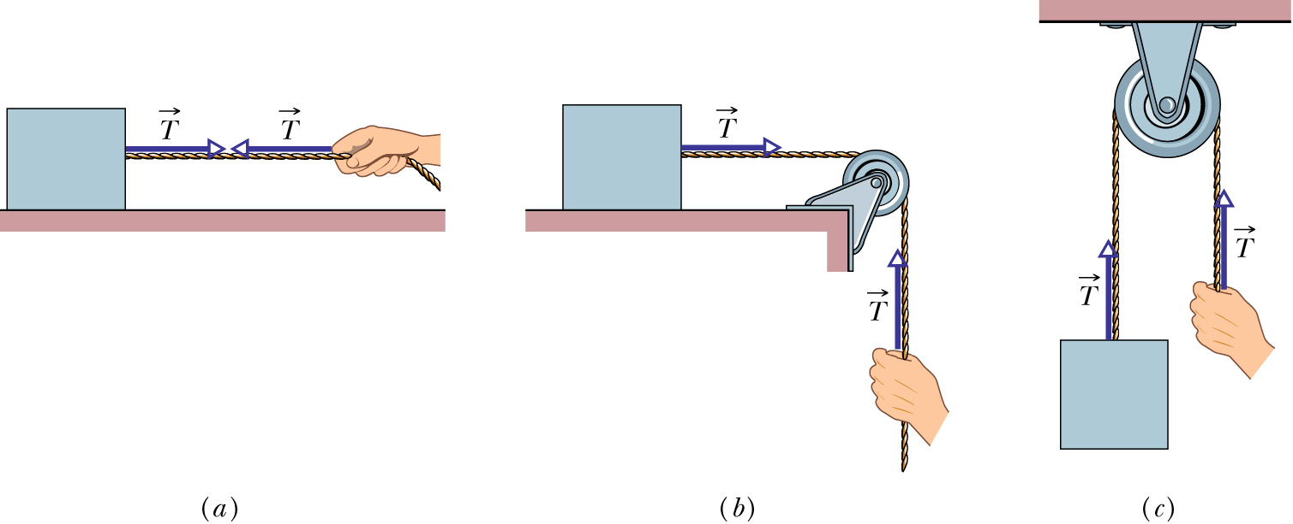
Example: (assume surface is frictionless)
Suppose T measured
a observed & measured
T = m a

Slide 15
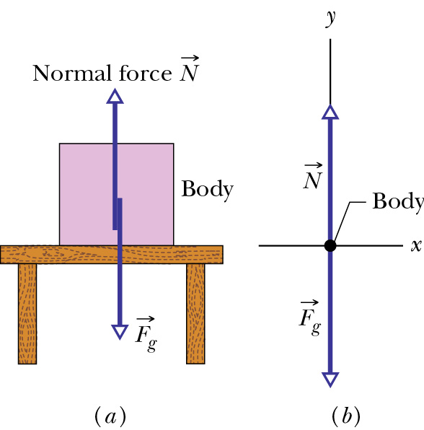
Example – support forces
➔F_{support} acts in direction ⊥ to surface
(in direction of surface “normal”)

Slide 16
Newton’s second law
F = m a
Types of forces:
Fundamental Approximate Empirical
Gravitational F=-mg j Friction
Electrical Support
Magnetic Elastic
Elementary
particles

Slide 17
Examples (one dimension):
(constant)

Slide 18
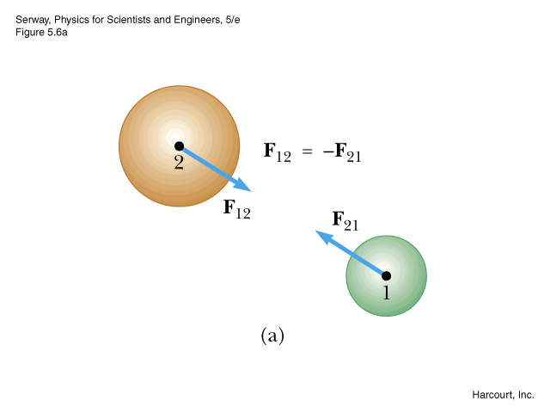
Newton’s third law
F₁₂ = - F₂₁
F_{P}
T
T
1
2
T=m₁a a=F_{P}/(m₁+m₂)
F_{P}-T=m₂a T=F_{P} (m₁/(m₁+m₂))

Slide 19
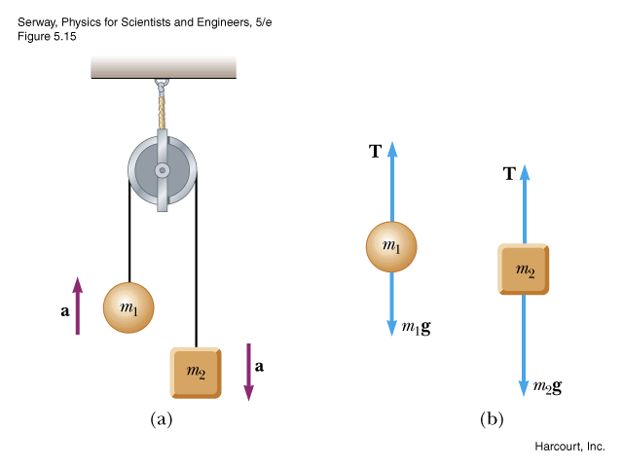
T-m₁g=m₁a T-m₂g=-m₂a => after some algebra:

Slide 20
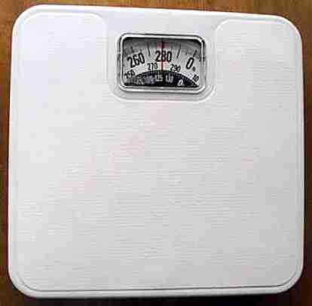
F_{gravity}=-mg j
F_{scale}
F_{scale} + F_{gravity} = 0; F_{scale} = mg
Question: What if you step on the scale in the elevator?
F_{scale} + F_{gravity} = m a; F_{scale} = mg +m a

Slide 21
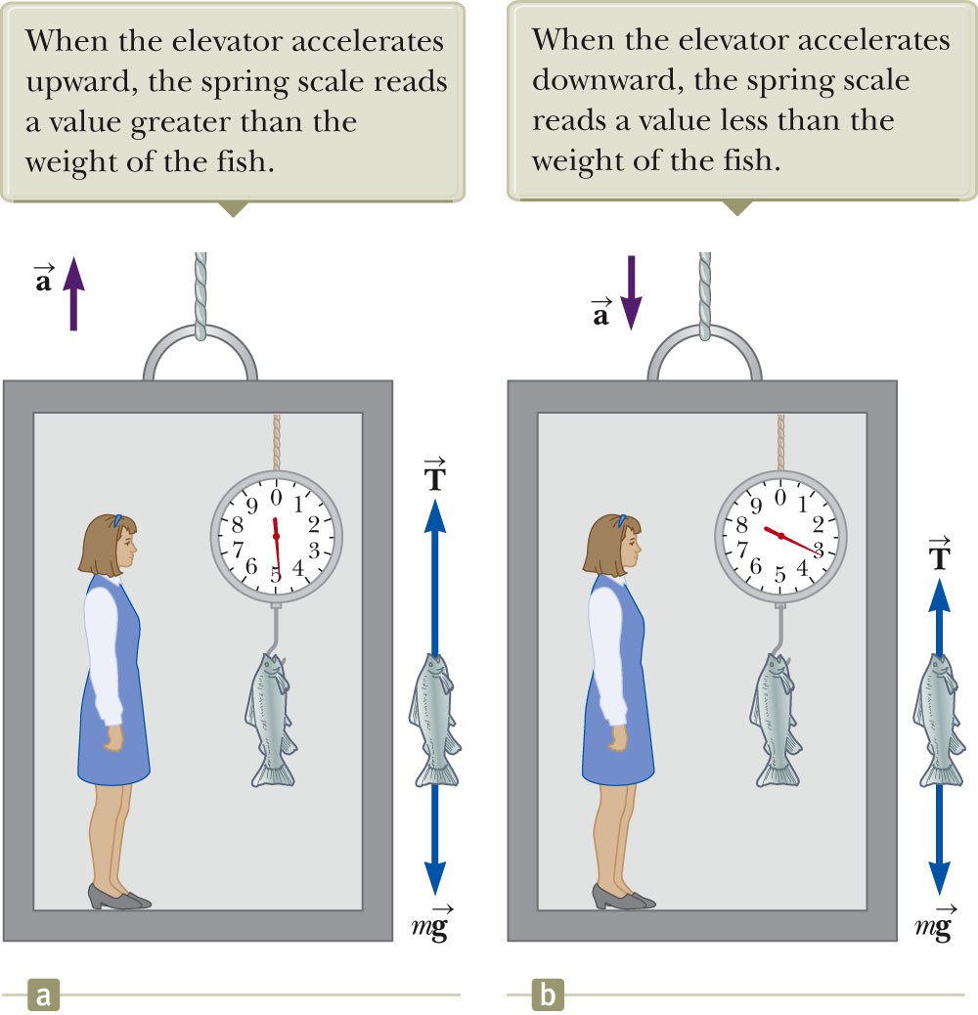

Slide 22
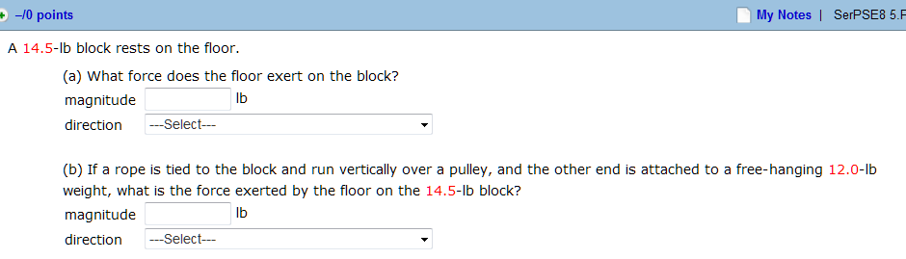
F_{floor} = mg
mg
T
T
F_{floor} = mg-T
Mg
mg

Slide 23
Exercise
For this exercise, you should ride the elevator from the first floor of Olin Physical Laboratory up to the second or third floor. While in the elevator, stand on the scale and record the scale readings to answer the following questions.
1. What is the scale reading when the elevator is stationary?
2. What is the scale reading when the elevator just starts moving upward?
3. What is the scale reading when the elevator is coming to a stop just before your destination floor?
x
>x
<x

