Slide 1
PHY 113 A General Physics I
9-9:50 AM MWF Olin 101
Plan for Lecture 8:
Chapter 5 – More applications of Newton’s laws
Two dimensional statics and dynamics
Friction forces
Notes:
Problems 1.1,1.6,1.10,1.11

Slide 3
Isaac Newton, English physicist and mathematician
(1642—1727)
In the absence of a net force, an object remains at constant velocity or at rest.
In the presence of a net force F, the motion of an object of mass m is described by the form F=ma.
F₁₂ =– F₂₁.
http://www.newton.ac.uk/newton.html

Slide 4
Detail: “Inertial” frame of reference
Strictly speaking, Newton’s laws work only in a reference frame (coordinate system) that is stationary or moving at constant velocity. In a non-inertial (accelerating) reference frame, there are some extra contributions.
iclicker question:
Are we (here in Winston-Salem)
In an inertial frame of reference (exactly)
In a non-inertial frame of reference
Newton’s laws are only approximately true in Winston-Salem, but the corrections are very small.

Slide 5
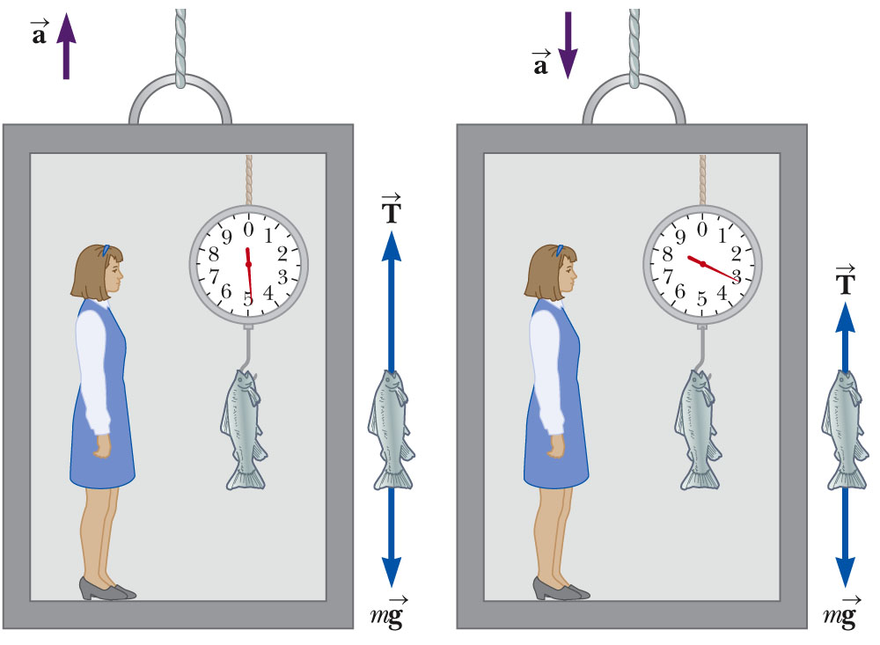
Example from last time – elevator accelerating upward or downward:

Slide 6
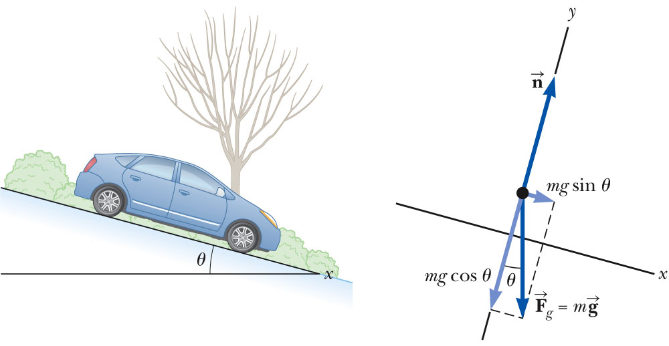
Example: 2-dimensional forces
A car of mass m is on an icy (frictionless) driveway, inclined at an angle t as shown. Determine its acceleration.
Conveniently tilted coordinate system:

Slide 7
Friction forces
The term “friction” is used to describe the category of forces that oppose motion. One example is surface friction which acts on two touching solid objects. Another example is air friction. There are several reasonable models to quantify these phenomena.
Surface friction:
Normal force between surfaces
Material-dependent coefficient
Air friction:
K and K’ are materials and shape dependent constants

Slide 8
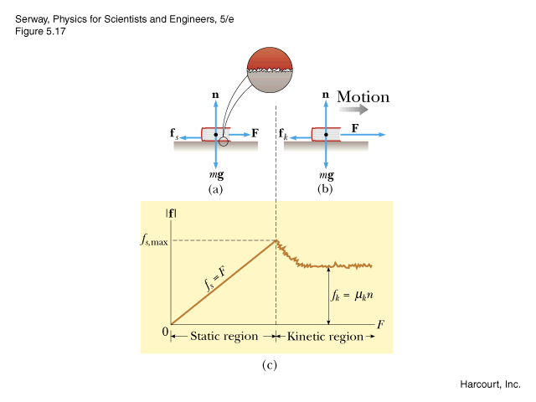
Models of surface friction forces
surface friction force
f_{s,max}=μ_{s}n
(applied force)
Coefficients μ_{s} , μ_{k} depend on the surfaces; usually, μ_{s} > μ_{k}

Slide 9
Some estimates of static and kinetic friction:
Material | μ_{s} | μ_{k}
Rubber on concrete | 1.0 | 0.8
Wood on wood | 0.3 | 0.2
Steel on steel with lubrication | 0.09 | 0.05
Teflon on teflon | 0.04 | 0.04

Slide 10
Surface friction:
F-f_{s} = 0 if F < μ_{s}n=μ_{s}mg
if F>μ_{s}n=μ_{s}mg , then F-f_{k}=ma (f_{k}= μ_{k}mg)

Slide 11
iclicker exercise:
The figure below shows a block of mass m moving to left at constant velocity v₀. How is this possible?
There is an additional horizontal force pulling the block to the left.
There is and additional horizontal force pulling the block to the right.
This is not a possible physical situation.
N
v₀
f = μ_{k}N
mg

Slide 12
n
f
mg cos θ
mg
mg sin θ
θ
just before block slips:
f_{s,max}-mg sin θ = μ_{s} n-mg sin θ = μ_{s} mg cosθ -mg sinθ = 0
➔ μ_{s} = tan θ

Slide 13
iclicker exercise:
Suppose you place a box on an inclined surface as shown in the figure and you notice that the box slides down the incline at constant velocity V. Which of the following best explains the phenomenon:
There is no net force acting on the box.
There is a net force acting on the box.
The coefficient of static friction is μ_{s} = tan θ.
The coefficient of kinetic friction is μ_{k} = tan θ.
V (constant)
θ

Slide 14
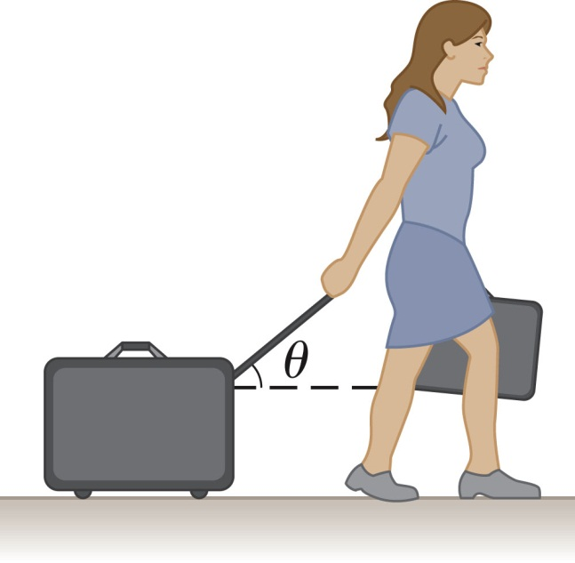
A women at an airport is towing her 20 kg suitcase at constant speed by pulling on a strap at an angle θ above the horizontal. She pulls on the strap with a P=35 N force, and the friction force on the suitcase is f=20 N. What is the value of the angle θ ?
N
P
f
mg

Slide 15
iclicker questions:
f
mg
θ
Suppose that μ_{s}=0.75 which means that the block starts to slide when θ= tan⁻¹(0.75) = 37º. What is f when θ= 20º?
A. mg sinθ B. μ_{s} mg sinθ C. mg cosθ D. μ_{s} mg cosθ

Slide 16
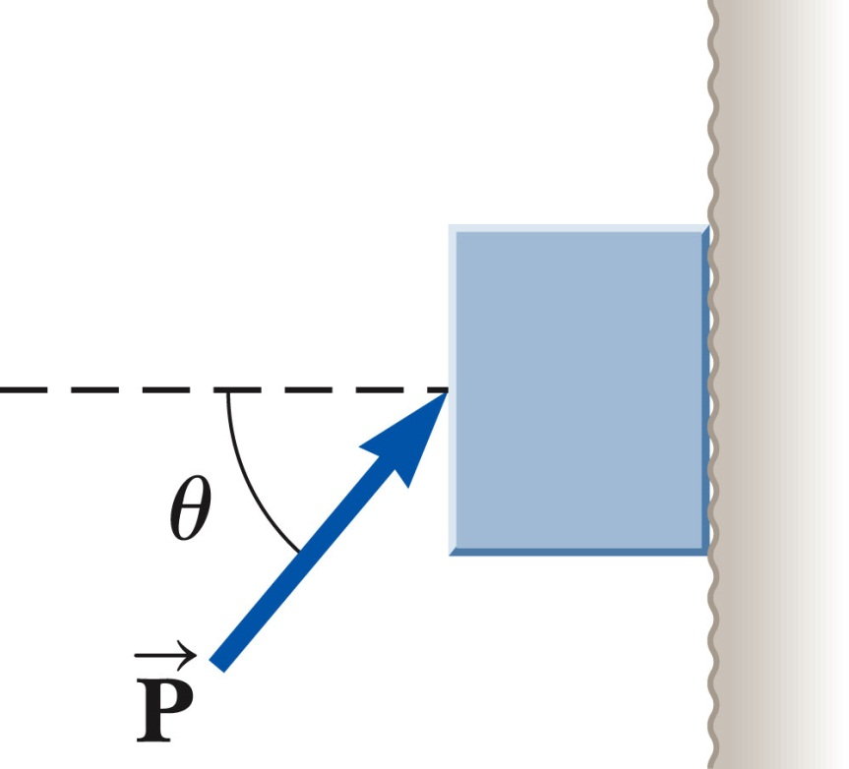
A block of mass 3 kg is pushed up against a wall by a force P that makes an angle of θ=50º with the horizontal. μ_{s}=0.25. Determine the possible values for the magnitude of P that allow the block to remain stationary.
f
N
f
mg

Slide 17
f
N
f
mg

