Slide 1
PHY 113 A General Physics I
9-9:50 AM MWF Olin 101
Plan for Lecture 9:
Review of Chapters 1-5
  Format of Wednesday’s exam
  Advice on how to prepare your equation sheet and your head for the exam
  Review and example problems
Notes:
Problems 1.1,1.6,1.10,1.11

Slide 2
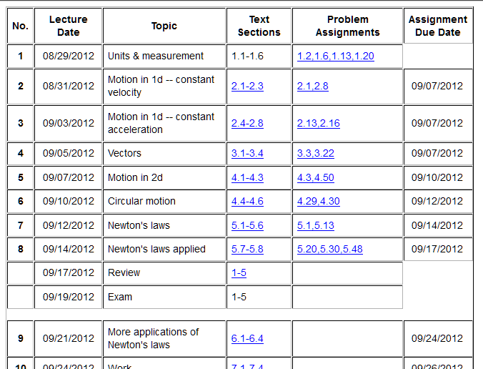

Slide 3
Format of Wednesday’s exam
  What to bring:
    Clear, calm head
    Equation sheet (turn in with exam)
    Scientific calculator
    Pencil or pen
    (Note: labtops, cellphones, and other electronic equipment must be off or in sleep mode.)
  Timing:
    May begin as early as 8 AM; must end ≤ 9:50 AM
  Probable exam format
    4-5 problems similar to homework and class examples pertaining to Chapters 1-5 of your text.
    Full credit awarded on basis of analysis steps as well as final answer

Slide 4
iclicker exercise:
When do plan to start the exam on Wednesday, September 19th?
  8 AM
  8:30 AM
  9 AM

Slide 5
What to include on equation sheet
Given information on exam | Suitable for equation sheet
Universal constants (such as g=9.8m/s²) | Trigonometric relations
Particular constants (such as μ_{s}, μ_{k}) | Simple derivative and integral relationships
Unit conversion factors if needed | General relationships of position, velocity, acceleration
 | Particular formulas for trajectory motion
 | Expression for centripetal acceleration
 | Expressions for model friction forces

Slide 6
Problem solving skills
Math skills
Equation Sheet
Advice:
Keep basic concepts and equations at the top of your head.
Practice problem solving and math skills
Develop an equation sheet that you can consult.

Slide 7
Problem solving steps
  Visualize problem – labeling variables
  Determine which basic physical principle(s) apply
  Write down the appropriate equations using the variables defined in step 1.
  Check whether you have the correct amount of information to solve the problem (same number of knowns and unknowns).
  Solve the equations.
  Check whether your answer makes sense (units, order of magnitude, etc.).

Slide 8
Review: position, velocity, and acceleration in one dimension

Slide 9
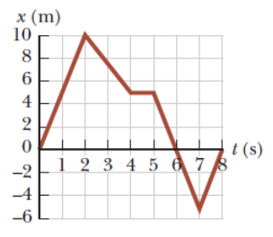
Graphical representation x(t)
What is the velocity at t=1s?

Slide 10
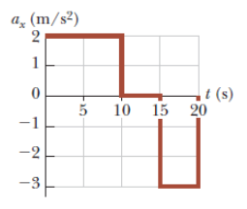
Graphical representation of a(t)
What is the velocity at t=5s?

Slide 11
Abstract notion of vectors:
Vector addition:
a + b
b
a
Vector subtraction:
a
a – b
-b

Slide 12
Vector components:
a_{y}
a_{x}

Slide 13
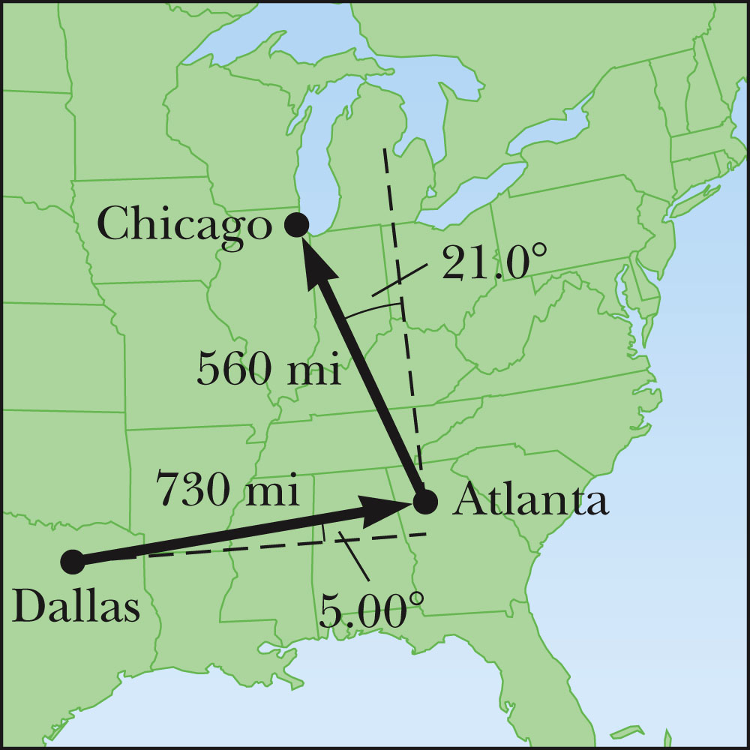
Example of vector addition:
b
a + b
a

Slide 14
Vectors relevant to motion in two dimenstions
Displacement: r(t) = x(t) i + y(t) j
Velocity: v(t) = v_{x}(t) i + v_{y}(t) j
Acceleration: a(t) = a_{x}(t) i + a_{y}(t) j

Slide 15
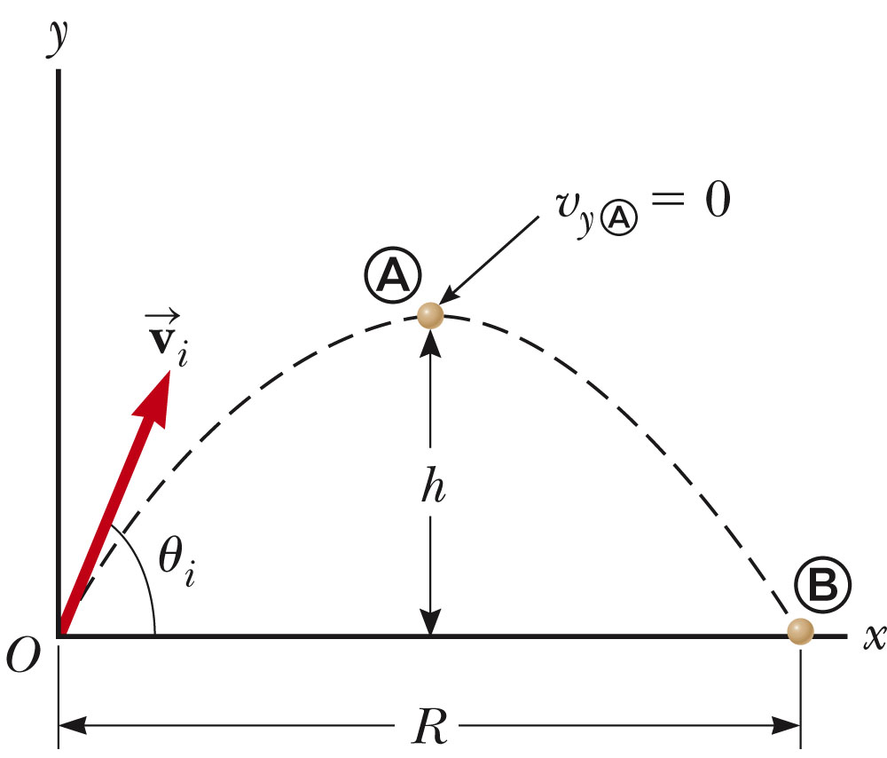
Projectile motion (near earth’s surface)

Slide 16
Projectile motion (near earth’s surface)
Trajectory equation in component form:
Trajectory path y(x); eliminating t from the equations:

Slide 17
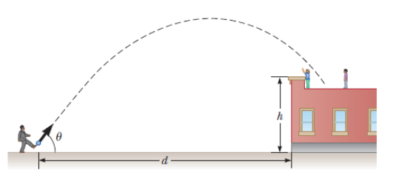
Example trajectory:
h=7.1m
θ_{i}=53º
d=24m=x(2.2s)
What is the initial velocity v_{i}?

Slide 18
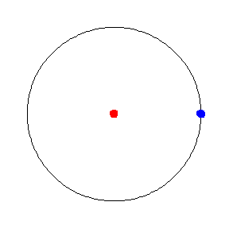
Uniform circular motion – another example
of motion in two-dimensions
animation from http://mathworld.wolfram.com/UniformCircularMotion.html

Slide 19
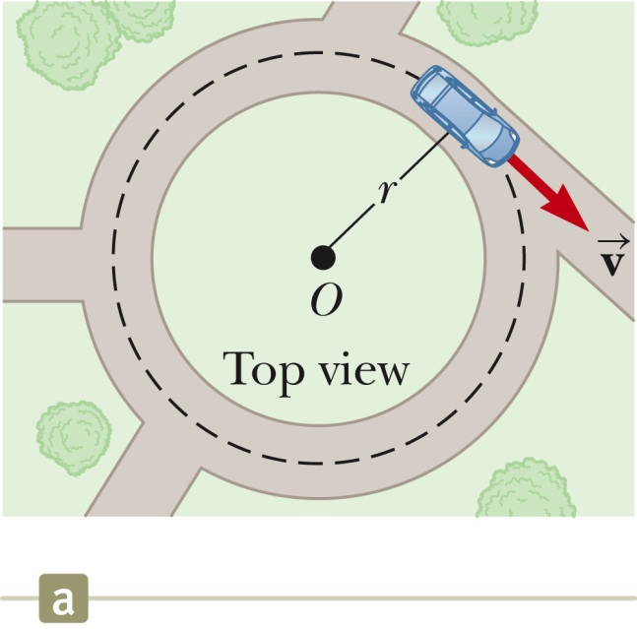
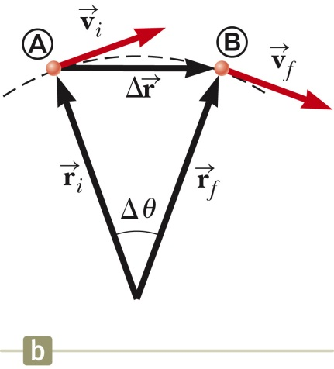
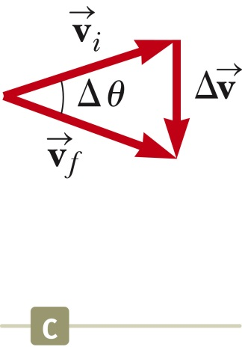
Uniform circular motion – continued

Slide 20
Uniform circular motion – continued
r
In terms of time period T for one cycle:
In terms of the frequency f of complete cycles:

Slide 21
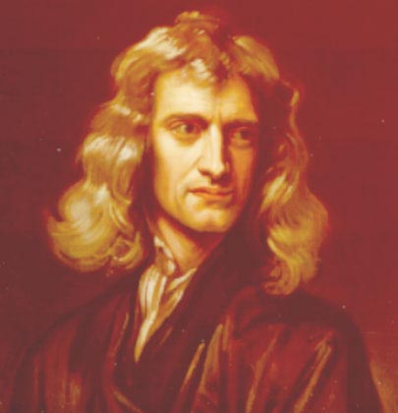
Isaac Newton, English physicist and mathematician
(1642—1727)
In the absence of a net force, an object remains at constant velocity or at rest.
In the presence of a net force F, the motion of an object of mass m is described by the form F=ma.
F₁₂ =– F₂₁.
http://www.newton.ac.uk/newton.html

Slide 22
Newton’s second law
F = m a
Types of forces:
Fundamental Approximate Empirical
Gravitational F=-mg j Friction
Electrical Support
Magnetic Elastic
Elementary
particles

Slide 23
Examples
F_{tension}= T j
F_{gravity}=-mg j
F_{gravity}=-mg j
F=F_{net}=F_{gravity}=(-mg) j = ma
F=F_{net}=F_{tension}+F_{gravity}=(T-mg) j =0
a=-gj

Slide 24
Free body diagrams:
  Consider m₁ and m₂ moving on a frictionless surface; connected with rope having tension T and pulled with force F_{P}. If m₁, m₂, and F_{P} are given, find T
F_{P}
T
T
1
2

Slide 25
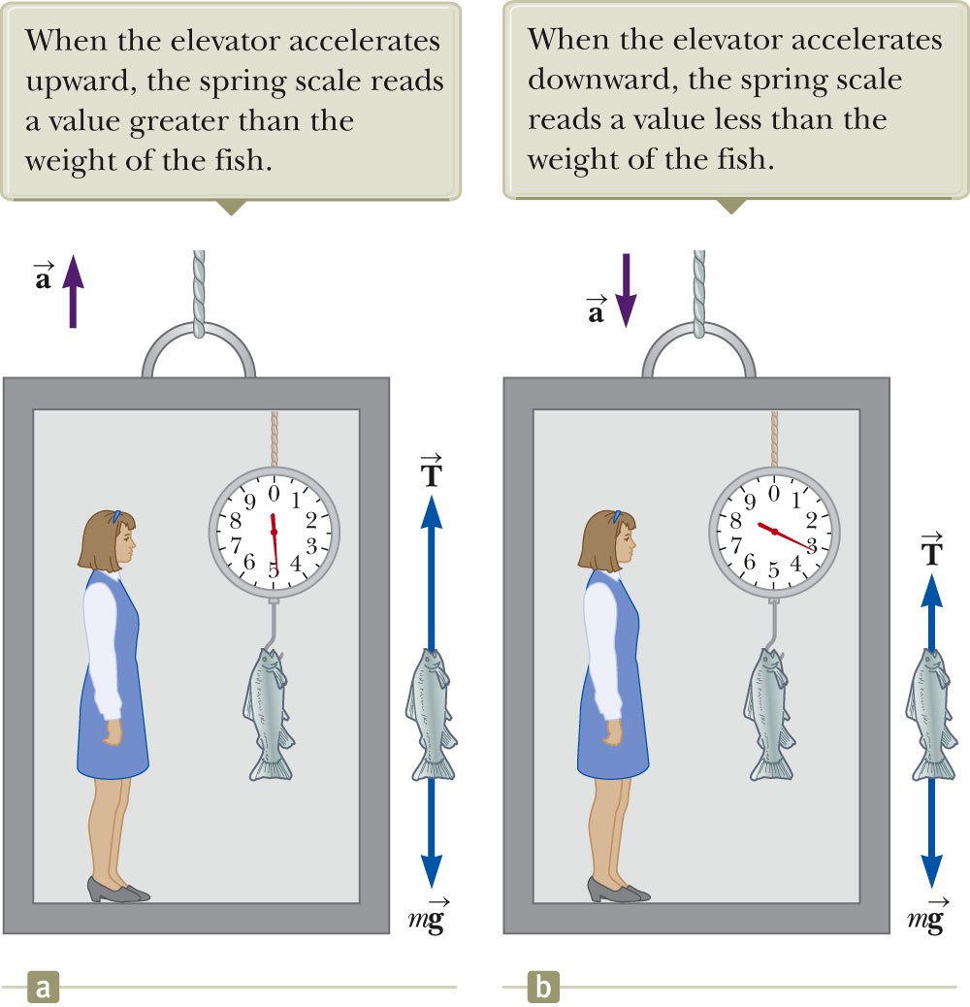

Slide 26
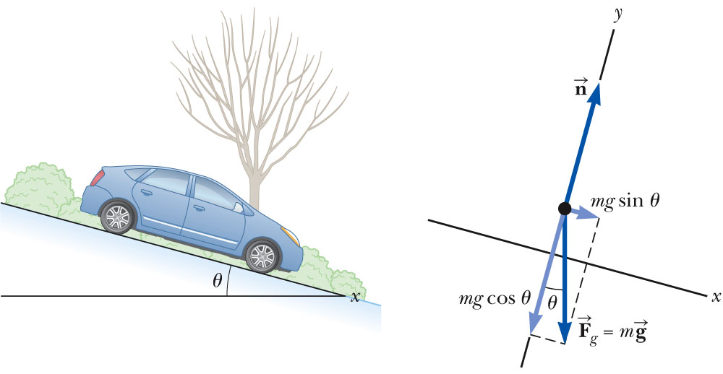
Example: 2-dimensional forces
  A car of mass m is on an icy (frictionless) driveway, inclined at an angle t as shown. Determine its acceleration.
Conveniently tilted coordinate system:

Slide 27
Friction forces
The term “friction” is used to describe the category of forces that oppose motion. One example is surface friction which acts on two touching solid objects. Another example is air friction. There are several reasonable models to quantify these phenomena.
Surface friction:
Normal force between surfaces
Material-dependent coefficient
Air friction:
K and K’ are materials and shape dependent constants

Slide 28
n
f=μ_{k}n
V (constant)
mg
θ

