Slide 1
PHY 711 Classical Mechanics and Mathematical Methods
10-10:50 AM MWF Olin 103
Plan for Lecture 15:
Start reading Chapter 4
Small oscillations about equilibrium
Normal modes

Slide 3
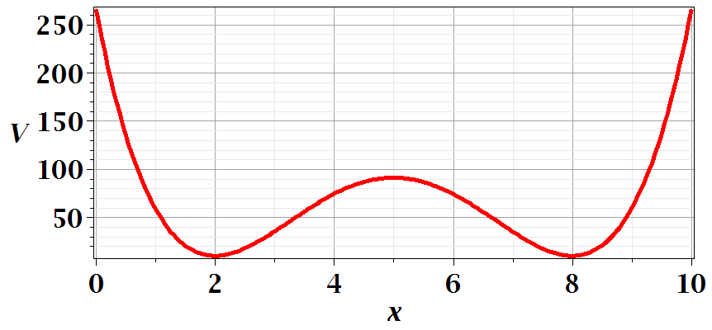
Motivation for studying small oscillations – many interacting systems have stable and meta-stable configurations which are well approximated by:

Slide 5
Example – linear molecule
m₁
m₂
m₃

Slide 10
Digression:

Slide 13
m₁
m₂
m₃
m₁
m₂
m₃
m₁
m₂
m₃

