Slide 1
PHY 711 Classical Mechanics and Mathematical Methods
10-10:50 AM MWF Olin 103
Plan for Lecture 2:
Comments on Maple software
Chapter 1 – scattering theory
  Rutherford scattering
  Scattering for arbitrary potential

Slide 2
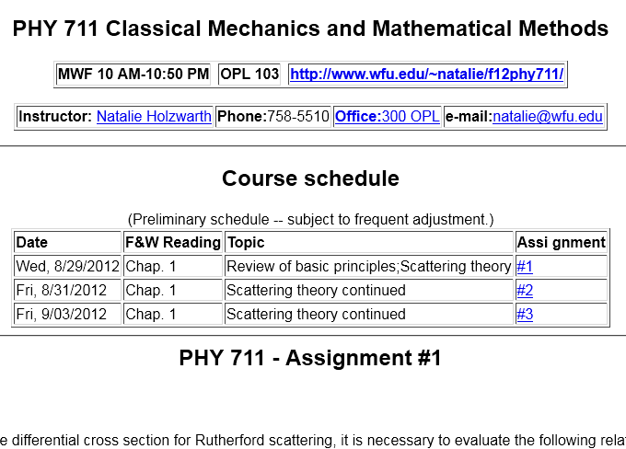

Slide 3
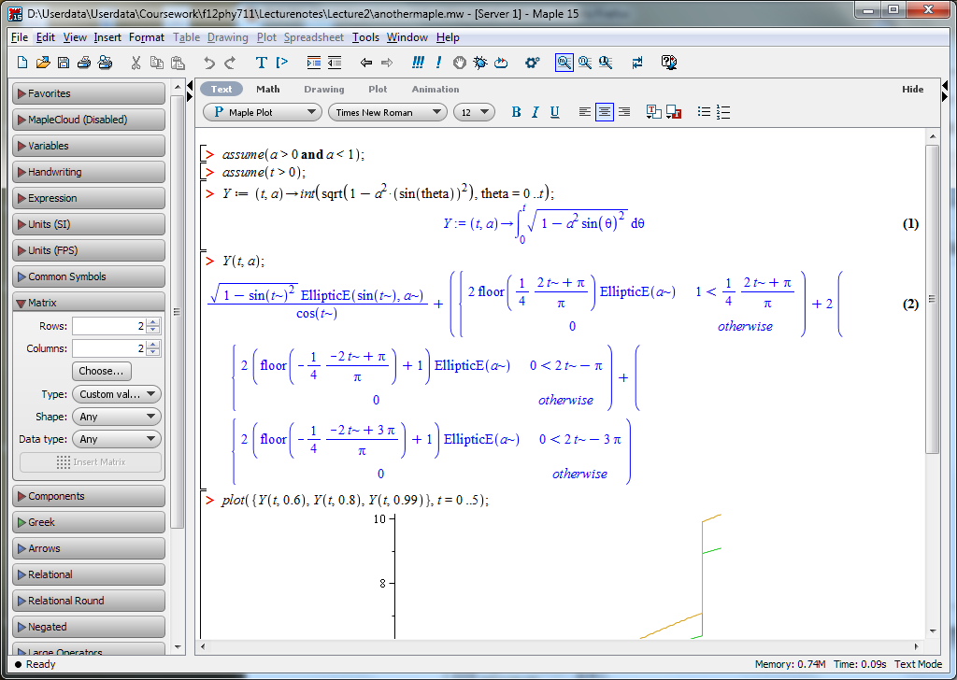
Some additional Maple examples

Slide 4
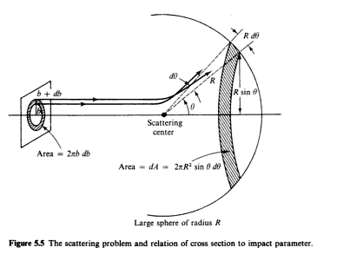
Scattering theory:

Slide 5
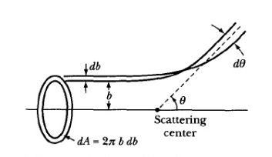
Figure from Marion & Thorton, Classical Dynamics

Slide 6
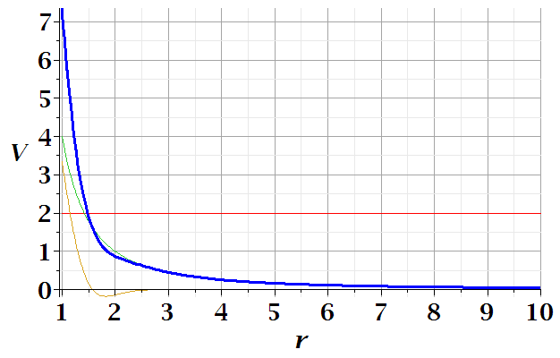
E
r_{min}

Slide 7
φ
r_{min}
r(φ)

Slide 13
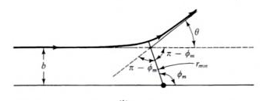
Relationship between φ_{max} and θ:

Slide 17
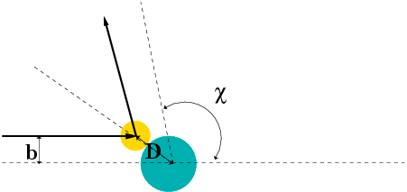
Hard sphere scattering

