Slide 1
PHY 711 Classical Mechanics and Mathematical Methods
10-10:50 AM MWF Olin 103
Plan for Lecture 27:
    Introduction to hydrodynamics
      Motivation for topic
      Newton’s laws for fluids
      Conservation relations

Slide 2
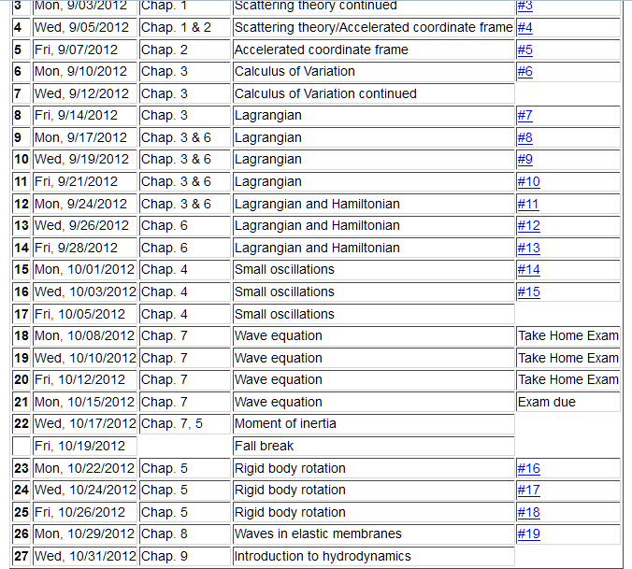

Slide 3
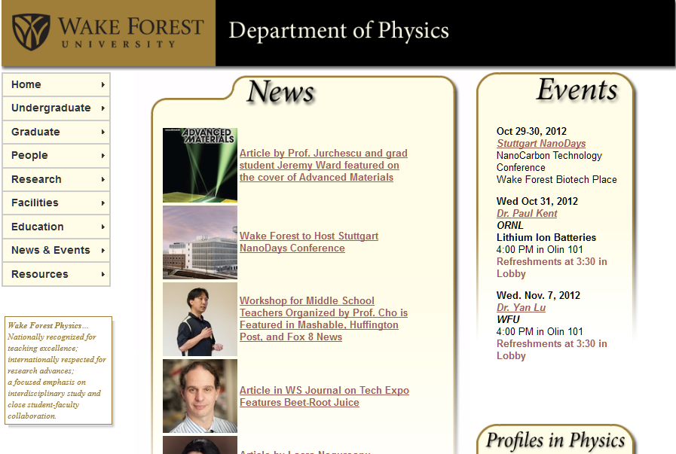

Slide 4
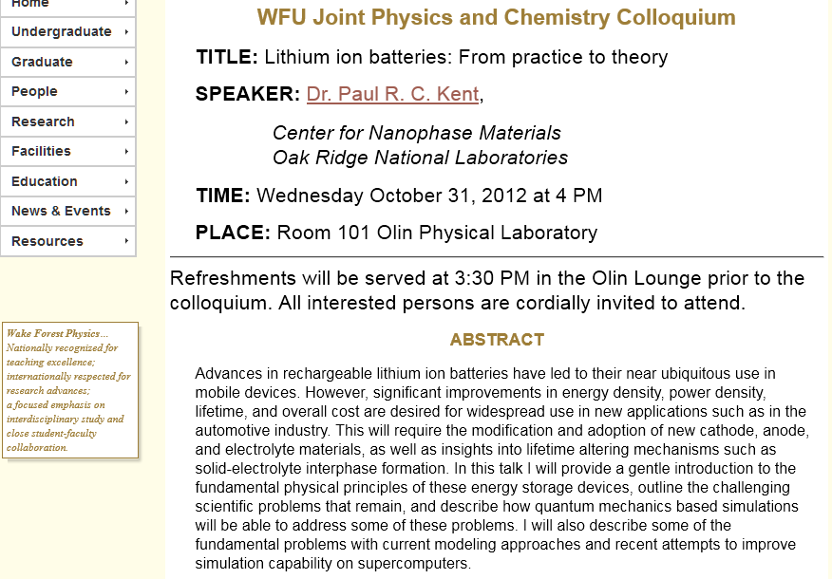

Slide 5
Motivation
  Natural progression from strings, membranes, fluids; description of 1, 2, and 3 dimensional continua
  Interesting and technologically important phenomena associated with fluids
Plan
  Newton’s laws for fluids
  Continuity equation
  Stress tensor
  Energy relations
  Bernoulli’s theorem
  Various examples
  Sound waves

Slide 6
Newton’s equations for fluids
  Use Lagrange formulation; following “particles” of fluid

Slide 7
p(x)
p(x+dx)

Slide 8
Newton’s equations for fluids -- continued

Slide 10
Newton’s equations for fluids -- continued

Slide 11
Continuity equation:

Slide 12
Solution of Euler’s equation for fluids

Slide 13
Bernoulli’s integral of Euler’s equation

Slide 14
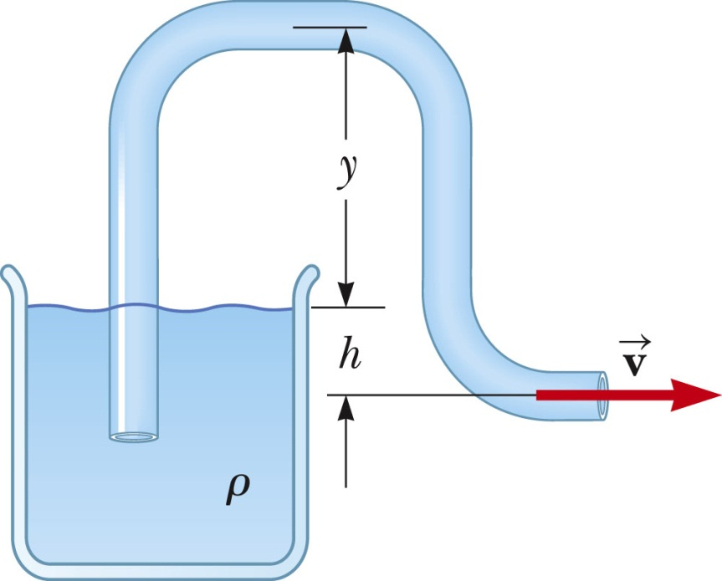
Examples of Bernoulli’s theorem
1
2

Slide 15
Examples of Bernoulli’s theorem -- continued
1
2

Slide 16
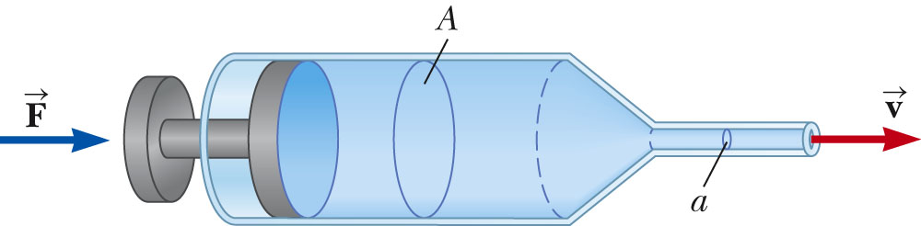
Examples of Bernoulli’s theorem -- continued
2
1

Slide 17
Examples of Bernoulli’s theorem -- continued
2
1

Slide 18
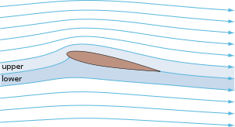
Examples of Bernoulli’s theorem – continued
Approximate explanation of airplane lift
Cross section view of airplane wing
http://en.wikipedia.org/wiki/Lift_%28force%29
1
2

