Slide 1
PHY 711 Classical Mechanics and Mathematical Methods
10-10:50 AM MWF Olin 103
Plan for Lecture 31:
Wave equation for sound
Standing waves
Green’s function for wave equation; wave scattering

Slide 2
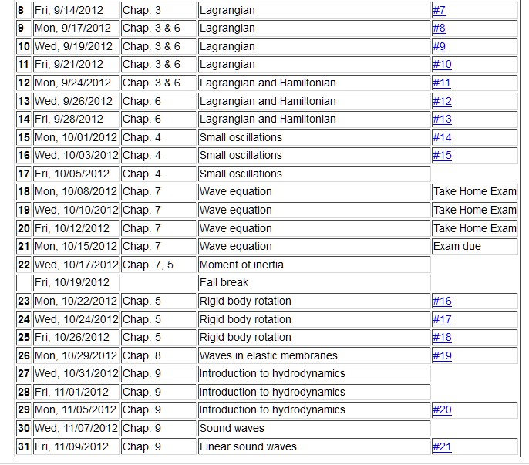

Slide 3
Linearization of the fluid dynamics relations:

Slide 6
Time harmonic standing waves in a pipe
a
L

Slide 10
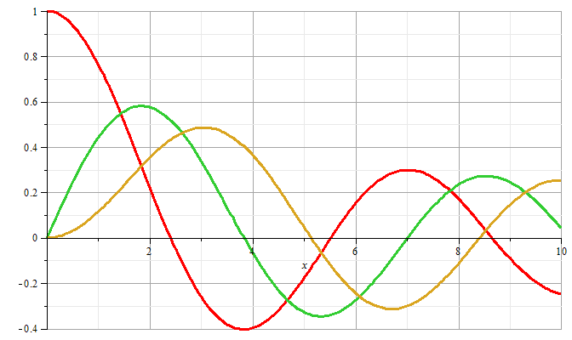
m=0
m=1
m=2

Slide 11
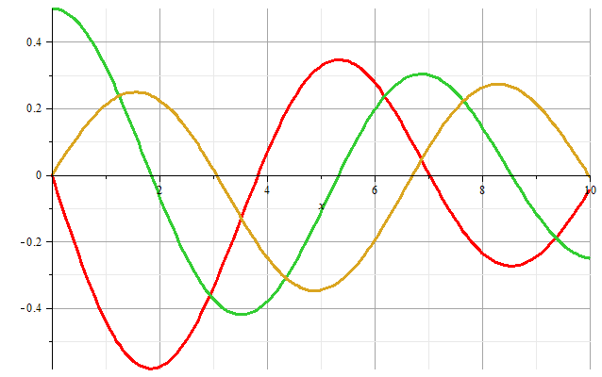
m=1
m=2
m=0
Zeros of derivatives: m=0: 0.00000, 3.83171, 7.01559
m=1: 1.84118, 5.33144, 8.53632
m=2: 3.05424, 6.70613, 9.96947

Slide 12
Boundary condition for z=0, z=L:

Slide 13
Example

Slide 14
Alternate boundary condition for z=0, z=L:

Slide 15
Other solutions to wave equation:

Slide 16
Wave equation with source:

Slide 17
Wave equation with source -- continued:

